Slide 1
Sunshine-Android Weather App
Created by: Abhinav Singh (1421506)
Mayank (1421553)
Masroor Ahmad(1421552)
Chhotu Kumar(1421524)

Slide 2
Project Profile

Slide 3
Project definition
Cloud-based weather application.
Display weather data upto two weeks.
A detailed view of weather report along with various factors.

Slide 4
Scope & Objective
Understand the tools and principles of android.
Understand the challenges associated with development for mobile environment.
Learn how to build great user experiences for android devices.

Slide 5
System study & problem formulation

Slide 6
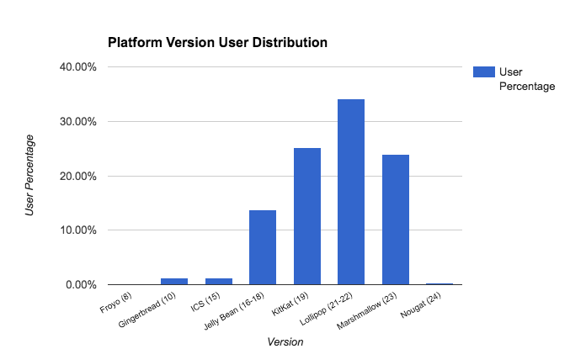
Data Analysis

Slide 7
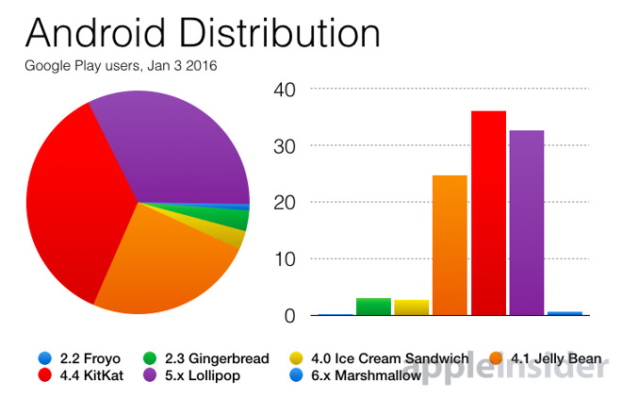

Slide 8
Proposed System
Compact weather applicaton with a user friendly interface.
Live notifications

Slide 9
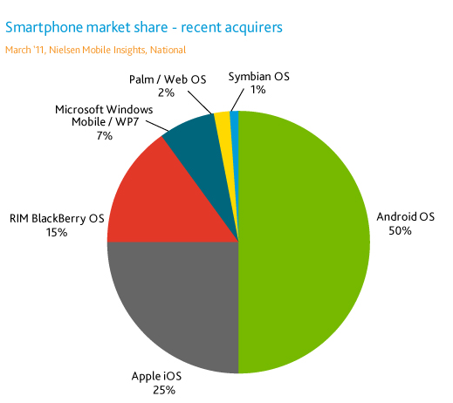
Technical feasibility
Android platform

Slide 10
Weather API framework.
Cloud-server (openweathermap.org).
SQLite database.

Slide 11
Operational feasibility
Implemented using Android studio.
Data stored using SQLite.
The concept of inner join for merging of both the location table and the weather data table.

Slide 12
Economical feasibility
Free and paid API keys.
Google play developer console.

Slide 13
System Requirements
RAM: 512Mb
CPU: Dual-Core Architecture
Clock- Speed: 1.0GHz
Resolution: Responsive design based on different screen size of devices.

Slide 14
Project Planning

Slide 15
Programming languages
JAVA
XML
SQLite

Slide 16
Development tools
Android Studio
Gradle
ListView & adapters
Threading & AsyncTask
Android permissions
Intents
Json parsing

Slide 17
Structured analysis & structured design

Slide 18
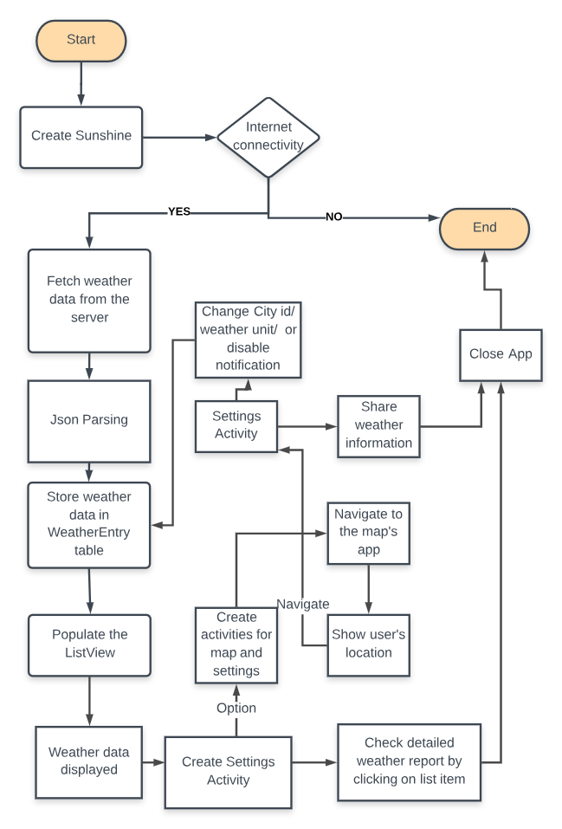
Data flow diagram

Slide 19
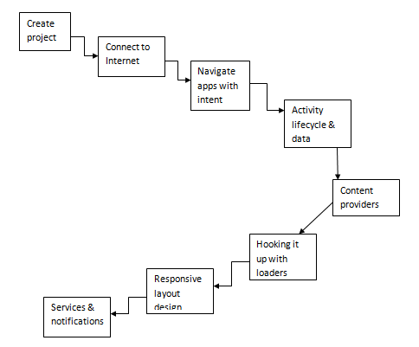
Flowchart

Slide 20
Detailed design

Slide 21
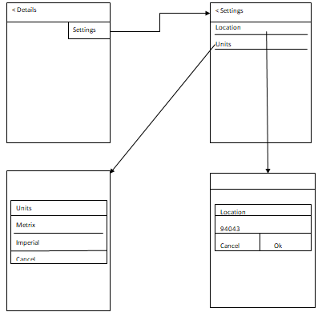
Front End design

Slide 22
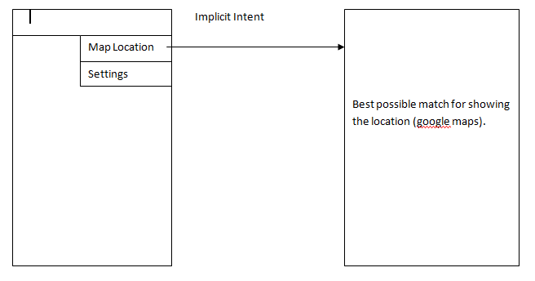

Slide 23
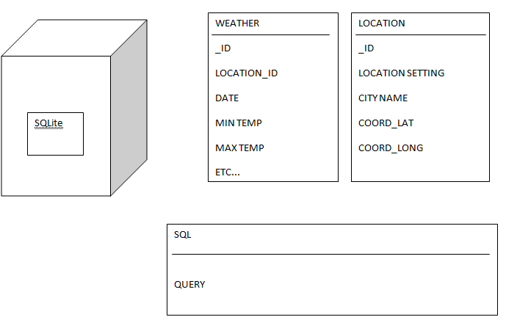
Back End design

Slide 24
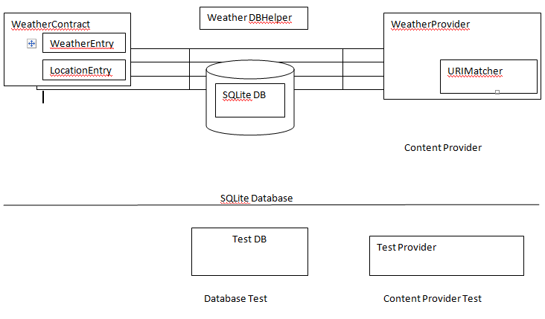
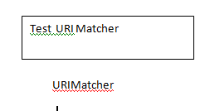

Slide 25
Testing & Implementation

Slide 26
Testing
System testing.
Integration testing
Unit testing.

Slide 27
Post implementation review
Check the need of improvements.
Check performance.
Responsive design.

Slide 28
Screenshots

Slide 29
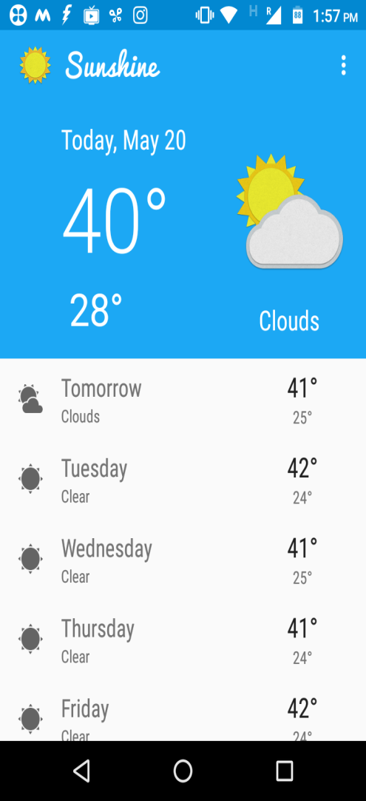
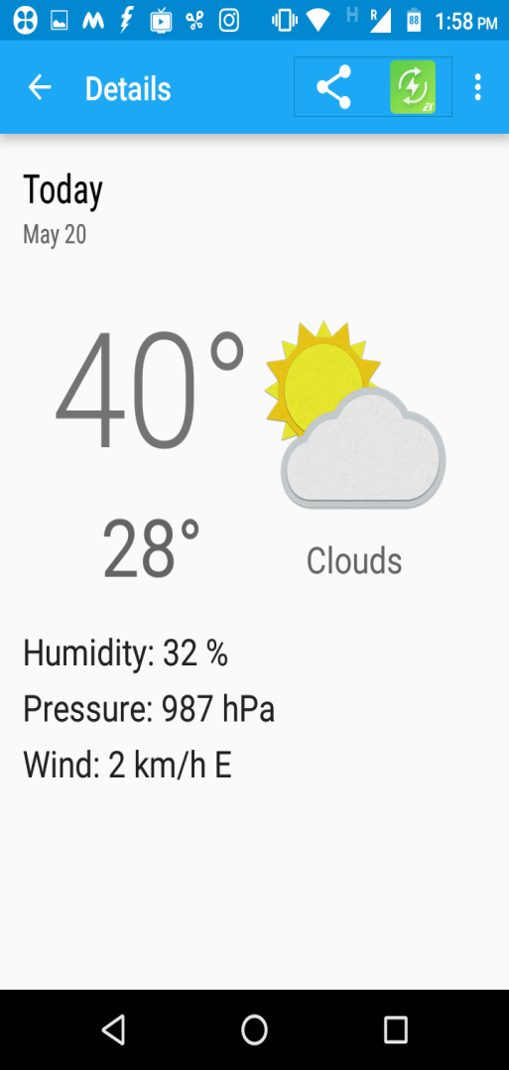
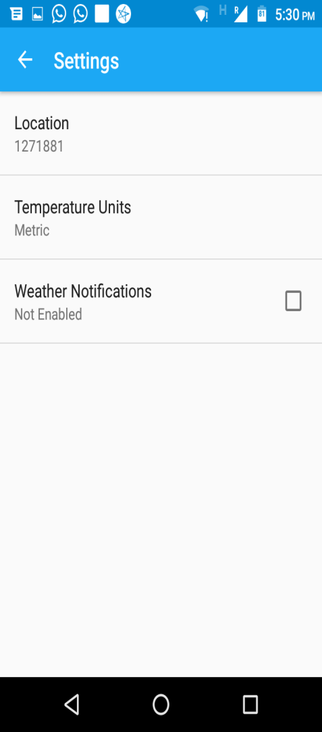
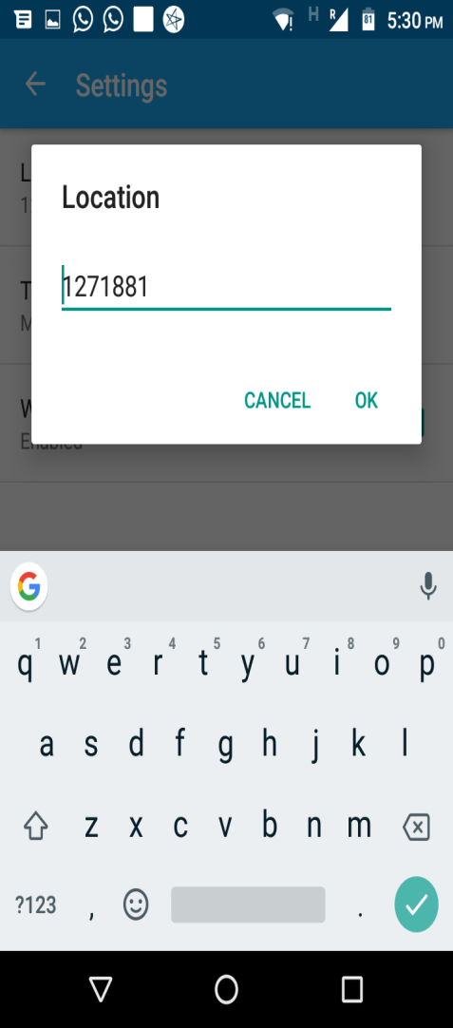

Slide 30
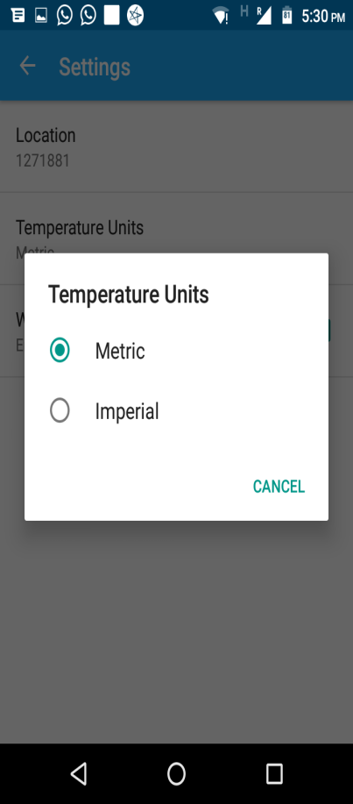
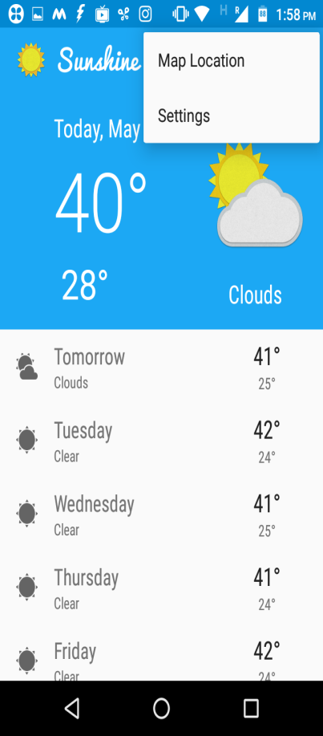
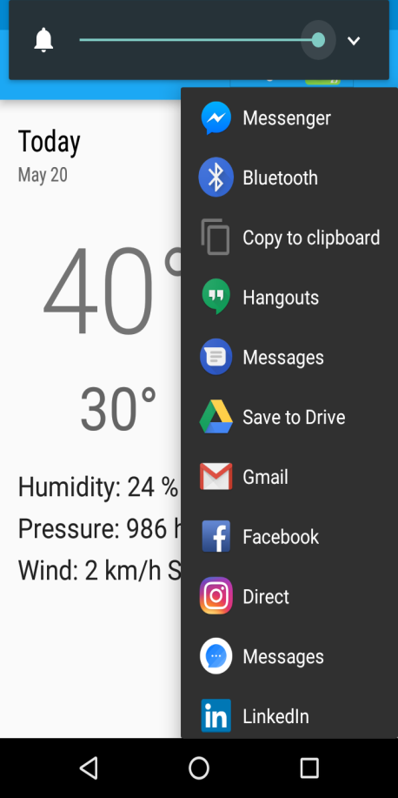
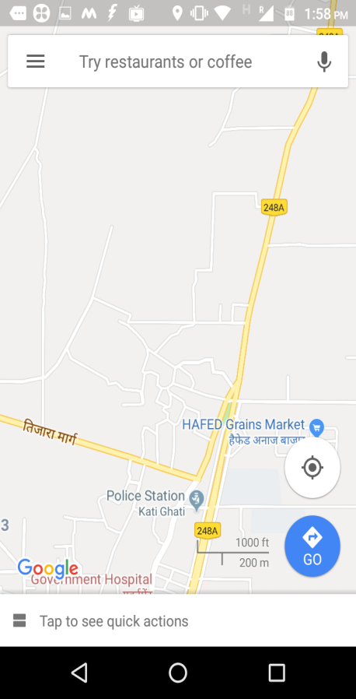

Slide 31
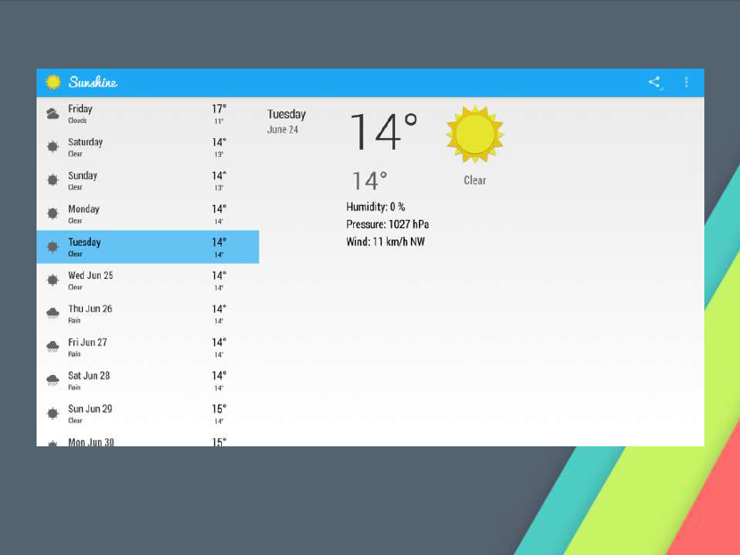

Slide 32
Conclusion
User- interface can be improved.
Further more featires can be added

Slide 33
Thank you☺

