Slide 1
THE REALITY OF BANKING SECURITY
"Last week, a bank developer committed a production database password to a public repository. It sat live, exposed to the internet, for 6 hours before anyone noticed."
Manual audits are too slow. Static spreadsheets fail. Credit data leaks in seconds. How does a SecOps team stay ahead of the risk?
SOVASCAN | Regulatory Code Compliance Platform | Continuous Auditing Solution
1 / 14

Slide 2

SovaScan
Intelligent Vulnerability, Configuration & Secret Security Analyzer
Tailored for Continuous Regulatory Auditing and Automated Remediation in Banking Codebases
National Hackathon 2026 | UCO Bank
Designed for Continuous CISO Security Gates & Active Auditing
Presented by: Team Verstappen Paglus
SOVASCAN | Regulatory Code Compliance Platform | Continuous Auditing Solution
2 / 14

Slide 3
Priya's Daily Threat Landscape
The reality of managing code security audits at a scale of 100+ active repositories
Priya's primary bottlenecks as a SecOps engineer:
• Lagging Security Visibility: Compliance audits are run manually twice a year. Between audits, developers commit code containing vulnerabilities undetected.
• Undetected Leaks in Repos: Database credentials and API key hashes are committed in local configurations. Generic scanners miss complex secret patterns.
• Disconnected Compliance Docs: RBI guidelines and SOC-2 trust criteria are tracked in spreadsheets, disjointed from actual code status.
THE FINANCIAL RISK
277 Days
Average time required to identify and resolve key leaks in large-scale repositories. Source: IBM Cost of a Data Breach Report
$4.5M
Average global cost of data breaches in banking and financial configurations. Source: IBM Cost of a Data Breach Report
Regulatory Risk
Heavy penalties by RBI for lacking continuous vulnerability assessment systems. Source: RBI Cybersecurity Guidelines
SOVASCAN | Regulatory Code Compliance Platform | Continuous Auditing Solution
3 / 14

Slide 4
Securing Priya's Workflow
Automated multi-vector scanning and live regulatory compliance mapping
How SovaScan streamlines Priya's dashboard audits:
• Continuous Scan Pipelines: Runs automated multi-vector scanning covering dependencies, secret detection, SAST, git history, and configs.
• Live Compliance Mapping: Translates raw CVEs and vulnerabilities directly into passing/failing control checklists for RBI, NIST, and SOC-2.
• One-Click Remediations: Priya can apply auto-fixes and roll back changes instantly, directly inside the dashboard panel.
THE SOLUTION BENEFIT
Real-Time WebSocket Warnings
Vulnerability findings and automated alerts sent in seconds upon scan completion.
100% Audit Ready
Continuous dashboard shows actual compliance posture for executive review.
Closed Loop
Identify, remediate, audit, and alert - all in a single integrated workflow.
SOVASCAN | Regulatory Code Compliance Platform | Continuous Auditing Solution
4 / 14

Slide 5
System Architecture
Core components and data relationships flowchart
Scan Orchestrator
ScanManager Task Runner Real-time WebSockets
Dashboard UI
API Router Gateway
React 18 / Zustand Recharts SVG Gauges
FastAPI Router API Key Verification
Multi-Vector Scanners
SQLite DB
SAST / Secrets / Deps Git History Crawler
sovascan.db Audit Log Ledger
Alert Dispatcher
Slack / Teams Alerting (Outbound SSRF Safe)
Threat Intel Feeds
OSV API / CVE Feeds CISA KEV / EPSS DB
⚡ Data Flow: Dashboard requests trigger secure APIs. The Gateway schedules task workers via ScanManager, audits threat parameters, updates SQLite states, dispatches Slack notifications, and streams progress alerts.
SOVASCAN | Regulatory Code Compliance Platform | Continuous Auditing Solution
5 / 14

Slide 6
Scan Execution Pipeline
Low-level task lifecycle and API/worker transaction flow
1. TRIGGER
2. API GATEWAY
3. DISPATCH
4. CLONE TARGET
User POSTs Git URL + key credentials to /api/v1/scan API route.
Router checks auth state, writes PENDING to DB, and returns a 202 ID.
ScanManager schedules worker task, decoupling scan from HTTP threads.
Worker spawns secure temporary clones of target Git directories.
8. WEBSOCKET FEED
7. WRITE DETAILS
6. COMPLIANCE MAPPING
5. EXECUTE AUDITS
UI receives completion events, re-indexing stats and compliance speedometer.
Persists findings, exports SBOM list, dispatches notifications.
Applies scoring modifiers and correlates issues to RBI/NIST controls.
Runs parallel vector checks: SAST, secrets, CVEs, git history, configs.
SOVASCAN | Regulatory Code Compliance Platform | Continuous Auditing Solution
6 / 14

Slide 7
Multi-Vector Scanning Engine
Parallel code audit layers checking for complex vulnerabilities
Dependency Analysis
Secret Detection
Static Analysis (SAST)
Extracts manifest definitions (package.json, requirements.txt, pom.xml) and runs CVE assessments via OSV API integrations.
Executes high-entropy Shannon algorithm checks + regex signatures to find raw passwords, private keys, and API tokens.
Seamlessly triggers Bandit (Python AST) and Semgrep (static pattern matching) subprocesses to audit source logic.
Git History Crawler
Configuration Audits
Dynamic Context-Scoring
Iterates through full commit logs (git log -p) to identify historical leaks hidden in older code revisions.
Audits deployment configurations (Dockerfiles, Nginx configs, env scripts) for insecure defaults and CORS issues.
Applies location-aware multipliers. Modifies risk scores if vulnerability is located in production vs testing directories.
SOVASCAN | Regulatory Code Compliance Platform | Continuous Auditing Solution
7 / 14

Slide 8
Regulatory Compliance Mapping
Translating code vulnerabilities directly to regulatory controls
NIST-CSF
SOC-2 Type II
OWASP Top 10
RBI-CSF Guidelines
National Institute of Standards & Technology
Service Organization Control Report
Open Web Application Security Project
Reserve Bank of India Guidelines
Maps code vulnerability scans onto core NIST pillars to trace posture.
Secures compliance gates by auditing trust service criteria.
Links code issues directly to major web vulnerability lists.
Audits specific Indian banking security regulations.
Identify, Protect, Detect, Respond, Recover
Security, Confidentiality, and Privacy Policies
Injection, XSS, SSRF, Broken Auth, Misconfiguration
PAN masking, Cryptography, Timeouts, Data encryption
SOVASCAN | Regulatory Code Compliance Platform | Continuous Auditing Solution
8 / 14

Slide 9
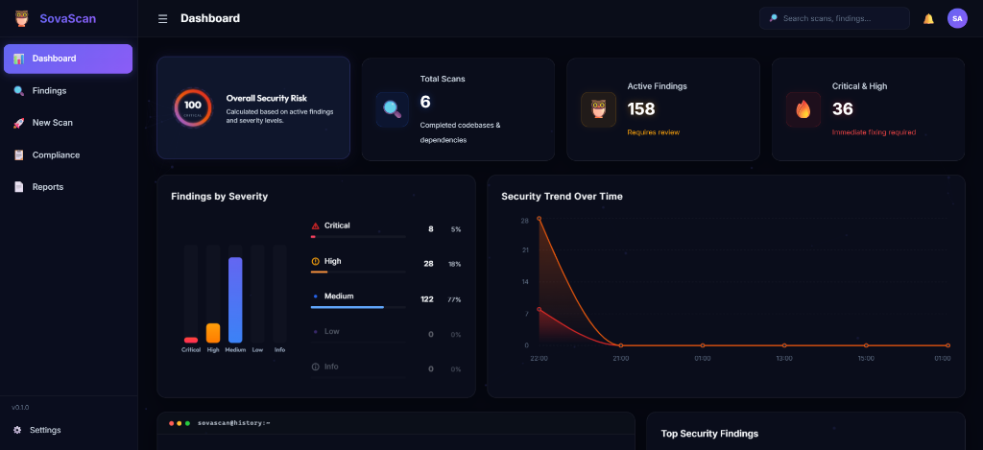
Priya's Cockpit: SovaScan Dashboard
Interactive analytical workspace and real-time dashboard stats
Dashboard Elements:
• Overall Security Risk: Circular dial detailing core vulnerabilities grouped into critical/high categories.
• Findings by Severity: Dynamically updated chart displaying counts (e.g. 122 Medium, 28 High, 8 Critical findings).
• Security Trend: Historical line graphs plotting scan vulnerability numbers over continuous execution periods.
• Terminal View: Bottom logging panel serving system output feeds direct to developers in real-time.
SOVASCAN | Regulatory Code Compliance Platform | Continuous Auditing Solution
9 / 14

Slide 10
Case Study: What Almost Went Wrong
SSRF vulnerability discovery and patch application on SovaScan webhook features
SSRF discovery & patching story:
• The Vulnerability Discovery: 48 hours before the hackathon, we scanned our outbound Slack alert webhook module. Discovered that unvalidated URL parameters allowed requesting local subnets.
• SSRF Mitigation Gate: Coded a DNS resolver checking domain IPs against local and link-local ranges, rejecting private spaces and non-HTTPS targets.
• Credential Token Masking: Masked webhook secrets and DB connection URLs inside GET API returns, blocking plaintext info exposure to developers.
BEFORE: UNRESTRICTED SSRF RISK
Backend accepted arbitrary URL schemes and hosts, allowing an attacker with valid API credentials to execute requests to localhost, internal assets, or cloud metadata endpoints.
AFTER: DEFENSE-IN-DEPTH ENFORCEMENT
Strict URL verification executes socket DNS resolution first. Blocks loopbacks (127.0.0.1), subnets (10.x.x.x, 192.168.x.x), and AWS/GCP metadata (169.254.169.254). Credentials are fully masked on Settings APIs.
SOVASCAN | Regulatory Code Compliance Platform | Continuous Auditing Solution
10 / 14

Slide 11
Security-First Architecture
Applying production-grade security gates to protect internal banking APIs
SovaScan Security Gates:
• Outbound Webhook Gates: Validates incoming alert webhook URLs. Blocks loopbacks, private subnets, and cloud metadata endpoints (169.254.169.254).
• Secure Settings Storage: Uses dynamic, relative paths rather than absolute paths to load and save local server settings, preventing directory traversal leaks.
• Information Exposure Masking: Sensitive DB credentials and webhook keys are masked with asterisks before returning to Settings views.
SECURITY GATES METRICS
SSRF Validation
Scheme, Hostname, DNS Lookup and IP checks verified on save and trigger pathways
Asterisk Masking
Webhooks are masked like 'services/T01...****/B01...****/********'
Dynamic Config
.env is loaded from path relative to server root to avoid dev-machine path leakage
SOVASCAN | Regulatory Code Compliance Platform | Continuous Auditing Solution
11 / 14

Slide 12
Priya's Early Warning System
Live diagnostic triggers and secure internal alert integrations
Secure Alert Notifications:
• Slack & Teams integrations: Sends structured Slack markdown alert messages immediately upon scan completion to designated webhook URLs.
• Instant Diagnostic testing: Features a dedicated '⚡ Test Webhook Alert' button in the frontend Settings page to verify delivery parameters.
• Detailed alert payloads: Webhook message specifies target Git path, scan identifier, critical vulnerabilities count, and direct report link.
slack_payload_template.json
1 2 3 4 5 6 7 8 9
{ "text": "🚨 *SovaScan Security Alert*\n🛡️ *RBI CSF & PCI-DSS Audit Status*\n\n*Target:* `git://github.com/company/repo`\n*Critical Vulnerabilities:* `4`\n*High Vulnerabilities:* `12`\n🔗 <https://sovascan.internal/report/9c1a|View Audit Report>" }
SOVASCAN | Regulatory Code Compliance Platform | Continuous Auditing Solution
12 / 14

Slide 13
The Tech Stack & Live Demo Walkthrough
Open-source foundations powering the SovaScan audit portal and demo timeline
CORE TECHNOLOGY STACK
LIVE DEMO WALKTHROUGH
• React 18 & TypeScript: Powers the type-safe component dashboard web layout.
• Zustand State Store: Lightweight client-side data state caching and action pipelines.
• FastAPI Async Web Framework: Asynchronous HTTP backend routing and swift API key validations.
• Bandit & Semgrep SAST: Source code AST static checkers run in isolated subprocess channels.
• Configure Webhooks: Paste diagnostic webhook URL in settings and trigger 'Test Webhook Alert'.
• Scan Git Repository Target: Input target repository URL, start scan, and watch progress updates live.
• Audit & Remediate Controls: Map scan onto NIST-CSF controls. Apply 'Auto-Fix', write ledger justification, and verify compliance score increase.
• Audit Trail & CLI: Verify persistent ledger logs. Demonstrate terminal CLI checks and CycloneDX SBOM exports.
SOVASCAN | Regulatory Code Compliance Platform | Continuous Auditing Solution
13 / 14

Slide 14
THE CONTINUOUS CODE AUDIT MANDATE
CHOOSE OUR TECHNICAL DEEP-DIVE
"The next leaked banking credential is sitting in a Git commit right now."
Pick a topic and we will go deep for 60 seconds:
1. Shannon Entropy Detection
How our custom algorithms detect passwords and credentials in configuration structures with zero database signatures.
The only question is who finds it first -- an attacker, or a continuous code compliance tool like SovaScan.
2. Outbound SSRF Resolution Gates
How our socket DNS resolver blocks link-local addresses, loopbacks, and cloud metadata queries at the gateway level.
Presented by: Team Verstappen Paglus
3. Hashed API Key Verification
How SovaScan protects server configurations using SHA-256 salted hashes on incoming X-API-Key request headers.
🌐 github.com/abhinavsingh2403/SovaScan
🛡️ Deployable On-Premises (Zero-Trust Data Policy)
SOVASCAN | Regulatory Code Compliance Platform | Continuous Auditing Solution
14 / 14

