Slide 1

SovaScan
Intelligent Vulnerability, Configuration & Secret Security Analyzer
Tailored for Regulatory Compliance in Financial and Banking Codebases
🏆 National Hackathon 2026 | UCO Bank
Designed for CISO Security Gates & Continuous Code Audits
Presented by: Team SovaScan (Abhinav Singh & Team)
🦉 SOVASCAN | UCO BANK HACKATHON 2026
1 / 13

Slide 2
The Problem Statement
Operational challenges & compliance risks in banking security audits
Banking security audits face major bottlenecks:
• Manual & Infrequent Audits: SecOps runs manual codebase reviews only once or twice a year, leaving vulnerabilities active in production for months.
• Exposed Secrets & Keys: APIs, encryption credentials, and DB strings are frequently leaked in git commits. Traditional code scanning tools lack high-entropy detection.
• Spreadsheet compliance tracking: Framework compliance checks (RBI Cyber Security, NIST-CSF, SOC-2) are tracked manually in static sheets rather than mapping live to code status.
• No remediation loops: Identifying errors is easy, but security analysts lack instant validation systems to apply fixes and log justification audits simultaneously.
THE FINANCIAL RISK
250+ Days
Average time to identify a secret leak in enterprise repository structures
$4.3M
Average global cost of data breaches in banking & financial infrastructures
Non-Compliance
Heavy penalties by RBI for lacking continuous vulnerability assessment systems
🦉 SOVASCAN | UCO BANK HACKATHON 2026
2 / 13

Slide 3
SovaScan: The Solution
Automated multi-vector scanning and live regulatory compliance mapping
How SovaScan secures banking codebases:
• Continuous Scan Pipelines: Runs automated multi-vector scanning covering dependencies, secret detection, SAST, git history, and configs.
• Live Compliance Mapping: Translates raw CVEs and vulnerabilities directly into passing/failing control checklists for RBI, NIST, and SOC-2.
• One-Click Remediations: Security operators can apply auto-fixes and roll back changes instantly, directly inside the dashboard panel.
• Persistent Audit Ledger: Forces developers and operators to write justifications before applying fixes, keeping an immutable ledger of all actions.
THE SOLUTION BENEFIT
Seconds
Real-time vulnerability findings and automated alerts sent via WebSockets
100% Audit Ready
Continuous dashboard shows actual compliance posture for executive review
Closed Loop
Identify, remediate, audit, and alert - all in a single integrated workflow
🦉 SOVASCAN | UCO BANK HACKATHON 2026
3 / 13

Slide 4
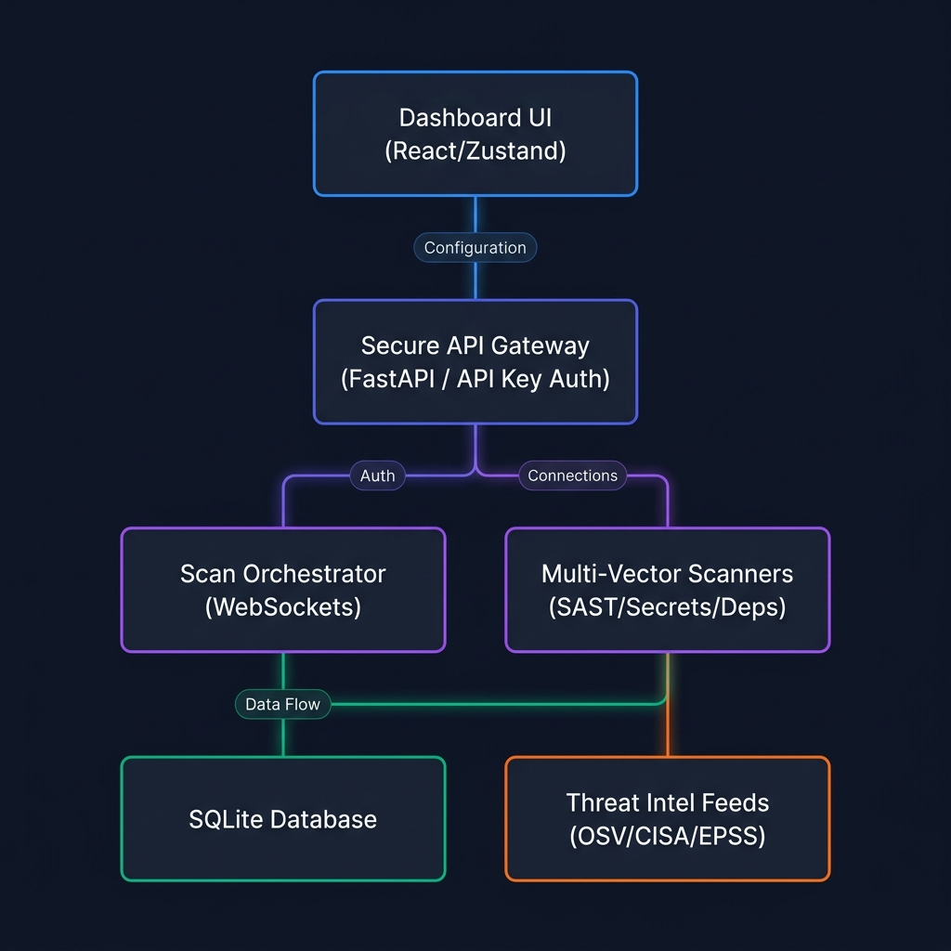
System Architecture
High-level core component boundaries & async task flow
Architectural Pillars:
• React Dashboard: State managed via lightweight, fast-loading Zustand. Recharts powers severity distribution mapping.
• FastAPI Gateways: Handles secure incoming HTTP routing. Uses a custom middleware to verify hashed, active API Keys.
• Background Scan Manager: Spawns subprocesses to decouple scans from request loops. WebSockets stream live feedback chunks.
• Threat Intelligence: Retrieves upstream vulnerabilities on-demand from OSV and maps them locally into cached SQLite structures.
🦉 SOVASCAN | UCO BANK HACKATHON 2026
4 / 13

Slide 5
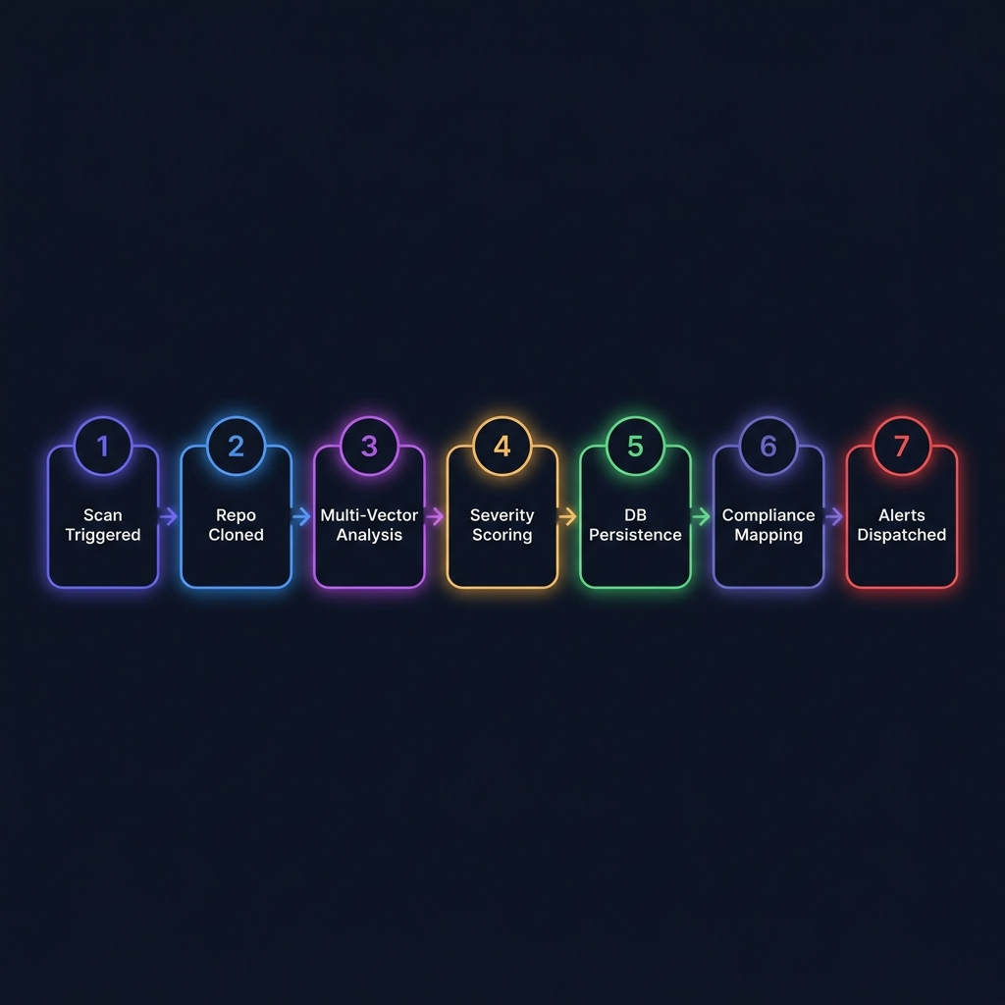
Scan Execution Pipeline
Low-level task lifecycle and API/worker transaction flow
Scanning Lifecycle:
• 1. Request Dispatch: Frontend sends POST /scan payload. Router validates API key and target scheme, replying instantly with 202 Accepted.
• 2. Async Execution: Orchestrator clones target Git repo to secure, temporary directories, running isolated vector sub-scanners.
• 3. Normalization & Save: Raw outputs are scored dynamically, persisted to SQLite, and temp clones are completely purged.
• 4. Real-time broadcast: Completion details and vulnerability counts are broadcast instantly over WebSockets to dashboards.
🦉 SOVASCAN | UCO BANK HACKATHON 2026
5 / 13

Slide 6
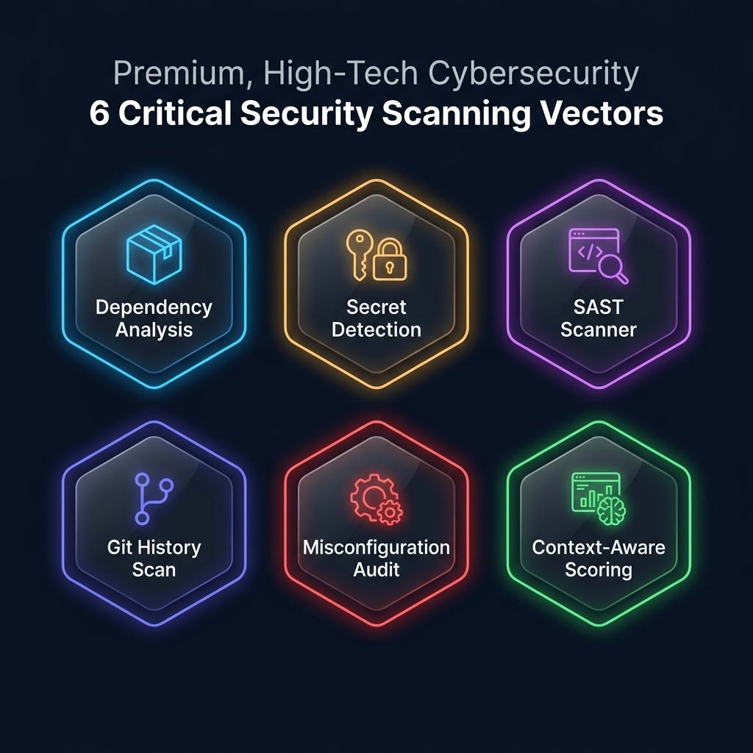
Multi-Vector Scanning Engine
Parallel code audit layers checking for complex vulnerabilities
How SovaScan Audits Code:
• Dependency Analysis: Extracts package manifests (package.json, requirements.txt, pom.xml) and runs CVE audits via upstream OSV API.
• Secret Detection: Executes high-entropy checks + regex signatures to find raw passwords, private keys, and API tokens.
• SAST Subprocesses: Seamlessly triggers Bandit (Python AST) and Semgrep (static patterns) to look for structural vulnerabilities.
• Git History Crawler: Iterates through full commit logs (git log -p) to identify historical leaks hidden in older code commits.
🦉 SOVASCAN | UCO BANK HACKATHON 2026
6 / 13

Slide 7
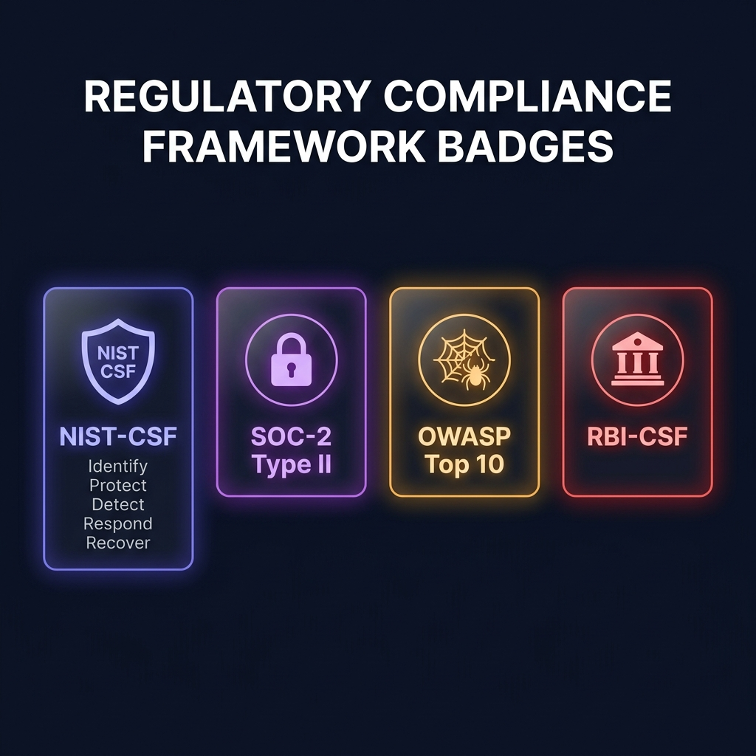
Regulatory Compliance Mapping
Translating code vulnerabilities directly to regulatory controls
Supported Banking Frameworks:
• NIST Cyber Security Framework: Maps code vulnerability scans onto core NIST pillars (Identify, Protect, Detect, Respond, Recover) to trace compliance.
• SOC-2 Type II Trust Criteria: Secures compliance gates by auditing trust service criteria: Security, Confidentiality, and Privacy policies.
• OWASP Top 10 Web Security: Links code issues directly to injection, broken authorization, secure misconfiguration, and SSRF lists.
• RBI Cybersecurity Guidelines: Audits specific banking requirements: PAN masking, cryptographic algorithms, session timeouts, and encryption.
🦉 SOVASCAN | UCO BANK HACKATHON 2026
7 / 13

Slide 8
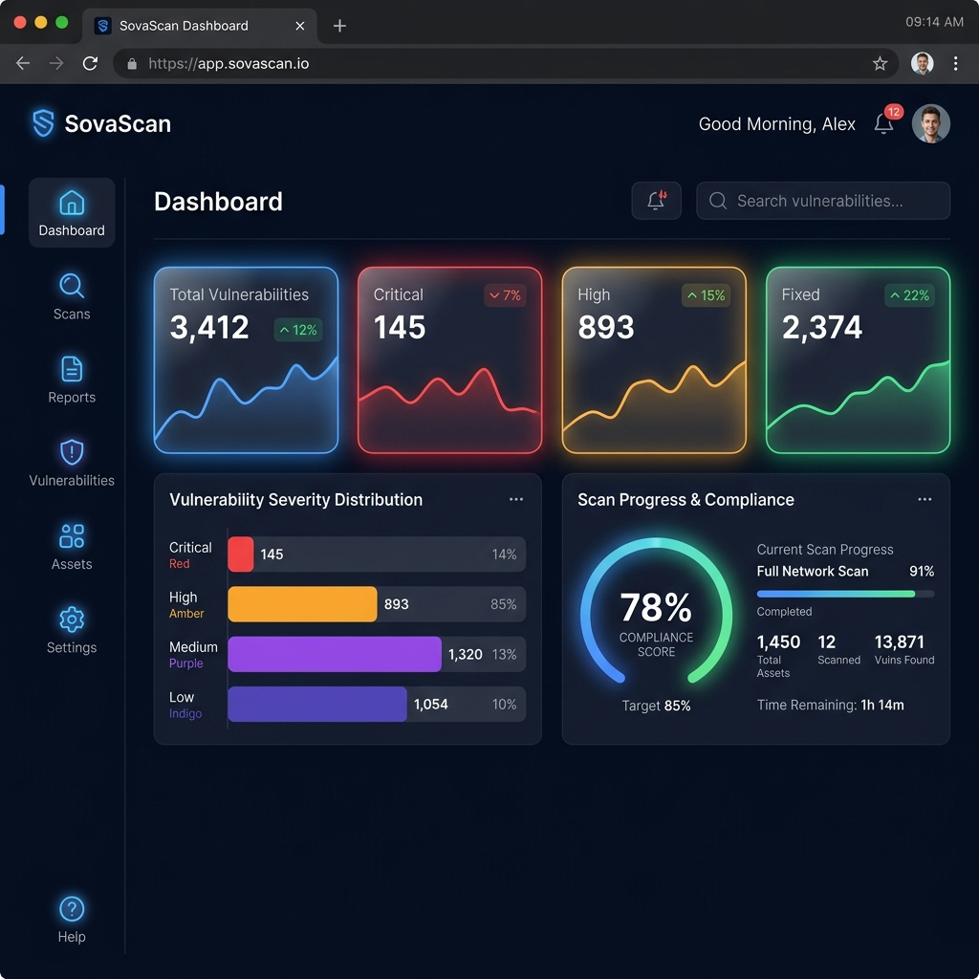
Developer & Security Dashboard
Full overview of SovaScan's rich analytical workspace
Dashboard Controls:
• Posture Overview: Visualizes severity distributions, vulnerability counts, and scan trend graphs in high-contrast React charts.
• Scan Execution: Operators enter target Git repositories directly. Streams execution state live via WebSockets.
• Remediation Engine: Supports automated auto-fix functions directly from the findings board, including rollback configurations.
• Compliance Checklists: Radial speedometer gauge displaying compliance scores, categorized controls, and requirement lists.
🦉 SOVASCAN | UCO BANK HACKATHON 2026
8 / 13

Slide 9
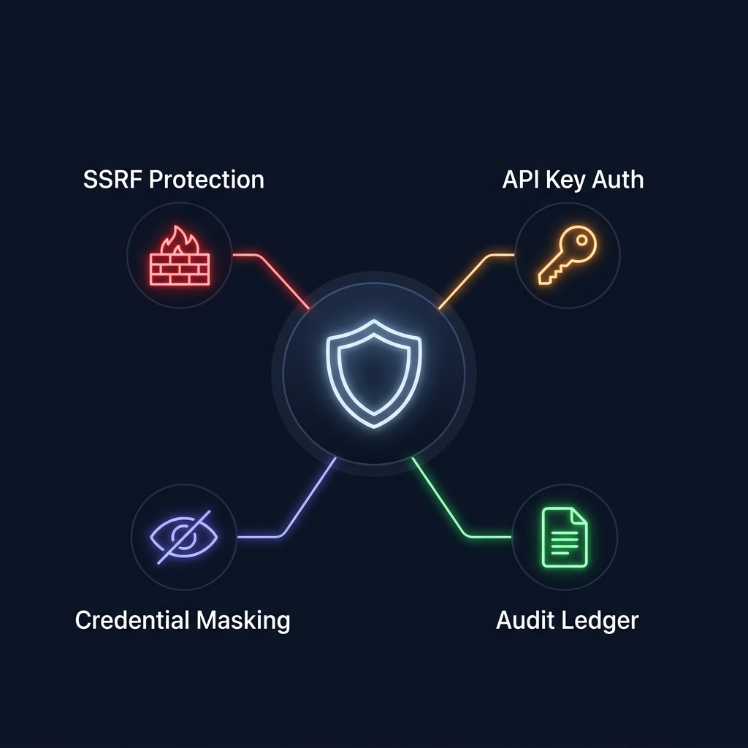
Security-First Architecture
Applying production-grade security gates to protect internal banking APIs
SovaScan Security Gates:
• Full SSRF Protection: Validates incoming alert webhook URLs. Blocks loops, private IPs, and cloud metadata requests (169.254.169.254).
• Secure Settings Storage: Uses dynamic, relative paths rather than absolute paths to load and save local server settings, protecting host directories.
• Information Exposure Masking: Sensitive DB credentials and webhook keys are masked with asterisks before returning to Settings views.
• API Key Security: Requests require custom `X-API-Key` headers. Stored keys are encrypted locally using SHA-256 salts.
🦉 SOVASCAN | UCO BANK HACKATHON 2026
9 / 13

Slide 10
Real-Time Webhook Alerting
Live diagnostic triggers and external alert integration
Secure Alert Notifications:
• Slack & Teams integrations: Sends structured Slack markdown alert messages immediately upon scan completion to designated webhook URLs.
• Instant Diagnostic testing: Features a dedicated '⚡ Test Webhook Alert' button in the frontend Settings page to verify delivery parameters.
• Detailed alert payloads: Webhook message specifies target Git path, scan identifier, critical vulnerabilities count, and direct report link.
• SSRF validation gate: Validates scheme/host parameters in outbound requests dynamically before dispatching HTTP payloads.
SLACK ALERT JSON PAYLOAD
{ "text": "🚨 *SovaScan Security Alert*\n🛡️ *RBI CSF & PCI-DSS Audit Status*\n\n*Target:* `git://github.com/company/repo`\n*Critical Vulnerabilities:* `4`\n*High Vulnerabilities:* `12`\n🔗 <http://localhost:8000/report/9c1a|View Audit Report>" }
🦉 SOVASCAN | UCO BANK HACKATHON 2026
10 / 13

Slide 11
The Core Technology Stack
Open-source foundations powering the SovaScan audit portal
FRONTEND LAYER
BACKEND SERVICES
SECURITY & DEV-OPS
React 18 & TypeScript
FastAPI Async Gateway
OSV Vulnerability API
Type-safe component dashboard framework
Asynchronous HTTP backend routing and API key filters
Continuous CVE databases queryable via API vectors
Zustand State Manager
SQLAlchemy Core
Docker & Compose
Frictionless global state stores with client caching
Object-relational mapping models with SQLite connections
Multi-container build parameters and network environments
Recharts Visualizer
Pydantic v2 Schemas
Bandit & Semgrep
Dynamic SVG gauges and vulnerability distributions
Strict input serialization and payload type validations
Source static analysis libraries run as subprocesses
Vite Bundler
Click & Rich CLI
GitHub Actions CI/CD
Custom rollup configuration with node-module chunking
Command line scanning tools printing colorized reports
Automated code integration checkpoints and testing workflows
🦉 SOVASCAN | UCO BANK HACKATHON 2026
11 / 13

Slide 12
The Live Demo Plan
Step-by-step walkthrough demonstrating SovaScan capabilities
STAGE 1
STAGE 2
STAGE 3
Configure & Test Alerts
Scan Target Repository
Review Compliance Scores
Open settings. Paste webhook.site diagnostic webhook URL and trigger 'Test Webhook Alert' to demonstrate outbound JSON traffic.
Input the target Git repository. Trigger scan and show real-time WebSocket progress bars detailing SAST / secrets check phases.
Examine NIST-CSF, SOC-2, and OWASP-10 frameworks checking failed compliance controls and violation lists.
STAGE 4
STAGE 5
STAGE 6
Remediate Vulnerability
Immutable Audit Ledger
CLI Scan & SBOM
Locate a vulnerable item, execute 'Auto-Fix', write operators' justification ledger, and watch compliance scores rise.
Visit Profile page. Display the persistent SQLite log detailing the timestamped fix action and security reason.
Demonstrate CLI tool: run 'sovascan scan' inside terminal to export interactive HTML scan reports and CycloneDX SBOMs.
🦉 SOVASCAN | UCO BANK HACKATHON 2026
12 / 13

Slide 13
Thank You
Questions & Discussion
🌐 Project Repository: github.com/abhinavsingh2403/SovaScan
💻 Local Dashboard Endpoint: http://localhost:8000
Designed for Enterprise Code Governance & Regulatory Compliance
🦉 SOVASCAN | UCO BANK HACKATHON 2026
13 / 13

