Slide 1


Thynk Unlimited
SDAS
Student Dropout
Analysis System
Predicting dropout risk and improving student retention through analytics and interventions
Presenter: [Your Name] | College: [College Name]
Guide: [Guide Name] | Date: 2024

Slide 2
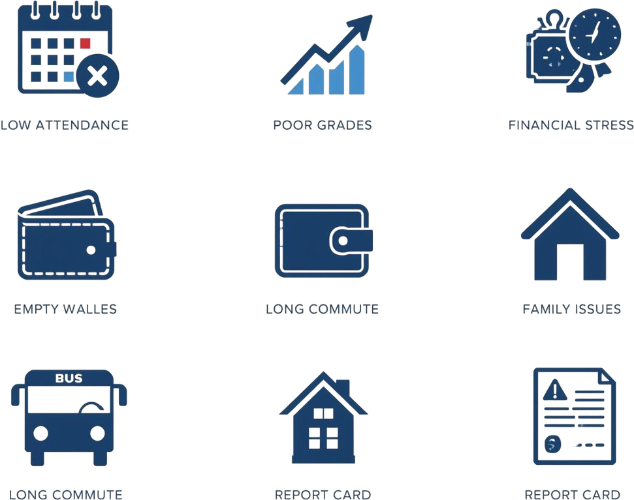
Problem
Statement
Student dropout is a major challenge affecting education outcomes worldwide. Early identification is critical but often missed.
Contributing Factors:
• Low attendance & poor academic performance
• Financial problems & economic hardship
• Long commute distances from school
• Previous academic failures
• Family background & social issues
Manual tracking is time-consuming and error-prone, making timely intervention difficult.

Slide 3

Project Objective
1
Early detection of at-risk students
SDAS aims to empower educators with data-driven tools to identify and support at-risk students before dropout occurs
2
Facilitate school monitoring of student data
3
Provide actionable insights for counselors and administrators
4
Improve planning and effectiveness of interventions
5
Enhance overall student retention rates

Slide 4
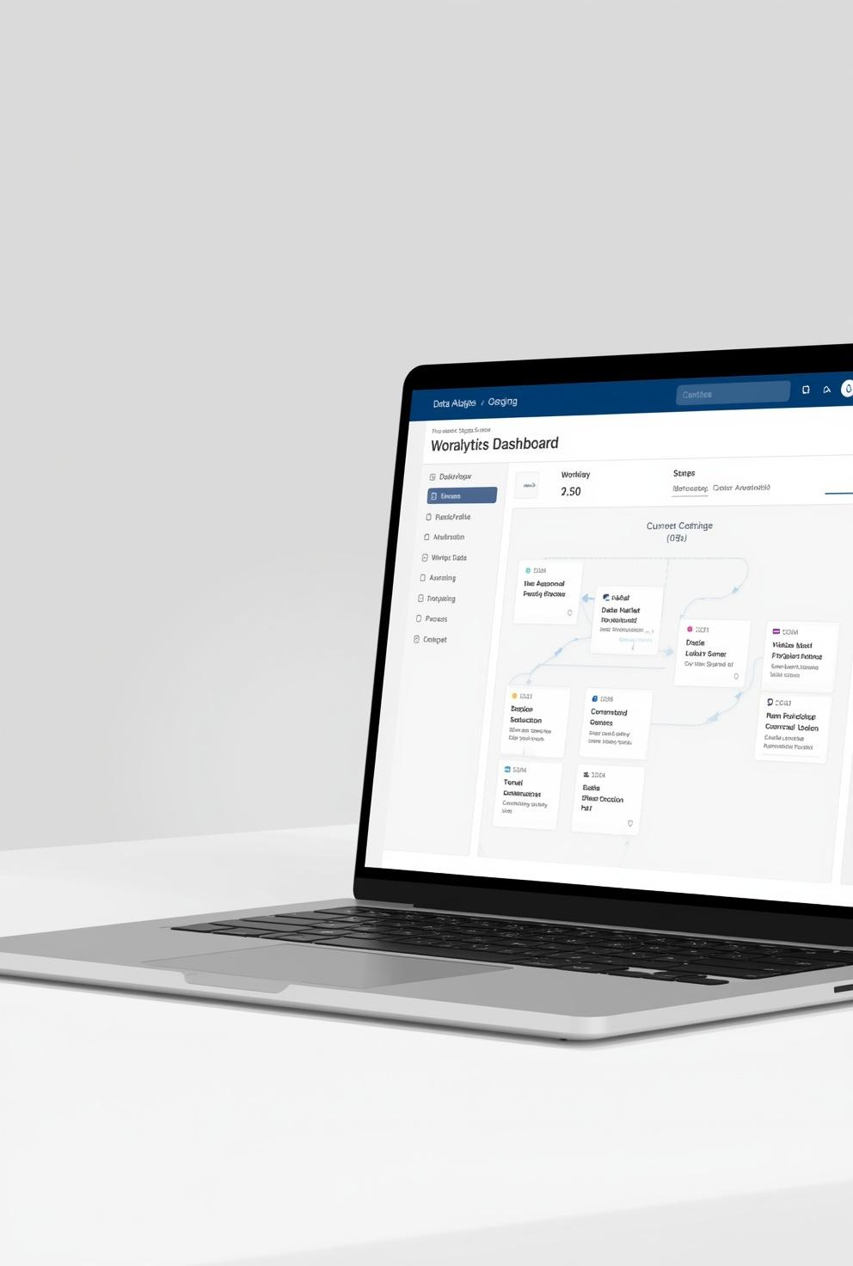

Proposed Solution
SDAS is a web-based Student Dropout Analysis System designed to predict risk and enable timely interventions.
✦ Student Data Integration — Centralized academic, attendance, and demographic records
✦ Risk Scoring Algorithms — Multi-factor dropout probability calculation
✦ Analytics Dashboards — Visual KPIs and trend charts for administrators
✦ Intervention Tracking — Log and monitor counseling actions with timelines
✦ Counselor Assignment — Role-based access and real-time communication

Slide 5



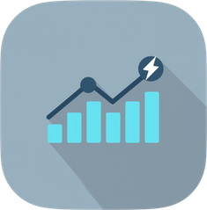
Technology Stack
Frontend
Backend
Database
Tools
Vite + JS
Node.js
MongoDB
Chart.js & Socket.IO
HTML, CSS, Tailwind CSS, Vanilla JS
Express.js REST API
JSON / MongoDB storage
JWT Auth, Real-time updates

Slide 6






Frontend Architecture
SDAS is built as a Single Page Application (SPA) with modular page-based navigation
Landing Page
Students Module
Public entry point introducing SDAS with project overview and navigation
Student roster with search, filters, risk levels, and detailed profile views
Login Module
Analytics Module
Role-based authentication for Admin and Counselor using JWT tokens
Interactive charts for risk distribution, area analysis, and attendance simulation
Dashboard
Central hub showing KPIs, risk summaries, and recent intervention activity

Slide 7

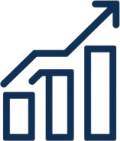

Core Functionalities
User login and authentication with role-based access (Admin, Counselor)
Student risk score calculation based on attendance, GPA, and multiple factors
Detailed student profiles with dropout probability scores and risk trends

Slide 8
Dashboard KPI Highlights
34%
72%
3 Key
High-Risk Students
Avg. Attendance
Risk Drivers Flagged

Slide 9
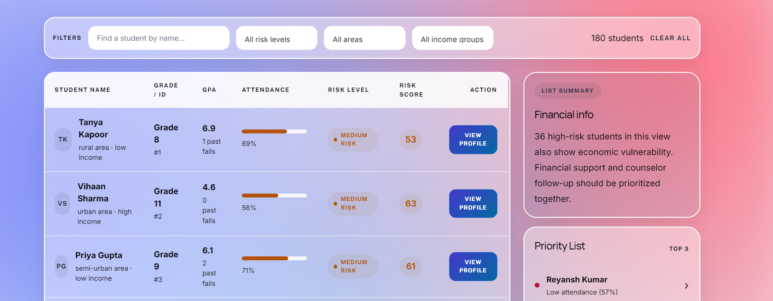
Student Management
The student roster provides powerful search and filtering capabilities by risk level, geographic area, and economic status. Each student profile displays a comprehensive view of key indicators to support counselor decision-making and timely intervention. Profiles include attendance records, GPA trends, dropout probability scores, and dynamic risk trend graphs — enabling administrators and counselors to quickly identify and act on students who need support.
Risk Level Filter
Attendance
GPA Trends
Dropout Score
Risk Graphs

Slide 10

Analytics & Prediction Functionality
1
Attendance & GPA — primary risk score drivers
Supports data-driven decisions to identify and act on at-risk students early and effectively
2
Economic status & commute distance factors
3
Previous failures & parent education level
4
Risk distribution, area map & grade-wise charts
5
Economic group analysis & attendance simulation

Slide 11
Intervention & Counselor Management
Structured support mechanisms to guide at-risk students back on track
✔ Counseling sessions, parent meetings, and academic support logging
✔ Financial aid and mentorship program tracking per student
✔ Admin assigns counselors; real-time updates via Socket.IO notifications

Slide 12


System Workflow
1
2
3
User Login
Student Data Fetch
Risk Calculation
Admin or Counselor logs in with role-based JWT authentication to access the system
System retrieves student records including attendance, GPA, economic status, and commute data
Dropout risk scores are computed using multi-factor algorithm and displayed on the analytics dashboard
4
5
Select Student & Log Intervention
Assign Counselor & Real-time Update
Counselor reviews at-risk student profile and logs intervention such as counseling or academic support
Admin assigns counselor to student; Socket.IO pushes real-time notifications to all relevant users

Slide 13
Benefits & Impact
How SDAS creates measurable value for students, counselors, and institutions
Early identification of dropout risk enables timely, targeted interventions
Data-driven decisions improve school strategies and counselor effectiveness
Better coordination between admin and counselors enhances overall student retention

Slide 14

Thank You
Thank you for your attention
Questions? We'd love to hear from you.
SDAS - Student Dropout Analysis System

