Slide 1
Lending Club Loan Applicant Worthiness Analysis Report
Analysis of the Applicants Data and Recommendations.
Abhinav Tyagi (Facilitator. abhinav@vayubiotech.com)
Vinay Pai (Member. vinaypai1977@gmail.com)

Slide 2
Objectives.
Target
Objective 1
By the end of presentation, you will in a position to quickly make transformational changes to your loan applicant handling. We have condensed all data provided to us you into a series of easily understandable visualisations.
You will no longer be in dark or confusion about the information you need to make the right decision.
We Are Excited To Share Our Discoveries With You!
We are to present our final recommendations on the Loan Applicants. A detailed, simple and complete analysis report to drive profit maximising decisions for your organisation, based on Loan Applicant data given to us.
Minimise the Charge Offs, by identifying demographics least likely to falter.
Objective 2
Objective 2
Capture all the demographics that are capable of paying back the loans.

Slide 3
Analysis
Analysis done on cleaned and outlier adjusted data. Logarithmic Functions Have been used to minimise skewed output due to highly unpredictable variables.
To Get To The Surface, You must first, Dive in Deep…
We Will Run the Following Analysis On The Data:
1. Univariate Analysis 2. Bi-Variate Analysis
3. Multivariate Analysis
We won’t until every important variable finds its role in our Analysis. :-)
Take a deep breath, let's dive in…

Slide 4
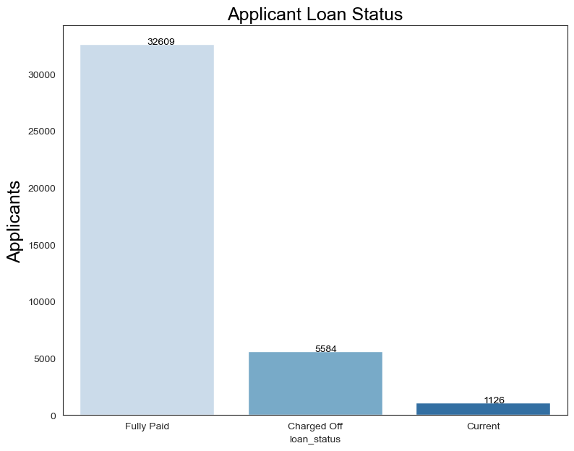
This Preliminary Analysis Reveals the Following Information About Loan Status:
FULLY PAID | 82.96%
CHARGE-OFF | 14.17%
CURRENT | 02.87%
Charge-Off Rate is Alarmingly High, so Let’s First Understand its Correlation to Other Factors…

Slide 5
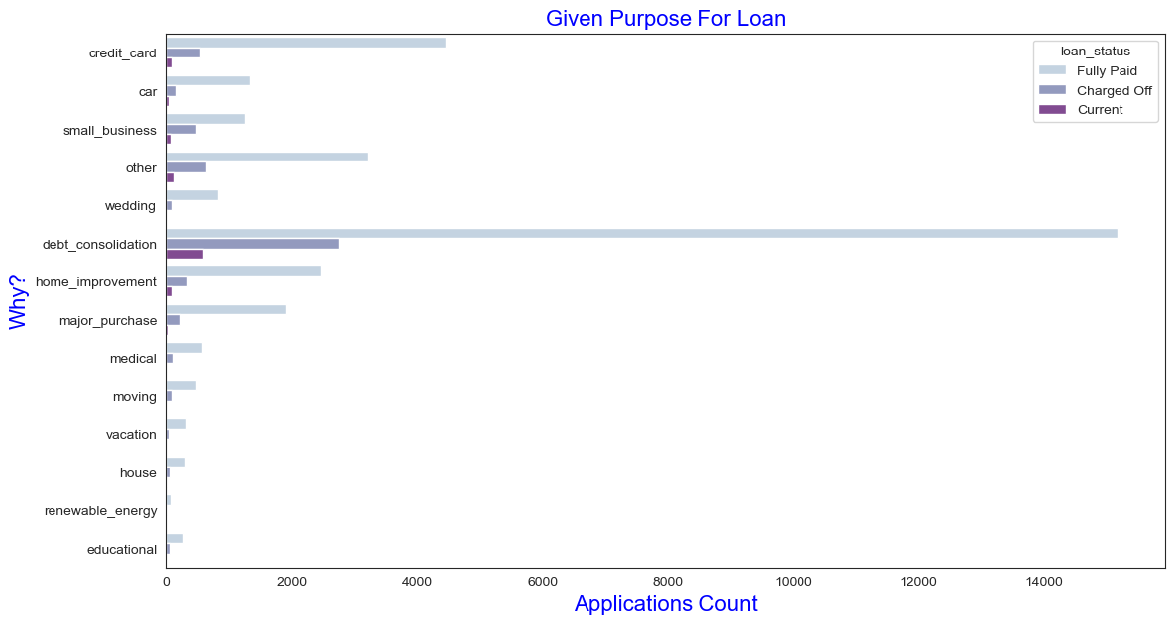
Impact Of Stated Loan Purpose On Repayment Variables
Observations:
Loans For Paying Off Other Liabilities Like Credit Card and other types of consolidation have a high charge-off rate.
Yet, at the same time, they form the majority of loan applications with lending club.
Major Purchase | 7.49%
Credit Card | 12.92%
Other | 10.05%
Home Improvement | 7.48%
Small Business | 4.60%
Debt Consolidation | 46.93%
TOTAL: 89.47%!

Slide 6
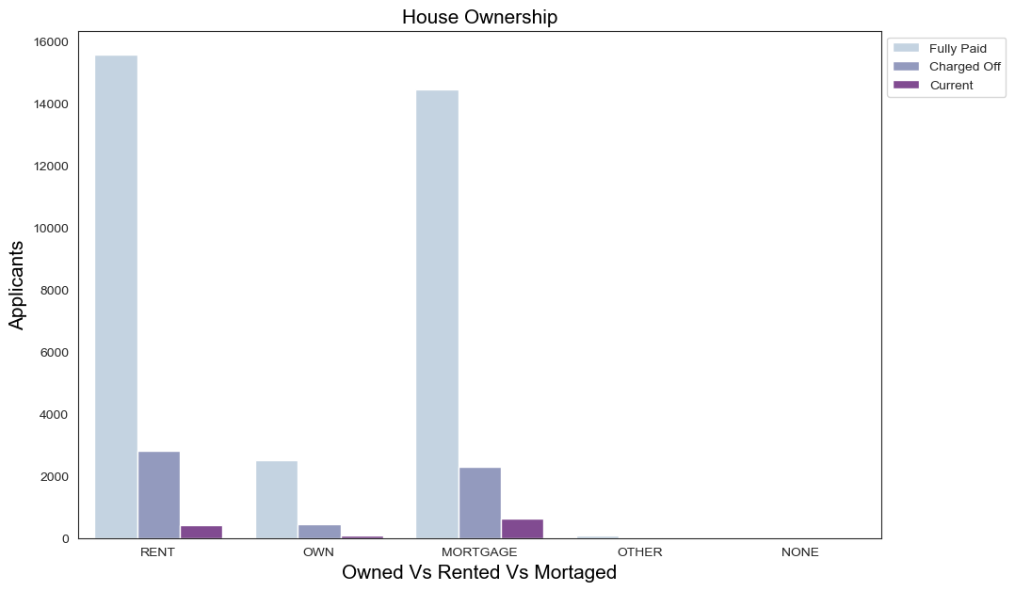
Home Ownership and High Pay Back Rate
An Individual with an owned home is about 10 times less likely To Be Charged Off than a person who Rents or Mortgage’s his residence.

Slide 7
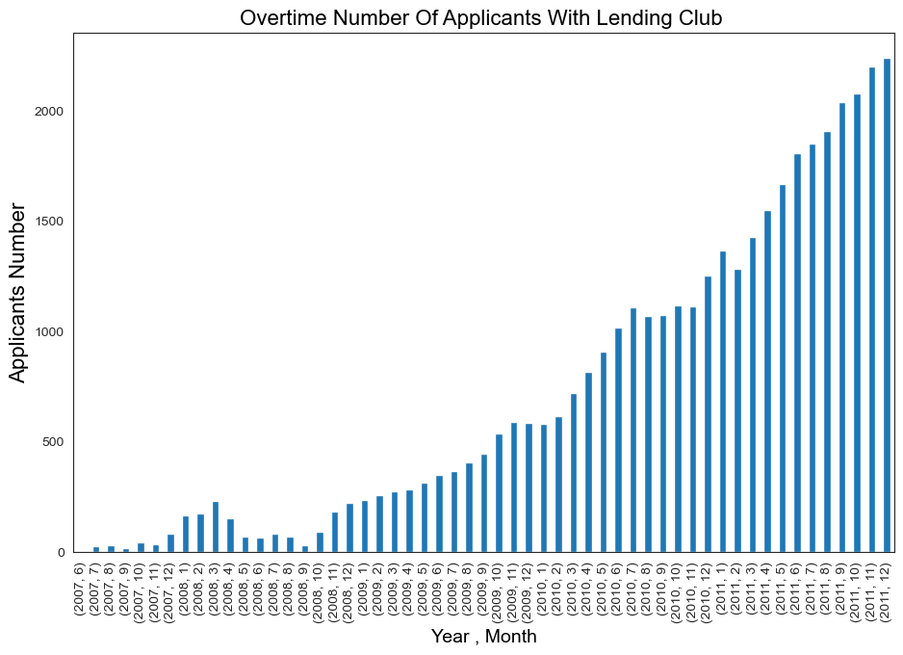
Lending Club - Organisation YoY Trajectory
Recommendations
While lending club a has made a massive growth in Loan Applicants, that growth naturally translates to a huge a backlog of increased Charge Offs. This is because at such large scales, the same percentage of charge offs lead to a huge number of absolute charge offs at much higher rates.

Slide 8
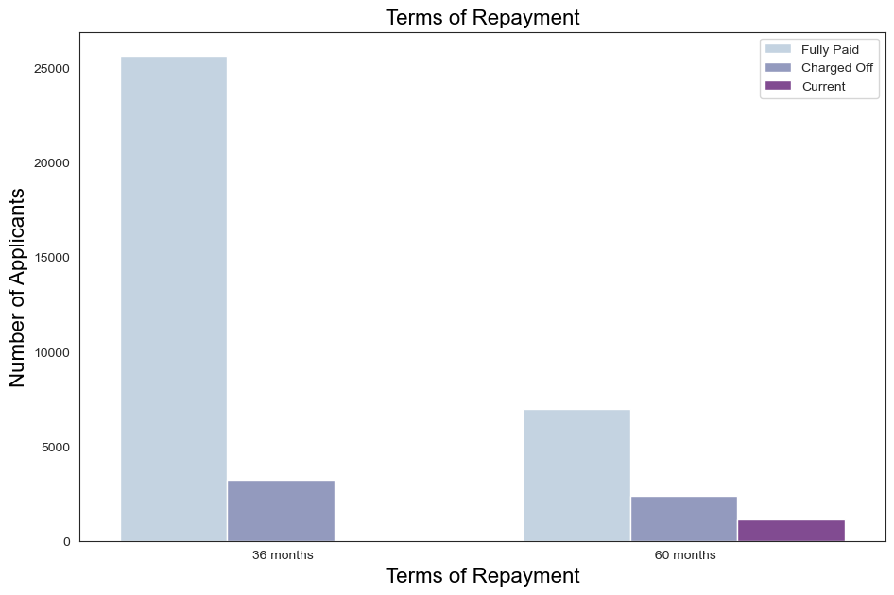
Terms of Repayment And Chargeback Rates
Recommendations
A person going with a 36 month Repayment plan is considerably more likely to make full payment compared to someone opting for larger terms, like 60 months. Therefore, they also get lower interest rates.

Slide 9
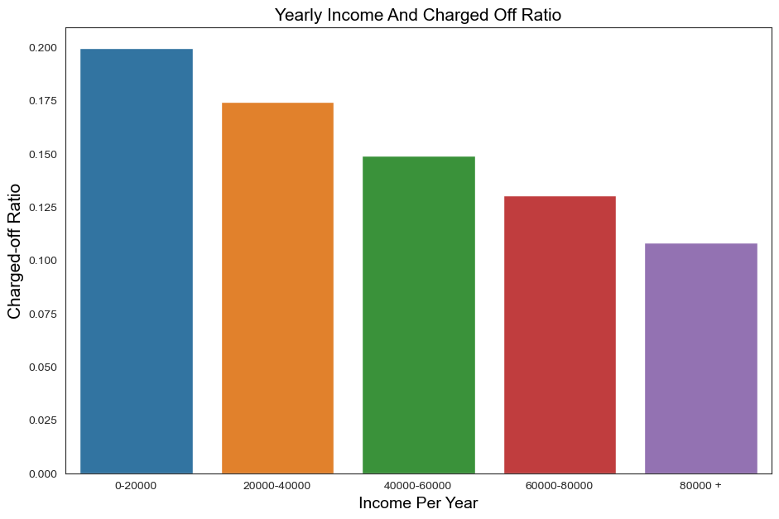
Impact of Yearly Incomes on Charge Back Pay Off rates
Recommendations
A person with lower salary, like in the range of 20000/- is much less likely to pay off charge offs compared to someone in 80000/- bracket. As we move up the income bracket, we can see a linear positive graph, as people with higher incomes tend to pay it off.

Slide 10
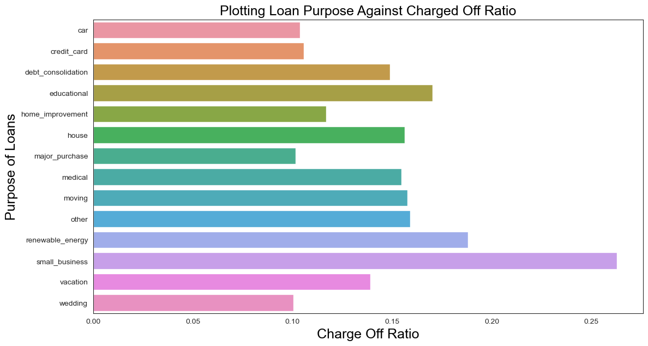
Impact of Stated Loan Purpose #2
Recommendations
Small Business applicants tend to get charged off the most, about twice as much as major purchases or weddings. It is a very difficult choice to discharge loans.
Weddings and Major Purchases based loans have lowest Charge off rates.

Slide 11
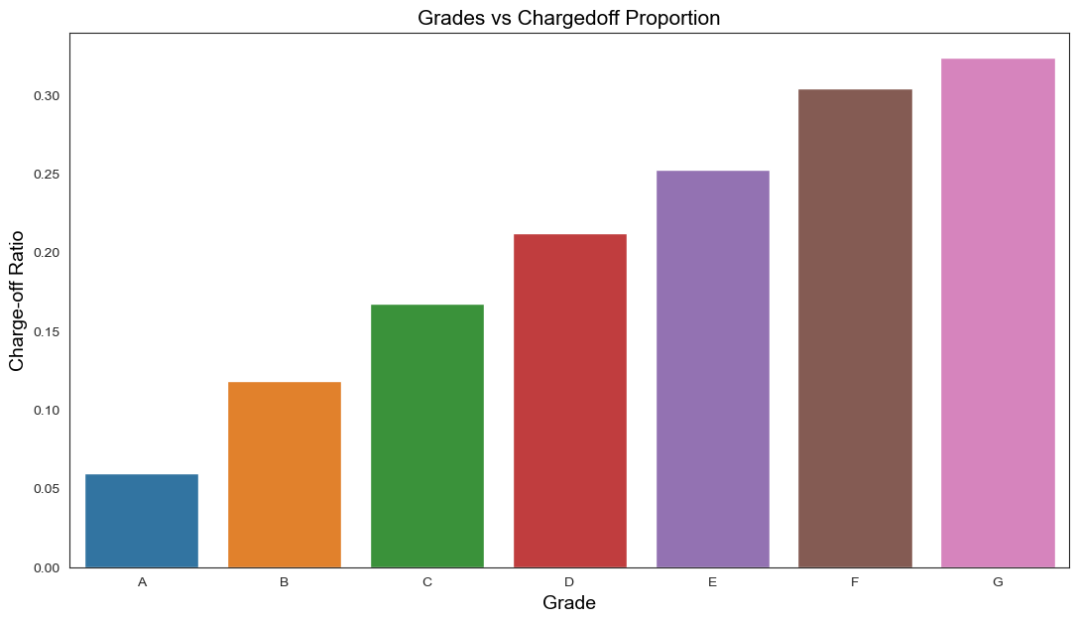
Impact of Credit Grades on Charge Back Pay Off rates
Recommendations
Grade A has the lowest Likelihood of being charged off and G highest, therefore, as the alphabets go on, charge off ratio increases, therefore a positive linear distribution between the two.

Slide 12
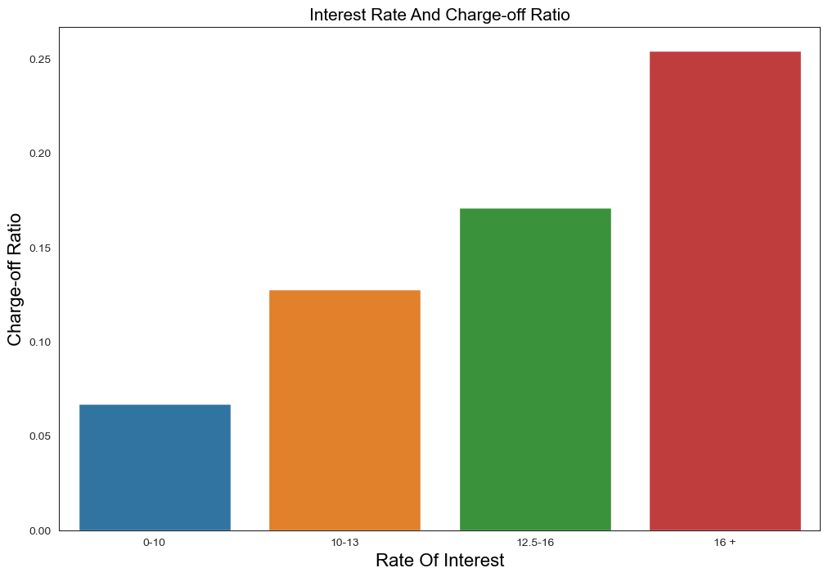
Impact of Rate of Interest On Charge Off Ratio
“More Will be Given Unto Those Who Have Everything, And the Little That Poor Have, Shall be Taken Away As Well.” - Old Testament
Recommendations
Linear and positive correlation between between Rate of Interest And Charge-off Ratio can be observed. Meaning
People are more likely to avoid paying on time if interest rates make them feel “cheated”.
Rate Of Interest is decided on the basis of Risk, so this might be because of it by design.

Slide 13
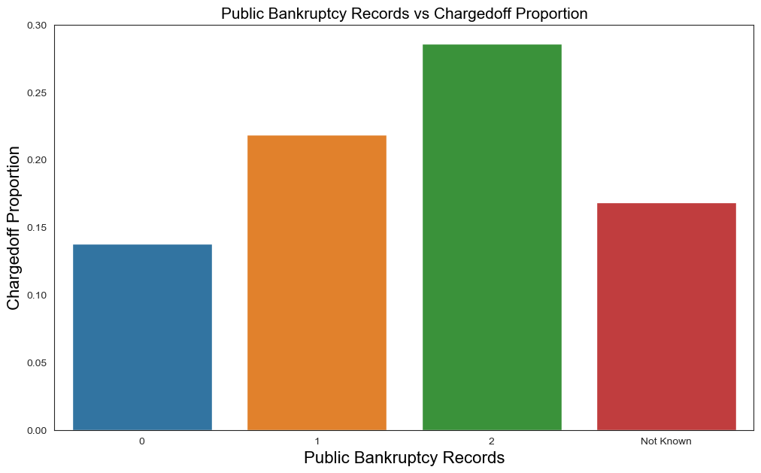
Impact of Bankruptcy Records on Charge Back Pay Off rates
Recommendations
Past Bankruptcies are a great way to predict future behaviour, as evidenced by the graph, correlation is strong and therefore, laon to such parties should be approved only after careful Deliberation.

Slide 14
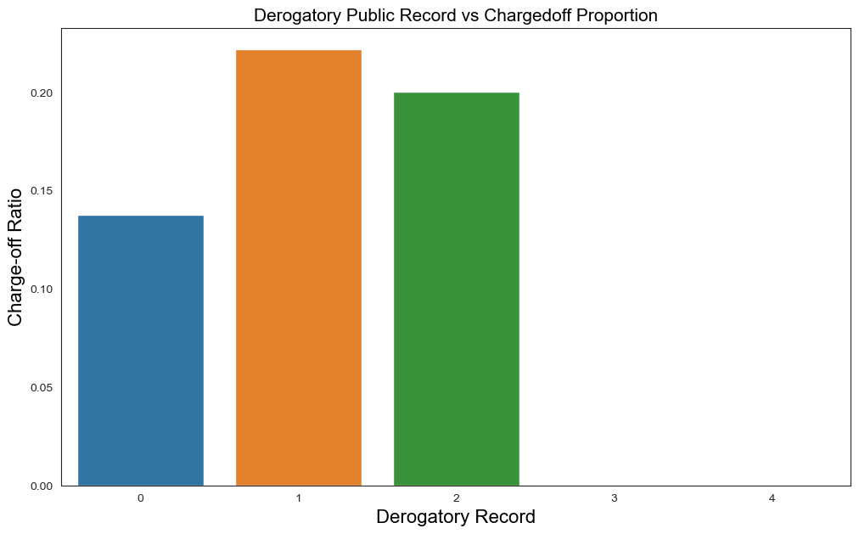
Derogatory Record v/s Loan Charge-Off Ratio
Recommendations
The very nature of this data has a significant amount of inbuilt baise. The very word “Derogatory”, unless entailing criminal conviction, is subjective, it means different things to different people. As witnessed by the graph, analysis has no real correlation and all over the place.
We should not skew our analysis by including this data.

Slide 15
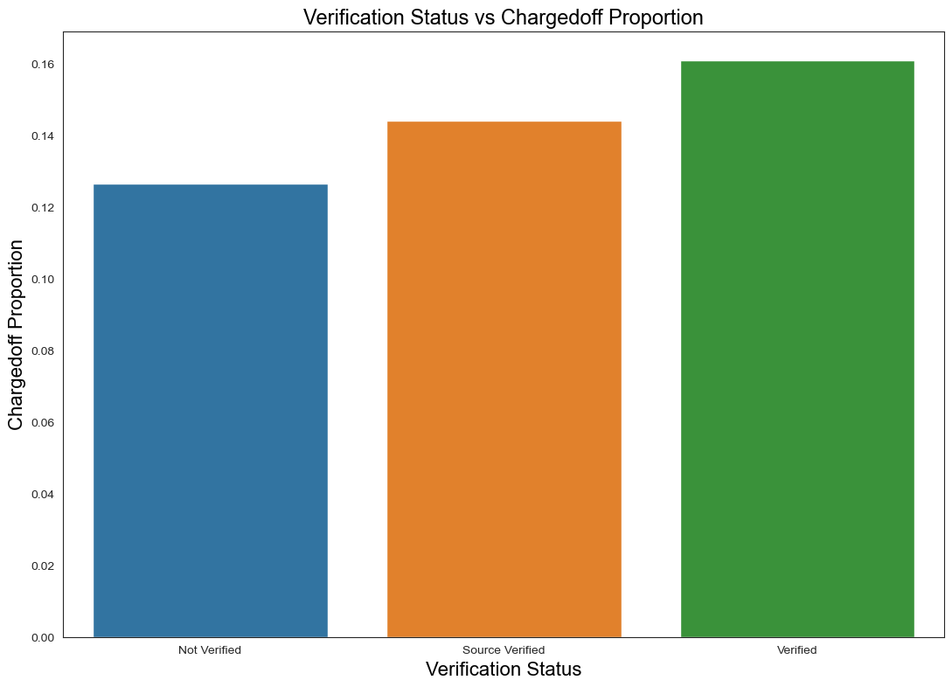
Impact of Verification Status on Charge Off Pay Off rates
Recommendations
Some correlation can be observed, but it is not definitive and variance isn’t enough to make a substantial impact.
Therefore, this data shall be excluded from the analysis as well.

Slide 16
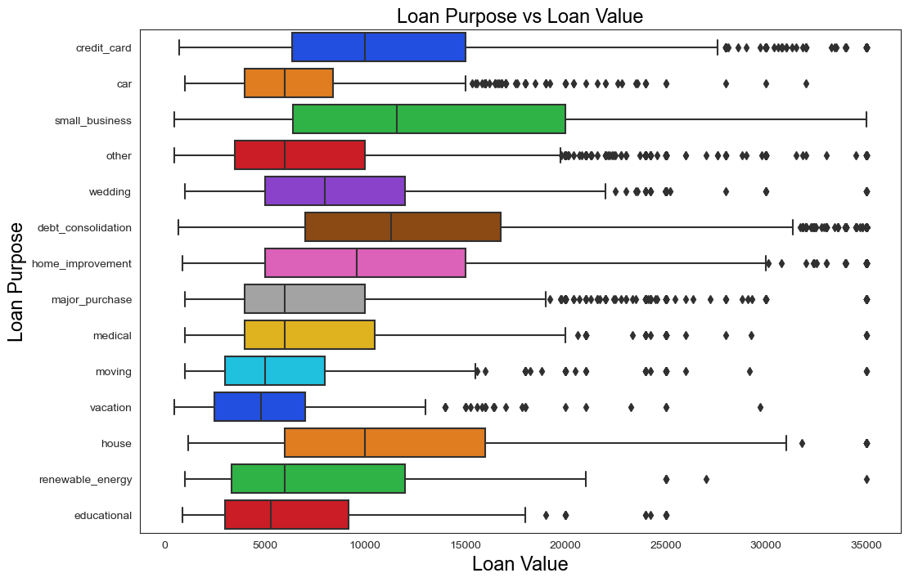
Impact of Given Loan Value On Loan Purpose #1
Recommendations
Small Businesses Tend to Take Largest Values of Loans. Whereas Educational Loans tend to be smallest. Surprisingly, small business loan values are even higher than house.

Slide 17
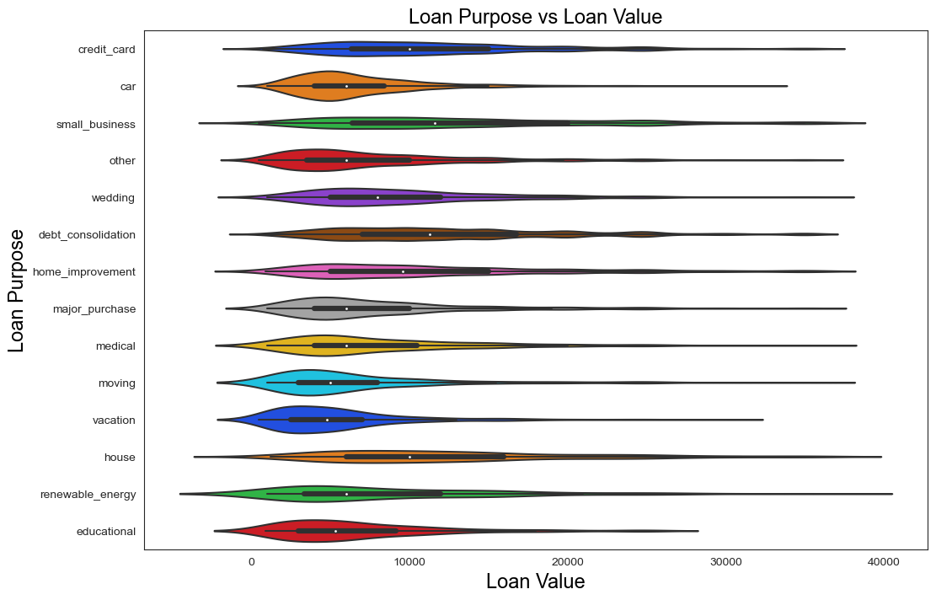
Impact of Given Loan Value On Loan Purpose #2 (Distribution analysis using violin chart)
Recommendations
Housing, Renewable and Small Business are evenly distributed compared to other plots, meaning value lacks hard edges, therefore final loan offer harder to pinpoint.

Slide 18
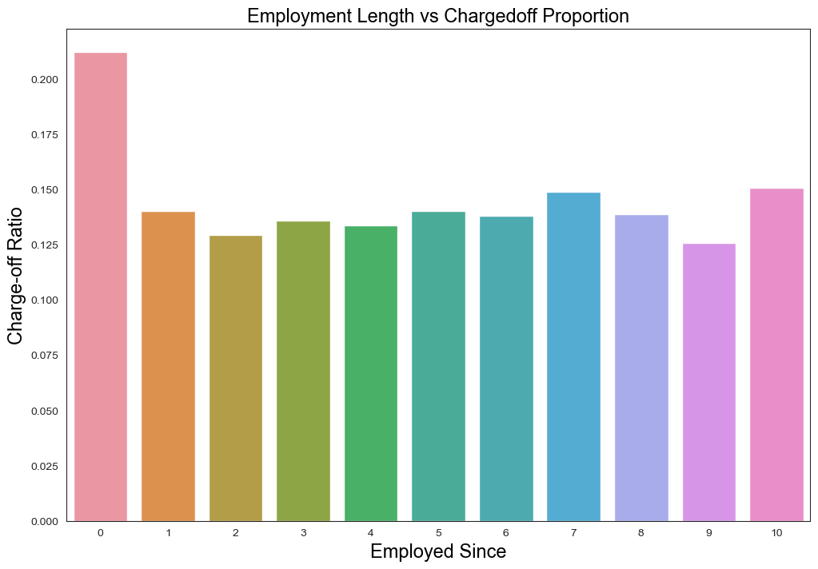
Impact Of Employment Period On Charge Off Ratio
Recommendations
This isn't a good predictor of charge off rates, because the chart is all over the place. Except for someone with less than 1 year of job experience, this datapoint isn't a good judge for anything. However, approval of loan for someone with less than one year of job experience should be analysed very serious, that's the only worthy data point in this analysis.

Slide 19
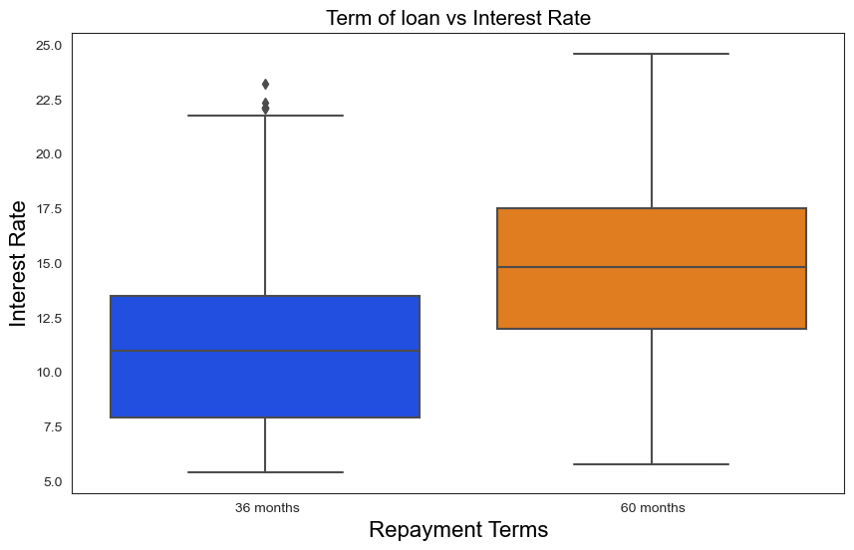
Impact of Interest Rates On Terms of Repayment
Direct, positive correlation between Repayment Terms and Interest Rates. For Long Duration, the likelihood of charge off increases (as analysed previously) and therefore higher interest rates are charged. Catch-22 Type Scenario.

Slide 20
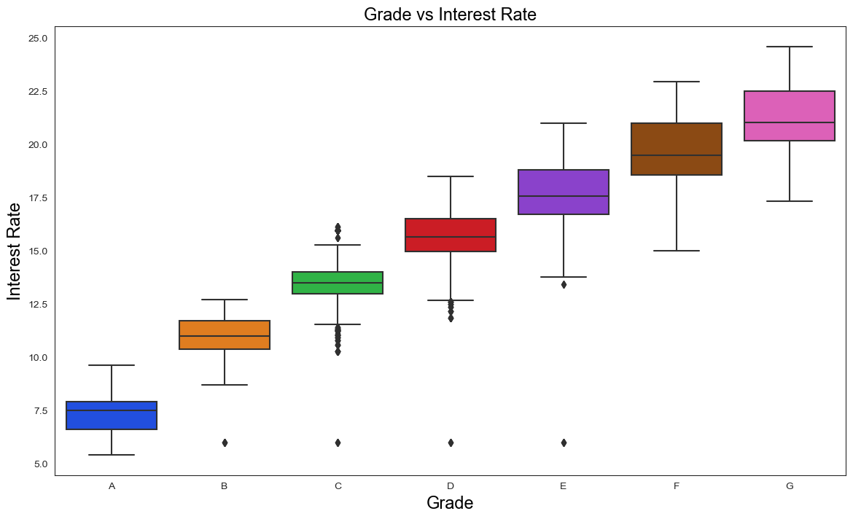
Impact Of Credit Grade on Interest Rate
We Observe a Very Strong Negative Correlation Between Applicant's Credit Grade And Interest Rates Offered to him. A Credit rating of A, corresponds to a very low likely of charge offs. As it declines, to B, C and then further down, interest rates start to go up radically. Meaning higher interest rates are charged as a means to cover for risk if the applicant's Credit Rating is Bad.

Slide 21
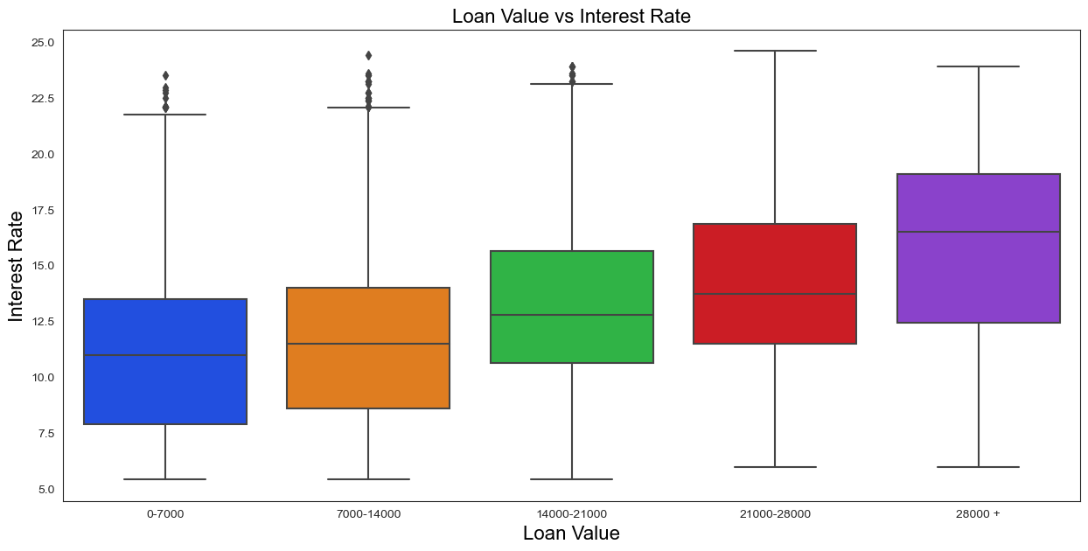
Impact of Loan Value On Interest Rate
Higher Loan Value corresponds to higher interest, since in case of charge offs, the organisation has a lot to lose. Therefore, risk must be compensated with higher interest Rates.

Slide 22
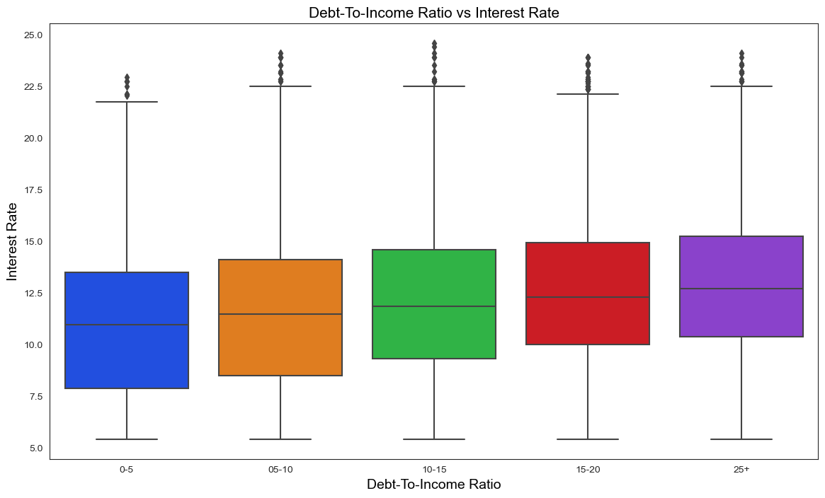
Impact of Applicant’s Debt-To-Income Ratio on Interest Rate
Postive Correlation. Lower Debt To Income Ratio Corresponds to lower Interest Rate and Vice Versa

Slide 23
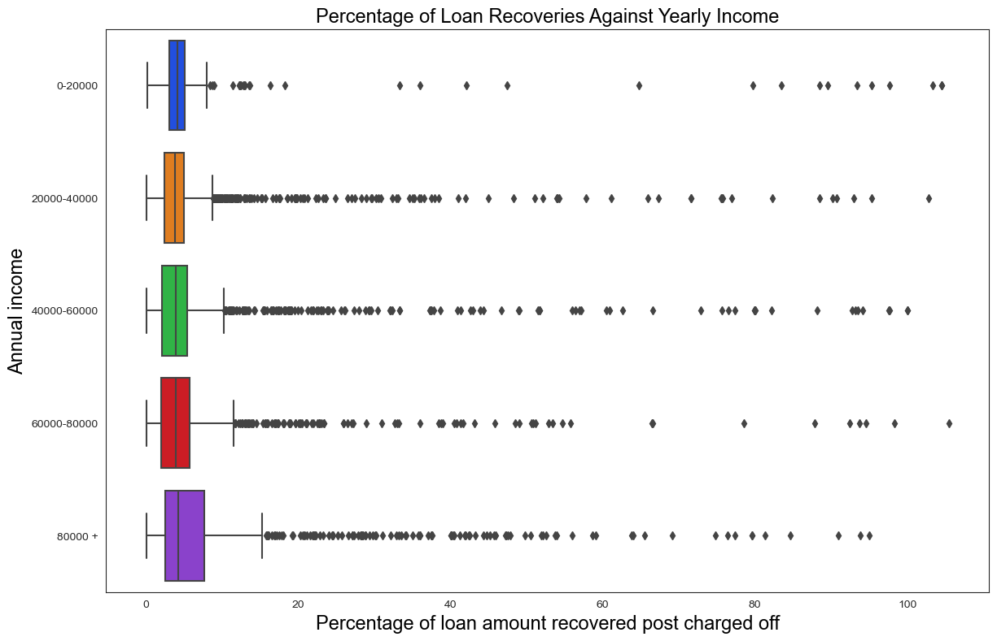
Impact Of Annual Income on Loan Amount Recovered
Higher Yearly Income Increases The Prevalence of Recovery of Charged Off Value, Making it Open of the most Thing Factors in Our Overall Analysis, as it Has Consistently Been an important Predictor of a Lot of Things.

Slide 24
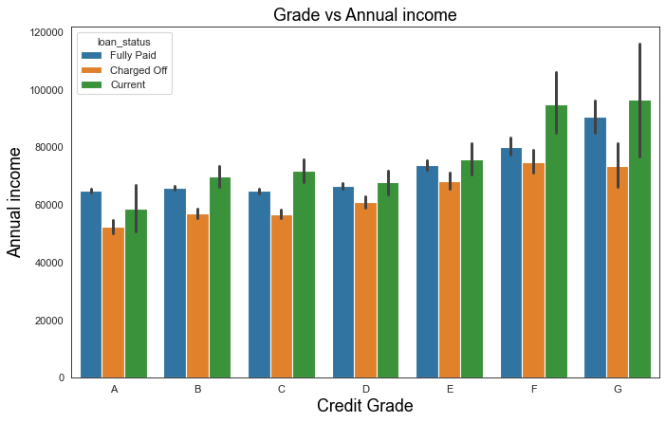
Impact of Applicant’s Credit Grades on Annual Income
It can be concluded across the Credit Grade that the people getting charged off are generally in the lower income group than the people getting lesser charge offs

Slide 25
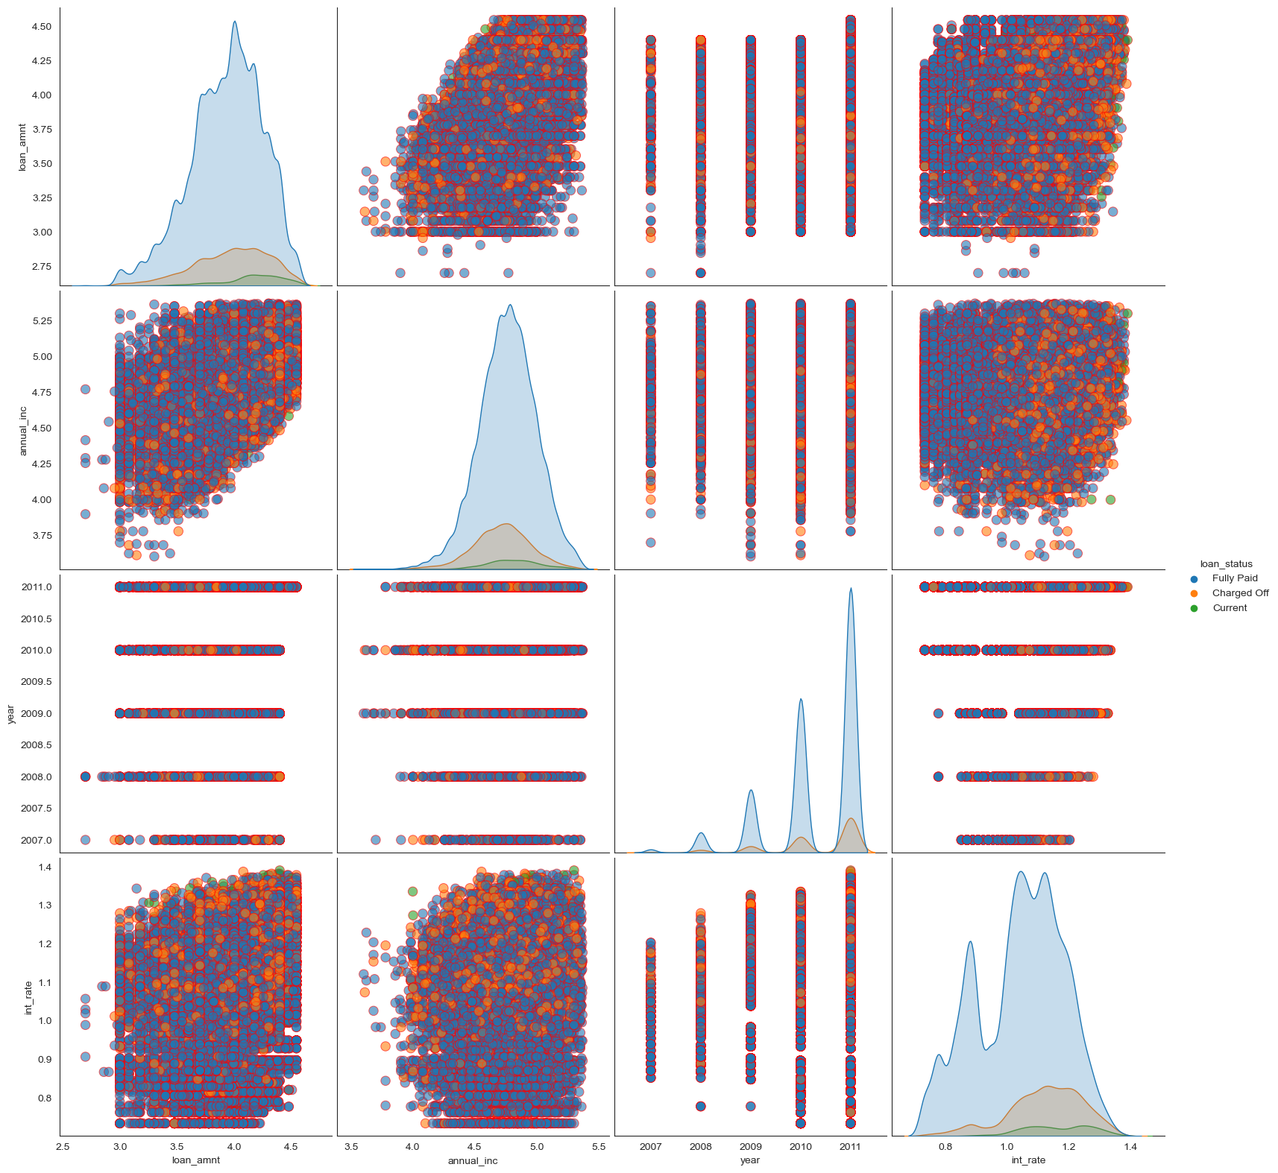
Pair Plots (Bird’s Eye View of Business Fidelity Overtime)
A YoY Growth Of Applicants can be seen over the years, which is good news, but also needs an upgrade in loss making fault line analysis.
Interest Rates and Charged Off Ratios are in direct correlation with each other.
Loan and Yearly Incomes are somewhat positively correlated.

Slide 26
Let’s Start With The Most Important 3 Factors
We Have Determined the BIG 3, that you should start optimizing…
Credit Rating
House Ownership
Terms of Repayment
Very High Correlation with Charge Offs. Prioritise the optimisation of this variable. Applicants with good Credit Rating are radically more likely to payback on time.
One of the Most important factors, when choosing the right candidate for loan. Very high correlation house ownership and repayment rate.
Candidates looking for longer term Repayment loans are generally much more likely to Charge Off. This is bad. And it needs to be predicted and minimised

Slide 27
Presented To Upgrad and IIIT-B
THANK YOU!
As a part of our case study, Titled, “Lending Club”
Abhinav Tyagi (Facilitator)
&
Vinay Pai
Presented By:
abhinav@vayubiotech.com
vinaypai1977@gmail.com

