Slide 1
NoctTwin
Happiest Health Digital Twin Challenge 2026
A personalised digital twin for nocturnal hypoglycemia in type 2 diabetes
Team AlooDUM · Arka Jain University · Abhinav Tiwary · Nivesh Kumar · Kriti Kumari · Bhoomi Singh

Slide 2
Lows that clinic visits miss
The problem
A sleeping patient cannot react to falling glucose. A clinic visit sees fasting glucose and HbA1c, not the night in between.
Silent at night
Too many readings
A short list
Nocturnal hypoglycemia often goes unnoticed by the patient.
CGM records the night, but thousands of readings are hard to review.
A clinician needs to know who is at risk tonight, and why.
NoctTwin · Team AlooDUM · Arka Jain University

Slide 3
Bedtime risk of a persistent low
Use case and data
At 22:00, estimate the risk of two or more consecutive CGM readings below 70 mg/dL between 23:00 and 06:00.
100
1,181
124
hospitalised patients
patient-nights
persistent lows (10.5%)
ShanghaiT2DM (Zhao et al., Scientific Data, 2023, CC BY 4.0). Dynamic stream: CGM every 15 minutes. Static stream: labs, medications, demographics. Anonymised public data only, in line with the DPDP Act and HIPAA.
NoctTwin · Team AlooDUM · Arka Jain University

Slide 4
One night, in three moments
How the twin works
18:00
22:00
23:00 to 06:00
Learn
Synchronise
Estimate and explore
Earlier nights, CGM, medications and labs build a personal overnight profile. Nothing after 22:00 is used.
The forecast starts from the actual reading, then relaxes toward the patient's own profile.
Calibrated risk, an uncertainty range, and what-if scenarios with assumed effects.
Calibrated logistic regression, validated by patient. Python, scikit-learn, SHAP, FastAPI, React and TypeScript.
NoctTwin · Team AlooDUM · Arka Jain University

Slide 5
Personal history improves prediction
Result 1
0.74 → 0.83
Metric | CGM only | With history
AUROC | 0.74 | 0.83
AUPRC | 0.35 | 0.48
Brier score | 0.073 | 0.065
AUROC, CGM alone to CGM plus the patient's earlier nights. Ranges over 20 repeated runs: 0.71 to 0.75, and 0.82 to 0.84. Paired gain +0.10, 95% CI +0.05 to +0.15.
Nights with earlier history: 1,081 nights, 101 events. Patient-grouped 5-fold validation, 20 seeds. Exploratory, with no external validation.
NoctTwin · Team AlooDUM · Arka Jain University

Slide 6
Forecast error and uncertainty
Result 2
Horizon | Synchronised | Hold bedtime value
1 hour | 14.8 | 18.5
3 hours | 19.4 | 32.0
6 hours | 16.1 | 37.0
±26 mg/dL
80% range. Held-out coverage 79.9%.
±38 mg/dL
90% range. Held-out coverage 89.8%, lower near the 3-hour mark at 86.3%.
Mean absolute error, mg/dL. The patient's own average profile is close at 6 hours (17.2).
NoctTwin · Team AlooDUM · Arka Jain University

Slide 7
What did not help, reported as found
Honest findings
Static data
First-night anomaly
Labs, demographics and medication tags added no measurable gain over CGM and history.
23.0% of first nights had a low, against 9.3% later. The cause is unresolved.
Concentrated events
Sulfonylurea subgroup
10% of patients hold 48% of the persistent lows.
Exploratory: 18 patients, 11 with events. No causal claim.
NoctTwin · Team AlooDUM · Arka Jain University

Slide 8
Alert burden
Clinical meaning
A precision of 75% is out of reach at safe sensitivity when the event rate is 10.5%.
1 in 3
NoctTwin is a screening and prioritisation aid, not a diagnostic device.
alerts is a true persistent low at 80% specificity, with about 1.8 alerts per patient-week.
NoctTwin · Team AlooDUM · Arka Jain University

Slide 9
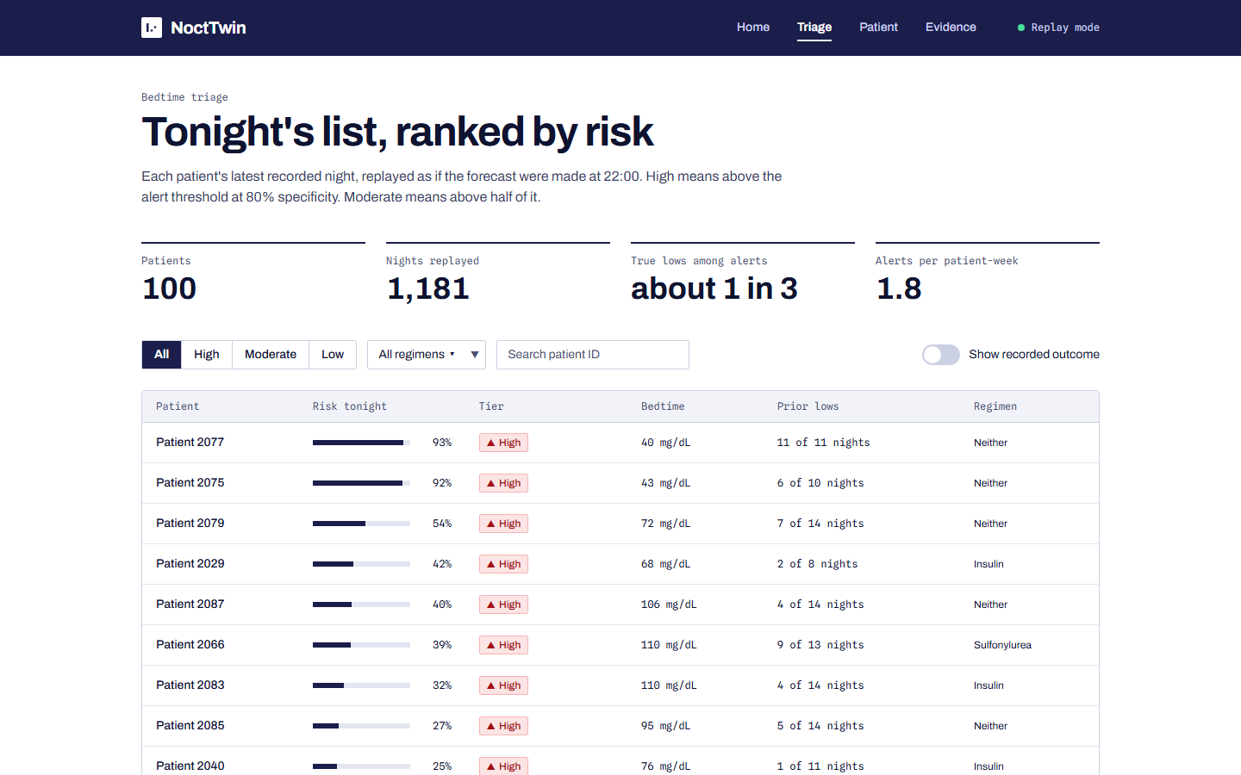
Tonight's list, and the reasons
The clinician's view
Triage board. Patients ranked by calibrated risk, with tiers tied to the alert threshold.
[Insert screenshots of the final triage and patient screens]
Patient twin. Recorded history, expected profile, uncertainty range, factors behind the flag, and what-if scenarios.
Replay mode. Recorded outcomes stay hidden by default.
NoctTwin · Team AlooDUM · Arka Jain University

Slide 10
What we state up front, and what comes next
Limits and outlook
Limits
Next steps
Hospitalised cohort and a small sample. No external validation. Regimen labels are per patient. What-if effects are assumptions.
Validate on outpatient and Indian cohorts. Test prospectively. Gather clinician feedback on alert burden.
Code: github.com/abhinavtiwary15/AlooDUM_ArkaJainUniversity · MIT licence · Data: ShanghaiT2DM, CC BY 4.0
NoctTwin · Team AlooDUM · Arka Jain University

