Slide 1
Adaptive Feature Mapping for Customizing Deep Learning Based Facial Expression Recognition Model
Adaptive Feature Mapping for Customizing Deep Learning Based Facial Expression Recognition Model
PRANAV PK
Roll no: 45 S7 B.Tech CSE
31/10/2018
Dept. of CSE, MACE Kothamangalam
1
Notes:
mace
10/31/2018

Slide 2
Adaptive Feature Mapping for Customizing Deep Learning Based Facial Expression Recognition Model
CONTENTS
Introduction
Facial Expression Database
Image Pre-processing
Deep Convolutional Neural Network
Adaptive Feature Mapping
31/10/2018
Dept. of CSE, MACE Kothamangalam
2
Notes:
2

Slide 3
Adaptive Feature Mapping for Customizing Deep Learning Based Facial Expression Recognition Model
CONTENTS
System Operation
Experiments
Conclusion
References
31/10/2018
Dept. of CSE, MACE Kothamangalam
3
Notes:
3

Slide 4
Adaptive Feature Mapping for Customizing Deep Learning Based Facial Expression Recognition Model
INTRODUCTION
Vital role in the artificial intelligence era.
Challenge of different head poses.
CNNs are also weak with cross-domain data.
AFM is a solution.
31/10/2018
Dept. of CSE, MACE Kothamangalam
4

Slide 5
Adaptive Feature Mapping for Customizing Deep Learning Based Facial Expression Recognition Model
INTRODUCTION(contd..)
Features can be transferred into a new space.
Types of Adaptive Feature Mapping.
Since AFM learns the data sequentially.
Deployed to deep learning models easily.
Novel pre-processing method .
31/10/2018
Dept. of CSE, MACE Kothamangalam
5

Slide 6
Adaptive Feature Mapping for Customizing Deep Learning Based Facial Expression Recognition Model
INTRODUCTION(contd..)
Domain adaption methods(AFM).
Large number of training data is proposed.
It can fine-tune the parameters and gain accuracy
e.g., Expression recognition applications
Virtual reality
Personalized recommendations
31/10/2018
Dept. of CSE, MACE Kothamangalam
6

Slide 7
Adaptive Feature Mapping for Customizing Deep Learning Based Facial Expression Recognition Model
FACIAL EXPRESSION DATABASE
Only seven common facial expressions are considered,
Anger
Disgust
Fear
Happiness
Sadness
Surprise
Neutral
31/10/2018
Dept. of CSE, MACE Kothamangalam
7

Slide 8
Adaptive Feature Mapping for Customizing Deep Learning Based Facial Expression Recognition Model
EXTENDED COHN-KANADE
Widely utilized to research in facial expression.
15 images in a sequence .
Expression intensity changes from low to high.
There are 630 images.
31/10/2018
Dept. of CSE, MACE Kothamangalam
8

Slide 9
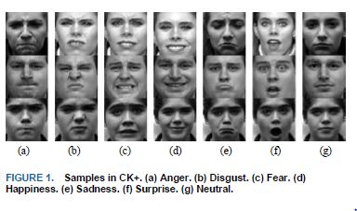
Adaptive Feature Mapping for Customizing Deep Learning Based Facial Expression Recognition Model
EXTENDED COHN-KANADE
Courtesy : https://ieeexplore.ieee.org/document/8291717
31/10/2018
Dept. of CSE, MACE Kothamangalam

Slide 10
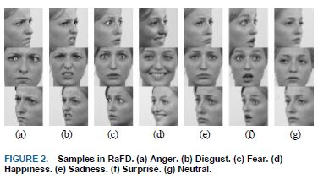
Adaptive Feature Mapping for Customizing Deep Learning Based Facial Expression Recognition Model
RADBOUD FACES DATABASE
RaFD is a high quality database of faces.
Contains pictures of 8 emotional expressions.
Including Caucasian males and females.
Courtesy : https://ieeexplore.ieee.org/document/8291717
31/10/2018
Dept. of CSE, MACE Kothamangalam
10

Slide 11
Adaptive Feature Mapping for Customizing Deep Learning Based Facial Expression Recognition Model
AMSTERDAM DYNAMIC FACIAL EXPRESSION SET
Around 10 emotional expressions are collected
Most of them are videos with head pose variations
Expression intensity also changes from low to high
Expressions start to become obvious
Then images are captured with fixed time steps
31/10/2018
Dept. of CSE, MACE Kothamangalam
11

Slide 12
Adaptive Feature Mapping for Customizing Deep Learning Based Facial Expression Recognition Model
PROPRIETARY DATABASE
372 videos are downloaded from YouTube.
Includes movies, film reviews, variety shows,etc.
Capture the face images with time intervals.
The images for categories are manually picked .
31/10/2018
Dept. of CSE, MACE Kothamangalam
12

Slide 13
Adaptive Feature Mapping for Customizing Deep Learning Based Facial Expression Recognition Model
IMAGE PRE-PROCESSING
SPATIAL NORMALIZATION
Adjust the alignment and rotation angle
A face alignment algorithm
Detect some landmarks
Nose will be shifted to the center
31/10/2018
Dept. of CSE, MACE Kothamangalam
13

Slide 14
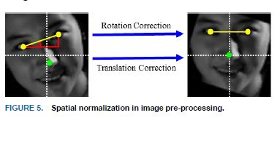
SPATIAL NORMALIZATION
Adaptive Feature Mapping for Customizing Deep Learning Based Facial Expression Recognition Model
Rotational Correction
Translation Correction
Courtesy : https://ieeexplore.ieee.org/document/8291717
31/10/2018
Dept. of CSE, MACE Kothamangalam
14

Slide 15
Adaptive Feature Mapping for Customizing Deep Learning Based Facial Expression Recognition Model
FEATURE ENHANCEMENT
Neighbor-Center Difference Image (NCDI).
To enhance the edges.
Subtract the center pixel from the neighbour .
Pixel values range -255 to 255 .
Produce the 8-channel NCDI .
31/10/2018
Dept. of CSE, MACE Kothamangalam
15

Slide 16
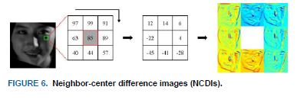
Adaptive Feature Mapping for Customizing Deep Learning Based Facial Expression Recognition Model
FEATURE ENHANCEMENT
Contour and background made sharper.
Facial image cropping is applied
Courtesy : https://ieeexplore.ieee.org/document/8291717
31/10/2018
Dept. of CSE, MACE Kothamangalam
16

Slide 17
Adaptive Feature Mapping for Customizing Deep Learning Based Facial Expression Recognition Model
FEATURE ENHANCEMENT
An elliptical cropping is done.
The ellipse function is :
31/10/2018
Dept. of CSE, MACE Kothamangalam
17

Slide 18
Adaptive Feature Mapping for Customizing Deep Learning Based Facial Expression Recognition Model
FEATURE ENHANCEMENT
Cost function :
x=[x1 x2 x3 …xn]
Y=[y1 y2 y3 …yn]
=Hyper parameter to regularize the optimization
31/10/2018
Dept. of CSE, MACE Kothamangalam
18

Slide 19
Adaptive Feature Mapping for Customizing Deep Learning Based Facial Expression Recognition Model
DEEP CONVOLUTIONAL NEURAL NETWORK
Based on caffe network CNN is designed
9 convolutional networks
2 max pooling layers
1 mean pooling layer
3 fully connected layer
1 Local Response Normalization layer
Softmax out put layer
31/10/2018
Dept. of CSE, MACE Kothamangalam
19

Slide 20
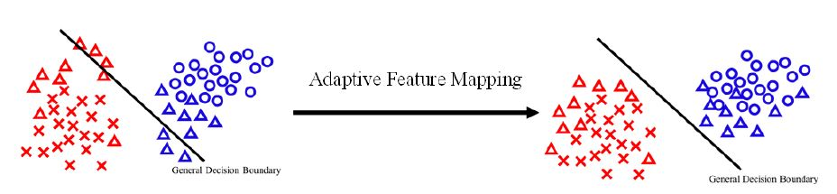
ADAPTIVE FEATURE MAPPING
Adaptive Feature Mapping for Customizing Deep Learning Based Facial Expression Recognition Model
Courtesy : https://ieeexplore.ieee.org/document/8291717
Red and blue colour are different categories.
Crosses and circles are trained data.
Triangle are the new testing samples.
31/10/2018
Dept. of CSE, MACE Kothamangalam
20

Slide 21
Adaptive Feature Mapping for Customizing Deep Learning Based Facial Expression Recognition Model
ADAPTIVE FEATURE MAPPING
Training data:
Ns= number of trained samples
Testing data:
Nt=batch size of the testing sample
Feature extractor =h(x|W)
W is the whole set of feature extractor
x is the8-channel NCDI
31/10/2018
Dept. of CSE, MACE Kothamangalam
21

Slide 22

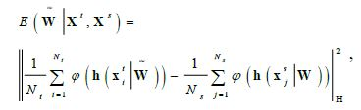
Adaptive Feature Mapping for Customizing Deep Learning Based Facial Expression Recognition Model
COST FUNCTION
Testing sample similar to trained samples
By domain adaptation the cost function is
31/10/2018
Dept. of CSE, MACE Kothamangalam
22

Slide 23
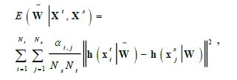
Adaptive Feature Mapping for Customizing Deep Learning Based Facial Expression Recognition Model
COST FUNCTION
Cross relations of trained and testing data
is the weights to represents the relevance
31/10/2018
Dept. of CSE, MACE Kothamangalam
23

Slide 24
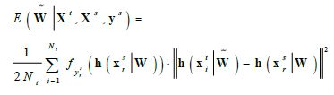
Adaptive Feature Mapping for Customizing Deep Learning Based Facial Expression Recognition Model
WEIGHTED ADAPTIVE FEATURE MAPPING
Probability distribution of output is taken
To regularize the cost function
Ys=labels of trained samples
F()=classifier
31/10/2018
Dept. of CSE, MACE Kothamangalam
24

Slide 25
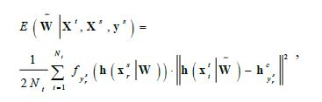
Adaptive Feature Mapping for Customizing Deep Learning Based Facial Expression Recognition Model
WEIGHTED CENTER REGRESSION AFM
CNN is a linear transformation.
Features can be linearly separable.
Found Center in each category.
=Labels of trained samples
hc =center of category
24/10/2018
Dept. of CSE, MACE Kothamangalam
25

Slide 26

Adaptive Feature Mapping for Customizing Deep Learning Based Facial Expression Recognition Model
COST FUNCTION
By the stochastic gradient descent equation is
is the learning rate
is the regularizing factor
to prevent out of bound
is the gradient of cost function
31/10/2018
Dept. of CSE, MACE Kothamangalam
26

Slide 27
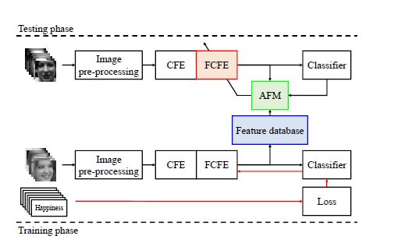
Adaptive Feature Mapping for Customizing Deep Learning Based Facial Expression Recognition Model
SYSTEM OPERATION
System Architecture
Courtesy : https://ieeexplore.ieee.org/document/8291717
31/10/2018
Dept. of CSE, MACE Kothamangalam
27

Slide 28
Adaptive Feature Mapping for Customizing Deep Learning Based Facial Expression Recognition Model
SYSTEM OPERATION
Extracted features stored in feature database.
AFM tune the weights of testing and database.
Relationship between features are found.
AFM is only applied to tune FCFE.
31/10/2018
Dept. of CSE, MACE Kothamangalam
28

Slide 29
Adaptive Feature Mapping for Customizing Deep Learning Based Facial Expression Recognition Model
SYSTEM OPERATION
Features around the boundary moved to centers.
Parameters are distributed in fully connected layers.
Misclassified labels can be corrected.
Samples with lower confidence are ignored.
31/10/2018
Dept. of CSE, MACE Kothamangalam
29

Slide 30
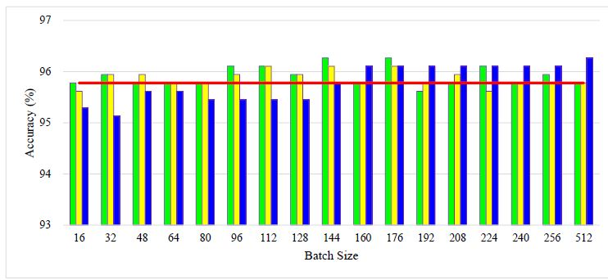
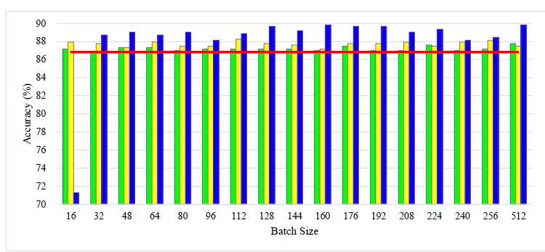
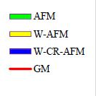
Adaptive Feature Mapping for Customizing Deep Learning Based Facial Expression Recognition Model
EXPERIMENTS
Courtesy : https://ieeexplore.ieee.org/document/8291717
31/10/2018
Dept. of CSE, MACE Kothamangalam
30

Slide 31
Adaptive Feature Mapping for Customizing Deep Learning Based Facial Expression Recognition Model
CONCLUSION
Pre-processing method can gain the higher accuracy.
Types of AFMs can reformulate the features samples.
Misclassified samples can be corrected.
It can tune a model to adapt to a specific condition.
AFMs can be deployed to real-time systems.
It learns batch by batch.
Not all of the training and testing data in one batch.
31/10/2018
Dept. of CSE, MACE Kothamangalam
31

Slide 32
Adaptive Feature Mapping for Customizing Deep Learning Based Facial Expression Recognition Model
REFERENCES
[1] R. E. Jack, O. G. B. Garrod, H. Yu, R. Caldara, and P. G. Schyns, “Facial expressions of emotion are not culturally universal,” Proc. National Academy of Sci. of the United States of America, vol. 109, no. 19, pp. 7241–7244, 2012.
[2] P. Lucey, J. F. Cohn, T. Kanade, J. Saragih, Z. Ambadar, and I. Matthews, “The extended cohn-kanade dataset (CK+): A complete dataset for action unit and emotion-specified expression,” In Comput. Vision and Pattern Recognition (CVPR) Workshops, 2010.
31/10/2018
Dept. of CSE, MACE Kothamanglam
32

Slide 33
Adaptive Feature Mapping for Customizing Deep Learning Based Facial Expression Recognition Model
REFERENCES
[3] O. Langner, R. Dotsch, G. Bijlstra, “Presentation and validation of the Radboud Faces Database,“ Cognition and Emotion, vol. 24, no. 8, pp. 1377–1388, 2010.
[4] J. van der Schalk, S. T. Hawk, A. H. Fischer, “Moving faces, looking places: The Amsterdam Dynamic Facial Expressions Set (ADFES),” Emotion, vol. 11, no. 4, pp. 907–920, 2011.
[5] W. Li, “A deep-learning approach to facial expression recognition with candid images,” MVA2015 IAPR Int. Conf. Mach. Vision Appl., May 18–22, 2015, Tokyo, Japan.
31/10/2018
Dept. of CSE, MACE Kothamanglam
33

Slide 34
Adaptive Feature Mapping for Customizing Deep Learning Based Facial Expression Recognition Model
THANK YOU
31/10/2018
Dept. of CSE, MACE Kothamangalam
34

