Slide 1
A COMPUTING PLATFORM FOR VIDEO CROWDPROCESSING USING DEEP LEARNING
COMPUTING PLATFORM FOR VIDEO CROWDPROCESSING
RAHUL A
Class no:47 s7 Btech CSE
15 NOVEMBER,2018

Slide 2
CONTENTS
COMPUTING PLATFORM FOR VIDEO CROWDPROCESSING
INTRODUCTION
RELATED WORK
OVERVIEW
PROCESSING UNDER WIFI
PROCESSING UNDER CELLULAR
IMPLEMENTATION
EVALUATION
CONCLUSION
REFERENCES

Slide 3
INTRODUCTION
COMPUTING PLATFORM FOR VIDEO CROWDPROCESSING
Smartphones are enabling users to generate and share videos.
CNN model
Computational limitations of mobile devices.
Processing under WIFI and processing under cellular (4G,LTE)
Crowed Vision
Batch processing

Slide 4
RELATED WORK
COMPUTING PLATFORM FOR VIDEO CROWDPROCESSING
MEDUSA
PICKLE
GIGASIGHT
Computation offload based application
MAUI, Herms investigation
Notes:
Direct based on rgb color spaces of the skin color
Indirect using data glove

Slide 5
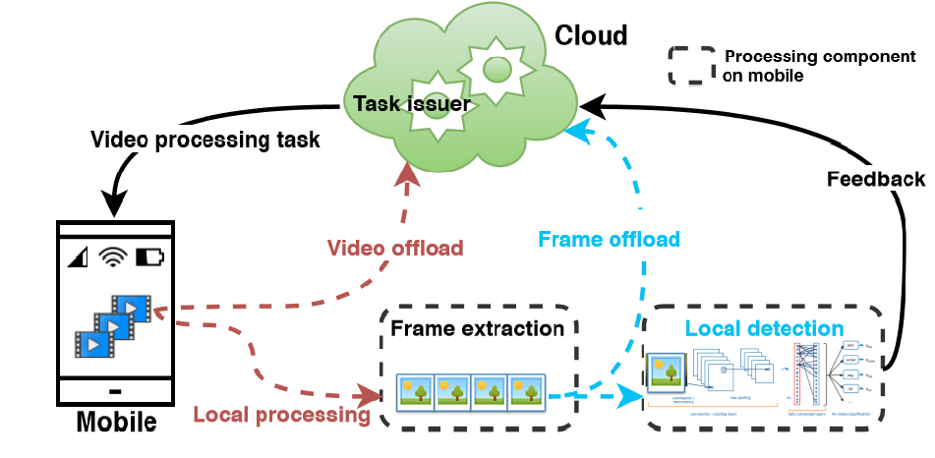
OVERVIEW
COMPUTING PLATFORM FOR VIDEO CROWDPROCESSING

Slide 6
OVERVIEW
COMPUTING PLATFORM FOR VIDEO CROWDPROCESSING
Crowd Vision is distributed computing platform
Caffe – deep learning frame work
The details of the query can be varying specificity
Offload videos to the cloud
Timeliness and accuracy
Issues in processing under WIFI and Cellular
Courtesy:https://ieeexplore.ieee.org/document/8314694

Slide 7
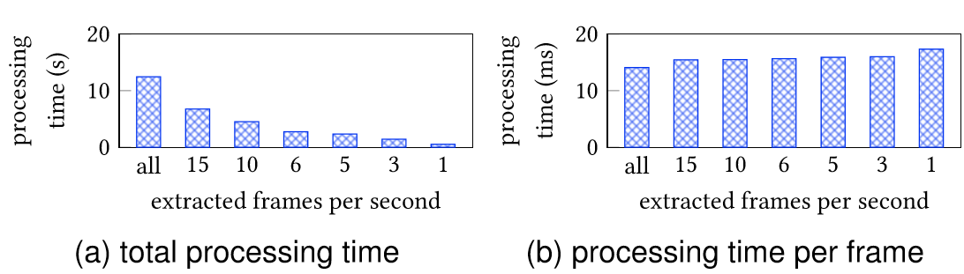
FRAME EXTRACTION
COMPUTING PLATFORM FOR VIDEO CROWDPROCESSING
Crowd vision takes frame extraction as a parameter
Different frame extraction rates

Slide 8
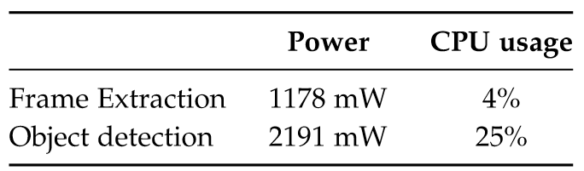
OBJECT DETECTION
COMPUTING PLATFORM FOR VIDEO CROWDPROCESSING
For object detection we currently use AlexNet
Caffe can be accelerated by CUDA enabled GPUs
Frame batching and individual performance
Power and CPU usage of frame extraction detection on smartphones

Slide 9
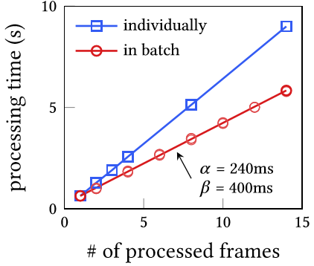
COMPUTING PLATFORM FOR VIDEO CROWDPROCESSING

Slide 10
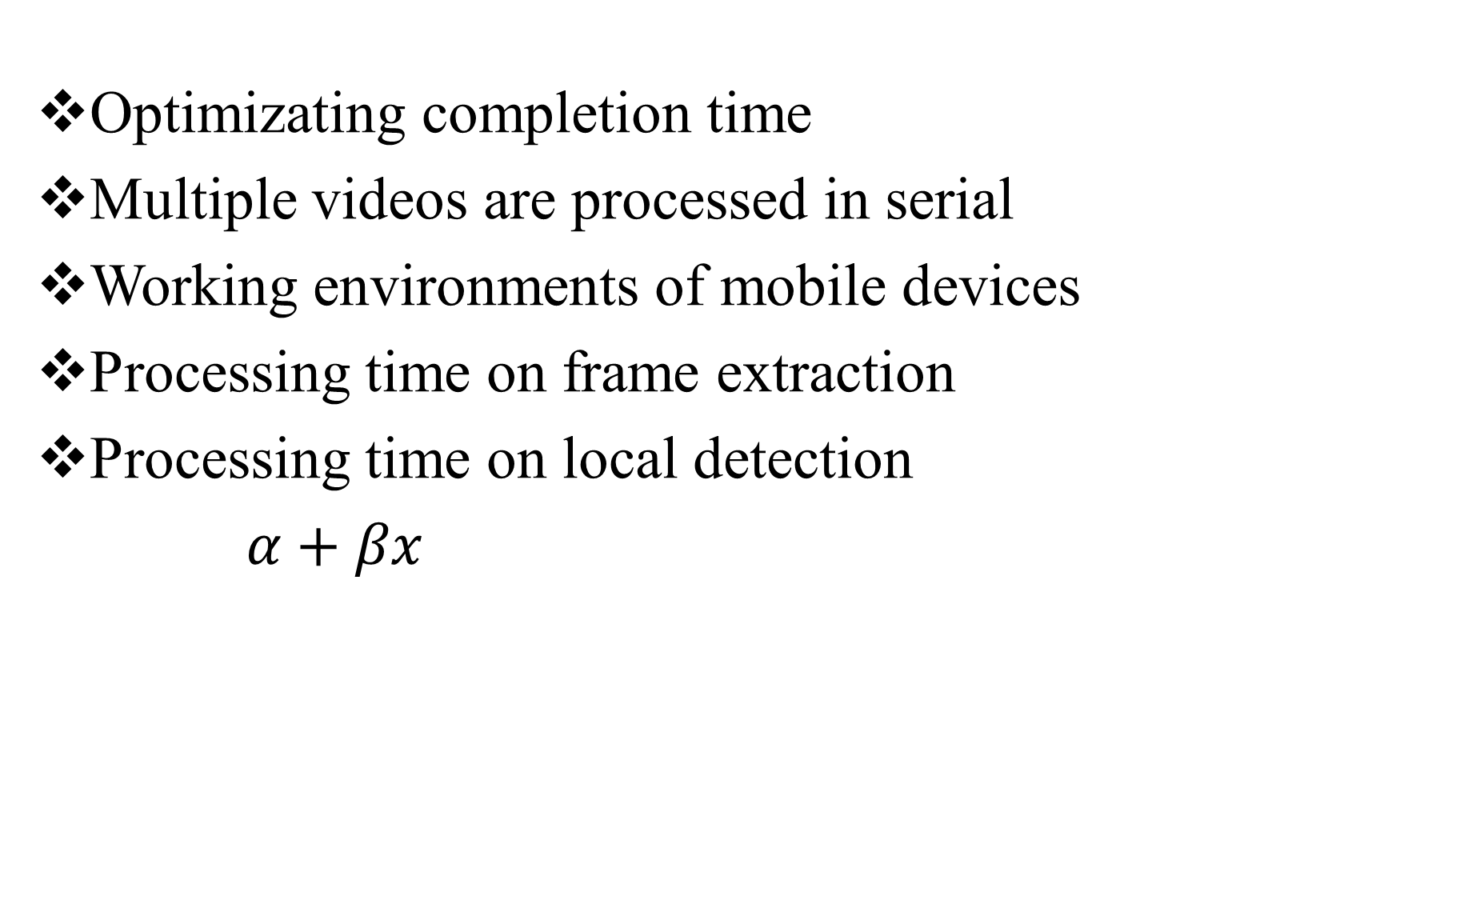
PROCESSING UNDER WIFI
COMPUTING PLATFORM FOR VIDEO CROWDPROCESSING
Optimizating completion time
Multiple videos are processed in serial
Working environments of mobile devices
Processing time on frame extraction
Processing time on local detection
$α+βx$
Courtesy:https://ieeexplore.ieee.org/document/8314695

Slide 11
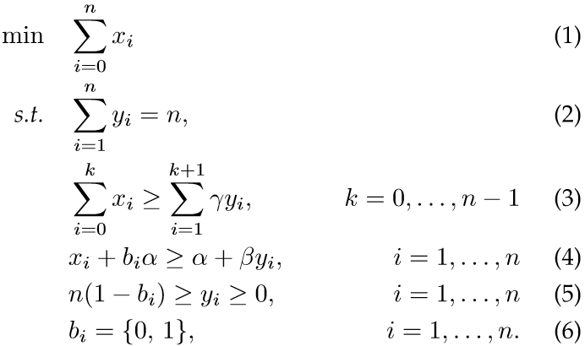
COMPUTING PLATFORM FOR VIDEO CROWDPROCESSING

Slide 12
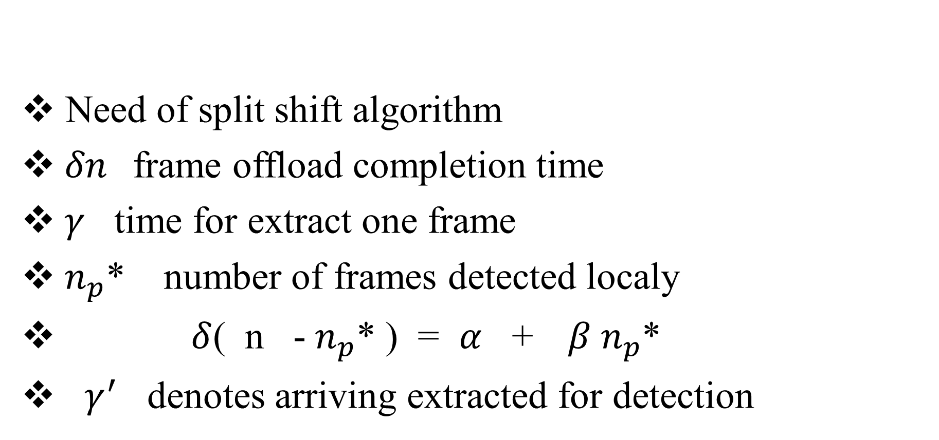
SPLIT- SHIFT ALGORITHM
COMPUTING PLATFORM FOR VIDEO CROWDPROCESSING
Need of split shift algorithm
$δn$frame offload completion time
$γ$ time for extract one frame
${ n}_{p}^{}$* number of frames detected localy
$δ$( n - $n_{p}^{}$* ) = $α$ +$β n_{p}^{}$*
$γ^{′}$ denotes arriving extracted for detection

Slide 13
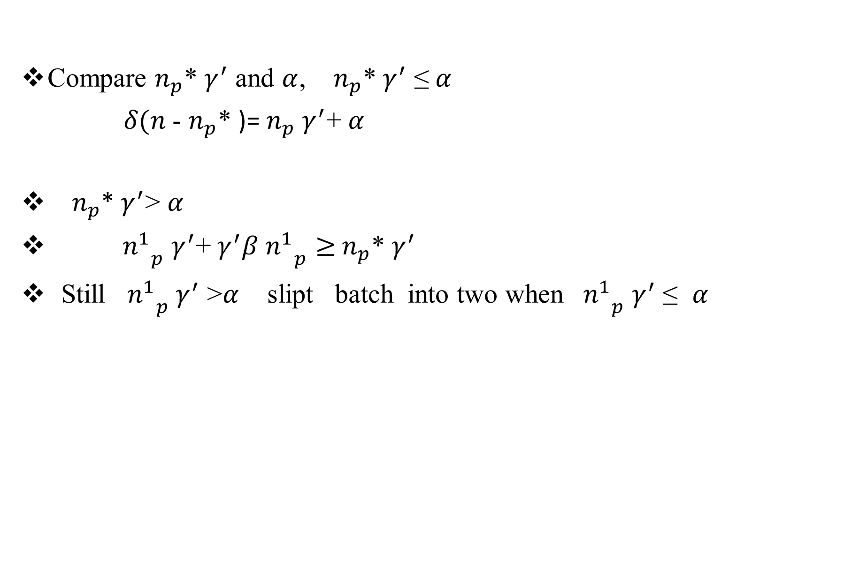
STEPS IN SPLIT SHIFT ALGORITHAM
COMPUTING PLATFORM FOR VIDEO CROWDPROCESSING
Compare $n_{p}^{}$* $γ^{′}$ and $α$, $n_{p}^{}$* $γ^{′}$ ≤ $α$
$δ(n$- $n_{p}^{}$* )= $n_{p}^{}$ $γ^{′}$+ $α$
${ n}_{p}^{}$* $γ^{′}$> $α$
${n_{}^{1}}_{p}$ $γ^{′}$+ $γ^{′}β$ ${n_{}^{1}}_{p}≥$ $n_{p}^{}$* $γ^{′}$
Still ${n_{}^{1}}_{p}$ $γ^{′}$ >$α$ slipt batch into two when ${{ n}_{}^{1}}_{p}$ $γ^{′}$ ≤ $α$

Slide 14
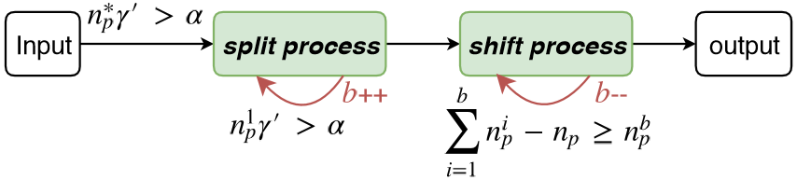
COMPUTING PLATFORM FOR VIDEO CROWDPROCESSING
Shift process
Courtesy:https://ieeexplore.ieee.org/document/8314694

Slide 15




OPTIMIZATION ENERGY CONSTRAINT
COMPUTING PLATFORM FOR VIDEO CROWDPROCESSING
Energy consumption of frame extraction and detection

Slide 16
PROCESSING UNDER CELLULAR
COMPUTING PLATFORM FOR VIDEO CROWDPROCESSING
Limitations of cellular connection
Completion time and energy consumption problem
Estimation of uplink rate and power
Dynamic cellular uplink data rate and power
Frame offload and local detection
Adaptive algoritham
Succesfull attempt and unsuccesfull atempt

Slide 17


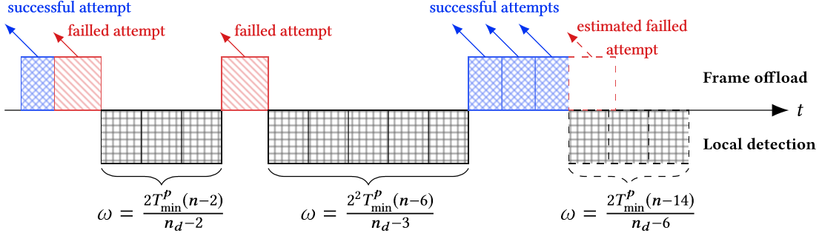
COMPUTING PLATFORM FOR VIDEO CROWDPROCESSING
Unsuccessful attempt
Back off timer

Slide 18
IMPLEMENTATION
COMPUTING PLATFORM FOR VIDEO CROWDPROCESSING
Implement on android cloud GTX TITAN X GPU
Google cloud messaging system and protocol buffer
Core services
Monitors
GUI
.

Slide 19
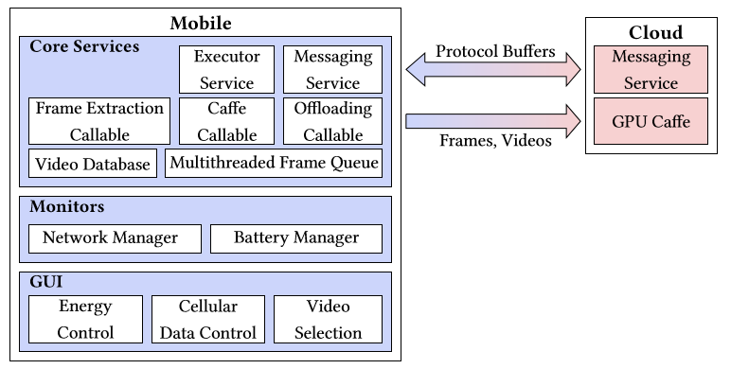
COMPUTING PLATFORM FOR VIDEO CROWDPROCESSING
Courtesy:https://ieeexplore.ieee.org/document/8314664

Slide 20
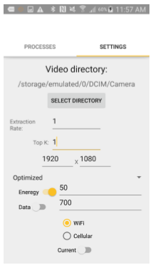
COMPUTING PLATFORM FOR VIDEO CROWDPROCESSING

Slide 21
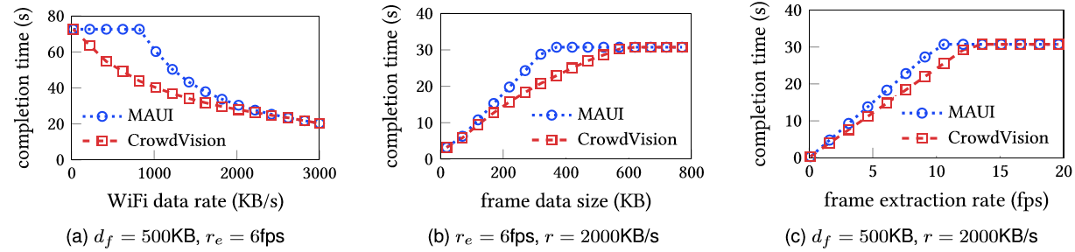
EVALUATION
COMPUTING PLATFORM FOR VIDEO CROWDPROCESSING
Performance under various settings
Compare with MAUI and Crowd vision under WIFI
Courtesy:https://ieeexplore.ieee.org/document/8314694

Slide 22
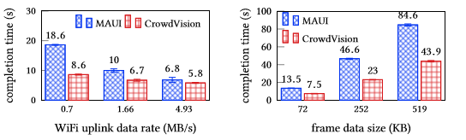
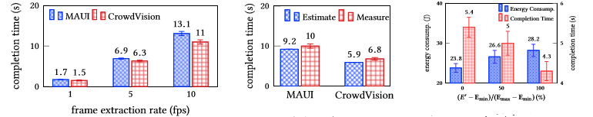
COMPUTING PLATFORM FOR VIDEO CROWDPROCESSING
Compare with MAUI and Crowd vision under cellular

Slide 23
CONCLUSIONS
COMPUTING PLATFORM FOR VIDEO CROWDPROCESSING
Designed
Optimize the performance
Implemented

Slide 24
REFERENCES(Contd..)
COMPUTING PLATFORM FOR VIDEO CROWDPROCESSING
Z. Lu, S. Rallapalli, K. Chan, and T. La Porta, “Modeling the resourcerequirementsofconvolutionalneuralnetworksonmobile devices,” in MM’17.
D. Yang, G. Xue, X. Fang, and J. Tang, “Crowdsourcing to smartphones: incentive mechanism design for mobile phone sensing,” in MobiCom’12.
D.Geiger,M.Rosemann,E.Fielt,andM.Schader,“Crowdsourcing information systems: deﬁnition, typology and design,” in Proceedings of the 33rd International Conference on Information Systems. Association for Information Systems/AIS Electronic Library (AISeL), 2012.
B. Morschheuser, J. Hamari, and J. Koivisto, “Gamiﬁcation in crowdsourcing: a review,” in HICSS, 2016, pp. 4375–4384.
D. P. Anderson, “Boinc: A system for public-resource computing and storage,” in proceedings of the 5th IEEE/ACM International Workshop on Grid Computing, 2004, pp. 4–10.
M.-R. Ra, B. Liu, T. L. Porta, and R. Govindan, “Medusa: A programming framework for crowd-sensing applications,” in MobiSys’12.

Slide 25
REFERENCES(Contd..)
COMPUTING PLATFORM FOR VIDEO CROWDPROCESSING
B. Liu, Y. Jiang, F. Sha, and R. Govindan, “Cloud-enabled privacypreserving collaborative learning for mobile sensing,” in SenSys’12.
P. Simoens, Y. Xiao, P. Pillai, Z. Chen, K. Ha, and M. Satyanarayanan, “Scalable crowd-sourcing of video from mobile devices,” in MobiSys’13.
K. Kumar, J. Liu, Y.-H. Lu, and B. Bhargava, “A survey of computation ofﬂoading for mobile systems,” Mobile Networks and Applications, vol. 18, no. 1, pp. 129–140, 2013.
E. Cuervo, A. Balasubramanian, D.-k. Cho, A. Wolman, S. Saroiu, R. Chandra, and P. Bahl, “Maui: making smartphones last longer with code ofﬂoad,” in MobiSys’10.
M. Barbera, S. Kosta, A. Mei, and J. Stefa, “To ofﬂoad or not to ofﬂoad? the bandwidth and energy costs of mobile cloud computing,” in INFOCOM’13.
C. Shi, K. Habak, P. Pandurangan, M. Ammar, M. Naik, and E. Zegura, “Cosmos: computation ofﬂoading as a service for mobile devices,” in MobiHoc’14.

Slide 26
THANK YOU

