Slide 1
Blockchain For Large-Scale Internet of Things Data Storage and Protection
RASNA K
ROLL NO:48 S7 BTECH CSE
DEPT. of CSE, MACE Kothamangalam
NOVEMBER 15,2018

Slide 2
Contents
Introduction
Blockchain
Edge computing
Blockchain Transaction work in IoT
Security
Data Trading
Conclusion

Slide 3
INRODUCTION
Cloud based IoT structure
Need high storage capacity
Easily leaked data
Miners
Validate and record transation
DHT

Slide 4
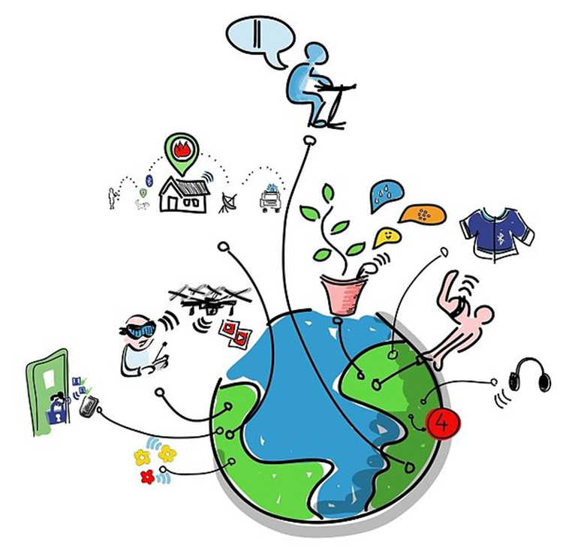
INTERNET Of THINGS
IoT is the network of physical objects.
courtesy: images.google.com

Slide 5
APPLICATIONS
Commercial applications
Industrial applications
Consumer applications

Slide 6

Architecture
Device tire
Gateway tire
Data centre /cloud tire
courtesy: images.google.com

Slide 7
Blockchain
Chain of blocks - contain information.
Invented in 1991.
Peer-to-peer network
Completely open to anyone.

Slide 8
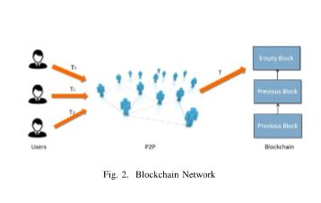
Blockchain network
Courtesy:http://ieeexplore.ieee.org/document/2853167

Slide 9
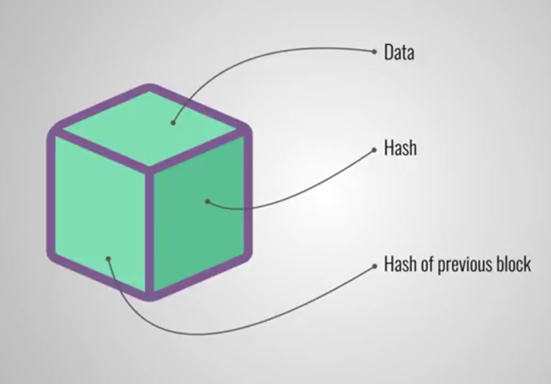
Blockchain(cont..)
Create a new block.
Proof-of-work.
courtesy: images.google.com

Slide 10
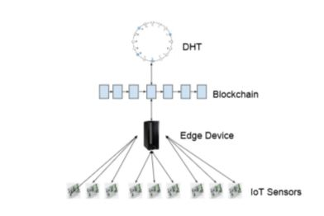
IoT data storage with blockchain
Courtesy.http://ieeexplore.ieee.org/document/2853167

Slide 11
IoT data storage(cont..)
IoT sensors send real time data to edge device
Data store in DHT

Slide 12
Edge computing
Opposed cloud computing
Manage the data storage
Manage the identities of IoT devices
Collect and forward data to DHT

Slide 13
Blockchain transaction work in IoT
Device registration
Verify a transaction
Store data
Access data

Slide 14
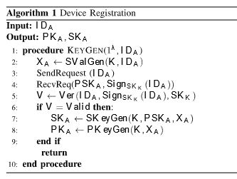
Device registration
Courtesy:http://ieeexplore.ieee.org/document/2853167

Slide 15
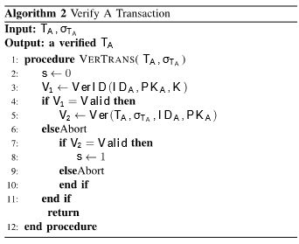
Verify a transaction
Courtesy.http://ieeexplore.ieee.org/document/2853167

Slide 16
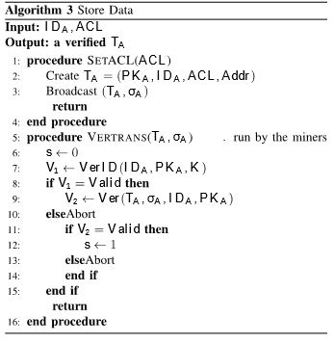
Store data
Courtesy.http://ieeexplore.ieee.org/document/2853167

Slide 17
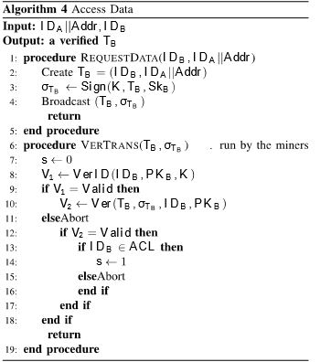
Access data
Courtesy.http://ieeexplore.ieee.org/document/2853167

Slide 18
Security
Privacy
Traceability and Accountability
Blockchain security

Slide 19
Privacy
Encryption
IoT device public key or entity public key
Confirmation before payment

Slide 20
Traceability and Accountability
DHT address will be recorded
Data owner know which entity accessed his data
Malicious attack are recorded

Slide 21
Blockchain security
Large number of miners
Mining award
Work with more IoT application

Slide 22
Data trading
Seller post a transaction
Buyer offer a deposit
Seller update ACL
Get back deposit

Slide 23
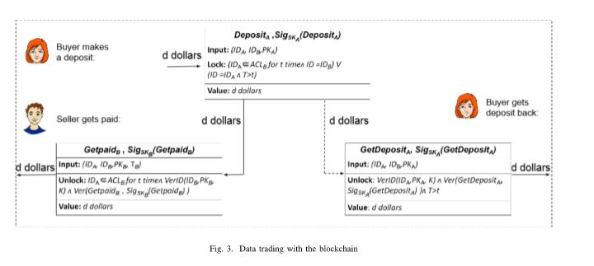
Data trading(cont..)
Courtesy.http://ieeexplore.ieee.org/document/2853167

Slide 24
ADVANTAGES
Decentralized storage
No centralized trusted server
Traceability and accountability

Slide 25
Conclusion
Centralized cloud server
Edge computing
Overcome centralized cloud server
Transaction process

Slide 26
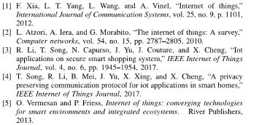
References

Slide 27
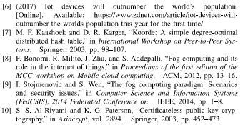
Reference (cont..)

Slide 28
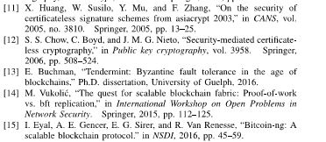
References (cont..)

Slide 29
THANK YOU

