Slide 1
A Software Defined Fog Node based Distributed Blockchain Cloud Architecture for IoT
Vishnupriya .M
Roll No:63 S7 Btech CSE
Dept. of CSE, MACE Kothamangalm
November 22,2018

Slide 2
CONTENTS
A Software Defined Fog Node based Distributed Blockchain Cloud Architecture for IoT
Keywords
Introduction
Need for block chains in distributed cloud storage
Required design principles
Distributed block chain cloud architecture

Slide 3
CONTENTS(contd…)
A Software Defined Fog Node based Distributed Blockchain Cloud Architecture for IOT
Edge computing network architecture
Performance evaluation
Conclusion
References

Slide 4
KEY WORDS
A Software Defined Fog Node based Distributed Blockchain Cloud Architecture for IoT
Internet of Things
Software Defined Networking
Blockchain
Cloud Computing
Fog Computing
Edge Computing

Slide 5
INTRODUCTION
A Software Defined Fog Node based Distributed Blockchain Cloud Architecture for IoT
IoT data : transmitted to remote cloud for processing through internet
IoT data are transmitted to cloud at high speed
Explore valuable information in real time
Design an efficient data-processing architecture
Cloud-based solutions : growing demand and the limited computing resources of IoT devices.

Slide 6
INTRODUCTION(contd…)
A Software Defined Fog Node based Distributed Blockchain Cloud Architecture for IoT
Centralized clouds : unlikely to deliver satisfactory services in near future.
Fog computing : layered service structure , an extension of cloud computing.
Storage hosts sell their surplus storage payments are made over the blockchain.

Slide 7
RESEARCH CONTRIBUTIONS
A Software Defined Fog Node based Distributed Blockchain Cloud Architecture for IoT
Distributed cloud architecture based on the blockchain technique
Secure distributed fog node architecture using SDN and blockchain
Proposed technique was evaluated and compared with existing model

Slide 8
NEED FOR BLOCKCHAIN IN DISTRIBUTED CLOUD
A Software Defined Fog Node based Distributed Blockchain Cloud Architecture for IoT
Full decentralization and true redundancy
Facilitates resource usage
Improves the Quality-of-Services
Cost reduction and Complete privacy

Slide 9
DESIGN PRINCIPLES
A Software Defined Fog Node based Distributed Blockchain Cloud Architecture for IoT
Resilience
Efficiency
Ease of deployment
Adaptability
High availability and fault tolerance
Performance (linear adaptability of performance)
Scalability

Slide 10
ARCHITECTURE DESIGN OVERVIEW
A Software Defined Fog Node based Distributed Blockchain Cloud Architecture for IoT
courtesy:https://ieeexplore.ieee.org/stamp/stamp.jsp?tp=&arnumber=8053750

Slide 11
ARCHITECTURE DESIGN OVERVIEW(contd…)
A Software Defined Fog Node based Distributed Blockchain Cloud Architecture for IoT
Categorized into three layers
Device
Fog
Cloud
Device Layer
Edge of the network
Sends filtered data consumed locally to fog layer
Edge of the network we deployed multi-interfaced Base Stations

Slide 12
ARCHITECTURE DESIGN OVERVIEW(contd…)
A Software Defined Fog Node based Distributed Blockchain Cloud Architecture for IoT
Fog Layer
Consists of high-performance distributed SDN controller
Each fog node covers the small associated community
Data analysis and service delivery in a timely manner
Provides localization

Slide 13
ARCHITECTURE DESIGN OVERVIEW(contd…)
A Software Defined Fog Node based Distributed Blockchain Cloud Architecture for IoT
Cloud Layer
Wide-area monitoring and control
Distributed cloud based on the blockchain technique
Provides secure, low-cost, and on-demand access to computing infrastructures
Servers, data, and applications

Slide 14
DISTRIBUTED BLOCKCHAIN AND CLOUD ARCHITECTURE
A Software Defined Fog Node based Distributed Blockchain Cloud Architecture for IoT
Selection of resource providers
Provision of services
Registration of transactions
Payment

Slide 15
DISTRIBUTED BLOCKCHAIN AND CLOUD ARCHITECTURE(contd..)
A Software Defined Fog Node based Distributed Blockchain Cloud Architecture for IoT
Proof-of-service
Matchmaking algorithm
Scheduling algorithm

Slide 16
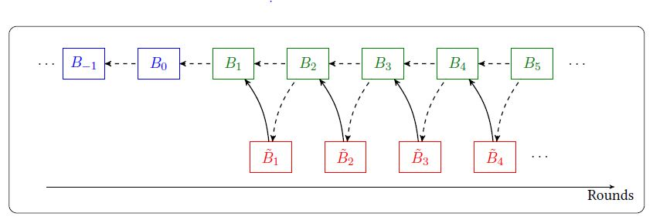
PROOF-OF-SERVICE
A Software Defined Fog Node based Distributed Blockchain Cloud Architecture for IoT
courtesy:https://ieeexplore.ieee.org/stamp/stamp.jsp?tp=&arnumber=8053750

Slide 17
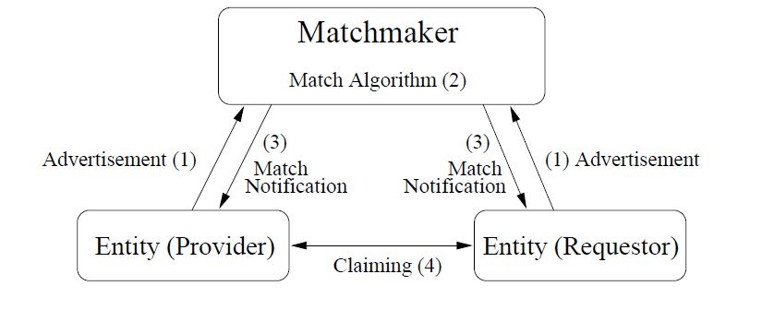
MATCHMAKING ALGORITHM
A Software Defined Fog Node based Distributed Blockchain Cloud Architecture for IoT
courtesy:https://ieeexplore.ieee.org/stamp/stamp.jsp?tp=&arnumber=8053750

Slide 18
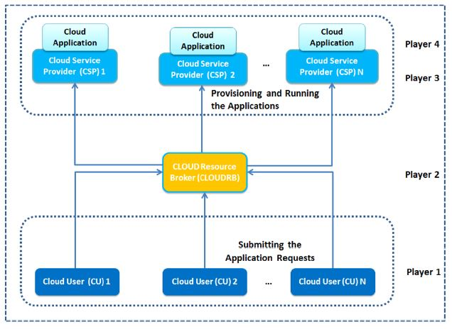
SCHEDULING ALGORITHM
A Software Defined Fog Node based Distributed Blockchain Cloud Architecture for IoT
courtesy:https://ieeexplore.ieee.org/stamp/stamp.jsp?tp=&arnumber=8053750

Slide 19
EDGE COMPUTING ARCHITECTURE
A Software Defined Fog Node based Distributed Blockchain Cloud Architecture for IoT
courtesy:https://ieeexplore.ieee.org/stamp/stamp.jsp?tp=&arnumber=8053750

Slide 20
EDGE COMPUTING ARCHITECTURE(contd…)
A Software Defined Fog Node based Distributed Blockchain Cloud Architecture for IoT
IoT devices’ communication to fog nodes happens through multi-interface BSs
BSs will consider as a gateway or as a forwarding SDN switch for the fog controller
Each fog node is composed of distributed SDN controllers
Uses the blockchain technique
Each SDN controller includes packet migration and flow rule analysis functions.

Slide 21
EDGE COMPUTING ARCHITECTURE(contd…)
A Software Defined Fog Node based Distributed Blockchain Cloud Architecture for IoT
This model consists of three different phases
First phase
To build an overall network view
This model monitors and parses to identify essential OpenFlow messages
Second phase
It analyses the parsed data set and extracts the routing topology state

Slide 22
EDGE COMPUTING ARCHITECTURE(contd…)
A Software Defined Fog Node based Distributed Blockchain Cloud Architecture for IoT
Construct a network flow topology graph with the traffic flow.
Maintains the topological status of the metadata
Third phase
Metadata flow of a set validates allowable metadata values .
When the model discovers a new flow behaviour: it does not trigger an alarm
Triggers alarms: it recognizes flow that challenges a specified security policy.

Slide 23
EDGE COMPUTING ARCHITECTURE(contd…)
A Software Defined Fog Node based Distributed Blockchain Cloud Architecture for IoT
Packets Parser
Flow Topology Graph Builder
Verifier
Generating path conditions (offline)
Generating reactive rules (online)
Migration Agent
Data Plan Cache

Slide 24
PERFORMANCE EVALUATION
A Software Defined Fog Node based Distributed Blockchain Cloud Architecture for IoT
Evaluate the proposed scheme by using the
Throughput
Response time
Delay-incurred performance metrics.
Accuracy of the proposed model
Speed with which it can detect and mitigate saturation attacks

Slide 25
PERFORMANCE EVALUATION (contd…)
A Software Defined Fog Node based Distributed Blockchain Cloud Architecture for IoT
Real-time traces of distributed private cloud data centre and Amazon EC2
Distributed private cloud: abundant resources was rendered on 6 desktops
Each desktop had 64 GB DDR3 RAM and an Intel i7 processor.
End user devices and fog nodes were rendered by laptops with limited resources.

Slide 26
PERFORMANCE EVALUATION (contd…)
A Software Defined Fog Node based Distributed Blockchain Cloud Architecture for IoT
Each of the laptops that we used had a 16 GB DDR3 RAM and an Intel i5 CPU
TFN2K tool to generate real-time attacks

Slide 27
PERFORMANCE EVALUATION(contd…)
A Software Defined Fog Node based Distributed Blockchain Cloud Architecture for IoT
Delay incurred by: a) an increase in the number of devices; and b) an increase in the number of requests
courtesy: https://ieeexplore.ieee.org/stamp/stamp.jsp?tp=&arnumber=8053750

Slide 28
PERFORMANCE EVALUATION (contd…)
A Software Defined Fog Node based Distributed Blockchain Cloud Architecture for IoT
With regard to the number of requests: a) the variation in response time; b) the variation in throughput
courtesy:https://ieeexplore.ieee.org/stamp/stamp.jsp?tp=&arnumber=8053750

Slide 29
PERFORMANCE EVALUATION (contd…)
A Software Defined Fog Node based Distributed Blockchain Cloud Architecture for IoT
Similarity Index(SI)
𝑆𝐼𝑡= 𝑆𝐼𝑡−1+ 𝜔
𝜔 - represents the latest byte-level statistics available at timestamp 𝑡.
t - timestamp
We consider 𝑆𝐼 to be the moving average of the difference in byte-level statistics.

Slide 30
CONCLUSION
A Software Defined Fog Node based Distributed Blockchain Cloud Architecture for IoT
Efficiently manage the raw data streams produced by large IoT devices
It is based on three emerging technologies: fog computing, SDN, and blockchain.
Support real-time data delivery, high scalability, security and low latency.
Reduce the end-to-end delay between IoT devices, computing resources ,
Reduced traffic load.

Slide 31
REFERENCES
A Software Defined Fog Node based Distributed Blockchain Cloud Architecture for IoT
[1] Top Strategic Predictions for 2017 and Beyond: Surviving the Storm Winds of Digital Disruption, https://www.gartner.com/doc/3471568? ref=unauthreader
[2] S. Singh, Y. S. Jeong, and J. H. Park, “A survey on cloud computing security: Issues, threats, and solutions,” Journal of Network and Computer Applications, vol. 75, pp. 200-222, Nov. 2016
[3] X. Sun, N. Ansari, and R. Wang, “Optimizing resource utilization of a data center,” IEEE Communications Surveys & Tutorials, vol. 18, no. 4, pp.2822-2846, Jan. 2016
[4] H. L. Truong and S. Dustdar, “Principles for Engineering IoT Cloud Systems,” IEEE Cloud Computing, vol. 2, no. 2, pp. 68–76, Mar. 2015
[5] L. Wang and R. Ranjan, “Processing Distributed Internet of Things Data in Clouds,” IEEECloud Computing, vol. 2, no. 1, pp. 76—80, Jan. 2015

Slide 32
REFERENCES(contd…)
A Software Defined Fog Node based Distributed Blockchain Cloud Architecture for IoT
[6] M. Chiang, and T. Zhang, “Fog and IoT: An overview of research opportunities,” IEEE Internet of Things Journal, vol. 3, no. 6, pp. 854-864, Dec. 2016
[7] A. Alrawais, A. Alhothaily, C. Hu, and X. Cheng, “Fog Computing for the Internet of Things: Security and Privacy Issues,” IEEE Internet Computing, vol. 21, no. 2, Mar. 2017
[8] K. Christidis, and M. Devetsikiotis, "Blockchains and Smart Contracts for the Internet of Things," IEEE Access, vol. 4, pp. 2292-2303, May 2016
[9] F. Tschorsch, and B. Scheuermann, "Bitcoin and beyond: A technical survey on decentralized digital currencies," IEEE Communications Surveys & Tutorials, vol. 18, pp. 2084-2123, Mar. 2016
[10] P. K. Sharma, S. Y. Moon, and J. H. Park, “Block-VN: A Distributed Blockchain Based Vehicular Network Architecture in Smart City,” Journal of Information Processing Systems, vol. 13, no. 1, pp. 184-195, Mar. 2017

Slide 33
A Software Defined Fog Node based Distributed Blockchain Cloud Architecture for IoT
THANK YOU….

