Slide 1
EARLY SEPSIS
WARNING
RESEARCH
DEMO
ICU time-series research prototype
Aman Joshi · Aadya Mendiratta · Abhinav Goel
Exploring hourly measurements and model-based warning signals
Not for clinical use
Notes:
Presenter: Aman Joshi
Introduce the team and project. Explain that this is an educational research prototype exploring hourly ICU measurements and the historical sepsis label, not a clinical diagnostic tool.

Slide 2
Why early warning is worth studying
ICU measurements change over time. A model can examine those patterns and flag a possible warning window for research.
Hourly observations
Possible warning window
Hour 1
Hour 2
Hour 3
Hour 4
Hour 5
Hour 6
A model signal is a prompt to examine data in a demonstration—not a diagnosis or care recommendation.
Aman Joshi • Early Sepsis Warning
Educational research prototype · Not for clinical use
02
Notes:
Presenter: Aman Joshi
Describe the motivation: measurements can evolve over time, so a research model can inspect patterns across hours. Clarify that our demo does not support care decisions.

Slide 3
Dataset and prediction target
PhysioNet / Computing in Cardiology Challenge 2019
Hourly ICU records
Challenge label window
Vitals such as heart rate, oxygen saturation, temperature and blood pressure
−6 h
Recorded onset
Additional laboratory and patient-context fields where available
Each row is one hourly observation
Positive label begins six hours before recorded onset and remains positive afterward.
The model estimates the dataset label, not an independently confirmed diagnosis.
Aman Joshi • Early Sepsis Warning
Educational research prototype · Not for clinical use
03
Notes:
Presenter: Aman Joshi
Explain that the data is from the public PhysioNet challenge and each row is an hour. The challenge marks the label positive beginning six hours before onset and keeps it positive afterwards, so the prediction target is a historical dataset label.

Slide 4
Model workflow
Only current and past information is used to form each hourly score
01
02
03
04
05
Hourly measurements
Causal features
Model score
Persistence rule
Demo display
Features include recent values, changes, rolling summaries and time since the last measurement.
The persistence rule checks recent hourly scores to reduce reliance on a single isolated reading.
Aman Joshi • Early Sepsis Warning
Educational research prototype · Not for clinical use
04
Notes:
Presenter: Aman Joshi
Walk through the five stages. Define features as information the model uses. Causal features use only current and past values, while the alert rule examines recent scores.

Slide 5
Model and features
The current demo candidate is LightGBM
A tree-based model using 200 features built from hourly records.
CURRENT VALUES
RECENT HISTORY
What was measured this hour
Last observed values and measurement freshness
CHANGES & TRENDS
RULE-INSPIRED FEATURES
Recent shifts and rolling summaries
Selected composites from clinical markers
The project also compares Logistic Regression and Histogram Gradient Boosting.
Aadya Mendiratta • Early Sepsis Warning
Educational research prototype · Not for clinical use
05
Notes:
Presenter: Aadya Mendiratta
Explain LightGBM in simple terms as a tree-based model. Describe the kinds of features used and mention the project’s comparison models without implying that model choice alone proves clinical value.

Slide 6
Exploratory evaluation
Held-out test comparison reported in the project report
LightGBM · 1-of-5
Histogram Gradient Boosting
Utility 0.444
Utility 0.423
PR-AUC 0.148
PR-AUC 0.122
ROC-AUC 0.854
ROC-AUC 0.841
Warning-window coverage 81.4%
Warning-window coverage 76.1%
Non-sepsis patients alerted 24.9%
Non-sepsis patients alerted 23.8%
Paired bootstrap utility difference: +0.0206 | 95% interval: −0.0035 to +0.0446
The interval includes zero. These exploratory results do not establish reliable clinical benefit.
The test split was examined during earlier project work; no independent clinical validation is available.
Aadya Mendiratta • Early Sepsis Warning
Educational research prototype · Not for clinical use
06
Notes:
Presenter: Aadya Mendiratta
Present the comparison without overstating it. PR-AUC is useful when positive rows are relatively uncommon. Warning-window coverage describes the share of sepsis cases with an alert during the target window. The paired bootstrap interval includes zero, and this previously examined test split is exploratory rather than independent clinical validation.

Slide 7
Limitations and interpretation
What this project can—and cannot—tell us
It predicts a historical challenge label, not a confirmed diagnosis.
Results may not generalize to other hospitals or patient populations.
False alerts and missed warning windows remain important concerns.
The model and alert thresholds are not validated for clinical decisions.
Next: a walkthrough using synthetic example data
Abhinav Goel • Early Sepsis Warning
Educational research prototype · Not for clinical use
07
Notes:
Presenter: Abhinav Goel
State the limitations directly. This project has no prospective clinical validation. Transition to the prototype walkthrough, which uses synthetic example data only.

Slide 8
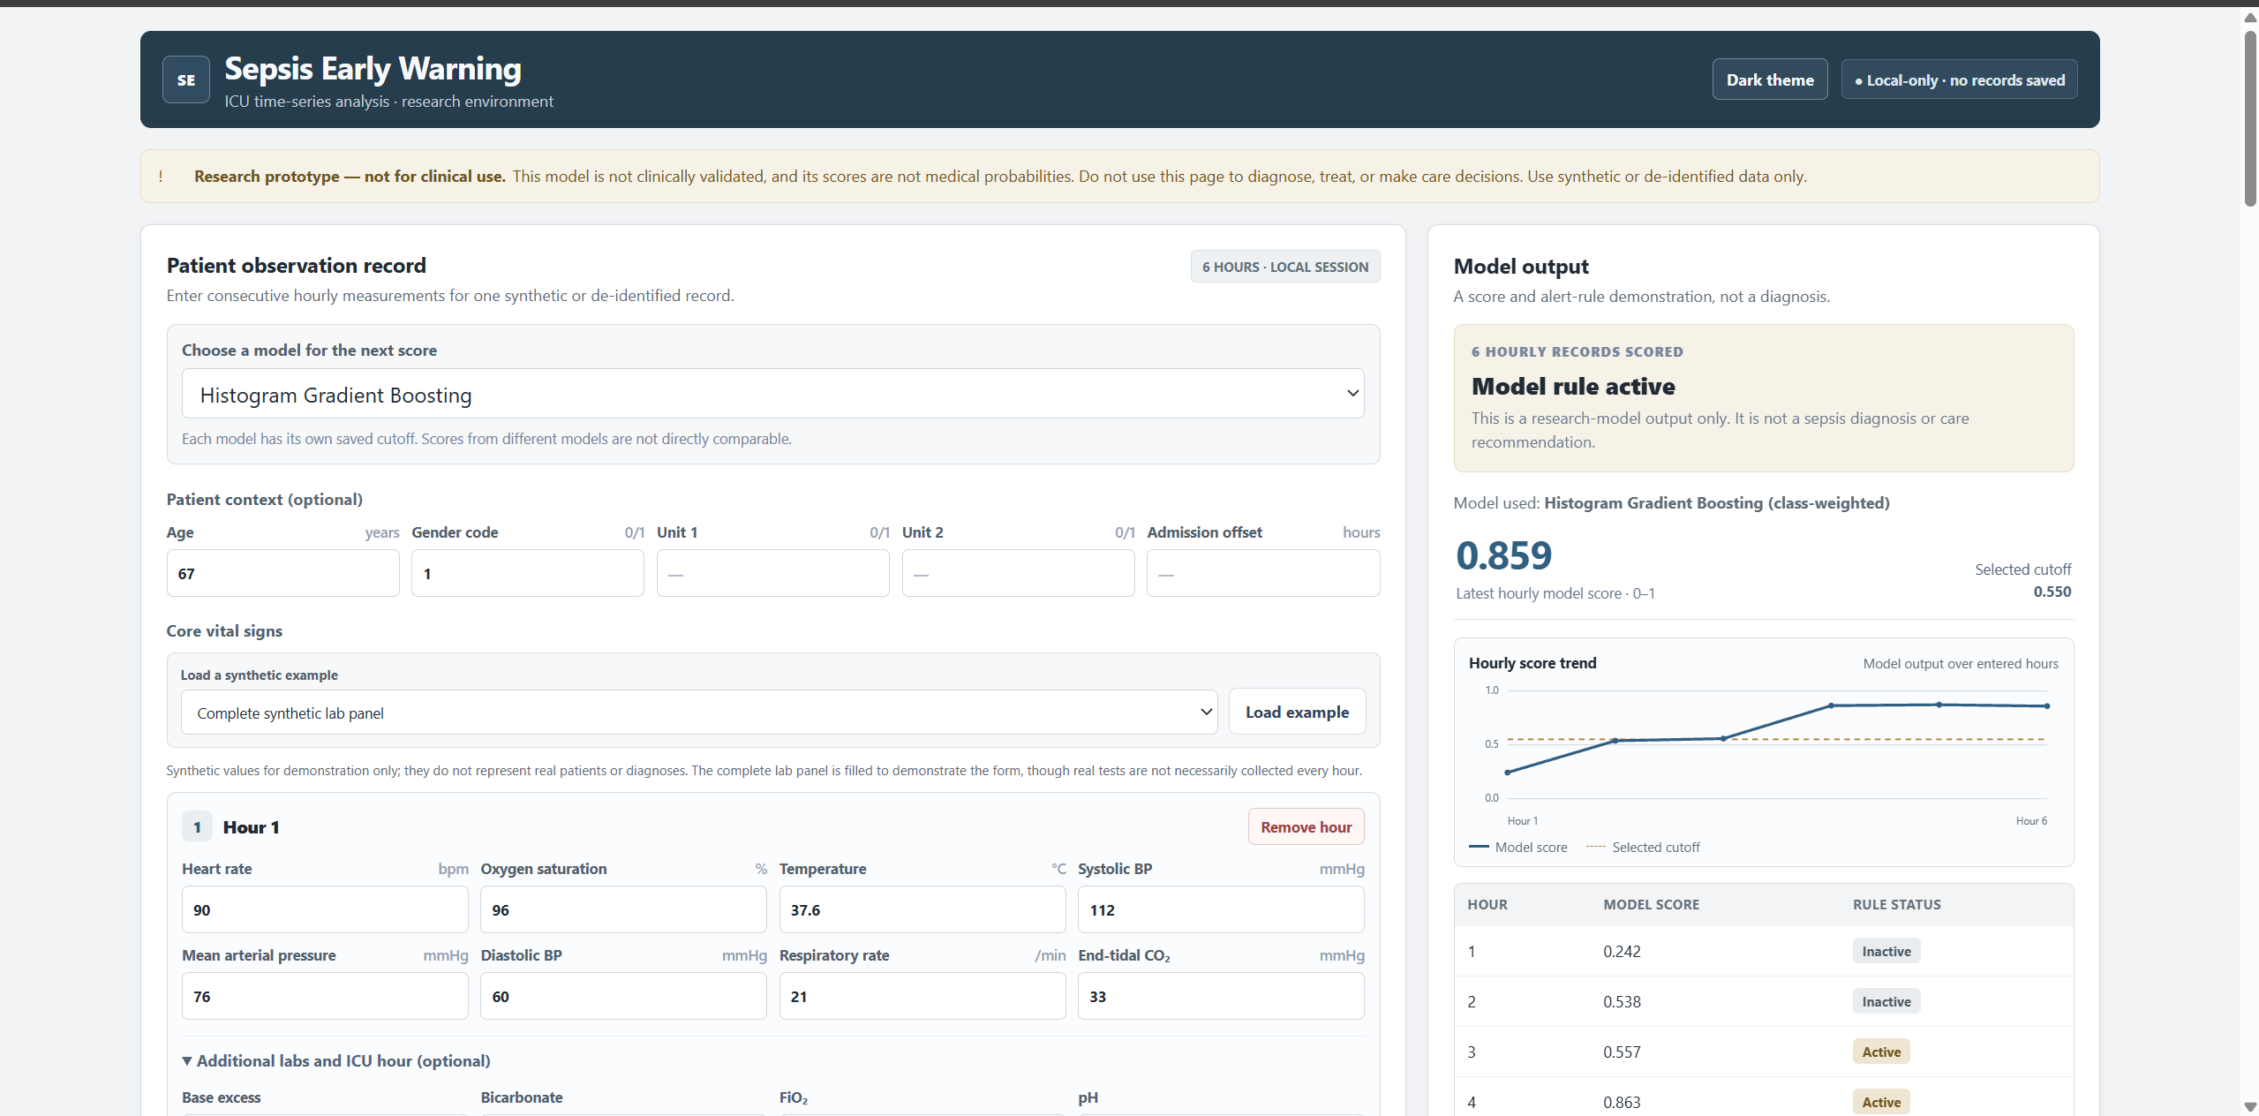
Prototype interface
A local research demo for entering hourly observations
Visible in the demo
Synthetic example data
Hourly observation form
Model selection and score output
Explicit research-only notice
Use synthetic or appropriately de-identified examples only.
Abhinav Goel • Early Sepsis Warning
Educational research prototype · Not for clinical use
08
Notes:
Presenter: Abhinav Goel
Point out the supplied screenshot from the actual prototype. It shows the hourly record form, a synthetic example, a model output and the research-only notice. For any live walkthrough, use synthetic data only.

Slide 9
Reading the prototype output
A model score and alert rule are demonstration outputs
Default persistence rule
1-of-5
At least one of the last five hourly scores meets its selected cutoff.
Recent hourly scores
H−4
H−3
H−2
H−1
Current
Below cutoff
Below cutoff
Meets cutoff
Below cutoff
Below cutoff
Any one meets cutoff → rule active
A score is not a medical probability, diagnosis, or recommendation for care.
Abhinav Goel • Early Sepsis Warning
Educational research prototype · Not for clinical use
09
Notes:
Presenter: Abhinav Goel
Explain that 1-of-5 means the rule activates when any one of the last five hourly model scores meets the selected cutoff. The timeline is a conceptual explanation, not patient data. Emphasize that scores are not medical probabilities or care instructions.

Slide 10
Conclusion and next steps
What we built
What comes next
An end-to-end educational prototype for exploring hourly ICU data and sepsis-label prediction.
Evaluate on a fresh, untouched dataset
Check performance across external sites
Study alert burden and warning timing
Research results are exploratory—not clinical evidence.
Thank you · Questions?
Aman Joshi · Aadya Mendiratta · Abhinav Goel
Abhinav Goel • Early Sepsis Warning
Educational research prototype · Not for clinical use
10
Notes:
Presenter: Abhinav Goel
Recap the end-to-end prototype and the exploratory nature of the evidence. Mention fresh evaluation, external validation and alert-burden review as next research steps. Thank the audience and invite questions.

