Slide 1

21AIE314 AI in Natural Language Processing
Course Instructor – Dr. Sachin Kumar
Batch B Group 13
Project title : Offensive Humour Detection

Slide 2
Team members
Name​ | Roll Number​
Karthik M S​ | CB.EN.U4AIE21121​
Abhinav Vura​ | CB.EN.U4AIE21177​
Bhaswanth Reddy I​ | CB.EN.U4AIE21106​
Sai Praneeth Reddy A​ | CB.EN.U4AIE21103​

Slide 3
Dataset:
The Offensive Humor Dataset from Kaggle is a collection of text samples categorized into four levels of offensiveness: mildly offensive, moderately offensive, highly offensive, and extremely offensive. Each entry in the dataset includes a joke or humorous statement, labeled according to its perceived level of offensiveness. This dataset is designed to aid in the development and evaluation of models aimed at detecting and classifying offensive content in humor. It is particularly useful for tasks in natural language processing, such as sentiment analysis, content moderation, and automated text classification.
Total of 92,153 jokes across 4 categories
Categories:
Clean Jokes (7,450 examples)
Dark Jokes (79,230 examples)
Dirty Jokes (5,473 examples)
News articles as non-jokes (10,710 examples)
Clean Jokes: Should we have to wash jokes before posting them here. Because they say clean jokes.
Dark Jokes: My grandparents told me "you're next" in a wedding. I told them the same when we attended a funeral.
Dirty Jokes: What's the difference between a dirty park and ride and a lobster with breast implants? One's a crusty bus station, and the other is a busty Crustacean
https://huggingface.co/datasets/metaeval/offensive-humor

Slide 4
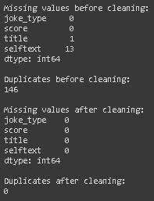
Pre-Processing

Slide 5
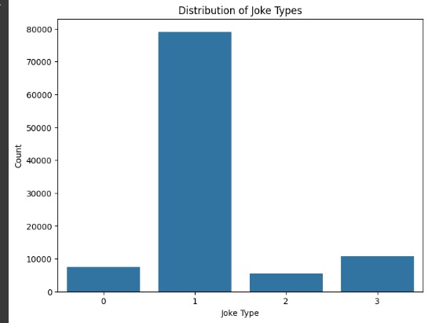
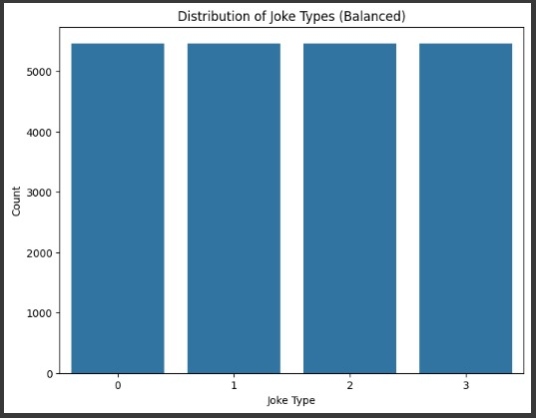

Slide 6
N-gram
Model\Metrics | Accuracy | Precision | Recall | F1-Score
SVM – rbf | 0.56 | 0.58 | 0.56 | 0.56
SVM – poly | 0.54 | 0.56 | 0.54 | 0.47
Random Forest | 0.59 | 0.59 | 0.59 | 0.59
XG-Boost | 0.55 | 0.56 | 0.55 | 0.54
KNN | 0.55 | 0.56 | 0.55 | 0.55
NTK | 0.55 | 0.56 | 0.55 | 0.55

Slide 7
Model\Accuracy | Class-0 | Class-1 | Class-2 | Class - 3
SVM – rbf | 0.59 | 0.39 | 0.28 | 0.99
SVM – poly | 0.02 | 0.94 | 0.21 | 0.97
Random Forest | 0.50 | 0.42 | 0.45 | 0.99
XG-Boost | 0.65 | 0.99 | 0.33 | 0.24
KNN | 0.51 | 0.38 | 0.35 | 0.97
NTK | 0.43 | 0.47 | 0.31 | 0.98

Slide 8
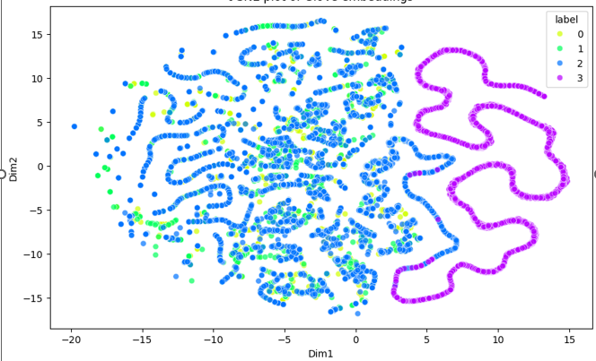

Slide 9
Tf-idf
Model\Metrics | Accuracy | Precision | Recall | F1-Score
SVM – rbf | 0.76 | 0.76 | 0.76 | 0.75
SVM – poly | 0.63 | 0.72 | 0.63 | 0.62
Random Forest | 0.72 | 0.72 | 0.72 | 0.72
XG-Boost | 0.74 | 0.74 | 0.74 | 0.74
KNN | 0.62 | 0.67 | 0.62 | 0.62
NTK | 0.67 | 0.71 | 0.67 | 0.66

Slide 10
Model\Accuracy | Class-0 | Class-1 | Class-2 | Class - 3
SVM – rbf | 0.83 | 0.58 | 0.63 | 0.99
SVM – poly | 0.92 | 0.38 | 0.39 | 0.81
Random Forest | 0.71 | 0.54 | 0.65 | 0.99
XG-Boost | 0.74 | 0.58 | 0.64 | 0.99
KNN | 0.80 | 0.49 | 0.37 | 0.82
NTK | 0.85 | 0.38 | 0.48 | 0.98

Slide 11
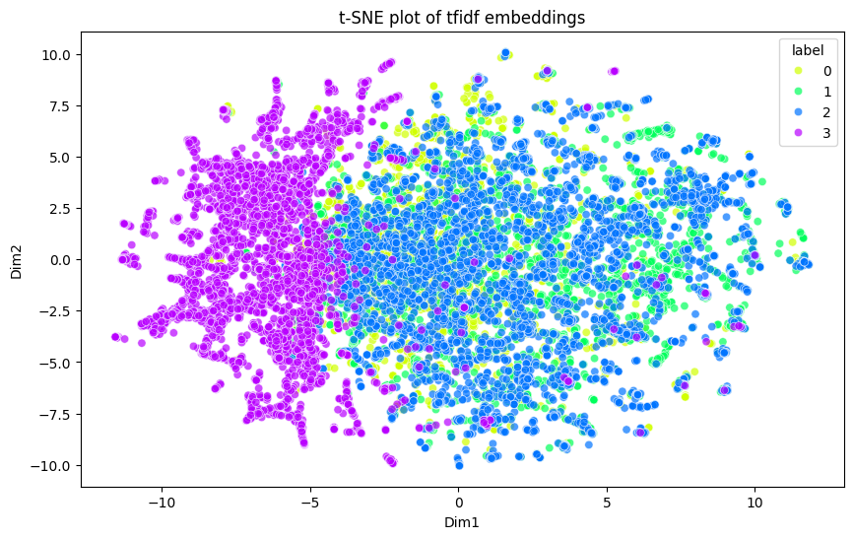

Slide 12
Glove
Model\Metrics | Accuracy | Precision | Recall | F1-Score
SVM – rbf | 0.72 | 0.72 | 0.72 | 0.72
SVM – poly | 0.71 | 0.72 | 0.72 | 0.71
Random Forest | 0.71 | 0.71 | 0.71 | 0.71
XG-Boost | 0.71 | 0.71 | 0.71 | 0.71
KNN | 0.71 | 0.71 | 0.71 | 0.71
NTK | 0.71 | 0.71 | 0.72 | 0.71

Slide 13
Model\Accuracy | Class-0 | Class-1 | Class-2 | Class - 3
SVM – rbf | 0.73 | 0.75 | 0.60 | 1
SVM – poly | 0.72 | 0.57 | 0.57 | 0.99
Random Forest | 0.74 | 0.56 | 0.56 | 0.99
XG-Boost | 0.71 | 0.57 | 0.58 | 0.99
KNN | 0.74 | 0.56 | 0.56 | 0.99
NTK | 0.69 | 0.57 | 0.60 | 1

Slide 14
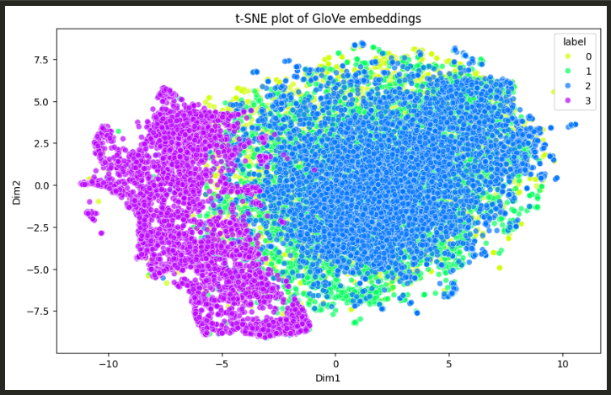

Slide 15
Fast text
Model\Metrics | Accuracy | Precision | Recall | F1-Score
SVM – rbf | 0.77 | 0.77 | 0.77 | 0.77
SVM – poly | 0.76 | 0.76 | 0.77 | 0.76
Random Forest | 0.74 | 0.75 | 0.75 | 0.74
XG-Boost | 0.76 | 0.76 | 0.76 | 0.76
KNN | 0.62 | 0.63 | 0.63 | 0.60
NTK | 0.73 | 0.73 | 0.73 | 0.73

Slide 16
Model\Accuracy | Class-0 | Class-1 | Class-2 | Class - 3
SVM – rbf | 0.81 | 0.63 | 0.65 | 1
SVM – poly | 0.79 | 0.65 | 0.62 | 1
Random Forest | 0.77 | 0.61 | 0.61 | 0.99
XG-Boost | 0.76 | 0.64 | 0.65 | 0.99
KNN | 0.40 | 0.43 | 0.68 | 1
NTK | 0.76 | 0.59 | 0.57 | 1

Slide 17
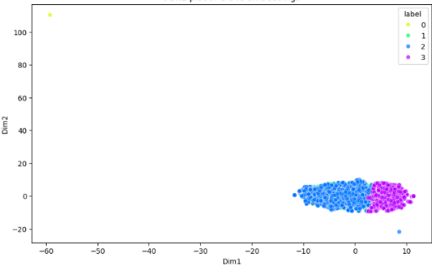
Tsne- plot

Slide 18
Word2Vec
Model\Metrics | Accuracy | Precision | Recall | F1-Score
SVM – rbf | 0.73 | 0.74 | 0.74 | 0.73
SVM – poly | 0.73 | 0.73 | 0.73 | 0.73
Random Forest | 0.71 | 0.71 | 0.71 | 0.71
XG-Boost | 0.73 | 0.73 | 0.73 | 0.73
KNN | 0.64 | 0.64 | 0.64 | 0.63
NTK | 0.71 | 0.71 | 0.71 | 0.71

Slide 19
Model\Accuracy | Class-0 | Class-1 | Class-2 | Class - 3
SVM – rbf | 0.74 | 0.58 | 0.63 | 1
SVM – poly | 0.76 | 0.55 | 0.62 | 0.99
Random Forest | 0.71 | 0.58 | 0.55 | 0.99
XG-Boost | 0.72 | 0.60 | 0.62 | 0.99
KNN | 0.43 | 0.42 | 0.71 | 1
NTK | 0.70 | 0.56 | 0.60 | 0.99

Slide 20
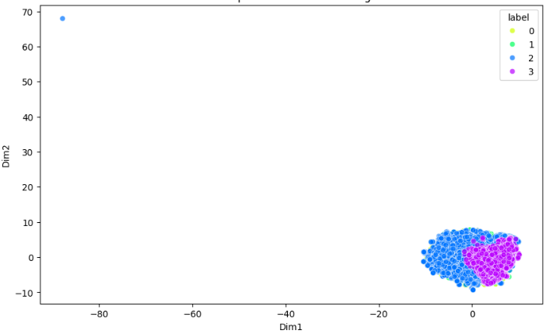
Tsne- plot

Slide 21
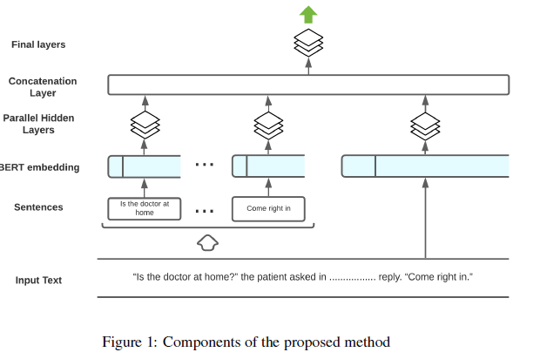
BERT
https://www.sciencedirect.com/science/article/pii/S0957417424005517

Slide 22
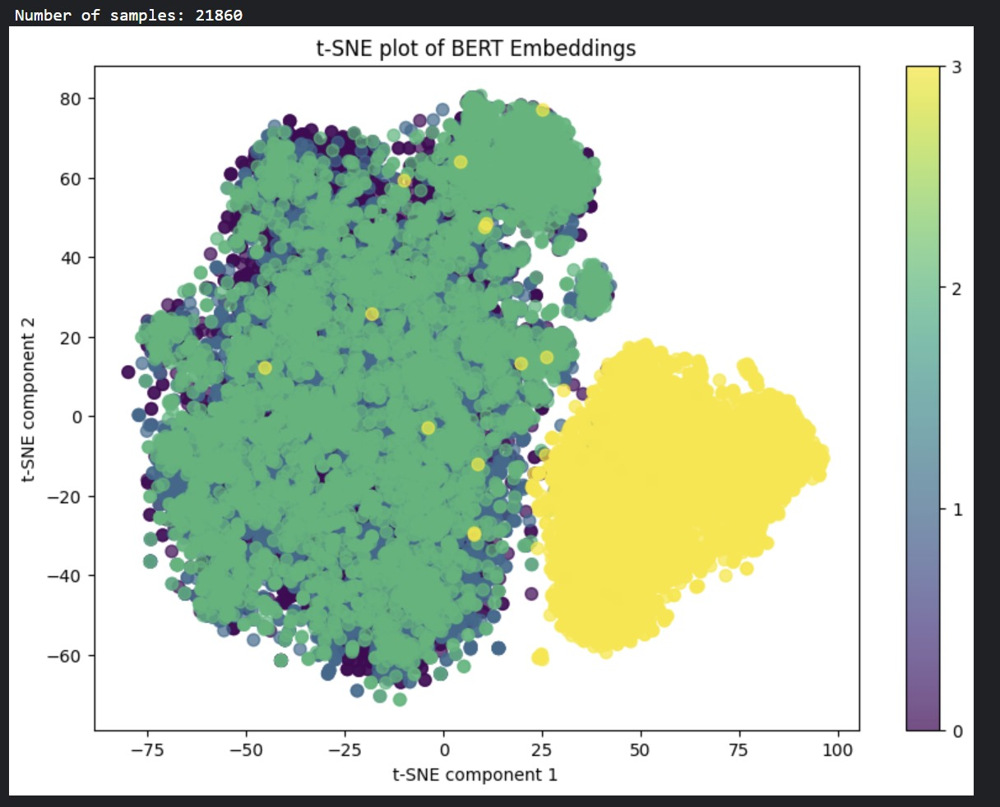
Tsne- plot
BERT Embedding for whole Text

Slide 23
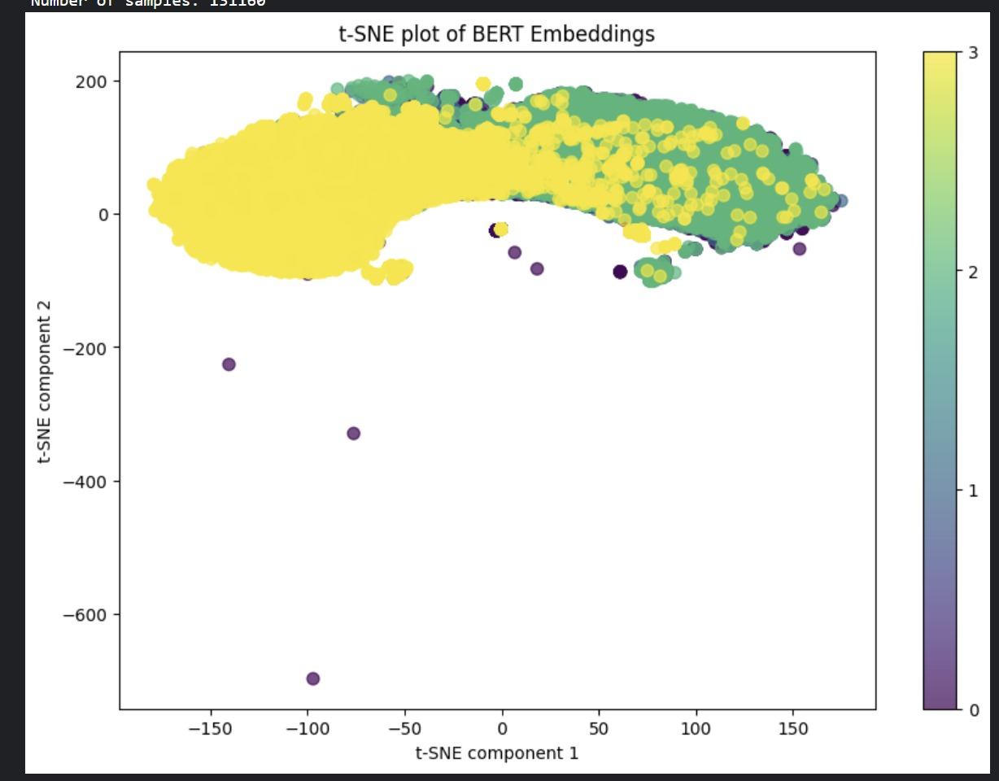
Tsne plot: BERT Embedding for Sentence

Slide 24
Evaluation Metrics
Class | Accuracy | Precision | Recall | F1-Score
Class 1 | 0.78 | 0.73 | 0.79 | 0.76
Class 2 | 0.65 | 0.69 | 0.65 | 0.67
Class 3 | 0.65 | 0.67 | 0.66 | 0.66
Class 4 | 1 | 1 | 1 | 1
Overall | 0.77 | 0.77 | 0.77 | 0.77

Slide 25
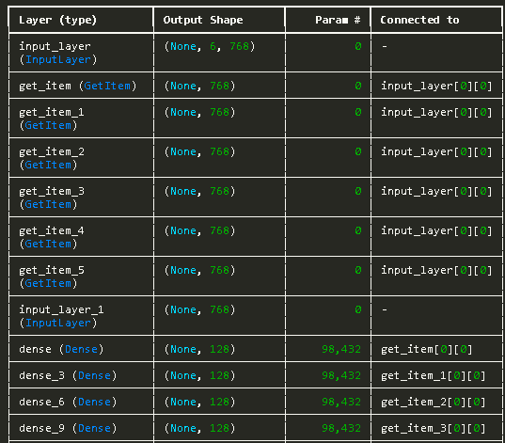
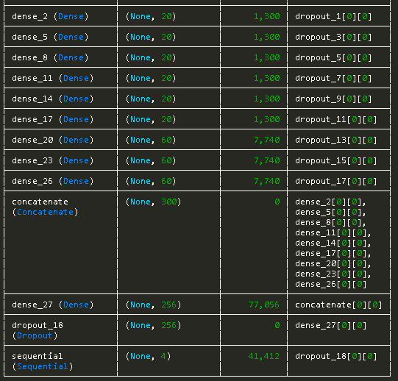
Model Summary

Slide 26
Conclusion
In this project, we explored the classification of offensive humor using both traditional machine learning models and a parallel neural network approach. By leveraging TF-IDF, n-gram, GloVe,fasttext , Word2Vec and BERT embeddings as feature representations, we trained models such as SVM, Random Forest, KNN,NTK and XGBoost, achieving notable performance improvements through comprehensive preprocessing and data balancing techniques.
Additionally, the parallel neural network, which effectively captured intricate semantic nuances, further enhanced the classification accuracy. The comparative analysis underscored the strengths of traditional models in handling structured feature sets, while the neural network demonstrated superior capability in modeling complex patterns within the offensive humor dataset.
This dual approach highlights the complementary nature of traditional machine learning and deep learning techniques in advancing NLP tasks.

Slide 27
Thank You

