Slide 1
Project 5: Kubernetes
Submitted by-
K. Abhinay
Guided by -
Sir Ashish

Slide 2
What is Kubernetes?
Kubernetes also known as K8s, is an open-source system for automating deployment, scaling, and management of containerized applications.
It groups containers that make up an application into logical units for easy management and discovery. Kubernetes builds upon 15 years of experience of running production workloads at Google, combined with best-of-breed ideas and practices from the community.

Slide 3

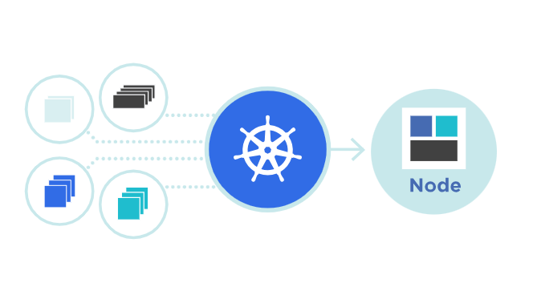
Kubernetes Features
Automated rollouts and rollbacks
Service discovery and load balancing
Storage orchestration
Self-healing
Secret and configuration management
Automatic bin packing
Batch execution
Horizontal scaling
IPv4/IPv6 dual-stack
Designed for extensibility

Slide 4
Project 5:
Kubernetes :-
Killercoda :-playground
https://killercoda.com/playgrounds/scenario/kubernetes
1 master and one node
for 60 minutes
pods 10:-httpd, caddy, nginx
5 from CLI and 5 from Defination -file.
https://kubernetes.io/docs/concepts/workloads/pods/
name:-every pod different name
label(key=value):-5 types
5 RC :-5 label(pod-label)
each RC should have 4 replicas.
https://kubernetes.io/docs/concepts/workloads/controllers/replicationcontroller/
deployment:-5

Slide 5
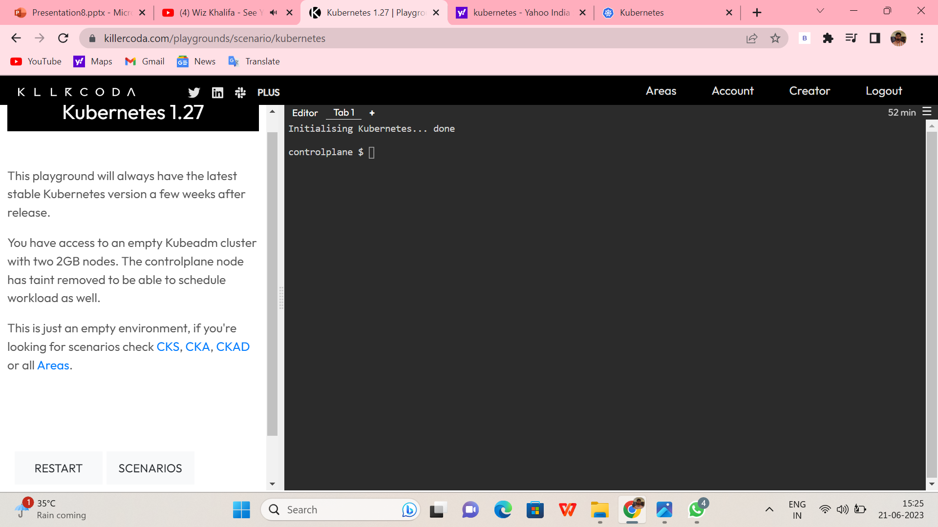
1. Create a Kubernetes cluster with one master node and one worker node.

Slide 6
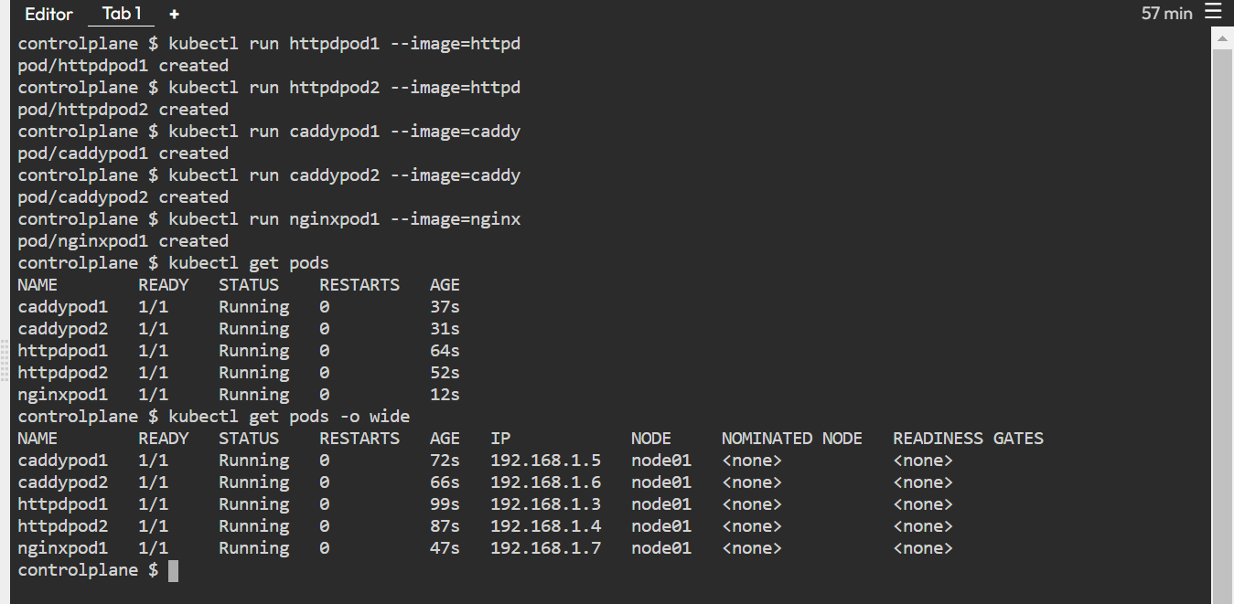
2. Deploy 5 pods with different names and using different container images (httpd, caddy, nginx). You can use the `kubectl run` command to create the pods directly from the command-line interface (CLI):

Slide 7
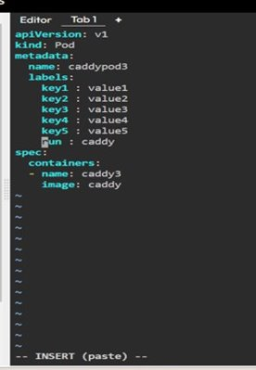
3. For the remaining five pods, create a YAML definition file for each pod and use the `kubectl create` command to create the pods from the definition files. Step1:
Step2:

Slide 8
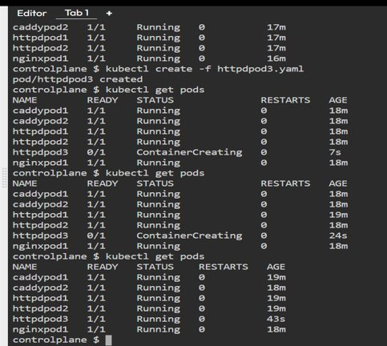
Step3:

Slide 9
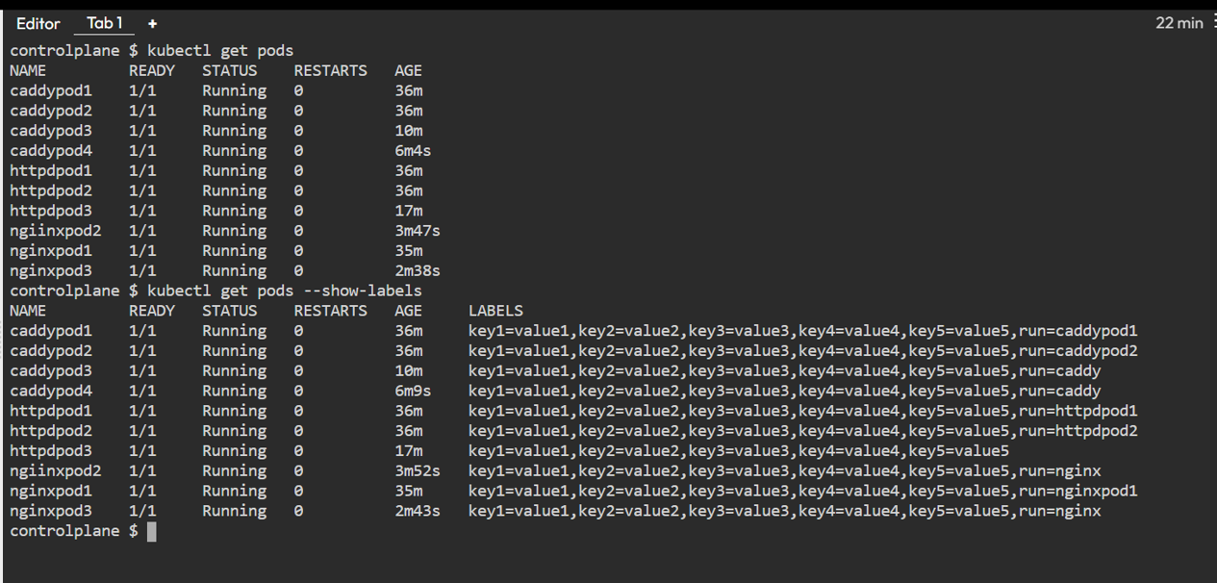
4. Assign labels to each pod using key-value pairs. You can assign five different labels with different values to each pod

Slide 10
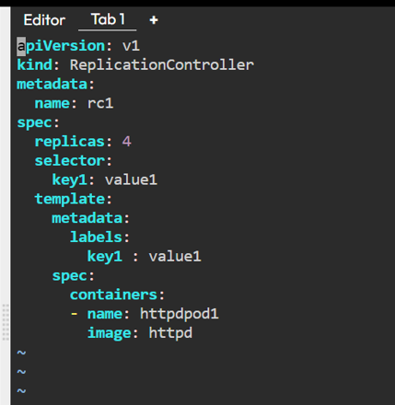
5. Create five ReplicationControllers (RC), each with a different label selector matching the labels assigned to the pods. Ensure that each RC has four replicas. You can create the RCs using YAML definition files or the `kubectl create` command. Step1:
Step2:

Slide 11

Step3:
6. Finally, create five Deployments, each representing a specific application or scenario. You can use the `kubectl create` command or create YAML definition files for the Deployments
Step1:

Slide 12
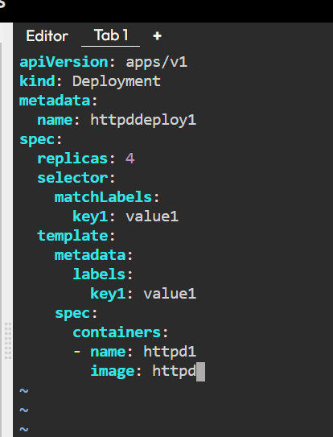

Step2:
Step3:

Slide 13
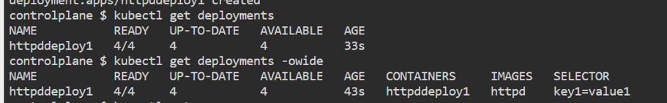
Once cross check the Deployments :

