Slide 1
Subtitle: Bluestock Fintech Capstone Project name: M Abhinaya Reddy Date: 12 June 2026
Title: Mutual Fund Analytics Platform

Slide 2
Problem & Objective
Data fragmentation across AMFI, NAV, SIP sources .
No unified risk-adjusted performance comparison .
No benchmark tracking for retail investors.
Static PDF reports with no drill-down capability

Slide 3
Data Sources
Dataset | Rows | Description
01_fund_master.csv | 40 | Master list of 40 mutual fund schemes
02_nav_history.csv | 46,000 | Daily NAV from Jan 2022 to May 2026
03_aum_by_fund_house.csv | 90 | Quarterly AUM for 10 fund houses
04_monthly_sip_inflows.csv | 48 | Monthly SIP inflow data
05_category_inflows.csv | 144 | Net inflows by fund category
06_industry_folio_count.csv | 21 | Total MF folios over time
07_scheme_performance.csv | 40 | Returns, Sharpe, Alpha, Beta, Drawdown
08_investor_transactions.csv | 32,778 | SIP/Lumpsum/Redemption transactions
09_portfolio_holdings.csv | 322 | Equity holdings per fund
10_benchmark_indices.csv | 8,050 | Nifty 50, Nifty 100, BSE SmallCap

Slide 4
System Architecture
Layer 1 — Extract: AMFI CSVs, mfapi.in REST API
Layer 2 — Transform: Pandas cleaning, forward-fill NAV, validate AMFI codes
Layer 3 — Load: SQLite star schema (5 tables)
Layer 4 — Analyse: Jupyter notebooks, risk metrics
Layer 5 — Visualise: Power BI dashboard (4 pages)

Slide 5
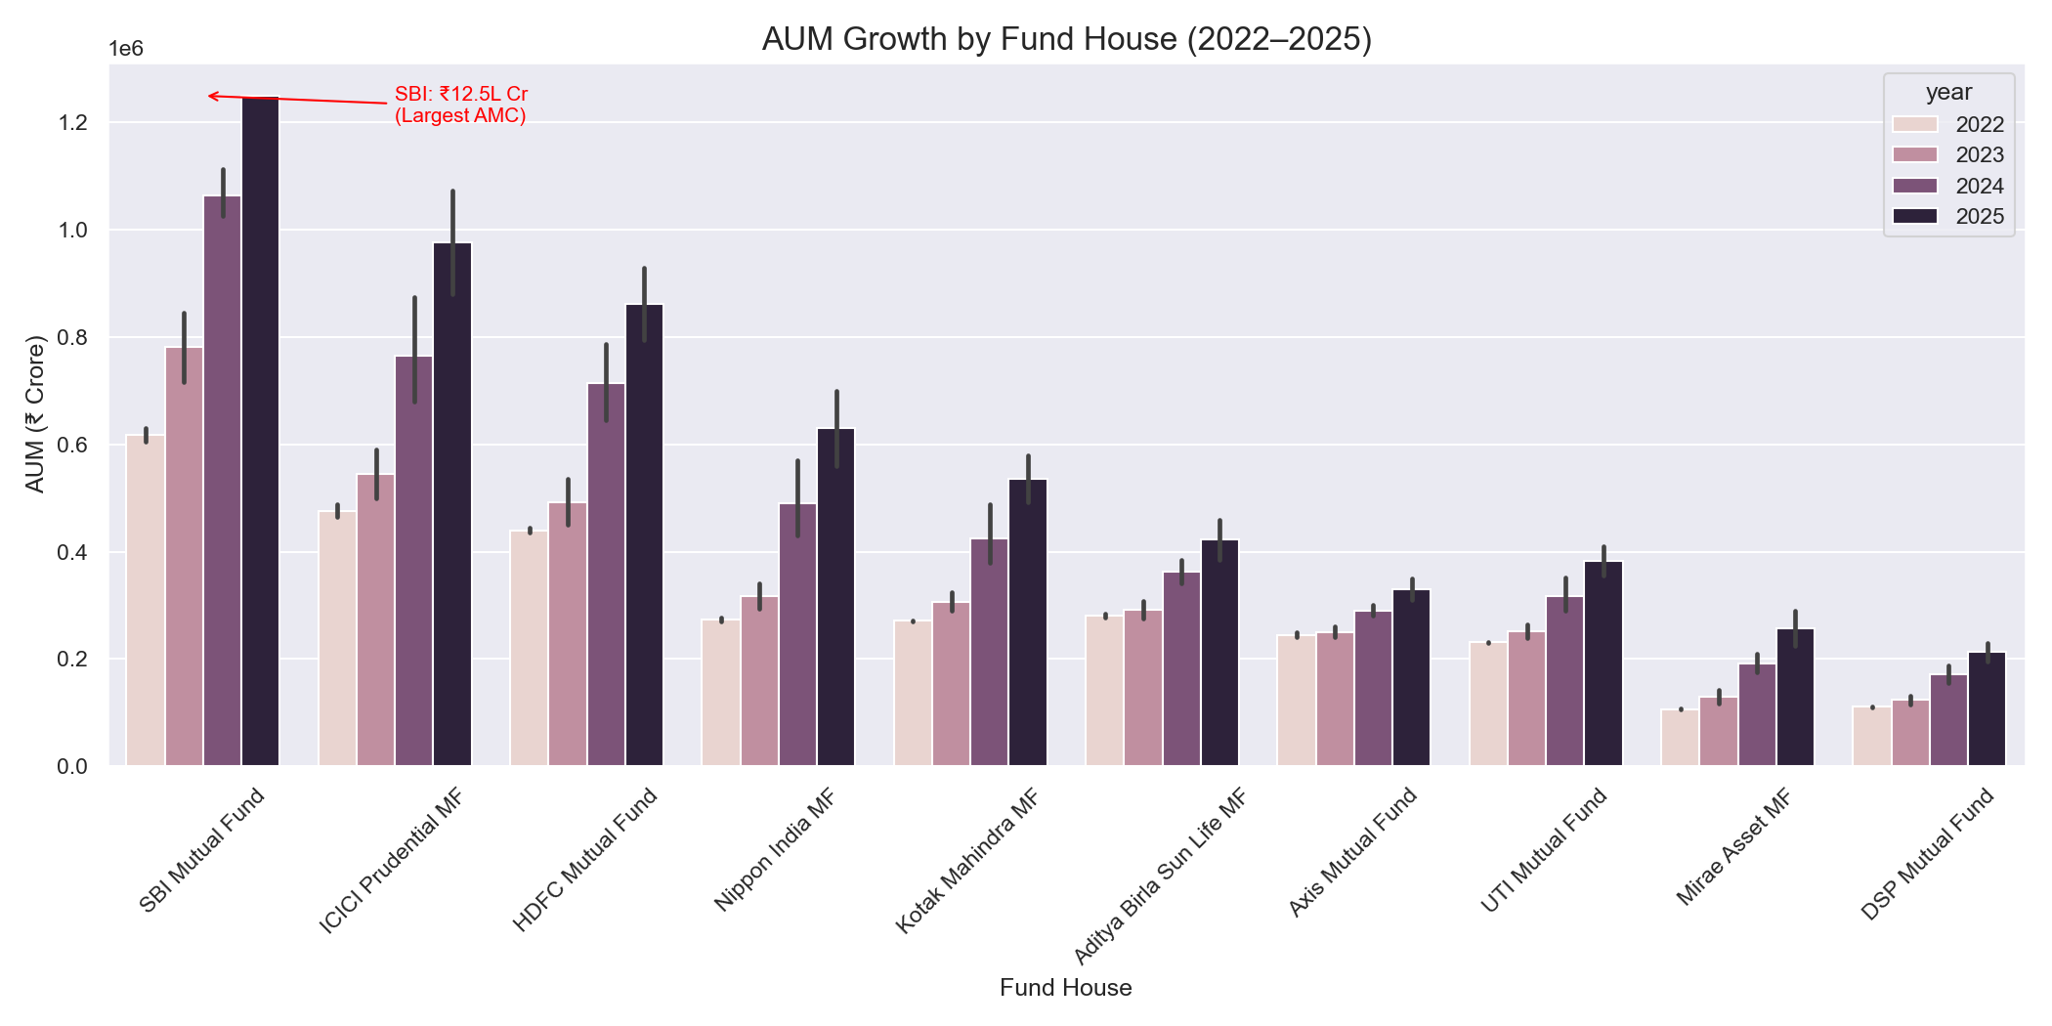
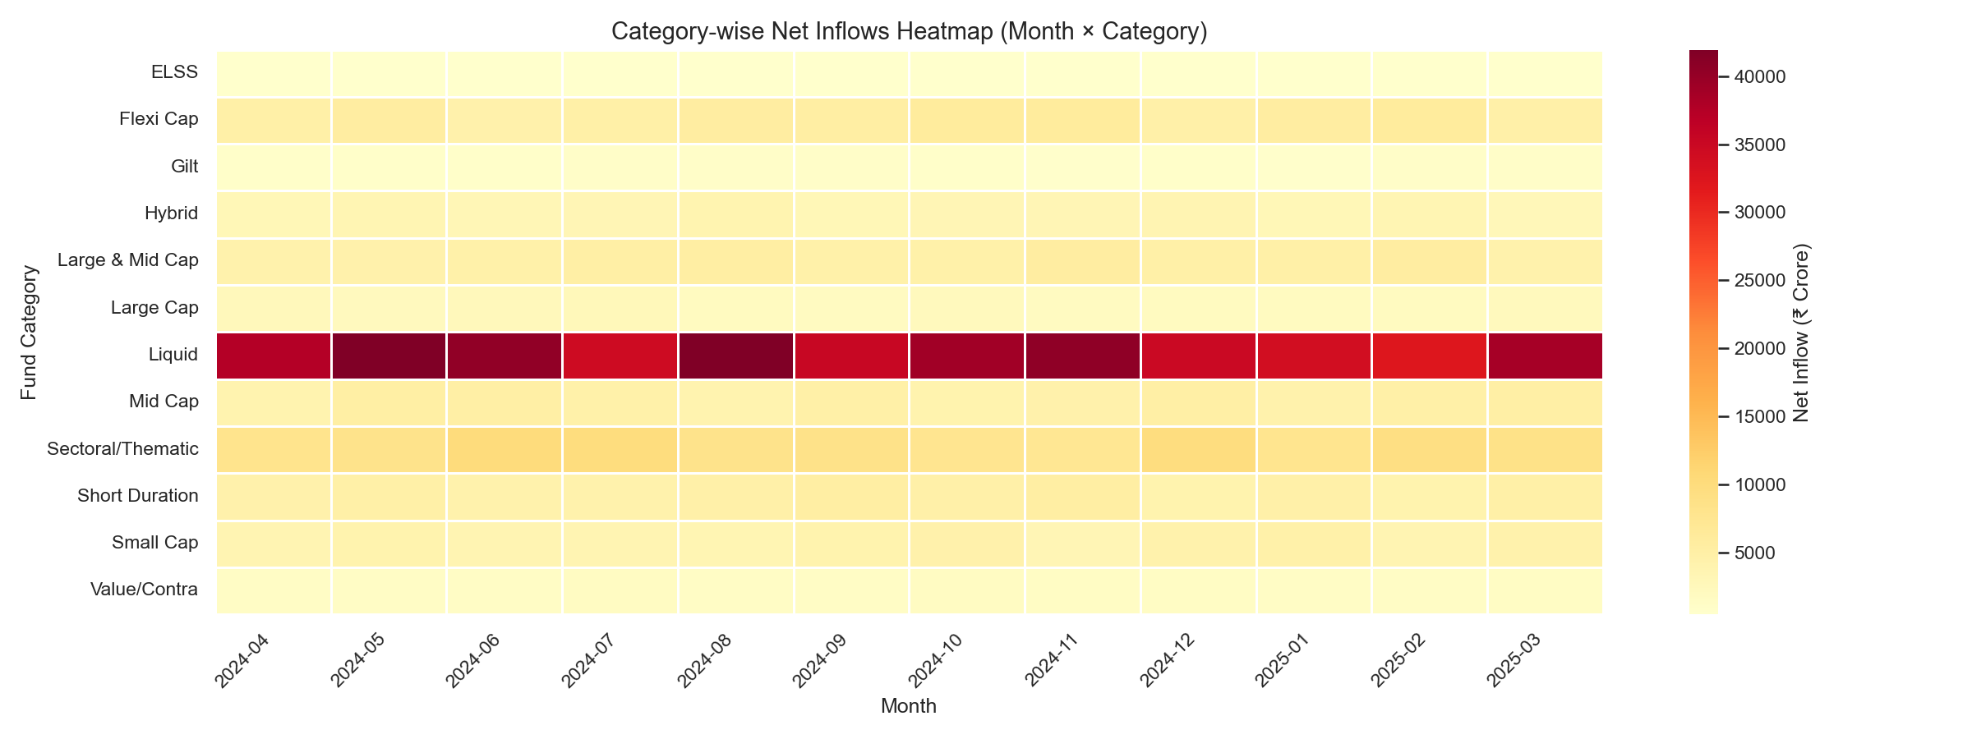
EDA Highlights — Market Trends
SBI dominates AUM at ₹12.5L Cr in 2025
Liquid funds receive highest inflows consistently

Slide 6
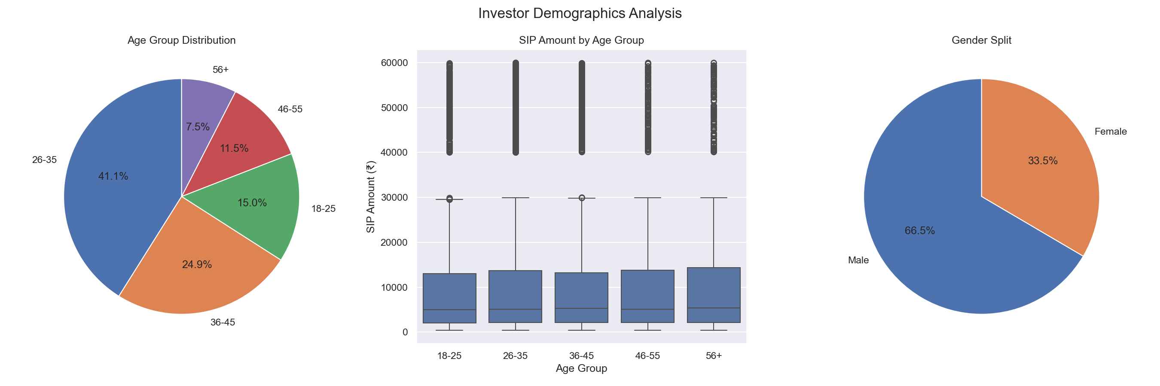
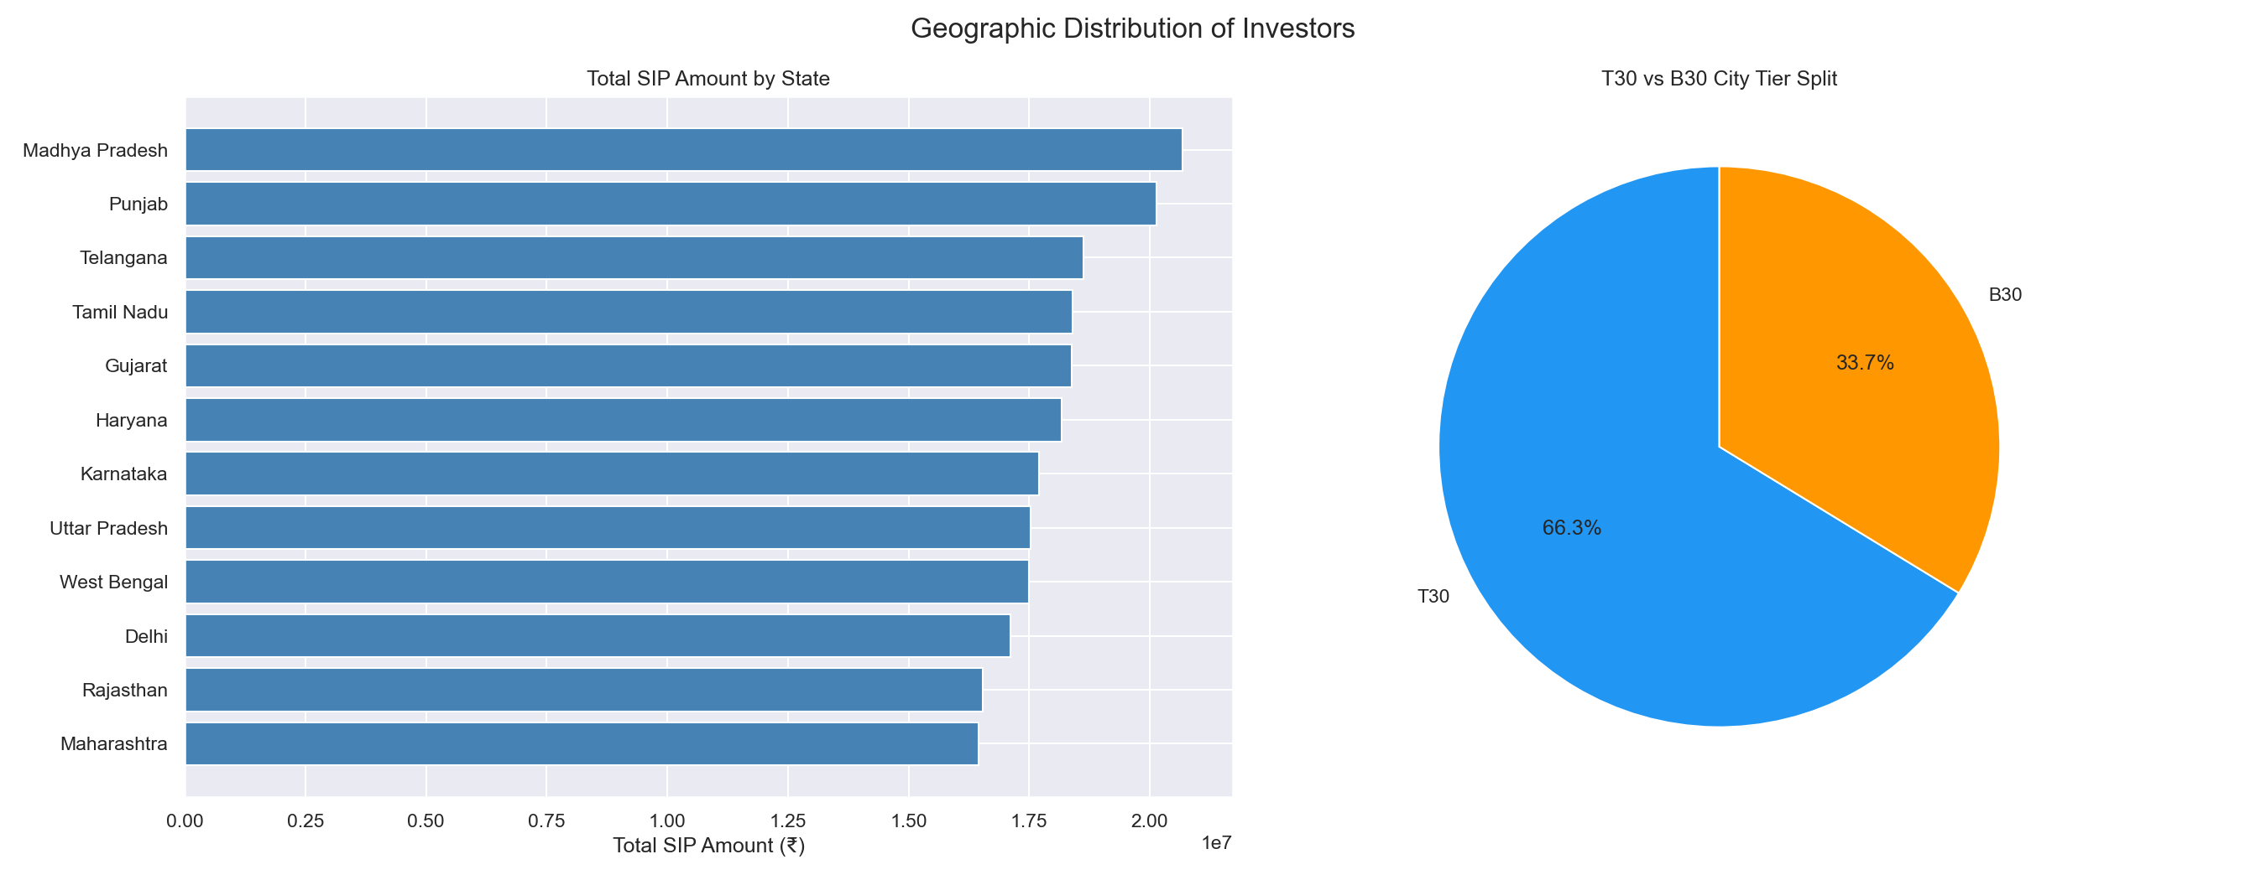
EDA Highlights — Investor Insights
26-35 age group drives 41.1% of investments
66.3% of investors from T30 cities

Slide 7
Fund Performance Analytics
Metric | Formula | Top Fund
CAGR (3yr) | (NAV_end/NAV_start)^(1/n) - 1 | Axis Midcap 35.1%
Sharpe Ratio | (Rp - Rf) / Std × √252 | Mirae Asset 1.07
Sortino Ratio | (Rp - Rf) / Downside Std × √252 | Mirae Asset 1.49
Max Drawdown | min(NAV / running_max - 1) | SBI Small Cap -52.57%
ICICI Pru Midcap ranked #1 in composite fund scorecard (score 85.13)

Slide 8
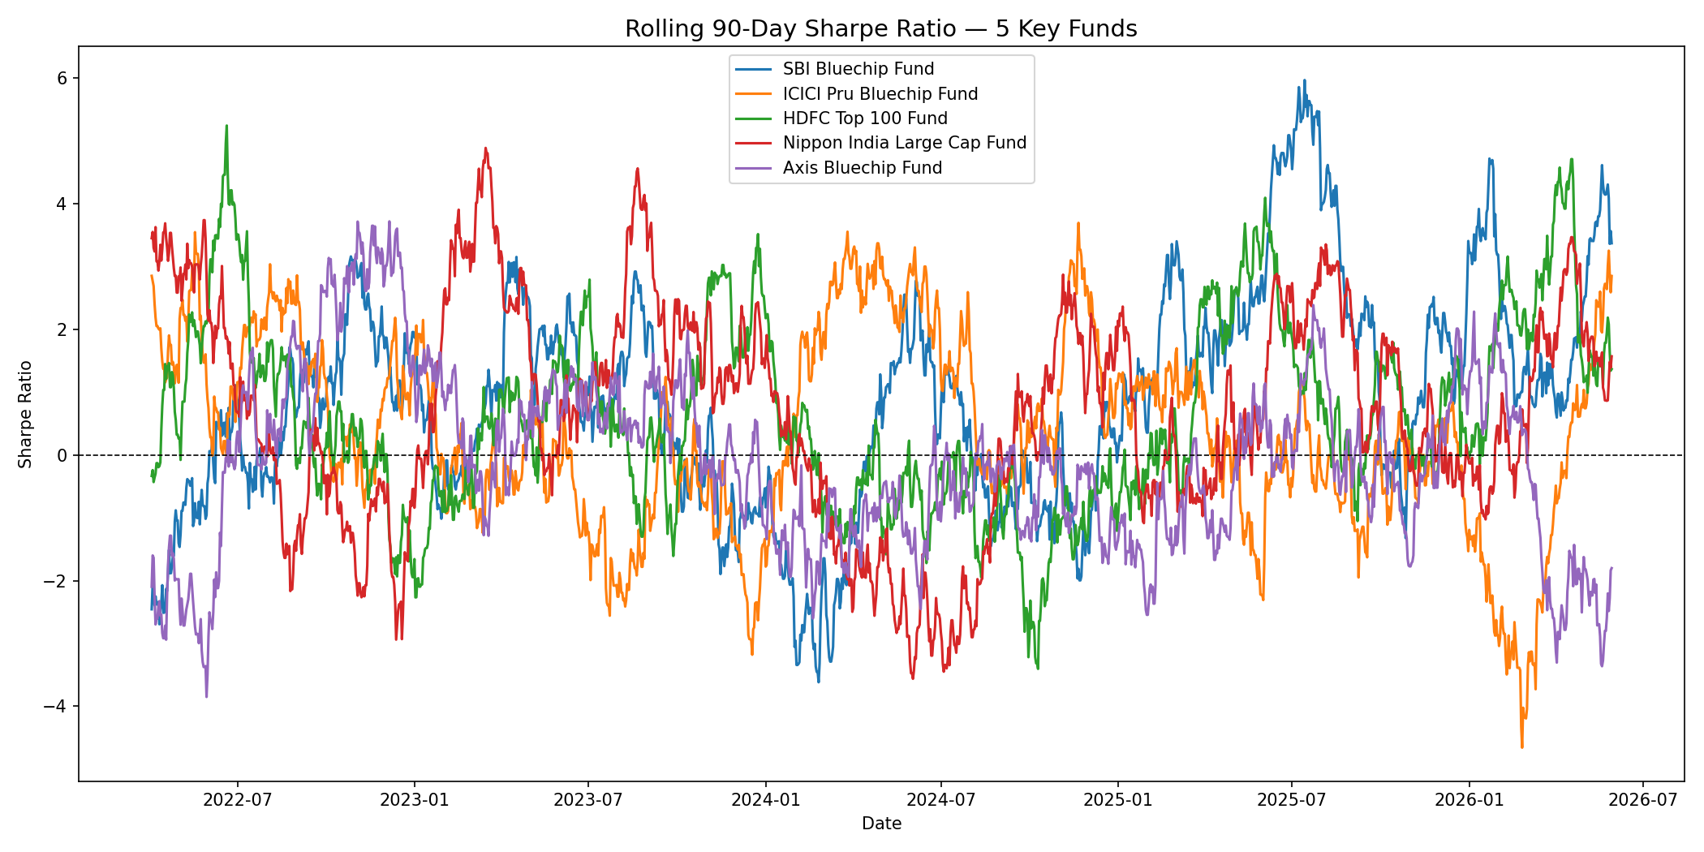
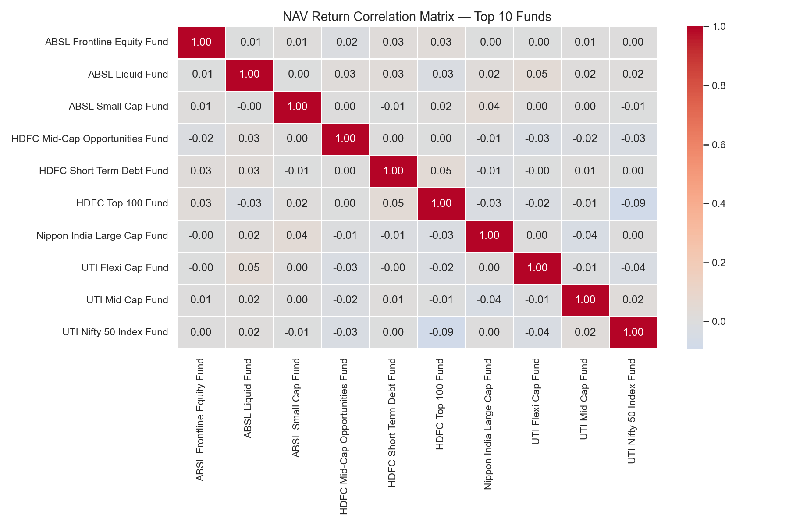
Risk Analysis
Fund correlations near zero — strong diversification benefit
Small Cap funds have highest VaR up to -2.39% daily

Slide 9
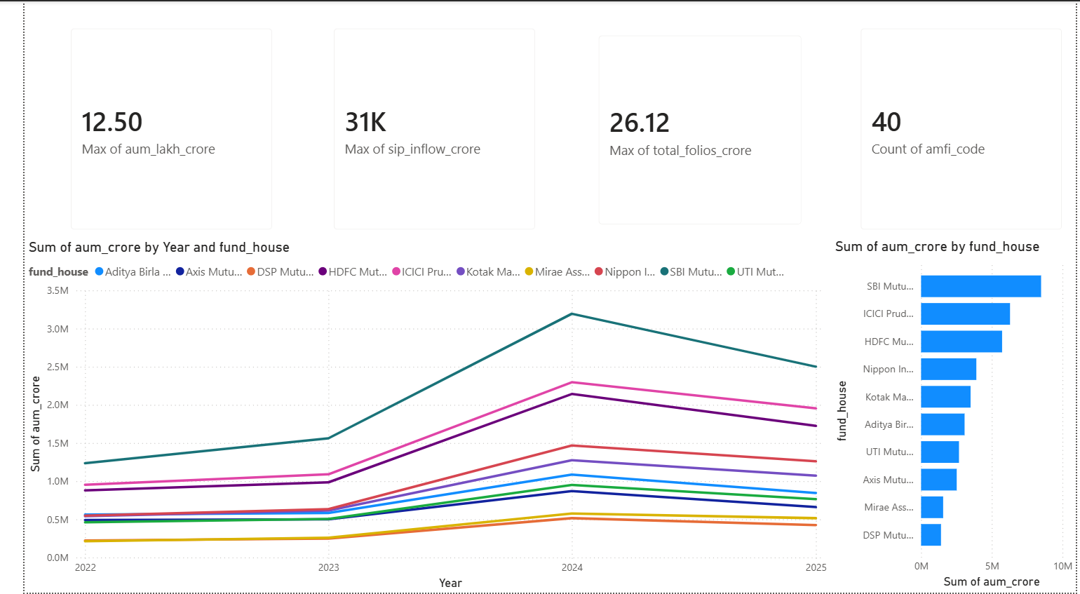
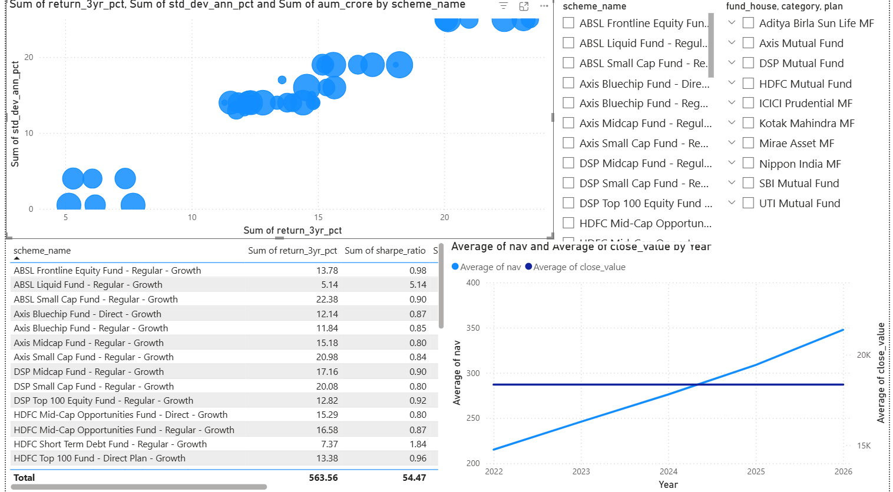
Power BI Dashboard — Industry Overview & Fund Performance

Slide 10
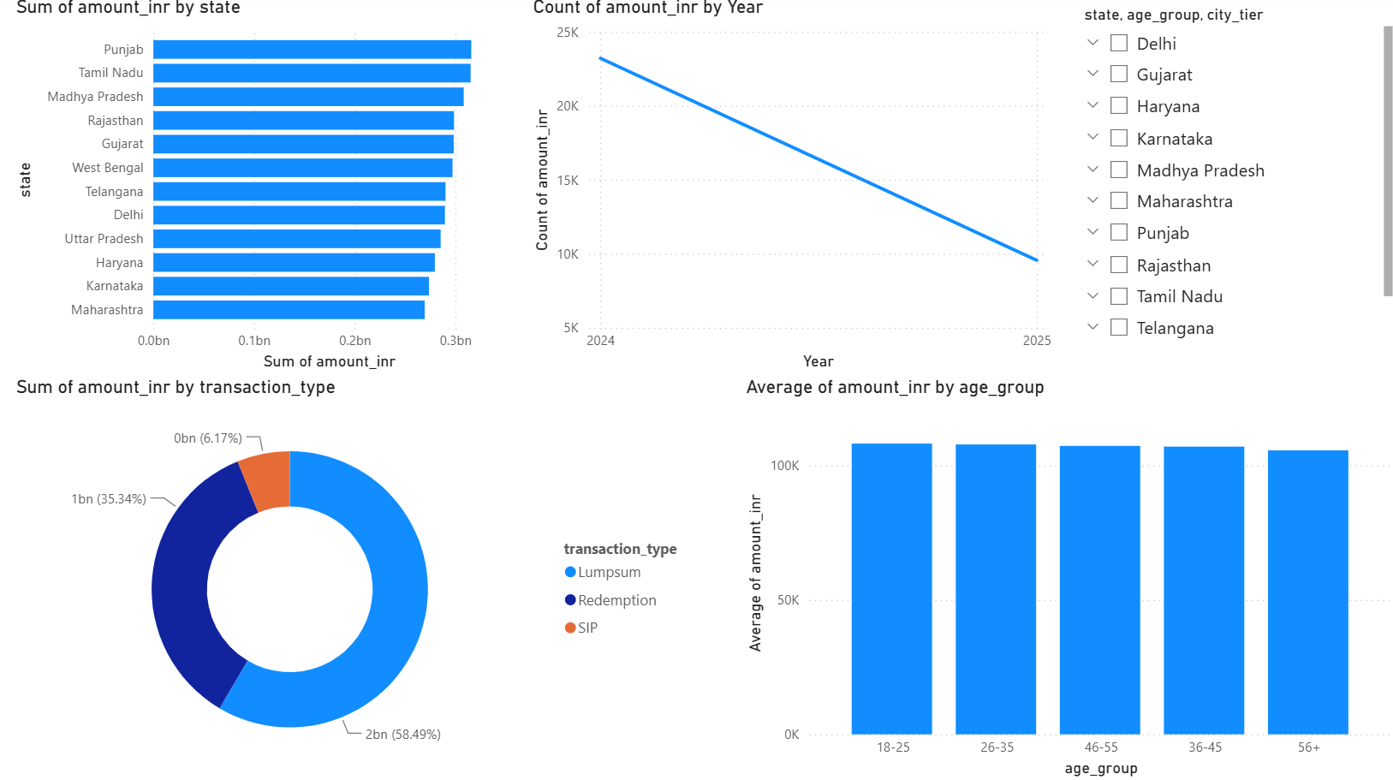
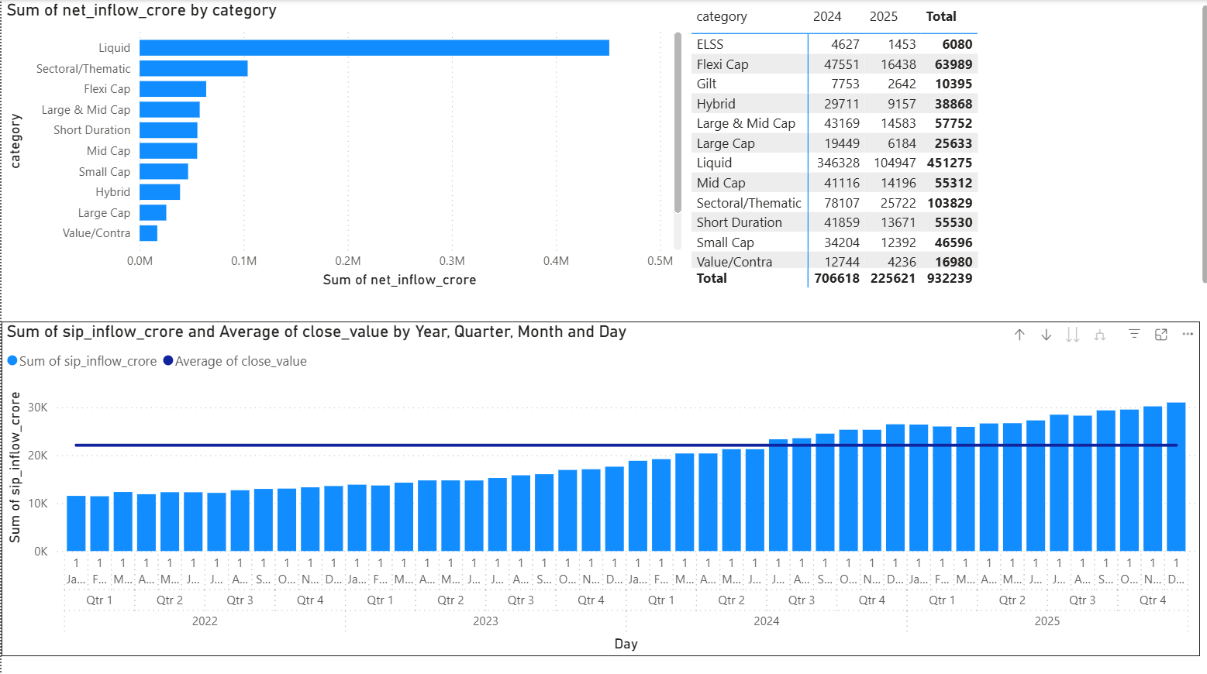
Power BI Dashboard — Investor Analytics & SIP Trends

Slide 11
Key Findings & Recommendations
Findings:
SBI is India's largest AMC at ₹12.5L Cr AUM
SIP inflows grew 3x to ₹31,002 Cr in 4 years
97.8% of SIP investors are irregular — avg gap 64.9 days
ICICI Pru Midcap is best composite performer
Small Cap funds carry highest risk (VaR -2.39%)
Recommendations:
AMCs should send SIP reminders to at-risk investors
Retail investors should prefer Moderate risk funds for stable returns
Banking sector concentration (19.2%) needs monitoring

Slide 12
Thank you
Bluestock Fintech Mutual Fund Analytics Platform
M Abhinaya Reddy
GitHub: github.com/abhinay1-11/bluestock_mf_capstone
Email: abhinaya11171@gmail.com

