Slide 1
DOCUMENT IDENTIFICATION WITH CONVOLUTIONAL NEURAL NETWORKS

Slide 2
RVL-CDIP DATASET
Ryerson Vision Lab Complex Document Information Processing
Data consists of digitally scanned documents of various types.
Presplit into 320,000 training, 40,000 validation, and 40,000 testing images
20,000 training per class, 2500 testing and validation per class
16 document classes: letter, form, email, handwritten, advertisement, scientific report, scientific publication, specification, file folder, news article, budget, invoice, presentation, questionnaire, resume, and memo

Slide 3
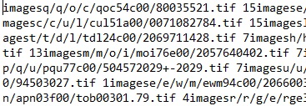
DATA CLEANING
0. letter
1. form
2. email
3. handwritten
4. advertisement
5. scientific report
6. scientific publication
7. specification
8. file folder
9. news article
10. budget
11. invoice
12. presentation
13. questionnaire
14. resume
15. memo
Image paths in yellow, class labels in red

Slide 4
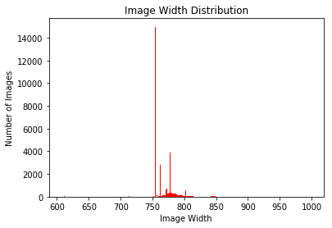
All image dimensions are 1000 pixels or less, though this will be scaled down for training efficiency

Slide 5
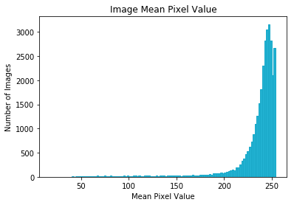
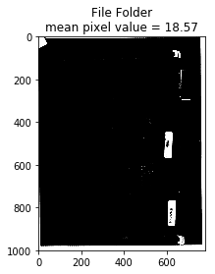
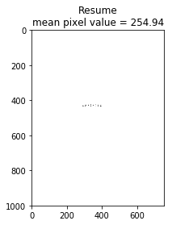

Slide 6
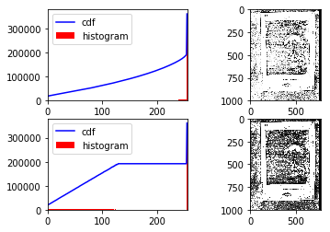
PREPROCESSING
Histogram Equalization

Slide 7
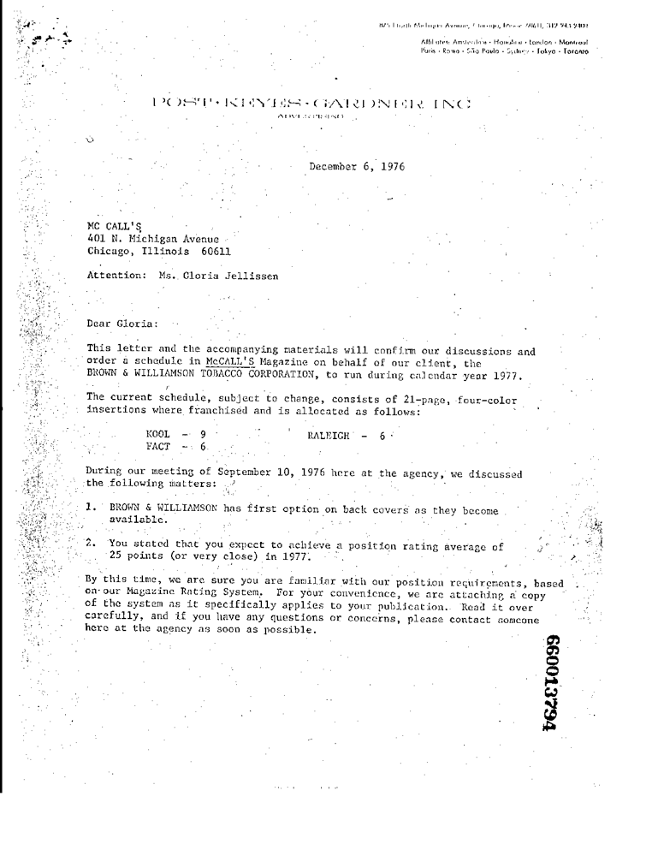

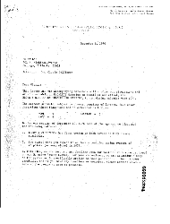


(1000, 782)
(500, 381)
(250, 190)
(125, 95)
(62, 47)

Slide 8
FINAL DATASET

Slide 9
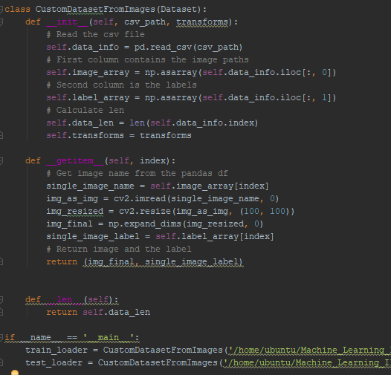
PyTorch
Loading custom dataset requires a custom data loader wrapped around PyTorch’s Dataset class
Create .csv for each dataset with two columns:
Full image path
Class labels
Results in data in format:
([Image_tensor], label_tensor)

Slide 10

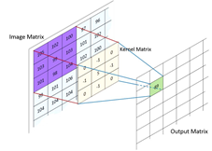
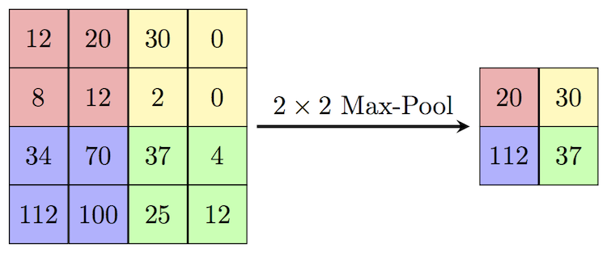
Convolutional Neural Networks
Convolutional Neural Network
Convolutional Layers
Stride over image with various number of weight matrices to detect edges and patterns
Parameters include: Kernel Size, Stride, Padding
Activation
ReLU
Max Pooling Layers
Shrink images based on maximum
value in kernel
Flatten
Flatten into 1d array
Fully Connected Layer
Fully connected layer
Softmax Output
Class probability

Slide 11
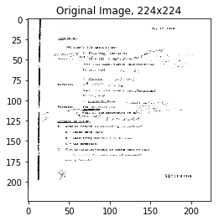
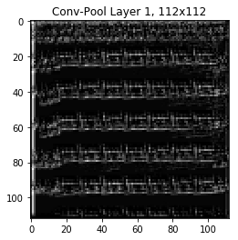
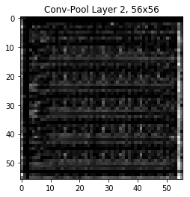
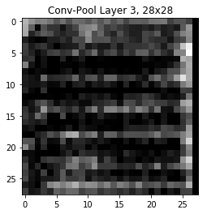
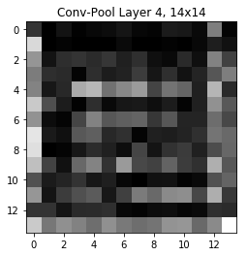
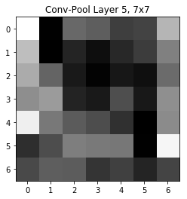

Slide 12
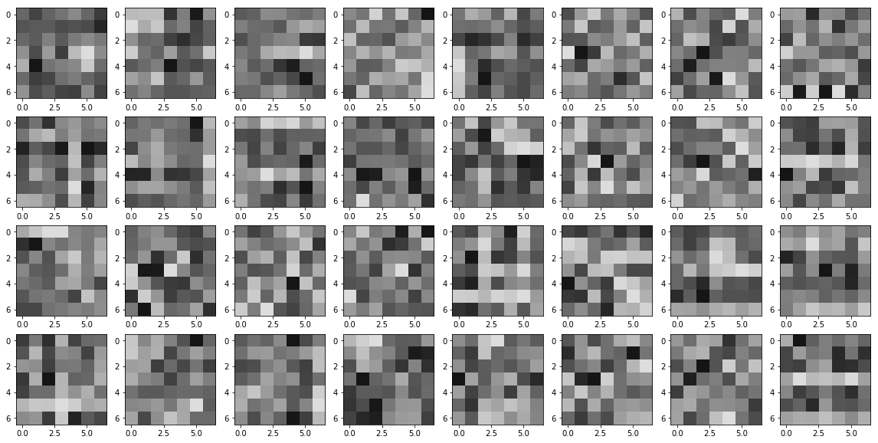
Initial Model (1st Conv Layer, 7x7 kernel)

Slide 14

