Slide 1
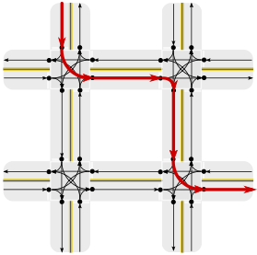
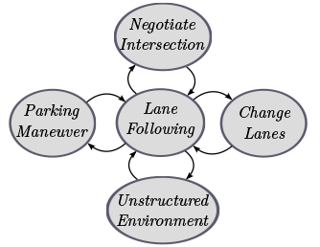
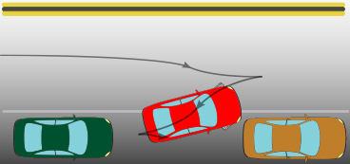
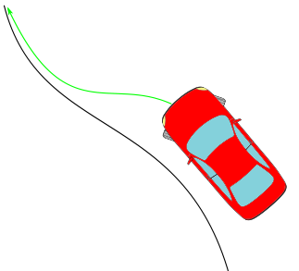
Raw sensor data
Perception
Localisation
Environment recognition
Perceived objects and signage
Decision
Route planning
Behavioural planning
Motion planning
Reference trajectory
Control
Local feedback
Throttle/steering commands

