Slide 1
Semiconductor Fundamentals
OUTLINE
General material properties
Crystal structure
Crystallographic notation
Read: Chapter 1

Slide 2
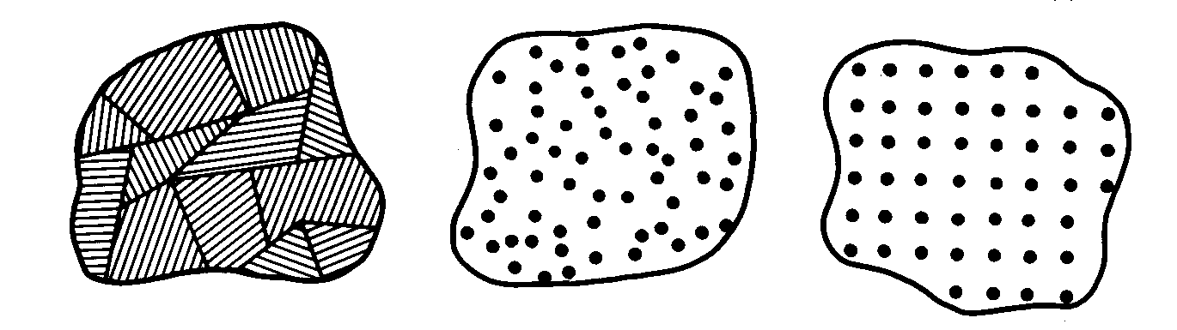
What is a Semiconductor?
Low resistivity => “conductor”
High resistivity => “insulator”
Intermediate resistivity => “semiconductor”
  conductivity lies between that of conductors and insulators
  generally crystalline in structure for IC devices
    In recent years, however, non-crystalline semiconductors have become commercially very important
polycrystalline amorphous crystalline

Slide 3
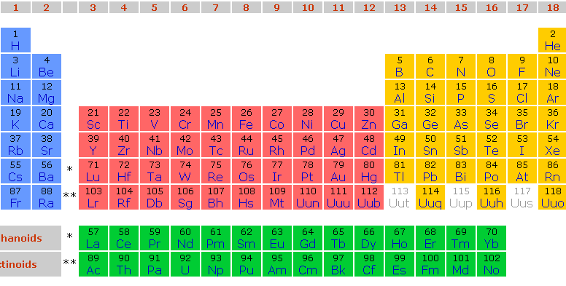
Semiconductor Materials
  Elemental:
  Compound:
  Alloy:

Slide 4
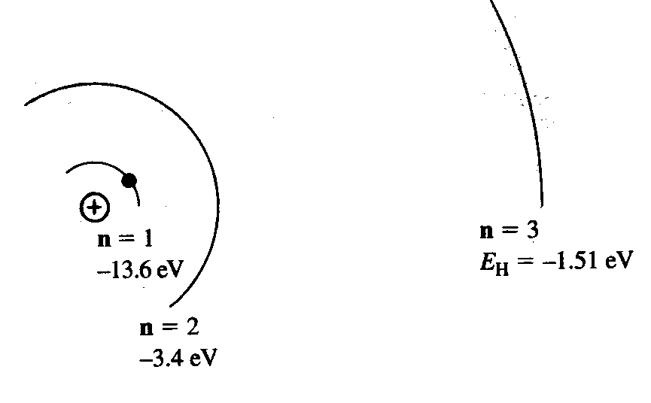
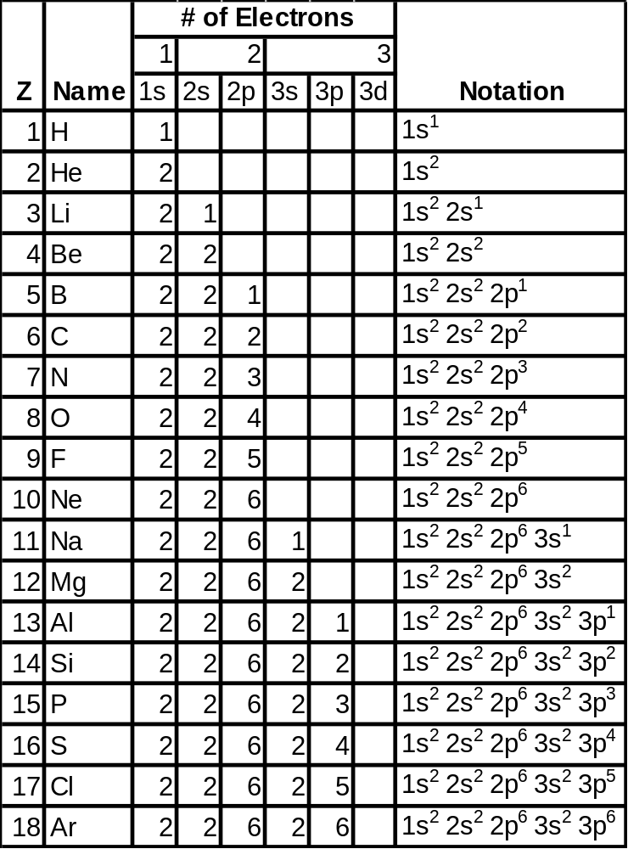
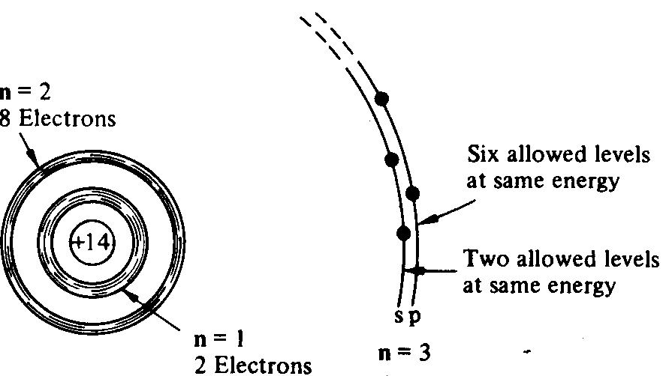
From Hydrogen to Silicon

Slide 5
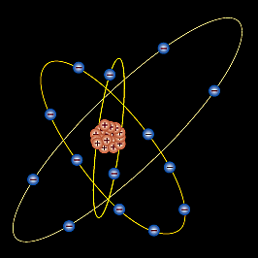
The Silicon Atom
14 electrons occupying the 1st 3 energy levels:
  1s, 2s, 2p orbitals filled by 10 electrons
  3s, 3p orbitals filled by 4 electrons
    To minimize the overall energy, the 3s and 3p orbitals hybridize to form 4 tetrahedral 3sp orbitals
      Each has one electron and
      is capable of forming a bond
      with a neighboring atom

Slide 6
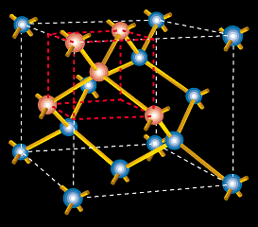
The Si Crystal
Each Si atom has 4 nearest neighbors
lattice constant
= 5.431Å
“diamond cubic” lattice

Slide 7
How Many Silicon Atoms per cm⁻³?
Number of atoms in a unit cell:
  4 atoms completely inside cell
  Each of the 8 atoms on corners are shared among cells
  → count as 1 atom inside cell
  Each of the 6 atoms on the faces are shared among 2
  cells → count as 3 atoms inside cell
  Total number inside the cell = 4 + 1 + 3 = 8
Cell volume:
  (.543 nm)³ = 1.6 x 10⁻²² cm³
Density of silicon atoms
  = (8 atoms) / (cell volume) = 5 x 10²² atoms/cm³

Slide 8
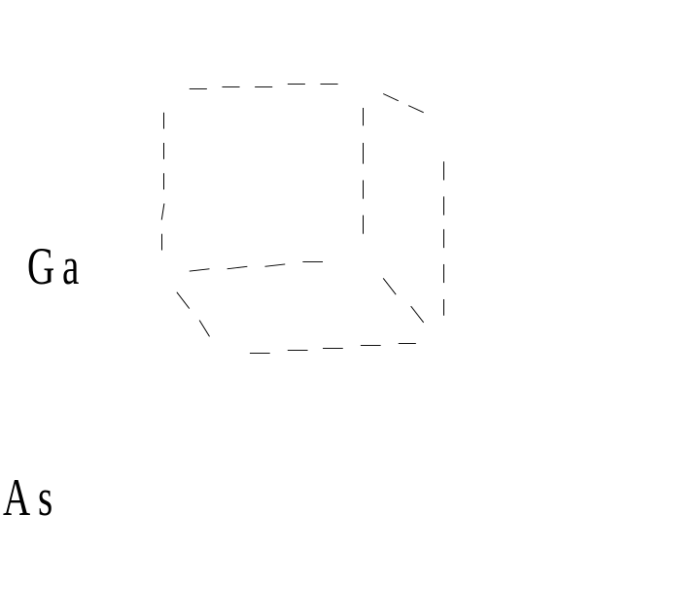
Compound Semiconductors
“zincblende” structure
III-V compound semiconductors: GaAs, GaP, GaN, etc.
  important for optoelectronics and high-speed ICs

Slide 9
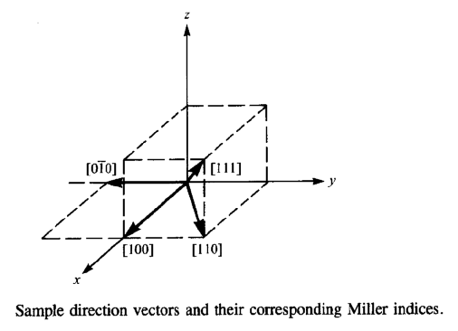
Crystallographic Notation
Miller Indices:
Notation | Interpretation
( h k l ) | crystal plane
{ h k l } | equivalent planes
[ h k l ] | crystal direction
< h k l > | equivalent directions
h: inverse x-intercept of plane
k: inverse y-intercept of plane
l: inverse z-intercept of plane
(Intercept values are in multiples of the lattice constant;
h, k and l are reduced to 3 integers having the same ratio.)

Slide 10
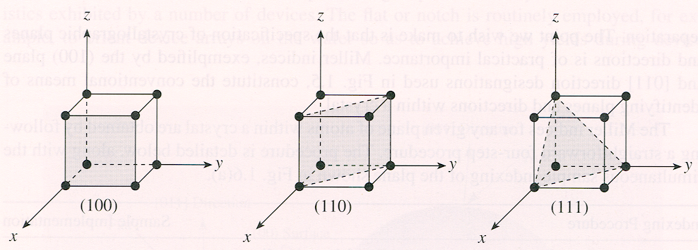
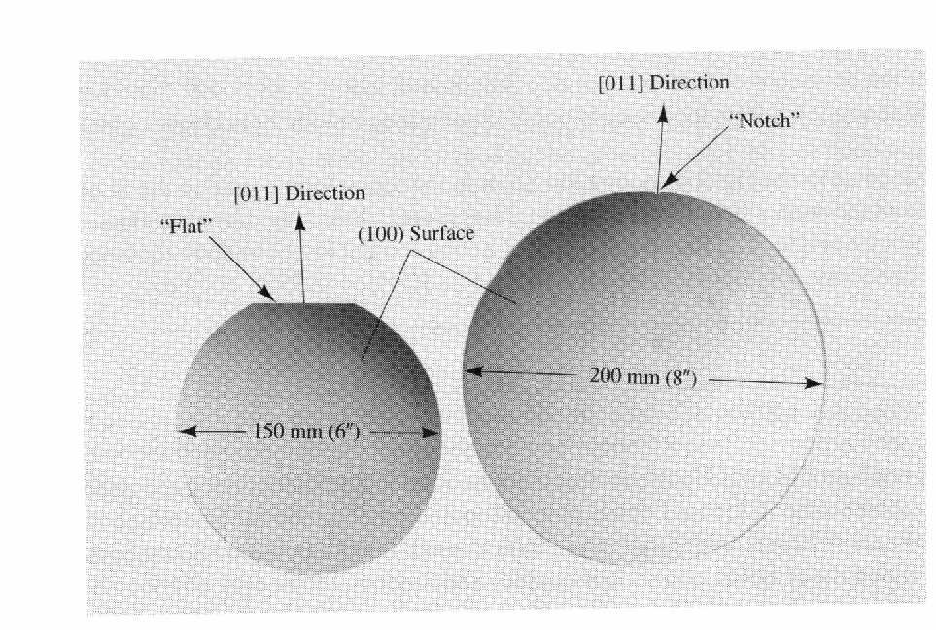
Crystallographic Planes and Si Wafers
Silicon wafers are usually cut along a {100} plane with a flat or notch to orient the wafer during IC fabrication:

Slide 11
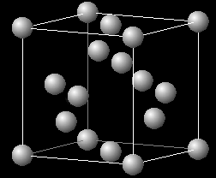
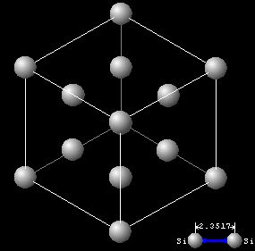
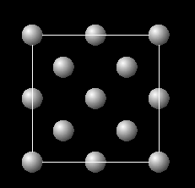
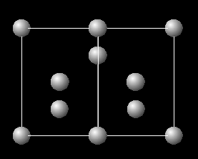
Crystallographic Planes in Si
Unit cell:
View in <111> direction
View in <100> direction
View in <110> direction

Slide 12
Summary
Crystalline Si:
  4 valence electrons per atom
  diamond lattice
    each atom has 4 nearest neighbors
  5 x 10²² atoms/cm³
Crystallographic notation
  Miller indices are used to designate planes and directions within a crystalline lattice

