Slide 1


Slide 2

Web Scraping and Exploratory Data Analysis
Data Collection
1.We have chosen the website MyCar.mu
2.This website features a variety of cars from different companies , including both new and second-hand vehicles
Features
Price: Cost of the car
Owner: Owner's name or indication if it's a second-hand or new car
Hybrid/Petrol: Indication of whether the car runs on oil or electric
Kilometers: Number of kilometers the car has traveled if it's second-hand
EMI per Month: Amount to be paid monthly
ref: Reference ID of the car
date: Date when the car model come
TEAM MEMBERS
MAHESH SAI
R.ABHINAY
GEETHA

Slide 3
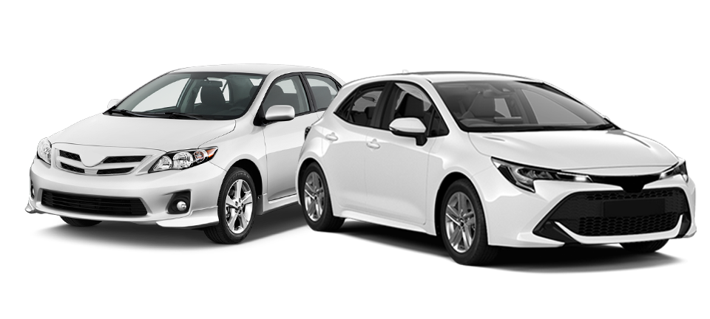
Problem statement
Based on customer requirements, we provide accurate information about new and used cars, including EMI options, pricing, and fuel type (petrol, diesel, hybrid, etc.).Additionally ,Who has listed the car on this website.

Slide 4
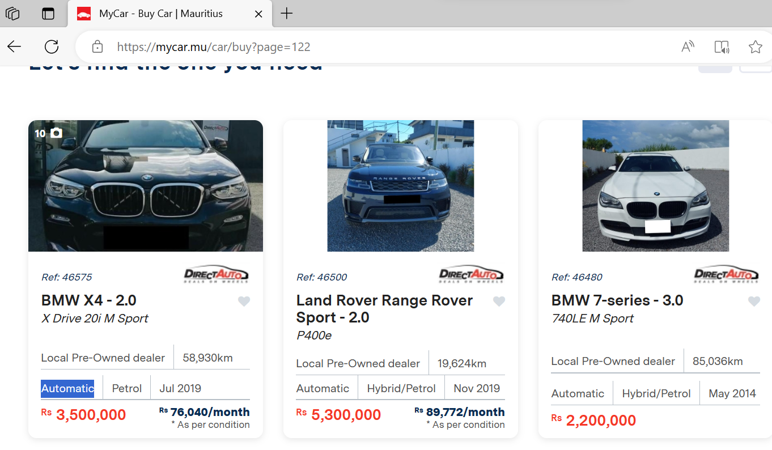
Out look of MYCar.mu

Slide 5
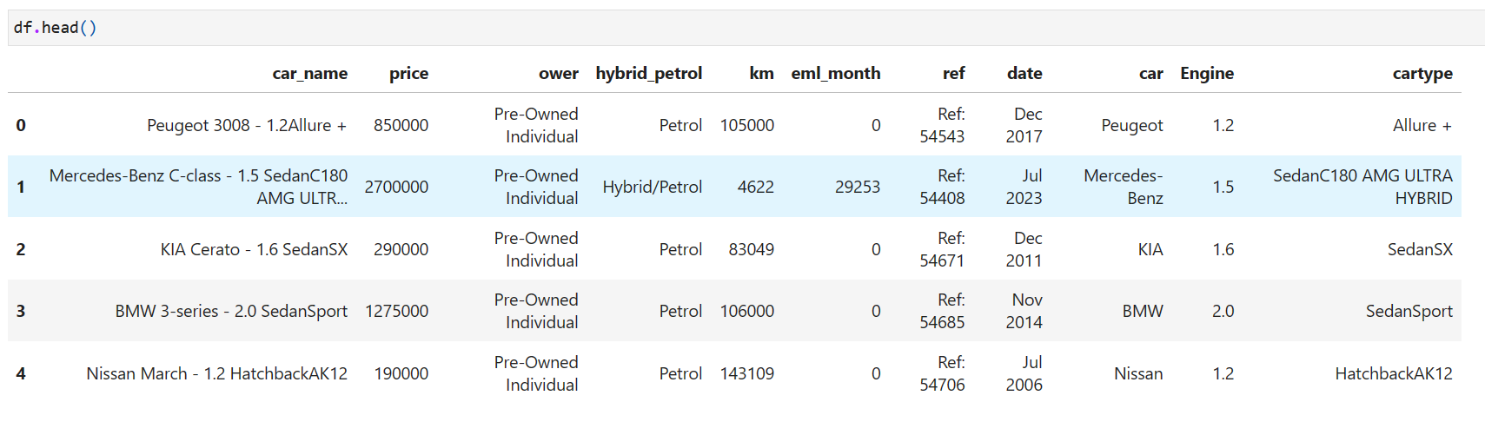
About Data set

Slide 6
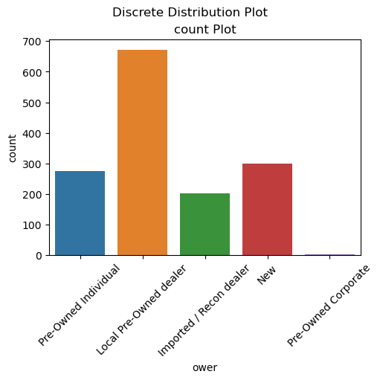
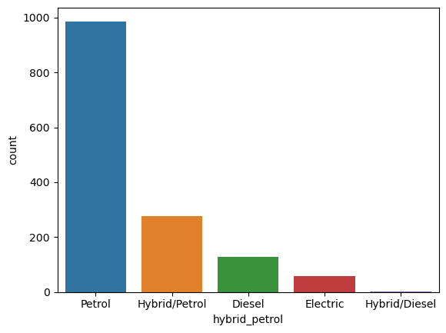
Most of the cars on this website are from local pre-owned dealers.
Most of the cars are running by petrol

Slide 7
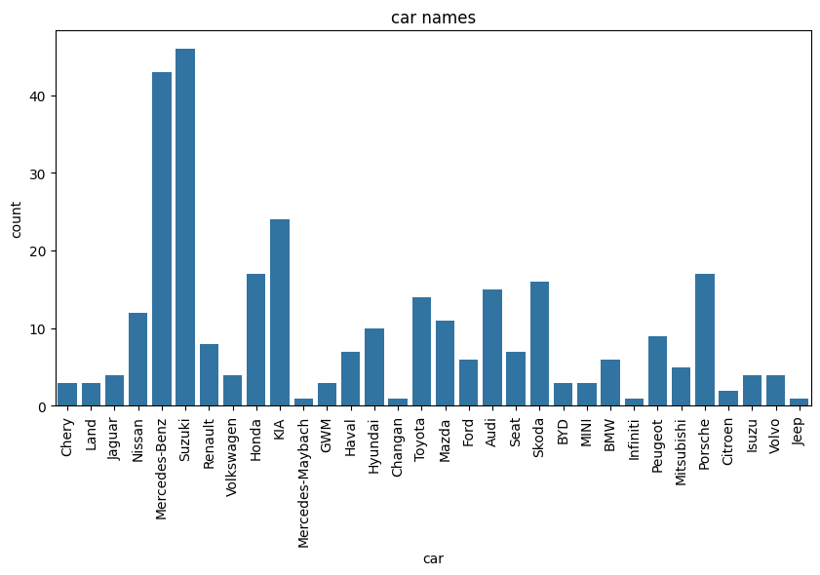
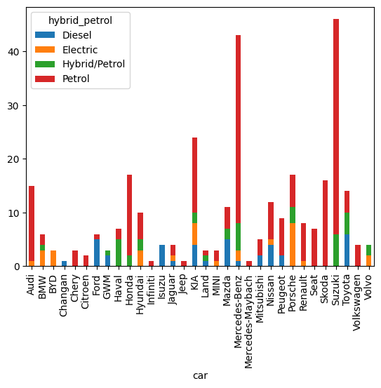
On this website, there is a higher presence of new Suzuki and Mercedes-Benz cars.
NEW - CARS
Most of the cars on this website are running by petrol, while some vehicles feature diesel, electric, and hybrid/petrol options.

Slide 8
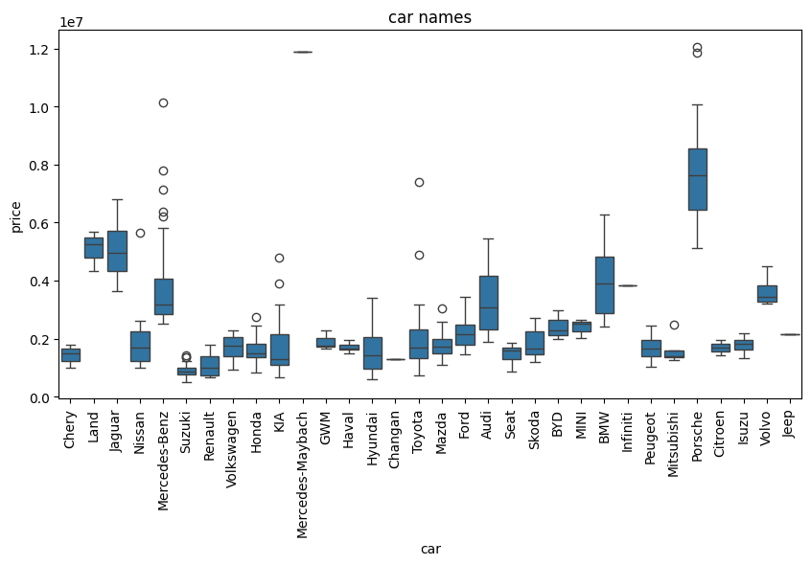
Here, the price distribution of the cars shows that Porsche cars have the highest prices among all the cars

Slide 9
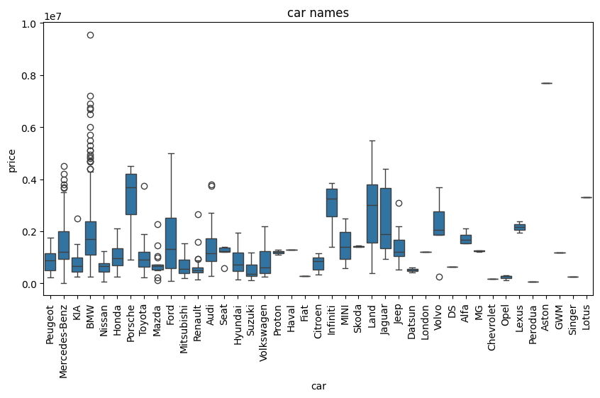
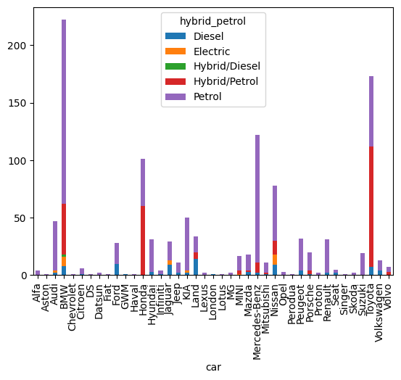
SECOUND-HAND-CARS
Here, in the second-hand cars, BMW cars have the highest prices among all the cars.
Most cars are running by petrol or hybrid/petrol, while hybrid/diesel cars are very rare.

Slide 10
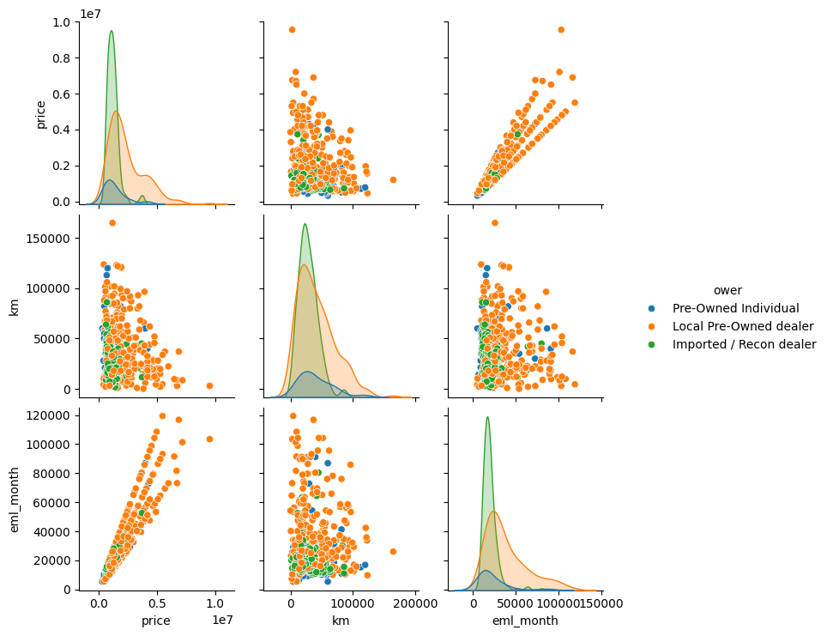
There is a strong relationship between the price and local pre-owned dealers, whereas there is a strong relationship between the monthly EMI and local pre-owned dealers.
CARS WITH EMI_MONTHLY

Slide 11
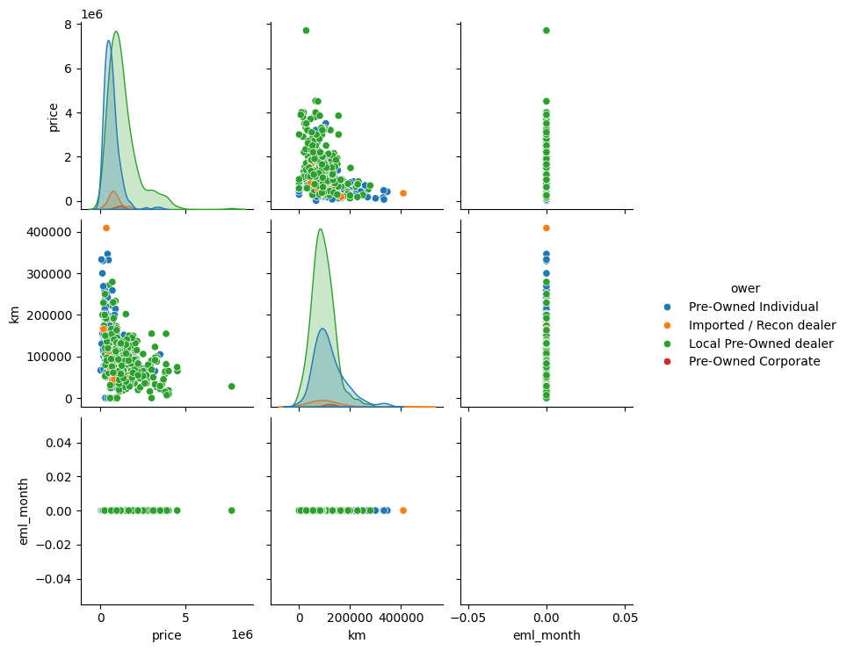
There is a strong relationship between the price and local pre-owned dealers
CARS NOT AVAILABLE EMI_MONTHLY

Slide 12
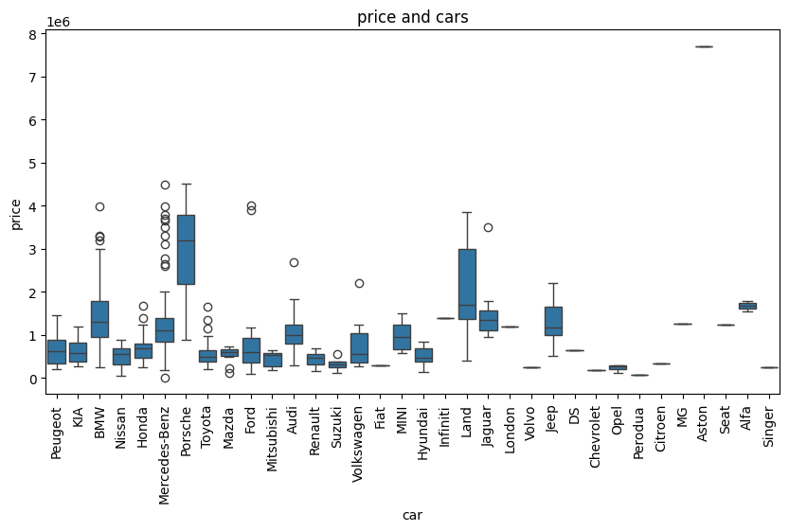
Here, in the cars not available emi monthly. Porsche ,land cars have the highest prices among all the cars.

Slide 13
CONCLUSION
1.The higher presence of new Suzuki and Mercedes-Benz cars because of petrol usage other company should also provide petrol usage like Volvo ,ISUZU ,BYO , Changan company cars.
2.Porsche and land company cars high in price no emi monthly ,company should provided offers and Discounts on sales.
3.Secound hand cars BMW , ford ,Land company high prices according vehicle condition and kilometers reading price should determine.
4.There mostly petrol usage and Diesel. Company’s should be provided to electric vehicles petrol and Diesel also to sales more cars.
5.Local pre- owned dealer mostly other dealers should get knowledge about
cars details implement better offers to customers.
Website: https://mycar.mu/car/buy

Slide 14


