Slide 1

ProjectStatement -Enhancing Search Engine Relevance for Video Subtitles
Linkedin :https://www.linkedin.com/posts/abhinay-rachakonda_machinelearning-nlp-internship-activity-7188902893033349121-5jr7?utm_source=share&utm_medium=member_desktop
Gihub:https://github.com/abhinay9505/Search-Engine-Project-
TEAM:
Rachakonda ABHINAY(IN1241214)
Vavilapalli JAYAKUMAR(IN1240687)

Slide 2
Background:
In the fast-evolving landscape of digital content, effective search engines play a pivotal role in connecting users with relevant information. For Google, providing a seamless and accurate search experience is paramount. This project focuses on improving the search relevance for video subtitles, enhancing the accessibility of video content.
Objective: Develop an advanced search engine algorithm that efficiently retrieves subtitles based on user queries, with a specific emphasis on subtitle content. The primary goal is to leverage natural language processing and machine learning techniques to enhance the relevance and accuracy of search results.

Slide 3
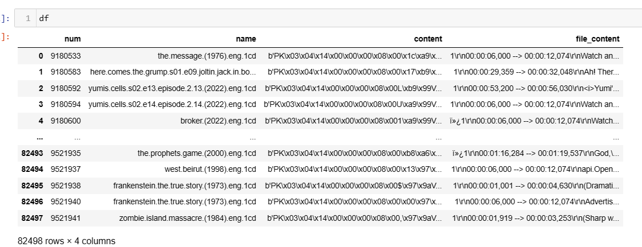
DATA COLLECTION:
Download the dataset and convert it from a .db file into a pandas DataFrame while we extract latin-1 to extract information from it.
Subsequently, select a representative subset comprising 30% of the data for analysis and processing.
This reduced dataset size ensures efficient computational handling while maintaining adequate data diversity for comprehensive exploration and modeling.

Slide 4
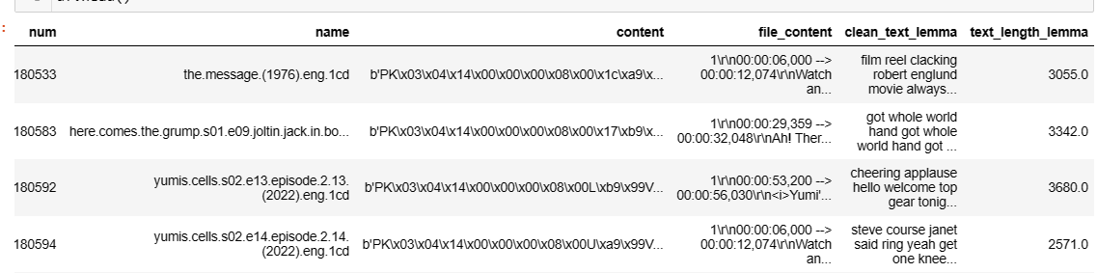
In the preprocessing stage, timestamps are removed, stop words and punctuations are eliminated, and all text is converted into lower case to ensure uniformity. Additionally, lemmatization is applied to reduce words to their base forms, enhancing the text's consistency and interpretability. These meticulous steps streamline the text data, preparing it for advanced analyses and modeling tasks.
DATA PREPROCESSING:

Slide 5
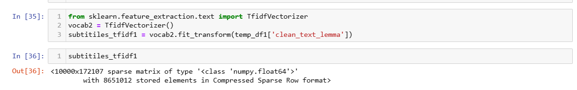
VECTORIZATION:
Utilizing Bag-of-Words (BOW) or TF-IDF to generate sparse vector representations, primarily aiding in constructing a Keyword-Based Search Engine for efficient retrieval based on keyword matches.
Leveraging BERT-based "Sentence Transformers" to generate embeddings that encode semantic information. These embeddings are instrumental in developing a Semantic Search Engine, allowing for a deeper understanding of text context and meaning.
Prior to integrating BERT, preprocessing steps such as text normalization and chunking necessary to enhance the efficiency and effectiveness of semantic representation.
TfIdf Sparse Matrix :

Slide 6
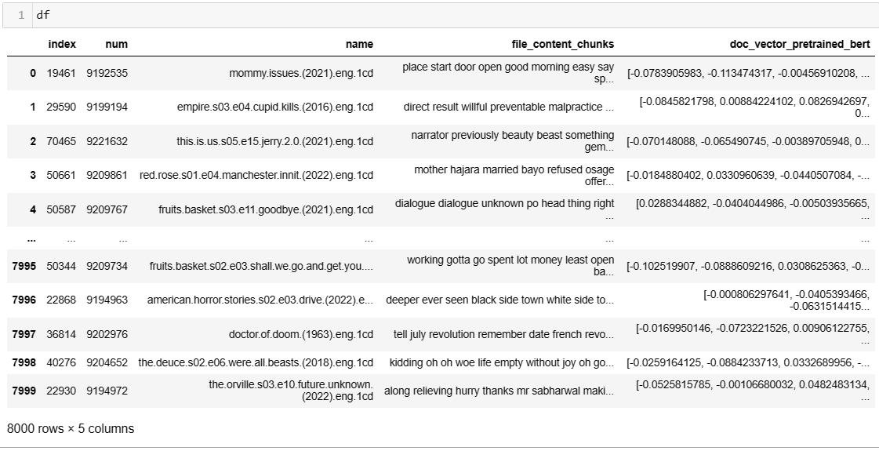
BERT VECTOR:

Slide 7
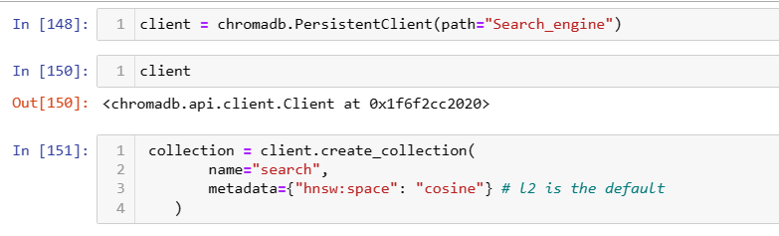
CHOMADB:
Incorporating ChromaDB,we store the generated embeddings efficiently to manage the substantial volume of data effectively.
By leveraging ChromaDB's capabilities, we ensure fast retrieval and storage of embeddings, enabling seamless integration with our search engine architecture.
This approach optimizes resource utilization and enhances scalability, laying a robust foundation for building advanced search functionalities based on semantic representations.

Slide 8
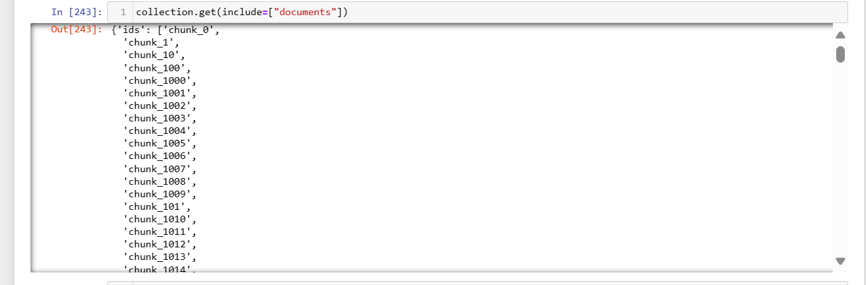
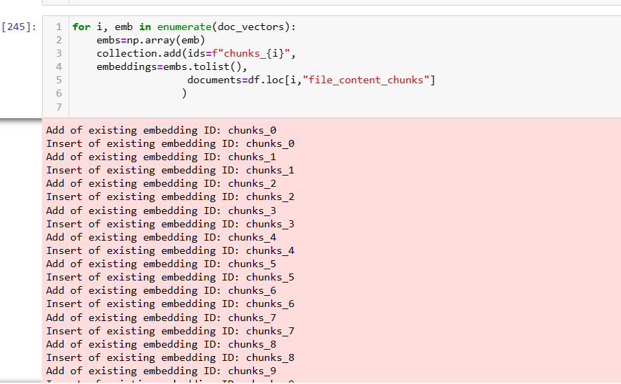
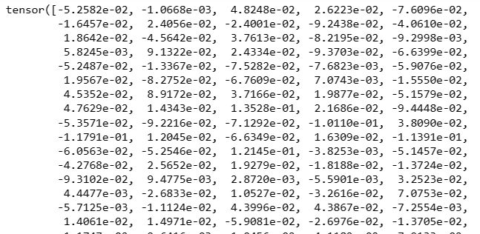

Slide 9
RETRIEVING:
For document retrieval, the following steps are executed:
1. Receive the user's search query.
2. Preprocess the query if necessary, ensuring consistency with the document data.
3. Generate a query embedding using appropriate techniques like BERT-based Sentence Transformers.
4. Utilize cosine distance to compute the similarity score between the query embedding and embeddings of documents in the database.
5. Leverage cosine similarity scores to rank and retrieve the most relevant candidate documents according to the user's search query, ensuring optimal search result relevance and accuracy.

Slide 10
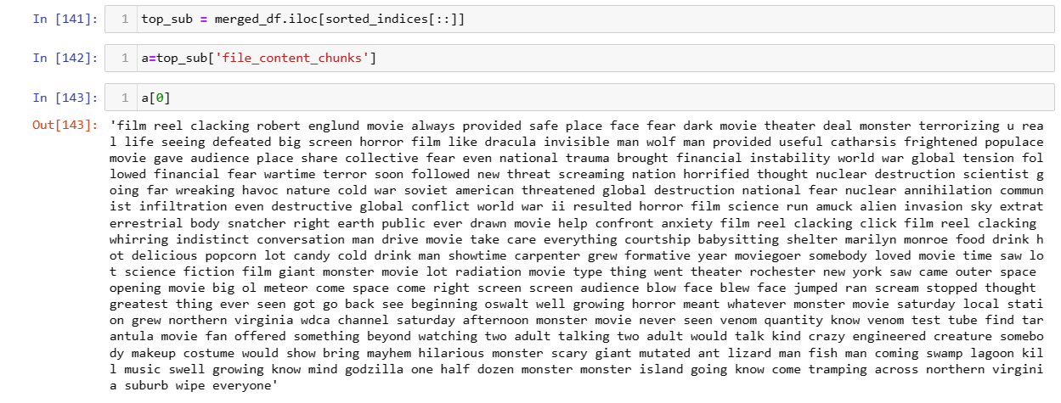
TOP_SUBTETLES:

Slide 11
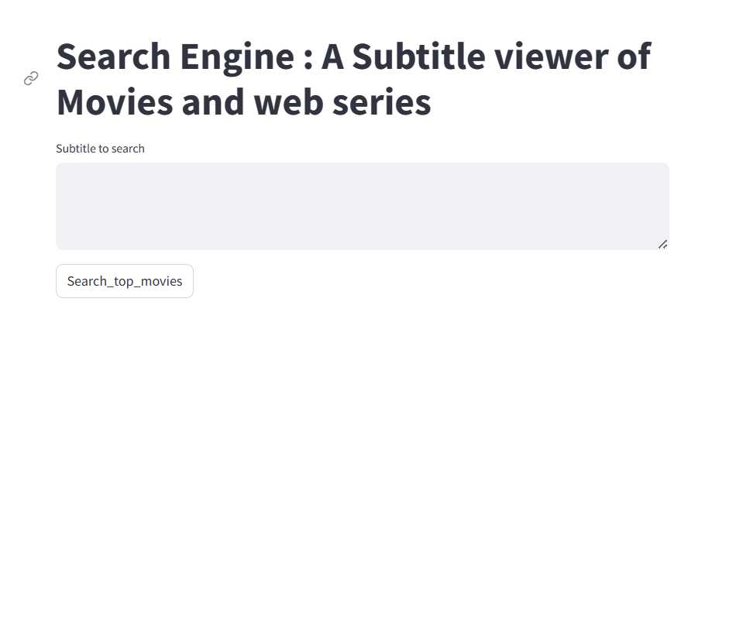
WEB APPLICATION:
1.Create a Streamlit Application which Takes User’s Input
2.After Click on the submit button which will redirected to a page where all the top 10 Subtitled movies with Subtitles

Slide 12
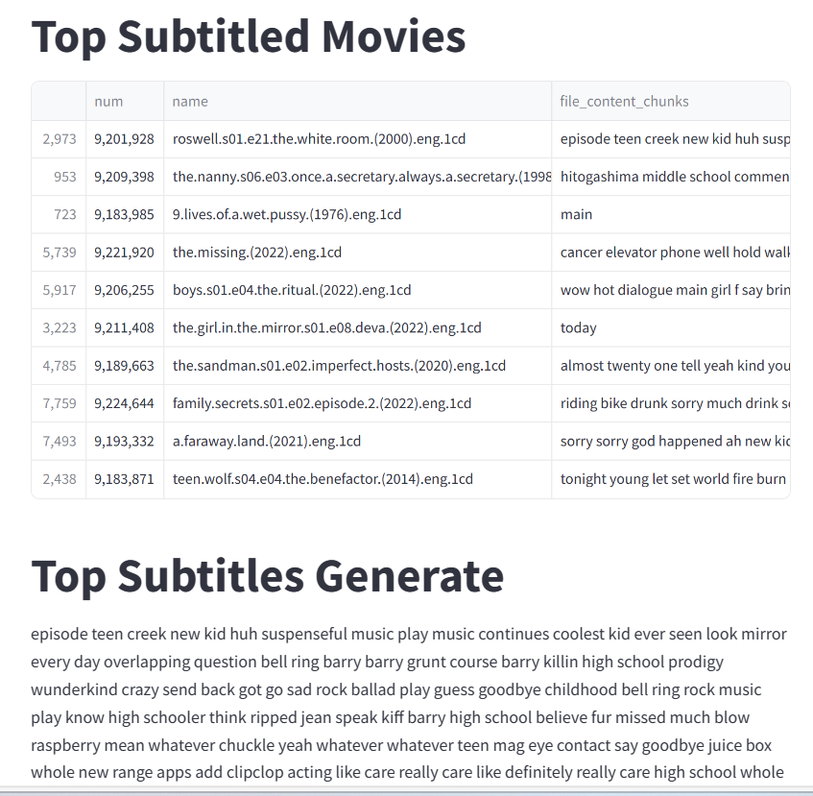
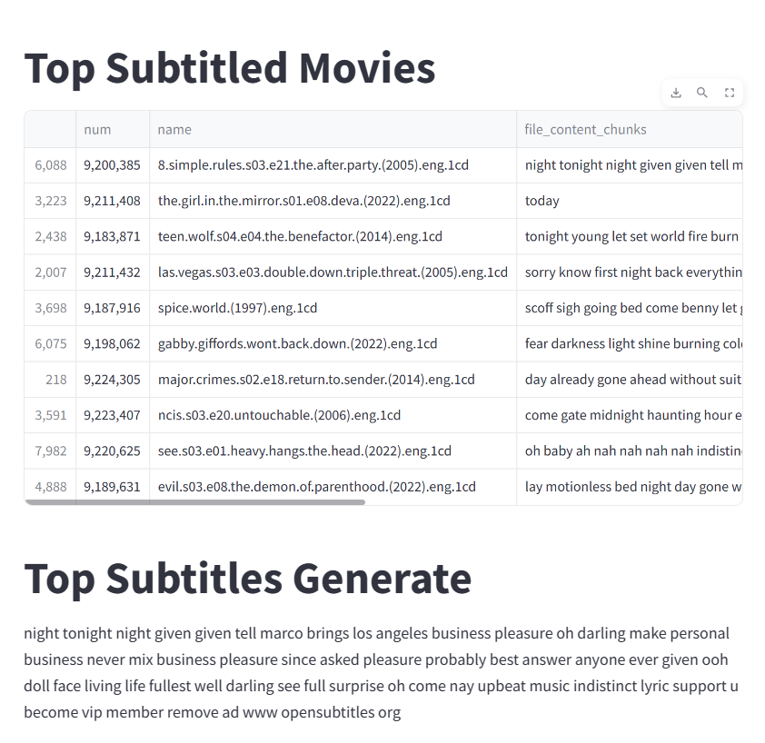

Slide 13

THANK YOU

