Slide 1
Unsupervised Fraud Detection
on the Kaggle Credit Card Dataset
Anomaly detection + clustering · 0 labels used in training
Run ID: 2026-04-24_1712 · Dataset: Kaggle Credit Card Fraud (ULB)
Date: 2026-04-24

Slide 2
The Problem
▸ 284,807 transactions over 48 hours — only 492 are fraud (0.17%)
▸ Class labels unavailable at inference time; unsupervised scoring required
▸ Naive 'predict all legit' → 99.83% accuracy, 0% fraud caught
▸ Evaluation via precision@top-k and ROC-AUC against held-out labels
99.83%
0.17%
Legitimate
Fraud
Class distribution — 578:1 imbalance
Source: outputs/eda_summary.md · outputs/runs/2026-04-24_1712/data_quality_report.md

Slide 3
Approach
▸ Feature engineering: log1p(Amount), hour_of_day, PCA components V1–V28
▸ StandardScaler applied to all 30 features — Class never seen by models
▸ Models: Isolation Forest · One-Class SVM · Local Outlier Factor
▸ Evaluation: precision@top-1% / top-0.1%, recall@top-1%, ROC-AUC vs held-out Class
Data 284K rows
Features log / hour / V1–V28
Models IF · LOF OCSVM
Score & Rank
→
→
→
Source: ml/00_build_features.py · ml/01_anomaly_detection.py · CLAUDE.md

Slide 4
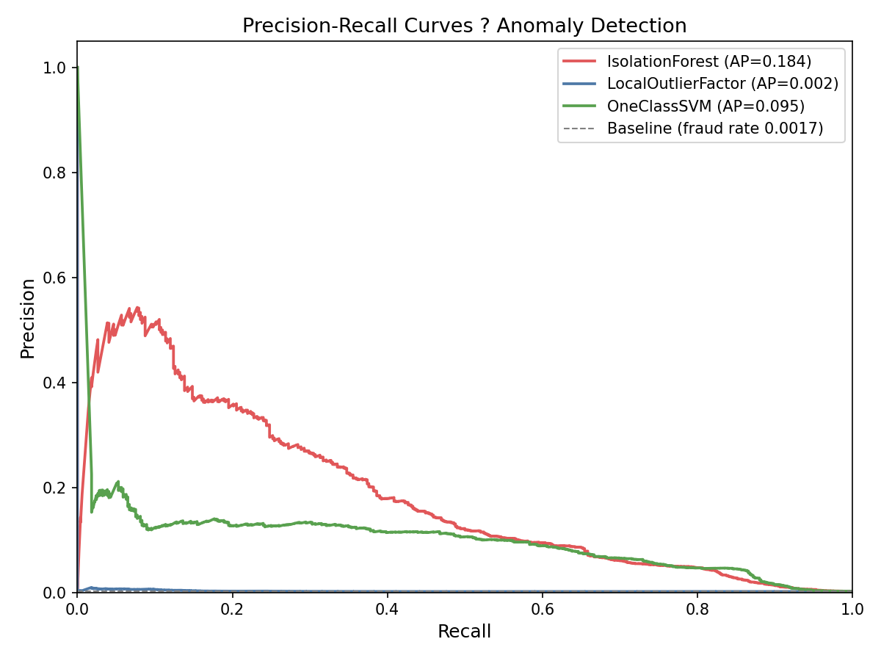
Results — Anomaly Detection
Model
Prec@top-1%
Prec@top-0.1%
Recall@top-1%
ROC-AUC
Isolation Forest
0.099
0.354
0.571
0.949
One-Class SVM
0.097
0.140
0.563
0.945
Local Outlier Factor
0.007
0.000
0.039
0.513
★ Best: Isolation Forest — 206× lift at top-0.1%, ROC-AUC 0.949
Source: outputs/ml/anomaly_metrics.csv · outputs/ml/anomaly_pr_curves.png

Slide 5
Takeaways & What's Next
Isolation Forest captures 64.6% of supervised performance with zero labels · ROC-AUC gap vs XGBoost: only 0.031 pts
Key Findings
What's Next
▸ Prec@top-0.1% = 35.4% → 206× lift over random selection
▸ Cluster 0 (7% of txns): fraud rate 0.624% — 3.6× average, no labels used
▸ Hours 2–4 AM: 24% of all fraud on just 5% of volume
▸ LOF fails (AUC 0.51) — density collapse in 30-dim PCA space
▸ Supervised upgrade: see outputs/ml_supervised_comparison.md
▸ Production monitoring: drift detection via data_quality_report.md
▸ Threshold tuning for review-queue capacity: threshold_decisions.md
Source: outputs/ml_supervised_comparison.md · outputs/ml/anomaly_metrics.csv · outputs/report.md

