Slide 1
Clustering
Abhinaya Sridhar Rajaram

Slide 2
Index
S No. | Main | Sub Heading | Slides
1 | Clustering and Data Issues in an Insurance Company | Cluster Analysis ---> Anomaly Detection in Internal Audit for Insurance Sector | 3 - 8
2 | Clustering on a College Dataset | Data Cleansing and Distance | 11 – 18
3 | Clustering on a College Dataset | Clustering Algorithm & Analysis | 19 – 26
4 | Clustering on a College Dataset | Cluster Visualization & Outlier Analysis | 27 - 29

Slide 3
Cluster Analysis ---> Anomaly Detection in Internal Audit for Insurance Sector
The nature of the group life insurance can bring about many risks into the policy administration and the audit.
AIM: Control and reduce the risk internal audit process.
Automating fraud filtering can be of great value to preventive continuous audits
Cluster analysis steps:
Group data points such that points within a single group or cluster are similar, while points in different groups are distinctive.
In Insurance sector claims with similar characteristics can be grouped in a cluster
Example: Large beneficiary payment, having huge interest amount and having been submitted long time before getting paid
Clusters with small population can be flagged for further investigation

Slide 4
Sample Data Set of an Insurance Company in US
Records of group life claim payments
Attributes related to the insured
Attributes related to the coverage
Attributes related to the group / company
Attributes related to the beneficiary
Attributes related to the payment
Understanding DATA:
Data is manually input into the system, several mistakes are found in the data, including wrong dates, typing errors, and misspellings.
Each claim received is identified by a claim id (CLM_ID).
Each claim ID is Approved, Denied, or Frozen
In BIOS Systems however these are individual payments for single or multiple beneficiaries, therefore in Original data set CLM_ID is NOT A UNIQUE IDENTIFIER

Slide 5
DATA PROBLEMS
Missing Value could mean
Real Missing Values
Attributes not used in the claim
Attributes lack variety ----> Majority of records can have same value
One claim can have multiple beneficiaries therefore say 45000 claims can have 65000 payments yet analysis will be done claim by claim
Beneficiary 1
Claim
Beneficiary 2

Slide 6
Newly Created Attributes that Could be used for Clustering
Percentage: Total interest payment / Total beneficiary payment
Average CLM_PMT: Average number of days between the claims received date and the payment date (a weighted average due to multiple payment dates)
DTH_CLM: Number of days between the death date and the claim received date.
Average DTH_PMT: Average number of days between the death date and the payment date (a weighted average is used because a claim could have multiple payment dates)
Normalization to aid comparison

Slide 7
Checking and Removing for Outliers
Not only single points but also small clusters can probably be considered outliers called a “cluster-based outlier”.
Outlier analysis
Observations that have low probability of being a member of a cluster (i.e. are far away from other members of the clusters) are identified as outliers.
OR
Clusters that have small populations should possibly be considered outliers. In this aspect, clusters populated with less than 1% of the whole population

Slide 8
Anomaly Detection Parameters
Check for characteristics in less populated clusters
Check for claims in these clusters whether they have high interest/beneficiary payment percentage and/or claims with a long period of time from death dates to payment dates
Examine the probability of individual observations’ cluster membership.
The claims, which have lower than 0.6 probabilities of belonging to the cluster they are assigned to, are identified as possible anomalies.

Slide 9
Possible areas of data mining and audit processes integration
Audit Process | Method | Possibility
Client Acceptance or Client Conti nuance | Classification and prediction - Evolution analysis | Financial Ratios-→Client Favorable/ Not Favorable Evolution Analysis-→ Acceptance level
Planning- Risk Assessment, Audit program preparation | Dependency analysis - Classification and prediction | Using risk triggers based on rations Combination of audit approach
Tests of Controls (Controls identification Control reliance assessment Sample Selection, Controls Testing, Results evaluation ) | For identification -→Classification - Data description Control Reliance-→Classification and prediction Sample Selection--→ Cluster analysis -→ Outlier analysis Control Testing --→Cluster analysis - Outlier analysis Result Evaluation-→ Classification | Controls Identification Classification Character of control-→Data Description Control Reliance level-→Categorized Sample selection-→Cluster Control Testing (Grouping and Outliers) Result Evaluation--→ Satisfactory/ Unsatisfactory and Iterating
Detailed Tests - Sample selection -Sample testing - Results evaluation | Sample selection→ Cluster& Outlier Analysis Sample testing-→ Cluster& Outlier Analysis Results evaluation-→Classification | Same as above
Opinion Issuance | -Dependency analysis -Classification and prediction | Using dependency analysis, circumstances or evidence that will affect the types of opinion issued can be collected. Then, based on the test results, audit findings, matters surfaced and other related circumstances, types of opinion can be rendered.

Slide 10
Clustering Illustrated on a College Data Set

Slide 11
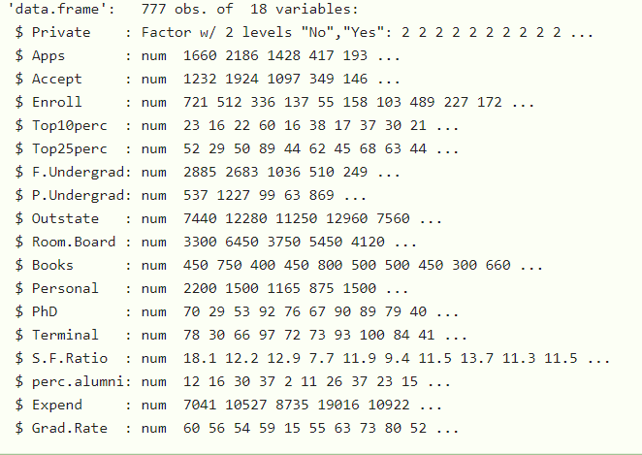
Data Set- College
'
Rows: 777
Columns: 18
NA values: None
anyNA(College, recursive = FALSE:
Notes:
set.seed(1680) # for reproducibility
library(dplyr) # for data cleaning
library(ISLR) # for college dataset
library(cluster) # for gower similarity and pam
library(Rtsne) # for t-SNE plot
library(ggplot2) # for visualization

Slide 12
CLUSTERING
Aim:
How a sample might be comprised of distinct subgroups
Type :
Clustering data of mixed types (e.g., continuous, ordinal, and nominal)
Method :
Gower distance
Partitioning around medoids
Silhouette width.

Slide 13
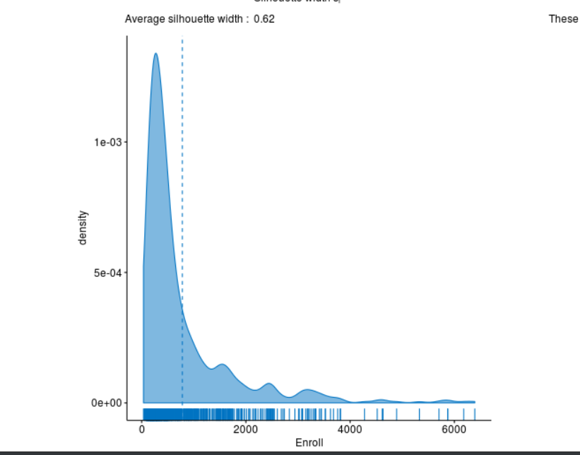
Step 1 - Checked Distribution of all column
Result:
Found positive skew in the Enroll column
Notes:
library(ISLR)
library(cluster)
library(reshape)
library(fpc)
data(College)
head(College)
library(rattle)
library(ggpubr)
# Basic density plot with mean line and marginal rug
ggdensity(College, x UE)
= "Enroll",
fill = "#0073C2FF", color = "#0073C2FF",
add = "mean", rug = TR

Slide 14
Data Cleansing And Preparation
Before clustering can begin, some data cleaning must be done:
Select important variables for analysis
Check and remove outliers
Standardize variables
Assess clusterability
Acceptance rate is created by dividing the number of acceptances by the number of applications
isElite is created by labeling colleges with more than 50% of their new students who were in the top 10% of their high school class as elite
Name | Accept Rate | Outstate | Enroll | Grad.rate | Private | IsElite
Harvard | .05 | 400 | 25 | 98 | Yes | Elite
Indiana State University | 30 | 300 | 45 | 20 | No | Not Elite
Notes:
attach(College)
College$Accept_rate= Apps/Accept
College$IsElite= ifelse(College$Top10perc>50, "Elite", "Not_Elite")
college_clean= sqldf("Select Accept_rate, Outstate, Enroll, Private, IsElite,Grad.Rate from College")

Slide 15
Steps followed in this Clustering Process
Created dissimilarity matrix using Gower distance for multi-scaled data
Looked for optimal number of clusters
Performed k-medoids clustering
Visualized clustering using Rtsne for visualization of multi-dimensional data

Slide 16
Clustering Method
Clustering algorithms work using dissimilarities or distances between objects, defined by a distance metric.
A distance metric calculates the distance between two objects. If we cannot define the distance between objects, then we cannot perform the clustering. This issue can occur when not all data is of the same type.
Gowers Distance was chosen because:
The standard k-means algorithm isn't directly applicable to categorical data
Sample space for categorical data is discrete, and doesn't have a natural origin. A Euclidean distance function from K means on such a space isn't really meaningful.
Notes:
gower_dist <- daisy(college_clean[, -1],
metric = "gower",
type = list(logratio = 3))

Slide 17
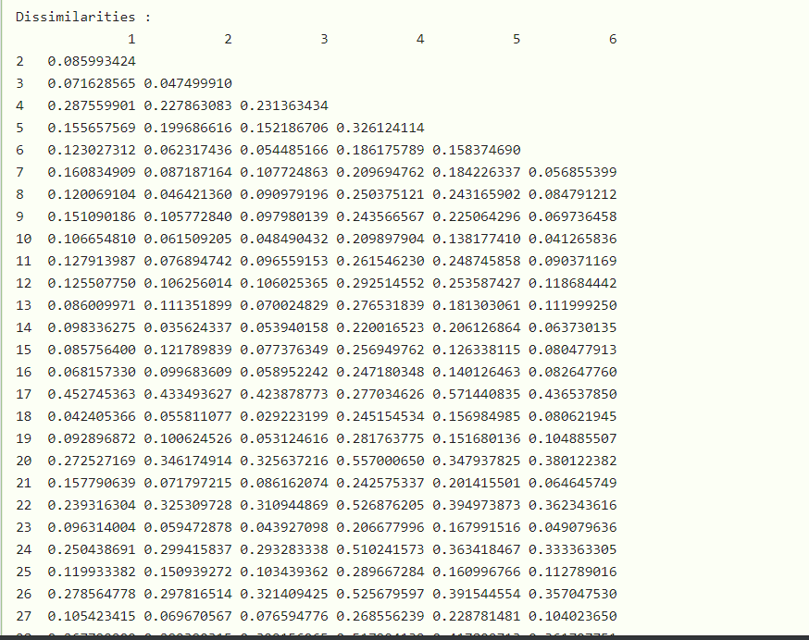
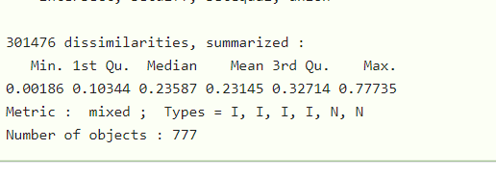
Steps to Gowers Distance
Step 1: Log Transformation -----> To correct skewness of Enroll
Step 2: Apply Gower Distance
Step 3 : Output of Dissimilarity
Notes:
summary(gower_dist)

Slide 18
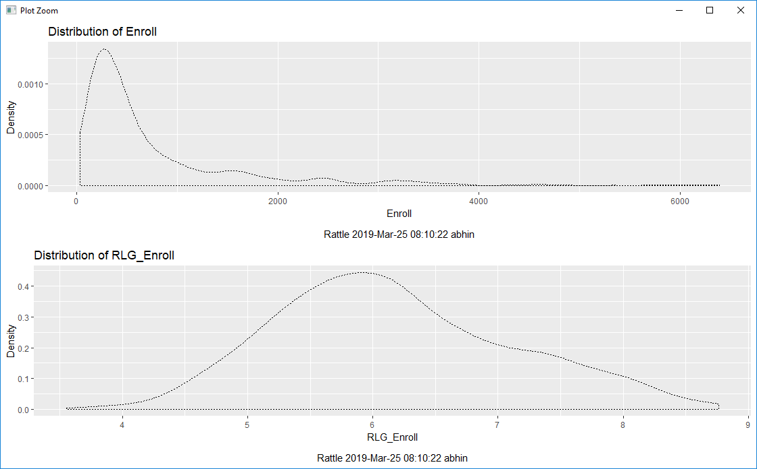
Distribution of Enroll before and after Log transformation

Slide 19
CLUSTERING ALGORITHM ---> Partitioning around Medoids
Partitioning around medoids is an iterative clustering procedure with the following steps:
Use optimum number of clusters (based on PAMK method and after considering Silhouette analysis)to become the medoids
Silhouette analysis measures how well an observation is clustered and it estimates the average distance between clusters. The silhouette plot displays a measure of how close each point in one cluster is to points in the neighboring clusters. A higher silhouette width is preferred to determine the optimal number of clusters. Observations with a negative width are probably placed in the wrong cluster
Assign every entity to its closest medoid (using our custom distance matrix in this case)
For each cluster, identify the observation that would yield the lowest average distance if it were to be re-assigned as the medoid. If so, make this observation the new medoid.
If at least one medoid has changed, return to step 2. Otherwise, end the algorithm.

Slide 20
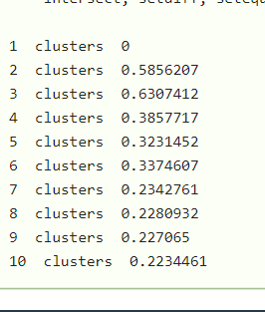
Selecting Optimum number of Clusters- Text
3 Clusters can be chosen based on higher silhouette width
Notes:
pamk.gow <- pamk(gower_dist, diss=TRUE, krange=1:10,
criterion='asw', critout=TRUE)

Slide 21
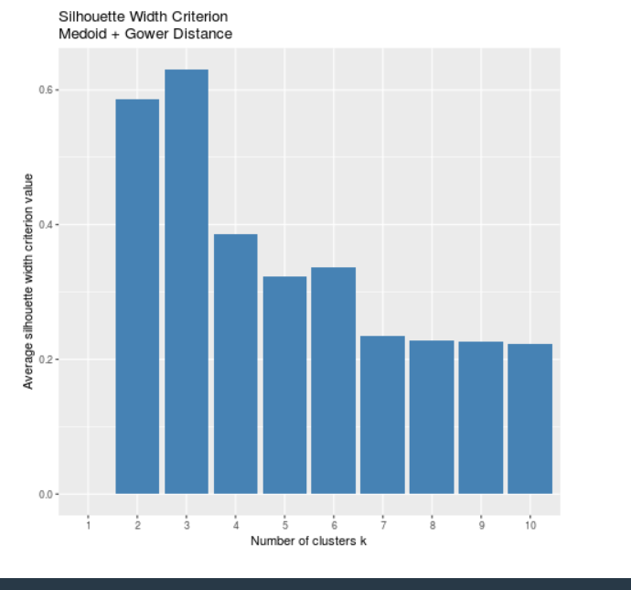
Visualizing Optimum Number of Clusters
Notes:
df_pamk <- melt(pamk.gow$crit)
df_pamk$index <- rownames(df_pamk)
plot3 <- ggplot(df_pamk, aes(x=index, y=value)) +
geom_bar(stat='identity', fill='steelblue') +
scale_x_discrete(limits=c(1:10)) +
ggtitle('Silhouette Width Criterion\nMedoid + Gower Distance') +
labs(x='Number of clusters k', y='Average silhouette width criterion value')
plot3

Slide 22
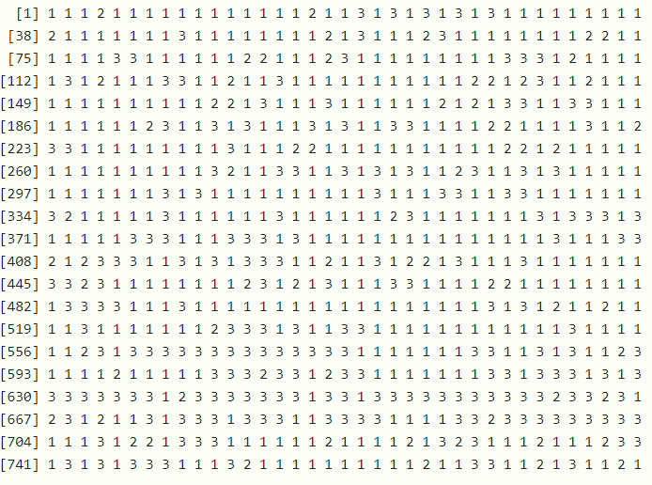
CLUSTER INTERPRETATION
After running the algorithm and selecting three clusters, we can interpret the clusters by running summary on each cluster.
pam_fit<-pam(gower_dist,diss = TRUE, k = 3)
pam_fit$clustering
Notes:
pam_fit <- pam(gower_dist, diss = TRUE, k = 3)
pam_fit$clustering
pam_fit<-pam(gower_dist,diss = TRUE, k = 3)
pam_fit$clustering

Slide 23

PAM FIT CLUSTERING
I put Pam.fit$clustering i.e cluster number to the college_clean data to see what cluster each variable belongs to
I checked out pam_fit mediods through pam_fit$medoids to find how many entries are there in every cluster
Notes:
pam_fit<-pam(gower_dist,diss = TRUE, k = 3)
pam_fit<-pam(gower_dist,diss = TRUE, k = 3)
college_clean$cluster= pam_fit$clustering
head(college_clean)

Slide 24
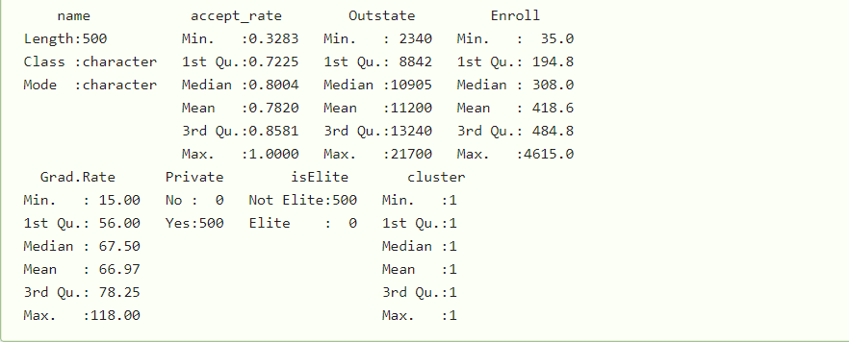
Cluster 1 --->Summary
Characteristics of Cluster 1:
Private Colleges that are not Elite
Out of State Tuition is Medium
Small levels of Enrollment
Notes:
cluster1 = college_clean%>%filter(cluster==1)
summary(cluster1)

Slide 25
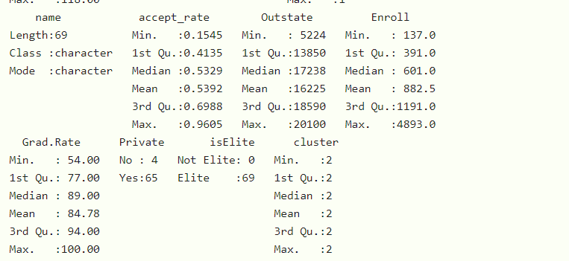
Cluster 2 --->Summary
Characteristics of Cluster 2:
Small number of Elite institutes
Lower Accept rate and high graduation rates
Mostly Private
High Outstate and high grad rates
Notes:
cluster2 = college_clean%>%filter(cluster==2)
summary(cluster2)

Slide 26
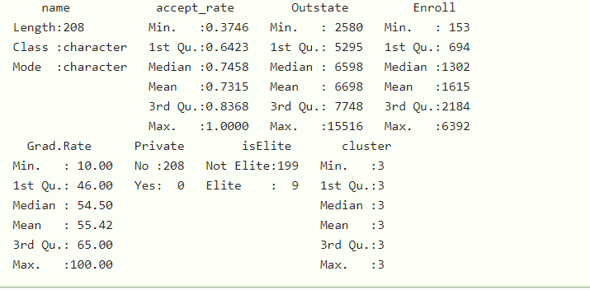
Cluster 3 ----->Summary
Characteristics of Cluster 3
Large number of public not elite institutions
High levels of enrollment low outstate tuition
Low graduation rate

Slide 27
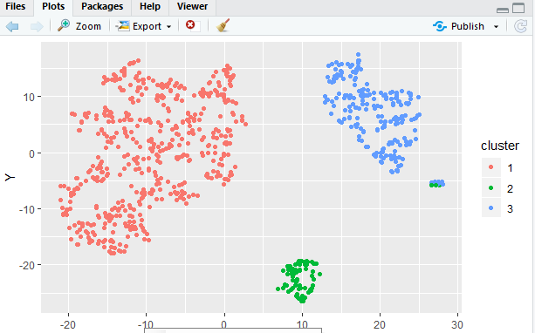
Projection of Clusters in a Visual Format
Applied Dimension Reduction technique called Distributed stochastic neighbor embedding or TSNE. This is similar in some aspects to Principal Component Analysis (PCA), used to visualize N variables into 2.
Notes:
tsne_obj <- Rtsne(gower_dist, is_distance = TRUE)
tsne_obj$Y= data.frame(tsne_obj$Y)
names(tsne_obj$Y)[names(tsne_obj$Y)=="X1"] <- "X"
tsnobject= tsne_obj$Y
names(tsne_obj$Y)[names(tsne_obj$Y)=="X2"] <- "Y"
tsnobject= tsne_obj$Y
tsnobject$cluster= as.factor(pam_fit$clustering)
tsnobject$College_Name=college_clean$Name
ggplot(aes(x = X, y = Y), data = tsnobject) +
geom_point(aes(color = cluster))

Slide 28
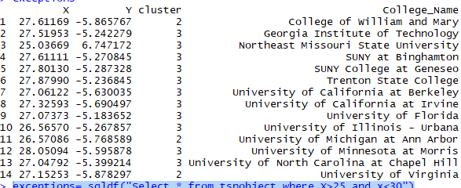
Outlier Analysis
Notes:
exceptions= sqldf("Select * from tsnobject where X>25 and x<30")

Slide 29
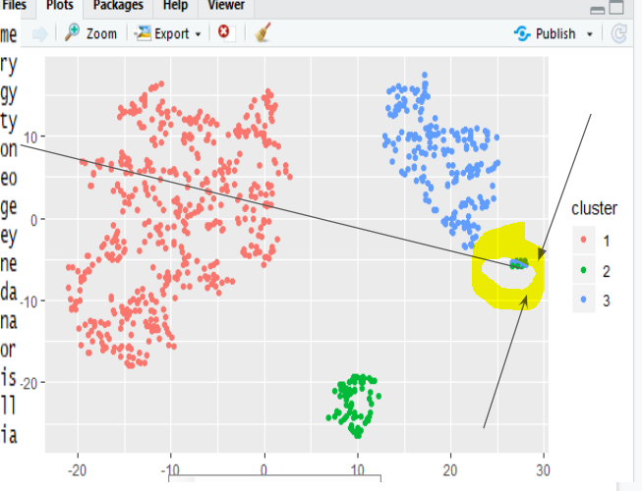
Outlier Analysis:
This group is made up of the larger, more competitive public schools, like the University of Virginia or the University of California at Berkeley.
While not large enough to warrant an additional cluster according to silhouette width, these 13 schools(pasted in previous slide) certainly have characteristics distinct from the other three clusters.
Notes:
References : https://www.r-bloggers.com/clustering-mixed-data-types-in-r/
https://pdfs.semanticscholar.org/2612/f764664796f911e9ff9a79b7bb9de84bf16c.pdf

