Slide 1
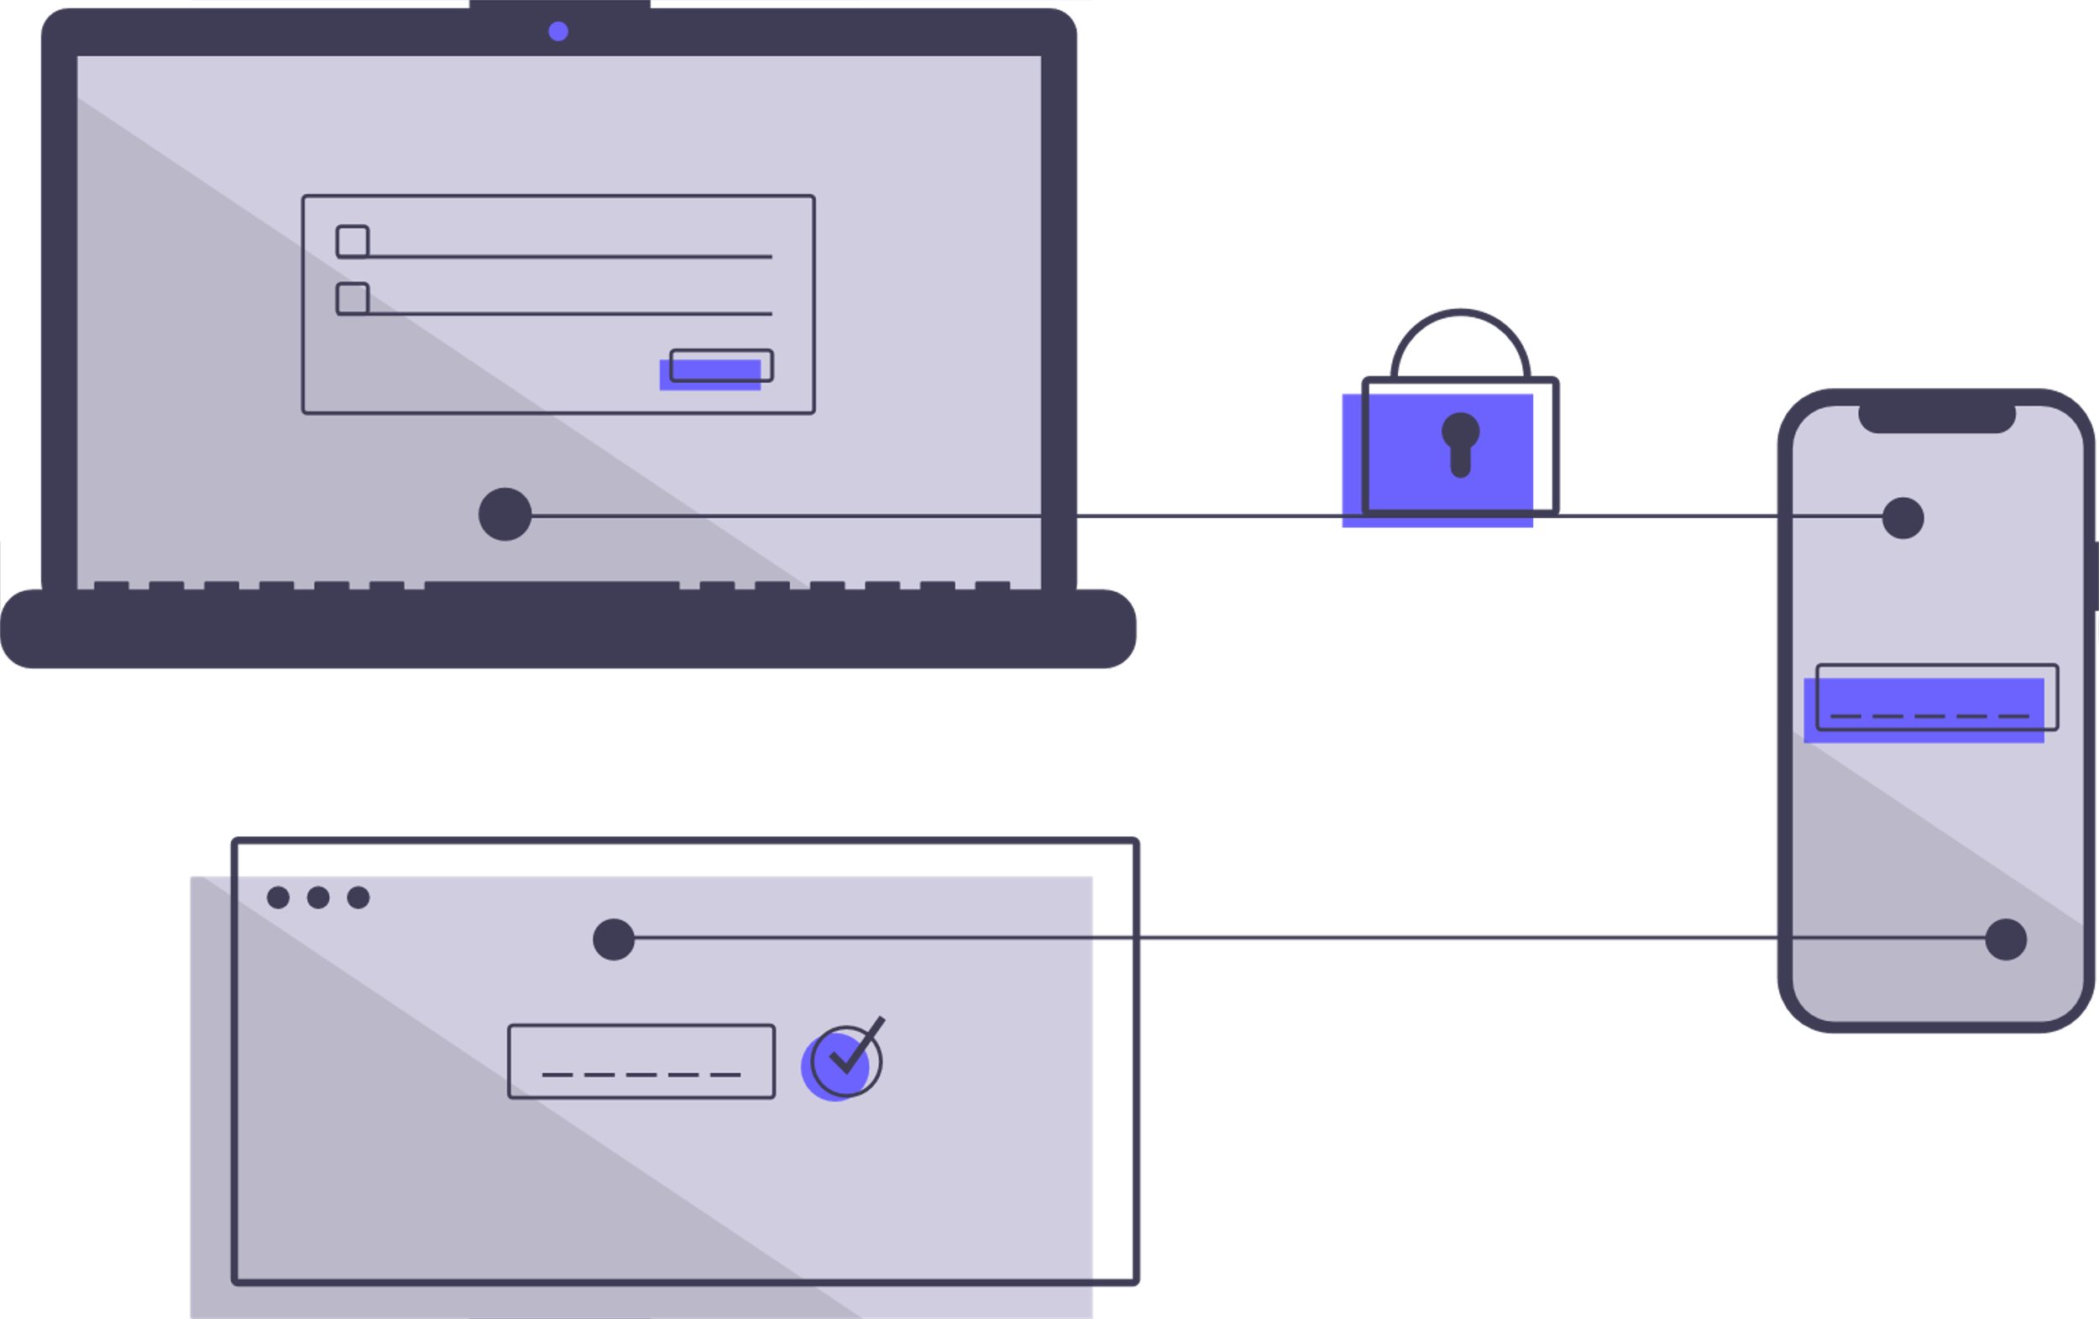
Design Smart Tv App Layout
Fundamental Towards UX
Guided By :
Gunjan Kadu.
Sagar Shimpi.
Presented By :
Virendra Kadam.
Ankush Gangal.
Abhinay Khalatkar.

Slide 2
Agenda
Introduction
Sign-up Page –Ankush
Home Page - Abhinay
Analytics page ,Profile selection - Virendra

Slide 3
Introduction
Smart TVs offer a convenient and integrated multimedia experience, providing access to a vast range of content and services directly from the TV screen. They combine traditional television capabilities with internet connectivity, making them versatile and capable entertainment devices.
Notes:
Internet Connectivity: Smart TVs are equipped with internet connectivity, allowing users to access online content and services directly on their TV screens. This includes streaming platforms, social media, web browsing, online gaming, and more.
Streaming and Content Access: Smart TVs provide built-in support for popular streaming services like Netflix, Hulu, Amazon Prime Video, and YouTube. Users can easily access a wide range of movies, TV shows, and other online content without the need for additional devices like streaming sticks or set-top boxes.
Apps and App Store: Smart TVs often come with an app store or marketplace where users can download and install various applications tailored for the TV platform. This opens up opportunities to use specialized apps for news, weather, sports, music, games, and other entertainment options.
Interactive Features: Smart TVs offer interactive features that enhance the user experience. This may include voice control, motion control, and gesture recognition, allowing users to navigate menus, control playback, and interact with content using intuitive methods.
Screen Mirroring and Casting: Many Smart TVs support screen mirroring or casting, enabling users to display content from their smartphones, tablets, or computers directly on the TV screen. This is particularly useful for sharing photos, videos, presentations, or playing mobile games on a larger display.
Integration with Smart Home Devices: Smart TVs can serve as a central hub for controlling other smart home devices. They can connect with devices like smart speakers, home automation systems, and voice assistants to create a unified smart home experience.
Regular Software Updates: Smart TVs often receive regular software updates from the manufacturer, providing bug fixes, security patches, and adding new features or improvements to the TV's functionality. This helps ensure that the TV remains up-to-date and compatible with the latest technologies and services.

Slide 4
SIGN-UP
It's important to note that privacy and data security considerations should be taken into account when implementing sign-up features in Smart TVs. User consent and clear privacy policies should be provided, and data should be handled in accordance with relevant regulations and best practices to ensure user trust and security.
Notes:
The use of a sign-up feature in Smart TVs can provide several benefits and functionalities:
Personalization: By having a sign-up feature, Smart TVs can allow users to create personalized accounts or profiles. This enables the TV to tailor content recommendations, preferences, and settings based on individual user profiles. Users can have their own customized experience with their favorite channels, apps, and settings.
Content Syncing: A sign-up feature can enable content syncing across multiple devices. Users can sign in to their accounts on different Smart TVs or companion devices and have their preferences, watch history, and saved content synchronized. This allows for a seamless experience when switching between devices.
Account-based Services: Some Smart TVs may offer subscription-based services or premium content that requires user authentication. With a sign-up feature, users can create accounts and securely log in to access these services, such as streaming platforms, video-on-demand services, or live TV subscriptions.
Parental Controls: Sign-up functionality can support parental control features. Parents can create accounts for their children and set up content restrictions or time limits. This ensures that children have access to age-appropriate content and provides a safer viewing experience.
Personalized Recommendations: By collecting user data through sign-up, Smart TVs can offer personalized content recommendations. Based on user preferences, viewing history, and other data, the TV can suggest relevant movies, TV shows, or channels that align with the user's interests.
Data and Usage Analytics: The sign-up feature allows TV manufacturers or service providers to gather user data and usage analytics. This information can be valuable for understanding user behavior, improving services, and delivering targeted advertising or content promotions.
Account Management: Sign-up functionality allows users to manage their accounts directly on the Smart TV. They can update their personal information, change passwords, link or unlink external accounts (e.g., social media or streaming services), and customize privacy settings.
It's important to note that privacy and data security considerations should be taken into account when implementing sign-up features in Smart TVs. User consent and clear privacy policies should be provided, and data should be handled in accordance with relevant regulations and best practices to ensure user trust and security.

Slide 5
Requirement
Varying demographics of different ages-should be simple
Need of a UI suitable for all users
Content should be easily accessible
Notes:
Simple and intuitive navigation: Users expect a UI that allows them to navigate through menus, settings, and apps effortlessly.
Content discovery: Users should be able to easily discover new shows, movies, and channels based on their interests and viewing history.
Personalization: The UI should provide personalized recommendations and content suggestions tailored to each user's preferences.
Customization: Users should have the ability to customize the UI,selecting preferred themes
Seamless streaming experience: Users expect smooth playback and minimal buffering when streaming content from various apps.

Slide 6
TV HOME
Accessibility to all apps
Trending visible shows
Can go through all content without opening the app
Color
Customization
Responsiveness
Notes:
1,2,3- Law of similer region
Each app shows only 4-7 elemets – millers law
4-Reson for picking this color was to decrease strain on eyes in night time and also as per our analysis we found that most of tv screen now a days turns on pixel during redering dark elements ,so it also good in order to save power
-profile icon and night mode toggler –some of the dialog principle self descrptivness and controllablity

Slide 7
Profile Screen
Purpose
Content
Responsive
Notes:
The main purpose of this code is to create a profile page where users can customize their profiles, adjust various settings, and view graphs related to their TV usage.
The profile page consists of a profile card that displays the user's details, such as their name, ranking, age, location, and email. It also includes a settings column with different options like picture, sound, game, general settings, support, and privacy. Users can select these options to customize their preferences.
One important aspect of this code is the inclusion of responsive design principles, which ensure that the profile page is accessible and looks good on different devices and screen sizes. The layout adapts based on the screen size, ensuring a consistent and user-friendly experience across various devices.

Slide 8
Requirements Analysis
Profile Customization
Settings Navigation
Content Display
Smooth Scrolling
Notes:
Requirements Analysis: The code fulfills the requirements of designing the profile component and settings section for the smart TV layout. It provides the following functionality and features:
Profile Customization: Users can easily view and manage their profile details, including their profile picture, name, ranking, age, location, and email. This allows them to personalize their profile according to their preferences.
Settings Navigation: The interface offers a straightforward and intuitive way for users to navigate through various settings options. They can choose from options such as picture, sound, game, general settings, support, and privacy, providing flexibility and customization.
Content Display: The code dynamically renders the appropriate content component based on the selected settings option. This ensures that users can access and adjust the relevant settings easily, enhancing their overall experience.
Smooth Scrolling: The inclusion of a bouncy image allows users to smoothly scroll to the content section with a single click. This feature improves the user experience by providing an efficient way to access the desired information without the need for manual scrolling.

Slide 9
Analysis of UI/UX Laws
Law of Proximity
Law of Similarity
Law of Fitts
Law of Visibility
Law of Consistency
Notes:
The code follows several UI/UX laws user-friendly interface:
Law of Proximity: The settings options in the Settings Column are visually grouped together
Law of Similarity: The settings options share a consistent visual style, using icons and text in a similar format. This creates a sense of familiarity and helps users recognize and understand each option easily.
Law of Fitts: The settings options are designed with a size and spacing that makes them easy to tap or select, reducing the chance of accidental clicks and improving the user's ability to interact with them accurately.
Law of Visibility: The chart sections appear when they are in the viewport, ensuring that users can see and engage with the charts easily. This improves their visibility and encourages users to explore the graphical data provided.
Law of Consistency: The selected settings option is visually highlighted as "active," providing clear feedback to users about their current selection. This consistency enhances the user's understanding of the interface and helps them navigate the settings options effectively.

Slide 10
Summery
The code successfully address to UI/UX laws and requirements by creating an intuitive and user-friendly interface for the profile component and settings section in the smart TV layout. The design choices, such as proximity, similarity, Fitts' law, visibility, and consistency, contribute to a seamless user experience. Additionally, the code fulfills the necessary functionalities, including profile customization, settings navigation, content display, and smooth scrolling, enhancing the overall usability and user satisfaction.

Slide 11
Thank You

