Slide 1
Introduction to JAVA

Slide 2
About the Java Technology
Java technology is both a programming language and a platform.
A platform is an environment that helps to develop and run programs written in any programming language.
Java is fast, reliable and secure.
From desktop to web applications, scientific supercomputers to gaming consoles, cell phones to the Internet, Java is used in every nook and corner.

Slide 3
In the Java programming language, all source code is first written in plain text files ending with the .java extension.
Those source files are then compiled into .class files by the javac compiler.
A .class file does not contain code that is native to your processor; it instead contains bytecodes — the machine language of the Java Virtual Machine (Java VM). JVM is the one that makes java platform independent.
The java launcher tool then runs your application with an instance of the Java Virtual Machine.

Slide 4
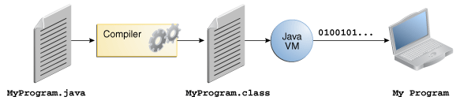
An overview of the software development process.

Slide 5
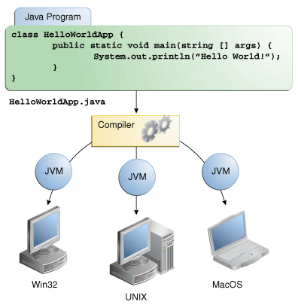
Because the Java VM is available on many different operating systems, the same .class files are capable of running on Microsoft Windows, Linux, or Mac OS.
Through the Java VM, the same application is capable of running on multiple platforms.

Slide 6
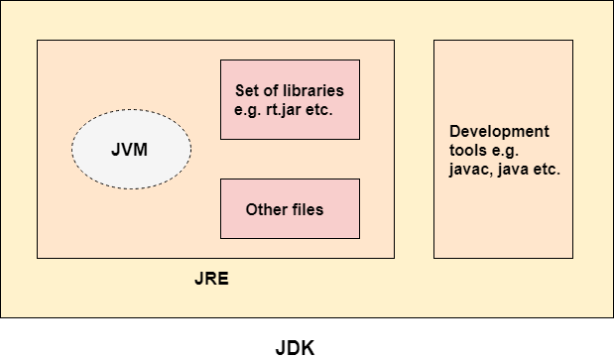
JDK
JDK is an acronym for Java Development Kit.
The Java Development Kit (JDK) is a software development environment which is used to develop Java applications and applets. It physically exists.
JDK is intended for software developers and includes development tools such as the Java compiler, Javadoc, Jar, and a debugger.
It contains JRE + development tools.

Slide 7
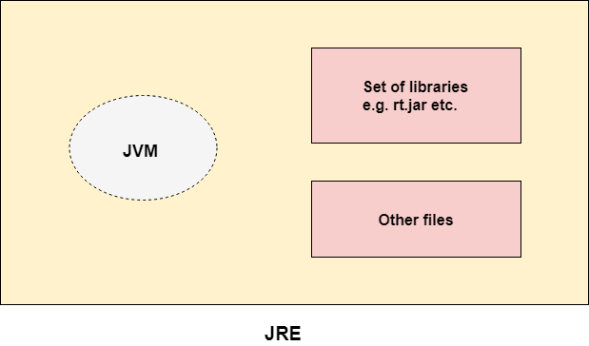
JRE
JRE is an acronym for Java Runtime Environment. It is also written as Java RTE.
JRE contains the parts of the Java libraries required to run Java programs and is intended for end users. JRE can be view as a subset of JDK..
It is used to provide the runtime environment.
It is the implementation of JVM. It physically exists.
It contains a set of libraries + other files that JVM uses at runtime.

Slide 8
JVM
JVM (Java Virtual Machine) is an abstract machine.
JVM (Java Virtual Machine) is an abstract machine. It is a specification that provides runtime environment in which java bytecode can be executed.
JVMs are available for many hardware and software platforms. It is a specification that provides a runtime environment in which Java bytecode can be executed.

Slide 9
To write your first program, you'll need:
The Java SE Development Kit .
You can download the Windows version .
A text editor
Here, we'll use Notepad, a simple editor included with the Windows platforms. You can easily adapt these instructions if you use a different text editor.
These two items are all you'll need to write your first application.

Slide 10
Creating Your First Application
Your first application, HelloWorldApp, will simply display the greeting "Hello world!".
To create this program, you will:
Create a source file
A source file contains code, written in the Java programming language, that you and other programmers can understand. You can use any text editor to create and edit source files.
Compile the source file into a .class file
The Java programming language compiler (javac) takes your source file and translates its text into instructions that the Java virtual machine can understand. The instructions contained within this file are known as bytecodes.
Run the program
The Java application launcher tool (java) uses the Java virtual machine to run your application.

Slide 11
Create a Source File
First, start your editor. You can launch the Notepad editor from the Start menu by selecting
Programs > Accessories > Notepad. In a new document, type in the following code:
/*
The HelloWorldApp class implements an application that simply prints "Hello World!" to standard output.
*/
class HelloWorldApp
{
public static void main(String[] args)
{
System.out.println("Hello World!"); // Display the string.
}
}
Note: Type all code, commands, and file names exactly as shown. Both the compiler (javac) and launcher (java) are case-sensitive, so you must capitalize consistently. HelloWorldApp is not the same as helloworldapp.

Slide 12
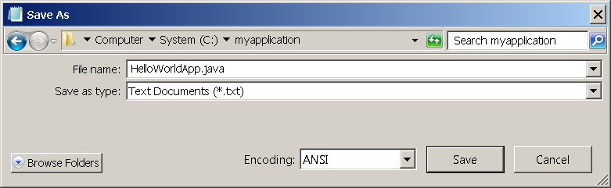
Save the code in a file with the name HelloWorldApp.java.
To do this in Notepad, first choose the File > Save As menu item. Then, in the Save As dialog box:
Using the Save in combo box, specify the folder (directory) where you'll save your file.
In this example, the directory is myapplication on the C drive.
In the File name text field, type "HelloWorldApp.java", including the quotation marks.
From the Save as type combo box, choose Text Documents (*.txt).
In the Encoding combo box, leave the encoding as ANSI.
When you're finished, the dialog box should look like this.
The Save As dialog just before you click Save. Now click Save, and exit Notepad.

Slide 13
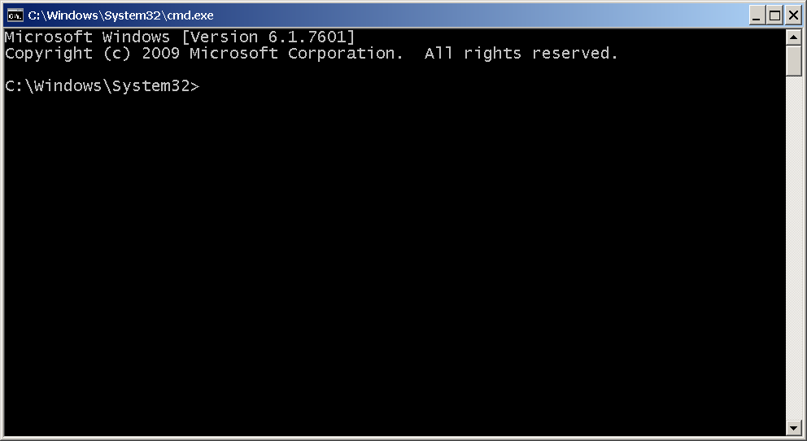
Compile the Source File into a .class File
Bring up a "command," window. You can do this from the Start menu by choosing Run... and then
entering cmd. The shell window should look similar to the following figure.

Slide 14
The prompt shows your current directory.
When you bring up the prompt, your current directory is usually your home directory for Windows.
To compile your source file, change your current directory to the directory where your file is located.
For example, if your source directory is myapplication on the C drive, type the following command at the prompt and
press Enter:
cd C:\myapplication
Now the prompt should change to C:\myapplication>.
Note:
To change to a directory on a different drive, you must type an extra command: the name of the drive.
For example, to change to the myapplication directory on the D drive, you must enter D:, as follows:
C:\>D:
D:\>cd myapplication
D:\myapplication>

Slide 15
If you enter dir at the prompt, you should see your source file, as follows:
C:\>cd myapplication
C:\myapplication>dir
Volume in drive C is System Volume Serial Number is F2E8-C8CC Directory of C:\myapplication 2014-04-24 01:34 PM
<DIR> . 2014-04-24 01:34 PM
<DIR> .. 2014-04-24 01:34 PM 267 HelloWorldApp.java 1 File(s) 267 bytes 2 Dir(s) 93,297,991,680 bytes free C:\myapplication>

Slide 16
Now you are ready to compile.
At the prompt, type the following command and press Enter.
javac HelloWorldApp.java
The compiler has generated a bytecode file, HelloWorldApp.class.
At the prompt, type dir to see the new file that was generated as follows:
C:\myapplication>javac HelloWorldApp.java
C:\myapplication>dir Volume in drive C is System Volume Serial Number is F2E8-C8CC Directory of C:\myapplication
2014-04-24 02:07 PM
<DIR> . 2014-04-24 02:07 PM
<DIR> .. 2014-04-24 02:07 PM 432 HelloWorldApp.class 2014-04-24 01:34 PM 267
HelloWorldApp.java 2 File(s) 699 bytes 2 Dir(s) 93,298,032,640 bytes free C:\myapplication>
Now that you have a .class file, you can run your program.

Slide 17
Run the Program
In the same directory, enter the following command at the prompt:
java HelloWorldApp
You should see the following on your screen:
C:\myapplication>java HelloWorldApp
Hello World!
C:\myapplication>

