Slide 1
CHAPTER -1 JAVA DATA TYPES

Slide 2
Java Comments
Comments can be used to explain Java code, and to make it more readable. It can also be used to prevent execution when testing alternative code.
Single-line comments start with two forward slashes (//).
Multi-line comments start with /* and ends with */.
Any text between /* and */ will be ignored by Java.

Slide 3
Java Variables
Variables are containers for storing data values.
In Java, there are different types of variables, for example:
String - stores text, such as "Hello". String values are surrounded by double quotes
int - stores integers (whole numbers), without decimals, such as 123 or -123
float - stores floating point numbers, with decimals, such as 19.99 or -19.99
char - stores single characters, such as 'a' or 'B'. Char values are surrounded by single quotes
boolean - stores values with two states: true or false

Slide 4
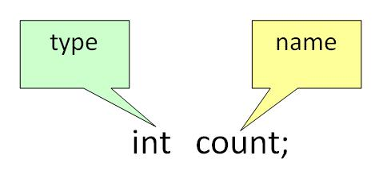
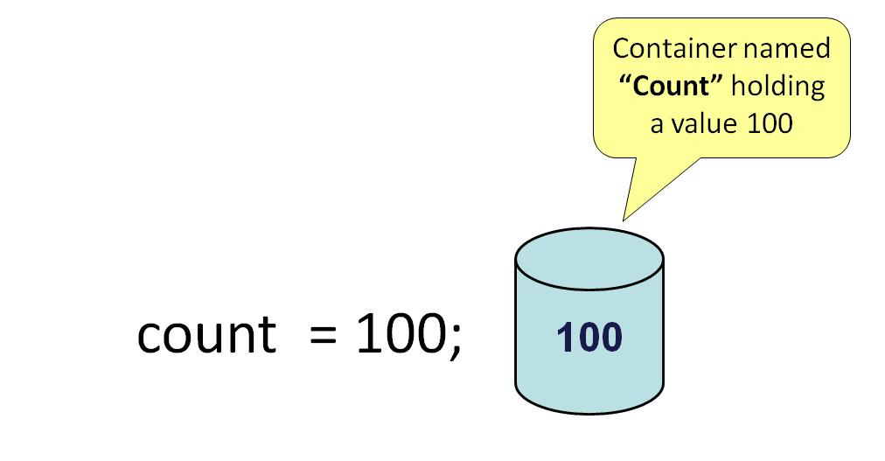
Java Variables
Syntax
type variable = value;
int myNum = 5;
float myFloatNum = 5.99f;
char myLetter = 'D’;
boolean myBool = true;
String myText = "Hello";
if you assign a new value to an existing variable, it will overwrite the previous value:
Example
Change the value of myNum from 15 to 20:
int myNum = 15;
myNum = 20; // myNum is now 20 System.out.println(myNum);
Run example
Final Variables
However, you can add the final keyword if you don't want others (or yourself) to overwrite existing values (this will declare the variable as "final" or "constant", which means unchangeable and read-only):
final int myNum = 15;
myNum = 20; // will generate an error: cannot assign a value to a final variable

Slide 5
Display Variables
String name = "John"; System.out.println("Hello " + name);
//try this program
class Test
{
public static void main(String args[])
{
String firstName = "John ";
String lastName = "Doe";
String fullName = firstName + lastName;
System.out.println(fullName);
System.out.println(“welcome ”+firstName+ “ “+lastName);
}
}
String firstName = "John ";
String lastName = "Doe";
String fullName = firstName + lastName;
System.out.println(fullName);
int x = 5;
int y = 6;
System.out.println(x + y); // Print the value of x + y
int x = 5, y = 6, z = 50;
System.out.println(x + y + z);

Slide 6
The general rules for constructing names for variables (unique identifiers) are:
Names can contain letters, digits, underscores, and dollar signs
Names must begin with a letter
Names should start with a lowercase letter and it cannot contain whitespace
Names can also begin with $ and _
Names are case sensitive ("myVar" and "myvar" are different variables)
Reserved words (like Java keywords, such as int or boolean) cannot be used as names

Slide 7
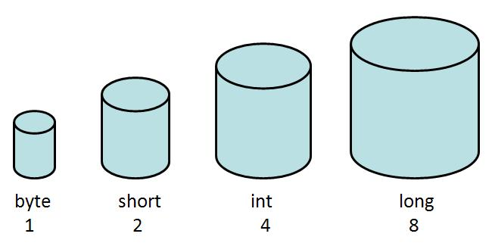
Data Types
Data types are divided into two groups:
Primitive data types – (already defined)
includes byte, short, int, long, float, double, boolean and char
Non-primitive data types – (created by the programmer)
such as String, Arrays and Classes
N0n-primitive are also called reference type because they refer to object.

Slide 8
Primitive Data Types
A primitive data type specifies the size and type of variable values, and it has no additional methods.
There are eight primitive data types in Java:
Data Type | Size | Description
byte | 1 byte | Stores whole numbers from -128 to 127
short | 2 bytes | Stores whole numbers from -32,768 to 32,767
int | 4 bytes | Stores whole numbers from -2,147,483,648 to 2,147,483,647
long | 8 bytes | Stores whole numbers from -9,223,372,036,854,775,808 to 9,223,372,036,854,775,807
float | 4 bytes | Stores fractional numbers. Sufficient for storing 6 to 7 decimal digits
double | 8 bytes | Stores fractional numbers. Sufficient for storing 15 decimal digits
boolean | 1 bit | Stores true or false values
char | 2 bytes | Stores a single character/letter or ASCII values

Slide 9
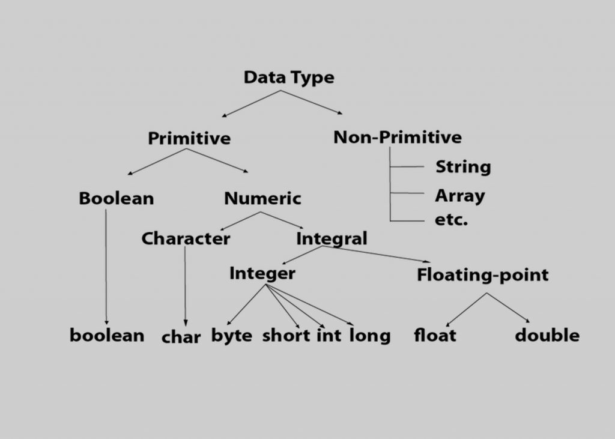
Class

Slide 10
byte:
This can hold whole number between -128 and 127.
Mostly used to save memory and when you are certain that the numbers would be in the limit specified by byte data type.
Default size of this data type: 1 byte.
Default value: 0
class JavaExample
{
public static void main(String[] args)
{
byte num; num = 113;
System.out.println(num);
}
}
Output:
113
Try the same program by assigning value assigning 150 value to variable num, you would get type mismatch error because the value 150 is out of the range of byte data type. The range of byte as I mentioned above is -128 to 127.

Slide 11
class JavaExample
{
public static void main(String[] args)
{ long num = -12332252626L; System.out.println(num);
}
}
class JavaExample
{
public static void main(String[] args)
{
double num = -42937737.9d; System.out.println(num);
}
}
Output:
-4.29377379E7
Output:
-12332252626
class JavaExample
{
public static void main(String[] args)
{
float num = 19.98f;
System.out.println(num);
}
}
Output:
19.98

Slide 12
Literals in Java
A literal is a fixed value that we assign to a variable in a Program.
int num=10;
char ch = 'A';
Here A is a char literal
byte b = 100;
short s = 200;
int num = 13313131;
long l = 928389283L;
double num1 = 22.4;
float num2 = 22.4f;
Note: Always suffix float value with the “f” else compiler will consider it as double.
char ch = 'Z’;
String str = “Hello”;
boolean: holds either true of false.
class JavaExample
{
public static void main(String[] args)
{
boolean b = false;
System.out.println(b);
}
}
Output:
false

Slide 13
String
A String in Java is actually a non-primitive data type, because it refers to an object.
The String object has methods that are used to perform certain operations on strings.
Why char uses 2 byte in java and what is \u0000 ?
It is because java uses Unicode system not ASCII code system. The \u0000 is the lowest range of Unicode system.

Slide 14
Non-Primitive Data Types
Non-primitive data types are called reference types because they refer to objects.
The main difference between primitive and non-primitive data types are:
Primitive types are predefined (already defined) in Java. Non-primitive types are created by the programmer and is not defined by Java (except for String).
Non-primitive types can be used to call methods to perform certain operations, while primitive types cannot.
A primitive type has always a value, while non-primitive types can be null.
A primitive type starts with a lowercase letter, while non-primitive types starts with an uppercase letter.
The size of a primitive type depends on the data type, while non-primitive types have all the same size.
Examples of non-primitive types are Arrays, Classes, Interface, etc. You will learn more about these in a later chapter.

Slide 15
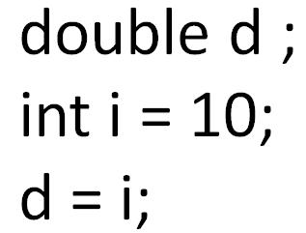
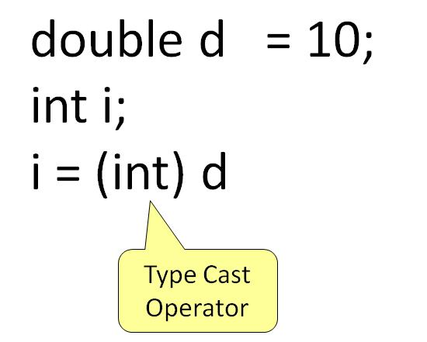
Java Type Casting
A variable of one type can receive the value of another type. Here there are 2 cases -
Case 1) Variable of smaller capacity is be assigned to another variable of bigger capacity. This process is Automatic, and non-explicit is known as Conversion
Case 2) Variable of larger capacity is be assigned to another variable of smaller capacity
In such cases, you have to explicitly specify the type cast operator. This process is known as Type Casting.
In case, you do not specify a type cast operator; the compiler gives an error. Since this rule is enforced by the compiler, it makes the programmer aware that the conversion he is about to do may cause some loss in data and prevents accidental losses.

Slide 16
Widening Casting
Widening casting is done automatically when passing a smaller size type to a larger size type:
Example
public class MyClass
{
public static void main(String[] args)
{
int myInt = 9;
double myDouble = myInt; // Automatic casting: int to double
System.out.println(myInt); // Outputs 9
System.out.println(myDouble); // Outputs 9.0
}
}

Slide 17
Narrowing Casting
Narrowing casting must be done manually by placing the type in parentheses in front of the value:
Example
public class MyClass
{
public static void main(String[] args)
{
double myDouble = 9.78;
int myInt = (int) myDouble; // Manual casting: double to int
System.out.println(myDouble); // Outputs 9.78
System.out.println(myInt); // Outputs 9
}
}

Slide 18
class Demo
{
public static void main(String args[])
{
byte x;
int a = 270;
double b = 128.128;
System.out.println("int converted to byte");
x = (byte) a;
System.out.println("a and x " + a + " " + x);
System.out.println("double converted to int");
a = (int) b;
System.out.println("b and a " + b + " " + a);
System.out.println("\ndouble converted to byte");
x = (byte)b;
System.out.println("b and x " + b + " " + x);
}
}
int converted to byte
a and x 270 14
double converted to int
b and a 128.128 128
double converted to byte
b and x 128.128 -128
When an integer value is converted into a byte, Java cuts-off the left-most 24 bits.

Slide 19
Java User Input (Scanner)
The Scanner class is used to get user input, and it is found in the java.util package.
import java.util.Scanner; // Import the Scanner class
class MyClass
{
public static void main(String[] args)
{
Scanner myObj = new Scanner(System.in); // Create a Scanner object
System.out.println("Enter username");
String userName = myObj.nextLine(); // Read user input
System.out.println("Username is: " + userName); // Output user input
}
}

Slide 20
Input Types
In the example above, we used the nextLine() method, which is used to read Strings. To read other types, look at the table below:
Method | Description
nextBoolean() | Reads a boolean value from the user
nextByte() | Reads a byte value from the user
nextDouble() | Reads a double value from the user
nextFloat() | Reads a float value from the user
nextInt() | Reads a int value from the user
nextLine() | Reads a String value from the user
nextLong() | Reads a long value from the user
nextShort() | Reads a short value from the user

Slide 21
import java.util.Scanner;
class MyClass
{
public static void main(String[] args)
{
Scanner myObj = new Scanner(System.in);
System.out.println("Enter name, age and salary:");
String name = myObj.nextLine(); // String input
int age = myObj.nextInt(); // Numerical input
double salary = myObj.nextDouble(); //Double input
System.out.println("Name: " + name);
System.out.println("Age: " + age);
System.out.println("Salary: " + salary);
}
}
Note: If you enter wrong input (e.g. text in a numerical input), you will get an exception/error message (like "InputMismatchException").
You will study more about exceptions and how to handle errors in the Exceptions chapter.

Slide 22
import java.util.Scanner;
class ScannerDemo1
{
public static void main(String[] args)
{
Scanner sc = new Scanner(System.in);
String name = sc.nextLine();
char gender = sc.next().charAt(0); // Character input
int age = sc.nextInt();
long mobileNo = sc.nextLong();
double cgpa = sc.nextDouble();
System.out.println("Name: "+name);
System.out.println("Gender: "+gender);
System.out.println("Age: "+age);
System.out.println("Mobile Number: "+mobileNo);
System.out.println("CGPA: "+cgpa);
}
}

Slide 23
Java Programs
Java Program to print hello message.
Java Program to Add two numbers. (read i/p from user)
Java Program to Multiply two numbers (read i/p from user)
Java Program to swap two numbers without using third variable.
Java Program to swap two numbers with
using third variable.
Java Program to print ASCII value of a character.

