Slide 1
JAVA STRINGS
CHAPTER 1

Slide 2
Java Strings
Strings are used for storing text.
A String variable contains a collection of characters surrounded by double quotes:
Example
Create a variable of type String and assign it a value:
String greeting = "Hello";

Slide 3
String Length
A String in Java is actually an object, which contain methods that can perform certain operations on strings.
For example, the length of a string can be found with the length() method:
String txt = "ABCDEFGHIJKLMNOPQRSTUVWXYZ";
System.out.println("The length of the txt string is: " + txt.length());

Slide 4
More String Methods
There are many string methods available, for example toUpperCase() and toLowerCase():
Example
String txt = "Hello World";
System.out.println(txt.toUpperCase()); // Outputs "HELLO WORLD"
System.out.println(txt.toLowerCase()); // Outputs "hello world"
Run example

Slide 5
Finding a Character in a String
The indexOf() method returns the index (the position) of the first occurrence of a specified text in a string (including whitespace):
Example
String txt = "Please locate where 'locate' occurs!";
System.out.println(txt.indexOf("locate")); // Outputs 7
Java counts positions from zero. 0 is the first position in a string, 1 is the second, 2 is the third ...

Slide 6
String Concatenation
The + operator can be used between strings to combine them.
This is called concatenation:
Example
String firstName = "John"; String lastName = "Doe"; System.out.println(firstName + " " + lastName);
Run example
You can also use the concat() method to concatenate two strings:
Example
String firstName = "John ";
String lastName = "Doe";
System.out.println(firstName.concat(lastName));

Slide 7
Special Characters
Because strings must be written within quotes, Java will misunderstand this string, and generate an error:
String txt = "We are the so-called "Vikings" from the north.";
The solution to avoid this problem, is to use the backslash escape character.
The backslash (\) escape character turns special characters into string characters:
Escape character | Result | Description
\' | ' | Single quote
\" | " | Double quote
\\ | \ | Backslash

Slide 8
Example
String txt = "We are the so-called \"Vikings\" from the north.";
String txt = "It\'s alright.";
String txt = "The character \\ is called backslash.";
Code | Result
\n | New Line
\r | Carriage Return
\t | Tab
\b | Backspace
\f | Form Feed

Slide 9
Adding Numbers and Strings
Java uses the + operator for both addition and concatenation.
Numbers are added. Strings are concatenated.
int x = 10;
int y = 20;
int z = x + y;
// z will be 30 (an integer/number)
String x = "10";
String y = "20";
String z = x + y;
// z will be 1020 (a String)
String x = "10";
int y = 20;
String z = x + y;
// z will be 1020 (a String

Slide 10
Java Math
class MyClass
{
public static void main(String[] args)
{
System.out.println(Math.max(5, 10));
}
}
Output
10
Math.min(5, 10);
Math.sqrt(64);
Math.abs(-4.7); returns absolute (positive) value.
Output
4.7
Math.random() returns a random number between 0.0 (inclusive), and 1.0 (exclusive):
Math.random();
Output
0.5985020495804849
To get more control over the random number, e.g. you only want a random number between 0 and 100, you can use the following formula:
int randomNum = (int)(Math.random() * 101); // 0 to 100
Output
10

Slide 11
Boolean Values
Java has a boolean data type, which can take the values true or false.
A boolean type is declared with the boolean keyword and can only take the values true or false:
boolean isJavaFun = true;
boolean isFishTasty = false;
System.out.println(isJavaFun); // Outputs true
System.out.println(isFishTasty); // Outputs false
int x = 10;
int y = 9;
System.out.println(x > y);
// returns true, because 10 is higher than 9
int x = 10;
System.out.println(x == 10);
// returns true, because the value of x is equal to 10

Slide 12
Command Line arguments in Java
If we run a Java Program by writing the command
“java Hello welcome to the world of java”
where the name of the class is “Hello”, then it will run upto Hello. It is command upto “Hello” and after that i.e “welcome to the world of java”, these are command line arguments.
When command line arguments are supplied to JVM, JVM wraps these and supply to args[]. It can be confirmed that they are actually wrapped up in args array by checking the length of args using args.length

Slide 13
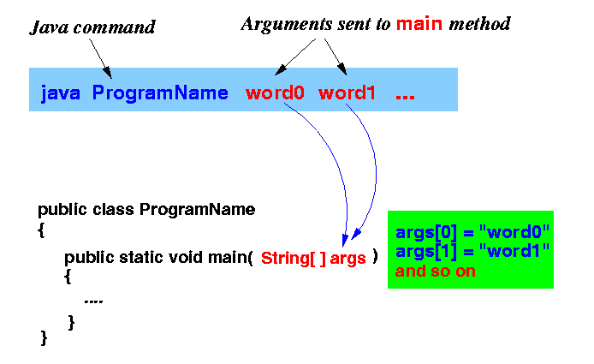

Slide 14
class Hello
{
public static void main(String[] args)
{
// check if length of args array is greater than 0
if (args.length > 0)
{
System.out.println("The command line arguments are:");
// iterating the args array and printing the command line arguments
for (String val:args)
System.out.println(val);
}
else
System.out.println("No command line "+ "arguments found.");
}
}

