Slide 1
JAVA aRRAYS
CHAPTER 1

Slide 2

Java ARRAYS
An array refers to a data structure that contains homogeneous elements. This means that all the elements in the array are of the same data type.
There are three main features of an array:
Dynamic allocation: In arrays, the memory is created dynamically, which reduces the amount of storage required for the code.
Elements stored under a single name: All the elements are stored under one name. This name is used any time we use an array.
Occupies contiguous location: The elements in the arrays are stored at adjacent positions. This makes it easy for the user to find the locations of its elements.

Slide 3
Java ARRAYS
Advantages of Arrays in Java
Java arrays enable you to access any element randomly with the help of indexes
It is easy to store and manipulate large data sets
Disadvantages of Arrays in Java
The size of the array cannot be increased or decreased once it is declared—arrays have a fixed size
Java cannot store heterogeneous data. It can only store a single type of primitives

Slide 4
Java ARRAYS
//declare and initialize and array
int[] age = {12, 4, 5, 2, 5};
Or
int age[]={12,4,5,2,5};
// declare an array int[] data;
// allocate memory data = new int[10];
int[] data=new int[10];
Or
int data[]=new int[10];

Slide 5
Java ARRAYS
String[] cars = {"Volvo", "BMW", "Ford", "Mazda"};
for (int i = 0; i < cars.length; i++)
{
System.out.println(cars[i]);
}
String[] cars = {"Volvo", "BMW", "Ford", "Mazda"};
for (String i : cars)
{
System.out.println(i);
}
declaration, instantiation and initialization
for each String element (called i - as in index) in cars, print out the value of i.
If you compare the for loop and for-each loop, you will see that the for-each method is easier to write, it does not require a counter (using the length property), and it is more readable

Slide 6
Java ARRAYS
Instantiation of an Array in Java
arrayRefVar=new datatype[size];
//Java Program to illustrate how to declare, instantiate, initialize
//and traverse the Java array.
class Testarray
{
public static void main(String args[])
{
int a[]=new int[5];
a[0]=10;
a[1]=20;
a[2]=70;
a[3]=40;
a[4]=50;
for(int i=0;i<a.length;i++)//length is the property of array
System.out.println(a[i]);
}
}
//declaration and instantiation
//initialization
//traversing array

Slide 7
import java.util.Scanner;
class ArrayExample
{
public static void main(String args[])
{
System.out.println("Enter the required size of the array");
Scanner s = new Scanner(System.in);
int size = s.nextInt();
int myArray[] = new int [size];
System.out.println("Enter the elements of the array one by one ");
for(int i = 0; i<size; i++)
{
myArray[i] = s.nextInt();
}
for(int i = 0; i<size; i++)
{
System.out.println(“myArray[“ + i + “]=” + myArray[i])
}
}
}

Slide 8
ArrayIndexOutOfBoundsException
The Java Virtual Machine (JVM) throws an ArrayIndexOutOfBoundsException if length of the array in negative, equal to the
array size or greater than the array size while traversing the array.
//Java Program to demonstrate the case of
//ArrayIndexOutOfBoundsException in a Java Array.
class TestArrayException
{
public static void main(String args[])
{
int arr[]={50,60,70,80};
for(int i=0;i<=arr.length;i++)
{
System.out.println(arr[i]);
}
}
}
Test it No
Output:
Exception in thread "main" java.lang.ArrayIndexOutOfBoundsException: 4 at TestArrayException.main(TestArrayException.java:5)
50
60
70
80

Slide 9
Multidimensional Arrays
A multidimensional array is an array containing one or more arrays.
int[][] myNumbers = { {1, 2, 3, 4}, {5, 6, 7, 8} };
int x = myNumbers[1][2];
System.out.println(x); // Outputs 7
[0] [1] [2] [3]
[0] 1 2 3 4
[1] 5 6 7 8
public class MyClass
{
public static void main(String[] args)
{
int[][] myNumbers = { {1, 2, 3, 4}, {5, 6, 7} };
for (int i = 0; i < myNumbers.length; ++i)
{
for(int j = 0; j < myNumbers[i].length; ++j)
{
System.out.println(myNumbers[i][j]);
} }
}
}
[0] [1] [2] [3]
[0] 1 2 3 4
[1] 5 6 7

Slide 10
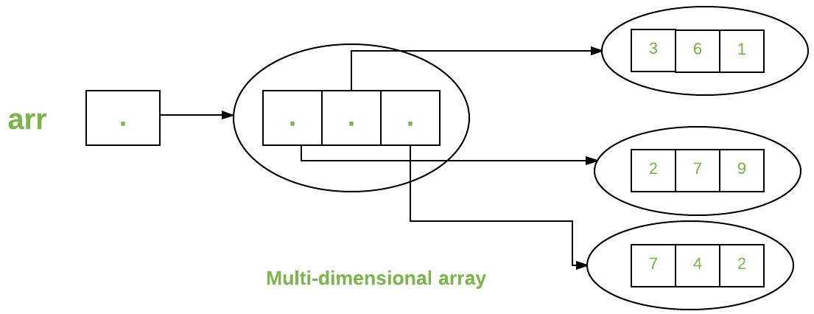
class multiDimensional
{
public static void main(String args[])
{
// declaring and initializing 2D array
int arr[][] = { {2,7,9},{3,6,1},{7,4,2} };
// printing 2D array
for (int i=0; i< 3 ; i++)
{
for (int j=0; j < 3 ; j++)
System.out.print(arr[i][j] + " ");
System.out.println();
}
}
}

Slide 11
VARIABLE SIZE ARRAYS
int x[][]=new int[3][];
X[0]=new int[2];
X[1]=new int[4];
X[2]=new int[3];
for (int i = 0; i < x.length; ++i)
{
for(int j = 0; j < x[i].length; ++j)
{
System.out.println(x[i][j]);
} }

Slide 12
public class Main
{
public static void main(String[] args)
{
int [][]a = new int[10][10];
for(int i = 0; i < 10; i++)
{
for(int j = 0; j < 10; j++)
{
System.out.printf("%2d ", a[i][j]);
}
System.out.println();
}
}
}
0 0 0 0 0 0 0 0 0 0
0 0 0 0 0 0 0 0 0 0
0 0 0 0 0 0 0 0 0 0
0 0 0 0 0 0 0 0 0 0
0 0 0 0 0 0 0 0 0 0
0 0 0 0 0 0 0 0 0 0
0 0 0 0 0 0 0 0 0 0
0 0 0 0 0 0 0 0 0 0
0 0 0 0 0 0 0 0 0 0
0 0 0 0 0 0 0 0 0 0

Slide 13
Sum values of an array
public class Exercise2
{
public static void main(String[] args)
{
int my_array[] = {1, 2, 3, 4, 5, 6, 7, 8, 9, 10};
int sum = 0;
for (int i : my_array)
sum += i;
System.out.println("The sum is " + sum);
}
}

Slide 14
Passing value To a method in java
class First
{
static void sum(int a, int b)
{
System.out.println("Sum="+(a+b));
}
public static void main(String args[ ])
{
int a=10, b=20;
sum(10,20);
}
}

Slide 15
Returning value from the Method
class First
{
static int sum(int a, int b)
{
return (a+b);
}
public static void main(String args[ ])
{
int a=10, b=20;
int s= sum(10,20);
System.out.println("sum="+s);
}
}

Slide 16
Passing Array to a Method in Java
//Java Program to demonstrate the way of passing an array to method.
class Testarray2
{
static void min(int arr[]) //creating a method which receives an array as a parameter
{
int min=arr[0];
for(int i=1;i<arr.length;i++)
if(min>arr[i]) 12., 45, 89, 67, 9
min=arr[i];
System.out.println(min);
}
public static void main(String args[])
{
int a[]={33,3,4,5};//declaring and initializing an array
min(a);//passing array to method
}
}

Slide 17
Returning Array from the Method
//Java Program to return an array from the method
class TestReturnArray
{
//creating method which returns an array
static int[] get()
{
int a[]={10,30,50,90,60}; //or int arr[]=new int[]{10,30,50,90,60};
return a;
}
public static void main(String args[])
{
//calling method which returns an array
int arr[]=get();
//printing the values of an array
for(int i=0;i<arr.length;i++)
System.out.println(arr[i]);
}
}

Slide 18
public class Exercise5
{
public static boolean contains(int[] arr, int item)
{
for (int n : arr)
{
if (item == n)
{
return true;
}
}
return false;
}
public static void main(String[] args)
{
int[] my_array1 = {1789, 2035, 1899, 1456, 2013, 1458, 2458, 1254, 1472, 2365,
1456, 2265, 1457, 2456};
System.out.println(contains(my_array1, 2013));
System.out.println(contains(my_array1, 2015));
}
}

