Slide 1
CLASSES AND OBJECTS IN JAVA
JAVA METHODS

Slide 2
JAVA METHODS
A method is a block of code which only runs when it is called.
You can pass data, known as parameters, into a method.
Methods are used to perform certain actions, and they are also known as functions.
Why use methods? To reuse code: define the code once, and use it many times.

Slide 3
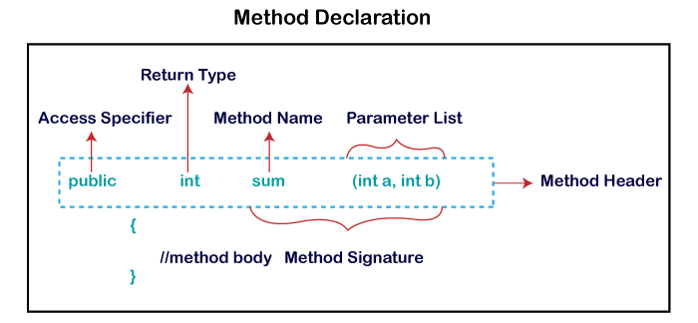

Slide 4
In general, method declarations has six components :
Modifier/Access specifier: Defines access type of the method i.e. from where it can be accessed in your application. In Java, there 4 type of the access specifiers.
public: accessible in all class in your application.
protected: accessible within the class in which it is defined and in its subclass(es)
private: accessible only within the class in which it is defined.
default : (declared/defined without using any modifier) : accessible within same class and package within which its class is defined.
The return type : The data type of the value returned by the method or void if does not return a value.
Method Name : the rules for field names apply to method names as well, but the convention is a little different.
Parameter list : Comma separated list of the input parameters are defined, preceded with their data type, within the enclosed parenthesis. If there are no parameters, you must use empty parentheses ().
Exception list : The exceptions you expect by the method can throw, you can specify these exception(s).
Method body : it is enclosed between braces. The code you need to be executed to perform your intended operations.

Slide 5
METHOD SIGNATURE
It consists of the method name and a parameter list (number of parameters, type of the parameters and order of the parameters). The return type and exceptions are not considered as part of it.
Method Signature of above function:
max(int x, int y)

Slide 6
class MyClass
{
static void myMethod()
{
System.out.println("I just got executed!");
}
public static void main(String[] args)
{
myMethod();
myMethod();
myMethod();
}
}

Slide 7
class MyClass
{
static void myMethod(String fname, int age)
{
System.out.println(fname + " is " + age);
}
public static void main(String[] args)
{
myMethod("Liam", 5);
myMethod("Jenny", 8);
myMethod("Anja", 31);
}
}

Slide 8
class MyClass
{
static int myMethod(int x, int y)
{
return x + y;
}
public static void main(String[] args)
{
int z ;
z= myMethod(5, 3);
System.out.println(z);
}
}

Slide 9
class MyClass
{
static void checkAge(int age)
{
if (age < 18)
{
System.out.println("Access denied - You are not old enough!");
}
else
{
System.out.println("Access granted - You are old enough!");
}
}
public static void main(String[] args)
{
checkAge(20);
}
}

Slide 10
// Program to illustrate methodsin java
import java.io.*;
class Addition
{
int sum = 0;
public int addTwoInt(int a, int b)
{
sum = a + b;
return sum;
}
}
class GFG
{
public static void main (String[] args)
{
Addition add = new Addition();
int s = add.addTwoInt(1,2);
System.out.println("Sum of two integer values :"+ s);
}
}

Slide 11
METHOD OVERLOADING
Method Overloading is a feature that allows a class to have more than one method having the same name, if their argument lists are different.
In order to overload a method, the argument lists of the methods must differ in either of these:
1. Number of parameters.
For example: add(int, int)
add(int, int, int)
2. Data type of parameters.
For example: add(int, int)
add(int, float)
3. Sequence of Data type of parameters.
For example: add(int, float)
add(float, int)

Slide 12
class DisplayOverloading
{
public void disp(char c)
{
System.out.println(c);
}
public void disp(char c, int num)
{
System.out.println(c + " "+num);
}
}
class Sample
{
public static void main(String args[])
{
DisplayOverloading obj = new DisplayOverloading();
obj.disp('a');
obj.disp('a',10);
}
}

Slide 13
class DisplayOverloading2
{
public void disp(char c)
{
System.out.println(c);
}
public void disp(int c)
{
System.out.println(c );
}
}
class Sample2
{
public static void main(String args[])
{
DisplayOverloading2 obj = new DisplayOverloading2();
obj.disp('a');
obj.disp(5);
}
}

Slide 14
Lets see few Valid/invalid cases of method overloading
Case 1:
int mymethod(int a, int b, float c)
int mymethod(int var1, int var2, float var3)
Result: Compile time error. Argument lists are exactly same. Both methods are having same number, data types and same sequence of data types.
Case 2:
int mymethod(int a, int b)
int mymethod(float var1, float var2)
Result: Perfectly fine. Valid case of overloading. Here data types of arguments are different.
Case 3:
int mymethod(int a, int b)
int mymethod(int num)
Result: Perfectly fine. Valid case of overloading. Here number of arguments are different.

Slide 15
Case 4:
float mymethod(int a, float b)
float mymethod(float var1, int var2)
Result: Perfectly fine. Valid case of overloading. Sequence of the data types of parameters are different, first method is having (int, float) and second is having (float, int).
Case 5:
int mymethod(int a, int b)
float mymethod(int var1, int var2)
Result: Compile time error. Argument lists are exactly same. Even though return type of methods are different, it is not a valid case. Since return type of method doesn’t matter while overloading a method.

Slide 16
class Demo
{
public int myMethod(int num1, int num2)
{
System.out.println("First myMethod of class Demo");
return num1+num2;
}
public int myMethod(int var1, int var2)
{
System.out.println("Second myMethod of class Demo");
return var1-var2;
}
}
class Sample4
{
public static void main(String args[])
{
Demo obj1= new Demo();
obj1.myMethod(10,10);
obj1.myMethod(20,12);
}
}
Answer: It will throw a compilation error: More than one method with same name and argument list cannot be defined in a same class.

Slide 17
class Demo2
{
public double myMethod(int num1, int num2)
{
System.out.println("First myMethod of class Demo");
return num1+num2;
}
public int myMethod(int var1, int var2)
{
System.out.println("Second myMethod of class Demo");
return var1-var2;
}
}
class Sample5
{
public static void main(String args[])
{
Demo2 obj2= new Demo2();
obj2.myMethod(10,10);
obj2.myMethod(20,12);
}
}
Answer:
It will throw a compilation error: More than one method with same name and argument list cannot be given in a class even though their return type is different. Method return type doesn’t matter in case of overloading.

Slide 18
JAVA STATIC KEYWORD
The static keyword in Java is used for memory management mainly. We can apply static keyword with variables, methods, blocks and nested classes. The static keyword belongs to the class than an instance of the class.
The static can be:
Variable (also known as a class variable)
Method (also known as a class method)
Block
Nested class

Slide 19
JAVA STATIC VARIABLE
If you declare any variable as static, it is known as a static variable.
The static variable can be used to refer to the common property of all objects (which is not unique for each object), for example, the company name of employees, college name of students, etc.
The static variable gets memory only once in the class area at the time of class loading.
Advantages of static variable
It makes your program memory efficient (i.e., it saves memory).

Slide 20
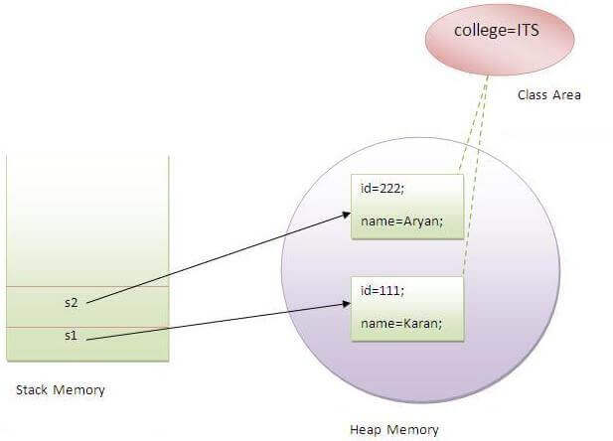

Slide 21
Example of static variable
class Student
{
int rollno;//instance variable
String name;
static String college ="ITS";
void display ()
{
System.out.println(rollno+" "+name+" "+college);
}
}
public class TestStaticVariable
{
public static void main(String args[])
{
Student s1 = new Student();
Student s2 = new Student();
//we can change the college of all objects by the single line of code
//Student.college="BBDIT";
s1.display();
s2.display();
}
}
Output:
111 Karan ITS
222 Aryan ITS

Slide 22
PROGRAM OF THE COUNTER WITHOUT STATIC VARIABLE
class Counter
{
int count=0;
int j;
//will get memory each time when the instance is created
Counter()
{
count++;//incrementing value
System.out.println(count);
}
public static void main(String args[])
{
//Creating objects
Counter c1=new Counter();
Counter c2=new Counter();
Counter c3=new Counter();
}
}
Count=3
J=0
J=0
j=0
c1
c2
c3
Output:
1
1
1

Slide 23
PROGRAM OF COUNTER BY STATIC VARIABLE
class Counter2
{
static int count=0;//will get memory only once and retain its value
Counter2()
{
count++;//incrementing the value of static variable
System.out.println(count);
}
public static void main(String args[])
{
//creating objects
Counter2 c1=new Counter2();
Counter2 c2=new Counter2();
Counter2 c3=new Counter2();
}
}
Output:
1
2
3

Slide 24
JAVA STATIC METHOD
class Calculate
{
static int cube(int x)
{
return x*x*x;
}
public static void main(String args[])
{
int result=Calculate.cube(5);
System.out.println(result);
}
}

Slide 25
RESTRICTIONS FOR THE STATIC METHOD
There are two main restrictions for the static method. They are:
The static method can not use non static data member or call non-static method directly.
this and super cannot be used in static context.
class A
{
int a=40;//non static
public static void main(String args[])
{
System.out.println(a);
}
}
Output:Compile Time Error

Slide 26
why is the java main method static? it is because the object is not required to call a static method. if it were a non-static method, jvm creates an object first then call main() method that will lead the problem of extra memory allocation.

Slide 27
ANONYMOUS OBJECT
Anonymous simply means nameless. An object which has no reference is known as an anonymous object. It can be used at the time of object creation only.
If you have to use an object only once, an anonymous object is a good approach. For example:
new Calculation();//anonymous object
Calling method through a reference:
Calculation c=new Calculation();
c.fact(5);
Calling method through an anonymous object
new Calculation().fact(5);

Slide 28
EXAMPLE
class Calculation
{
void fact(int n)
{
int fact=1;
for(int i=1;i<=n;i++)
{
fact=fact*i;
}
System.out.println("factorial is "+fact);
}
public static void main(String args[])
{
new Calculation().fact(5);//calling method with anonymous object
}
}

