Slide 1
Classes and objects in java
this Keyword

Slide 2
First, let's see an example without using this keyword:
class Main
{
int age;
Main(int age)
{
age = age;
}
public static void main(String[] args)
{
Main obj = new Main(8);
System.out.println("obj.age = " + obj.age);
}
}
Output:
obj.age = 0
In the above example, we have passed 8 as a value to the constructor. However, we are getting 0 as an output. This is because the Java compiler gets confused because of the ambiguity in names between instance the variable and the parameter.

Slide 3
Now, let's rewrite the above code using this keyword.
class Main
{
int age;
Main(int age)
{
this.age = age;
}
public static void main(String[] args)
{
Main obj = new Main(8);
System.out.println("obj.age = " + obj.age);
}
}
Output:
obj.age = 8
Now, we are getting the expected output. It is because when the constructor is called, this inside the constructor is replaced by the object obj that has called the constructor. Hence the age variable is assigned value 8.

Slide 4
In Java, this keyword is used to refer to the current object inside a method or a constructor. For example,
class Main
{
int instVar;
Main(int instVar)
{
this.instVar = instVar;
System.out.println("this reference = " + this);
}
public static void main(String[] args)
{
Main obj = new Main(8);
System.out.println("object reference = " + obj);
}
}
Output:
this reference = Main@4f023edb
object reference = Main@4f023edb

Slide 5
Using this for Ambiguity Variable Names
In Java, it is not allowed to declare two or more variables having the same name inside a scope (class scope or method scope). However, instance variables and parameters may have the same name. For example,
class MyClass
{
int age; // instance variable
MyClass(int age) // parameter
{
age = age;
}
}
In the above program, the instance variable and the parameter have the same name: age. Here, the Java compiler is confused due to name ambiguity.
In such a situation, we use this keyword.

Slide 6
if the name of the parameter and instance variable is different, the compiler automatically appends this keyword. For example, the code:
class Main
{
int age;
Main(int i)
{
age = i;
}
}
class Main
{
int age;
Main(int i)
{
this.age = i;
}
}

Slide 7
Another common use of this keyword is in setters and getters methods of a class. For example:
class Main
{
String name;
void setName( String name ) // setter method
{
this.name = name;
}
String getName() // getter method
{
return this.name;
}
public static void main( String[] args )
{
Main obj = new Main();
// calling the setter and the getter method
obj.setName("Toshiba");
System.out.println("obj.name: "+obj.getName());
}
}
Output:
obj.name: Toshiba
Here, we have used this keyword:
to assign value inside the setter method
to access value inside the getter method

Slide 8
Passing and Returning Objects in Java
Although Java is strictly pass by value, the precise effect differs between whether a primitive type or a reference type is passed.
When we pass a primitive type to a method, it is passed by value.
But when we pass an object to a method, the situation changes dramatically, because objects are passed by what is effectively call-by-reference.
While creating a variable of a class type, we only create a reference to an object. Thus, when we pass this reference to a method, the parameter that receives it will refer to the same object as that referred to by the argument.
This effectively means that objects act as if they are passed to methods by use of call-by-reference.
Changes to the object inside the method do reflect in the object used as an argument.

Slide 9
Passing and Returning Objects in Java
As we know that a reference in Java holds the memory location of object created if it is assigned to that reference otherwise it is initiated as null.
Now the point to remember here is that the value of the reference is the memory location of the assigned object,so whenever we pass the reference to any method as argument then we actually pass the memory location of that object which is assigned to that particular reference.
This technically means that the target method has memory location of our created object and can access it to.
So in case if target method access our object and make changes to any of property of it than we would encounter with the changed value in our original object

Slide 10
class ObjectPassDemo
{
int a, b;
ObjectPassDemo(int i, int j)
{
a = i;
b = j;
}
boolean equalTo(ObjectPassDemo o)
{
return (o.a == a && o.b == b);
}
}
// Driver class
public class Test
{
public static void main(String args[])
{
ObjectPassDemo ob1 = new ObjectPassDemo(100, 22);
ObjectPassDemo ob2 = new ObjectPassDemo(100, 22);
ObjectPassDemo ob3 = new ObjectPassDemo(-1, -1);
System.out.println("ob1 == ob2: "+ ob1.equalTo(ob2));
System.out.println("ob1 == ob3: " + ob1.equalTo(ob3));
}
}
Output:
ob1 == ob2: true
ob1 == ob3: false

Slide 11
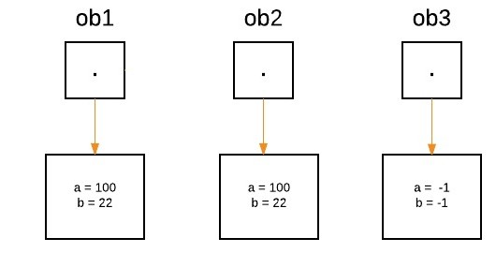
Three objects ‘ob1’ , ‘ob2’ and ‘ob3’ are created:
ObjectPassDemo ob1 = new ObjectPassDemo(100, 22);
ObjectPassDemo ob2 = new ObjectPassDemo(100, 22);
ObjectPassDemo ob3 = new ObjectPassDemo(-1, -1);

Slide 12
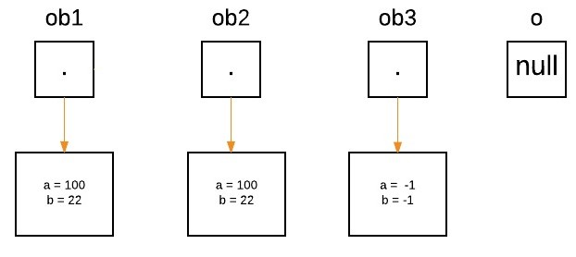
From the method side, a reference of type Foo with a name a is declared and it’s initially assigned to null.
boolean equalTo(ObjectPassDemo o);

Slide 13
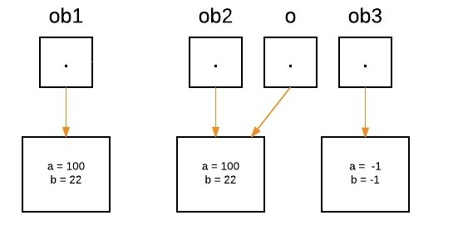
As we call the method equalTo, the reference ‘o’ will be assigned to the object which is passed as an argument, i.e. ‘o’ will refer to ‘ob2’ as following statement execute.
System.out.println("ob1 == ob2: " + ob1.equalTo(ob2));
Now as we can see, equalTo method is called on ‘ob1’ , and ‘o’ is referring to ‘ob2’. Since values of ‘a’ and ‘b’ are same for both the references, so if(condition) is true, so boolean true will be return.
if(o.a == a && o.b == b)

Slide 14
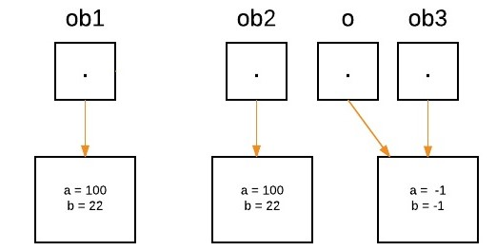
Again ‘o’ will reassign to ‘ob3’ as the following statement execute.
System.out.println("ob1 == ob3: " + ob1.equalTo(ob3));
Now as we can see, equalTo method is called on ‘ob1’ , and ‘o’ is referring to ‘ob3’. Since values of ‘a’ and ‘b’ are not same for both the references, so if(condition) is false, so else block will execute and false will be return.

Slide 15
class EmployeeTest
{
String name;
public String getName()
{
return name;
}
public void setName(String name)
{
this.name = name;
}
}
public class PassByValue
{
static int k =10;
static void passPrimitive(int j)
{
System.out.println("the value of passed primitive is " + j);
j = j + 1;
}
static void passReference(EmployeeTest emp)
{
EmployeeTest reference = emp;
System.out.println("the value of name property of our object is "+ emp.getName());
reference.setName("Bond");
}
public static void main(String[] args)
{
EmployeeTest ref = new EmployeeTest();
ref.setName("James");
passPrimitive(k);
System.out.println("Value of primitive after get passed to method is "+ k);
passReference(ref);
System.out.println("Value of property of object after reference get passed to method is” +ref.getName());
}
}
the value of passed primitive is 10
Value of primitive after get passed to method is 10
the value of name property of our object is James
Value of property of object after reference get passed to method is Bond

Slide 16
Defining a constructor that takes an object of its class as a parameter
class Box
{
double width, height, depth;
Box(Box ob)
{
width = ob.width;
height = ob.height;
depth = ob.depth;
}
Box(double w, double h, double d)
{
width = w;
height = h;
depth = d;
}
double volume()
{
return width * height * depth;
}
}

Slide 17
// driver class
public class Test
{
public static void main(String args[])
{
Box mybox = new Box(10, 20, 15);
Box myclone = new Box(mybox);
double vol;
vol = mybox.volume();
System.out.println("Volume of mybox is " + vol);
vol = myclone.volume();
System.out.println("Volume of myclone is " + vol);
}
}
Output:
Volume of mybox is 3000.0
Volume of myclone is 3000.0

Slide 18
Returning Objects
// Driver class
public class Test
{
public static void main(String args[])
{
ObjectReturnDemo ob1 = new ObjectReturnDemo(2);
ObjectReturnDemo ob2;
ob2 = ob1.incrByTen();
System.out.println("ob1.a: " + ob1.a);
System.out.println("ob2.a: " + ob2.a);
}
}
class ObjectReturnDemo
{
int a;
ObjectReturnDemo(int i)
{
a = i;
}
ObjectReturnDemo incrByTen()
{
ObjectReturnDemo temp = new ObjectReturnDemo(a+10);
return temp;
}
}
Output:
ob1.a: 2
ob2.a: 12

Slide 19
Access Modifiers in Java
There are two types of modifiers in Java: access modifiers and non-access modifiers.
The access modifiers in Java specifies the accessibility or scope of a field, method, constructor, or class.
We can change the access level of fields, constructors, methods, and class by applying the access modifier on it.

Slide 20
Access Modifiers in Java
There are four types of Java access modifiers:
Private: The access level of a private modifier is only within the class. It cannot be accessed from outside the class.
Default: The access level of a default modifier is only within the package. It cannot be accessed from outside the package. If you do not specify any access level, it will be the default.
Protected: The access level of a protected modifier is within the package and outside the package through child class. If you do not make the child class, it cannot be accessed from outside the package.
Public: The access level of a public modifier is everywhere. It can be accessed from within the class, outside the class, within the package and outside the package.
There are many non-access modifiers, such as static, abstract, synchronized, native, volatile, transient, etc. Here, we are going to learn the access modifiers only.

Slide 21
