Slide 1
JAVA INHERITANCE

Slide 2
JAVA INHERITANCE (EXTENDING CLASSES)
In Java, it is possible to inherit attributes and methods from one class to another.
For example, a child inherits the traits of his/her parents.
With inheritance, we can reuse the fields and methods of the existing class.
Hence, inheritance facilitates Reusability and is an important concept of OOPs
Inheritance represents the IS-A relationship which is also known as a parent-child relationship..

Slide 3
JAVA INHERITANCE
The class which inherits the properties of other is known as subclass (derived class, child class) and the class whose properties are inherited is known as superclass (base class, parent class).
Reusability: Inheritance supports the concept of “reusability”, i.e. when we want to create a new class and there is already a class that includes some of the code that we want, we can derive our new class from the existing class. By doing this, we are reusing the fields and methods of the existing class.

Slide 4
THE SYNTAX OF JAVA INHERITANCE
class Super
{
.....
.....
}
class Sub extends Super
{
.....
.....
}

Slide 5
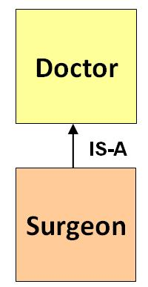
JAVA INHERITANCE EXAMPLE

Slide 6
class Doctor
{
void Doctor_Details()
{
System.out.println("Doctor Details...");
}
}
class Surgeon extends Doctor
{
void Surgeon_Details()
{
System.out.println("Surgen Detail...");
}
}
public class Hospital
{
public static void main(String args[])
{
Surgeon s = new Surgeon();
s.Doctor_Details();
s.Surgeon_Details();
}
}

Slide 7
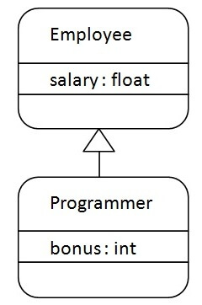
JAVA INHERITANCE EXAMPLE
class Employee
{
float salary=40000;
}
class Programmer extends Employee
{
int bonus=10000;
public static void main(String args[])
{
Programmer p=new Programmer();
System.out.println("Programmer salary is:"+p.salary);
System.out.println("Bonus of Programmer is:"+p.bonus);
}
}

Slide 8
class Calculation
{
int z;
public void addition(int x, int y)
{
z = x + y;
System.out.println("The sum of the given numbers:"+z);
}
public void Subtraction(int x, int y)
{
z = x - y;
System.out.println("The difference between the given numbers:"+z);
}
}
class My_Calculation extends Calculation
{
public void multiplication(int x, int y)
{
z = x * y;
System.out.println("The product of the given numbers:"+z);
}
public static void main(String args[])
{
int a = 20, b = 10;
My_Calculation demo = new My_Calculation();
demo.addition(a, b);
demo.Subtraction(a, b);
demo.multiplication(a, b);
}
}

Slide 9
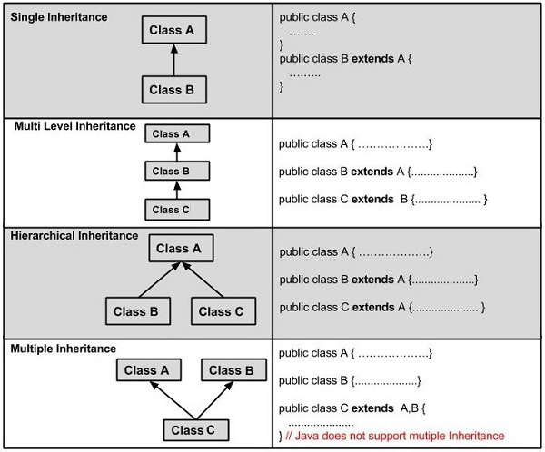
TYPES OF INHERITANCE IN JAVA

Slide 10
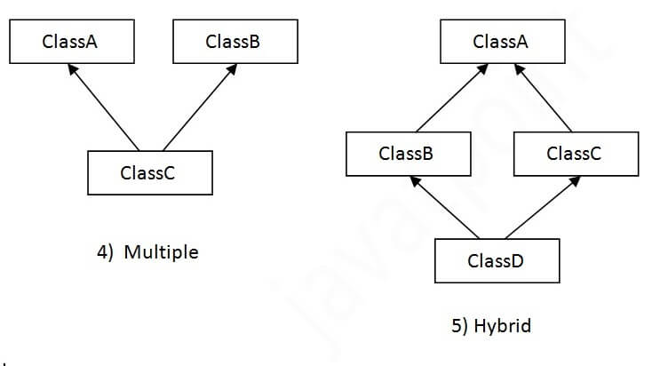
TYPES OF INHERITANCE IN JAVA
Hybrid Inheritance:
Hybrid inheritance is a combination of Single and Multiple inheritance.

Slide 11
WHY MULTIPLE INHERITANCE IS NOT SUPPORTED IN JAVA?
To reduce the complexity and simplify the language, multiple inheritance is not supported in java.
Consider a scenario where A, B, and C are three classes. The C class inherits A and B classes. If A and B classes have the same method and you call it from child class object, there will be ambiguity to call the method of A or B class.
Since compile-time errors are better than runtime errors, Java renders compile-time error if you inherit 2 classes. So whether you have same method or different, there will be compile time error.

Slide 12
class A
{
void msg()
{
System.out.println("Hello");
}
}
class B
{
void msg()
{
System.out.println("Welcome");
}
}
class C extends A,B
{
public static void main(String args[])
{
C obj=new C();
obj.msg();//Now which msg() method would be invoked?
}
}
Compile Time Error

Slide 13
INHERITANCE AND CONSTRUCTORS IN JAVA
constructor of sub class is invoked when we create the object of subclass, it by default invokes the default constructor of super class.
Hence, in inheritance the objects are constructed top-down.
The superclass constructor can be called explicitly using the super keyword, but it should be first statement in a constructor.
The super keyword refers to the superclass, immediately above of the calling class in the hierarchy.
The use of multiple super keywords to access an ancestor class other than the direct parent is not permitted

Slide 14
class ParentClass
{
ParentClass() //Parent class constructor
{
System.out.println("Constructor of Parent");
}
}
class JavaExample extends ParentClass
{
JavaExample() //child class constructor
{
System.out.println("Constructor of Child");
}
public static void main(String args[])
{
JavaExample Jobj=new JavaExample();
}
}
Output:
Constructor of Parent
Constructor of Child

Slide 15
class A
{
A() // LINE A
{
System.out.println("Created A");
}
}
class B extends A
{
B()
{
System.out.println("Created B");
}
}
class C extends B
{
C()
{
System.out.println("Created C");
}
}
class MultiLevelDefaultConstructors
{
public static void main(String arg[])
{
System.out.println("---------------");
A a = new A();
System.out.println("---------------");
B b = new B();
System.out.println("---------------");
C c = new C();
System.out.println("---------------");
}
}
OUTPUT
---------------
Created A
---------------
Created A
Created B
---------------
Created A
Created B
Created C

Slide 16
class Person
{
Person()
{
System.out.println("Person class Constructor");
}
}
class Student extends Person
{
Student()
{
super(); // invoke or call parent class constructor
System.out.println("Student class Constructor");
}
}
class Test
{
public static void main(String[] args)
{
Student s = new Student();
}
}
Output:
Person class Constructor
Student class Constructor

Slide 17
PARAMETERIZED SUPER() CALL TO INVOKE PARAMETERIZED CONSTRUCTOR OF PARENT CLASS
We can call super() explicitly in the constructor of child class, but it would not make any sense because it would be redundant. It’s like explicitly doing something which would be implicitly done otherwise.
However when we have a constructor in parent class that takes arguments then we can use parameterized super, like super(100); to invoke parameterized constructor of parent class from the constructor of child class.

Slide 18
class Parentclass
{
Parentclass()
{
System.out.println("no-arg constructor of parent class");
}
Parentclass(String str)
{
System.out.println("parameterized constructor of parent class");
}
}
class Subclass extends Parentclass
{
Subclass()
{
super(“Welcome");
System.out.println("Constructor of child class");
}
void display()
{
System.out.println("Hello");
}
public static void main(String args[])
{
Subclass obj= new Subclass();
obj.display();
}
}
/* super() must be added to the first statement of constructor otherwise you will get a compilation error. Another important point to note is that when we explicitly use super in constructor the compiler doesn't invoke the parent constructor automatically.*/
Output:
parameterized constructor of parent class
Constructor of child class
Hello

Slide 19
class A
{
int i;
A(int i)
{
this.i=i;
System.out.println("Created A");
}
}
class B extends A
{
B(int i, int j)
{
super(i);
this.j=j;
System.out.println("Created B");
}
}
class C extends B
{
C(int i, int j, int k)
{
super(i,j);
this.k=k;
System.out.println("Created C");
}
}
class MultiLevelDefaultConstructors
{
public static void main(String arg[])
{
System.out.println("---------------");
A a = new A(10);
System.out.println("---------------");
B b = new B(11,21);
System.out.println("---------------");
C c = new C(12,22,32);
System.out.println("---------------");
}
}
OUTPUT
---------------
Created A
---------------
Created A
Created B
---------------
Created A
Created B
Created C

Slide 20
THE USE OF SUPER KEYWORD
To access the data members of parent class when both parent and child class have member with same name.
2) To explicitly call the no-arg and parameterized constructor of parent class
3) To access the method of parent class when child class has overridden that method.

Slide 21
HOW TO USE SUPER KEYWORD TO ACCESS THE VARIABLES OF PARENT CLASS

Slide 22
When you have a variable in child class which is already present in the parent class then in order to access the variable of parent class, you need to use the super keyword.
//Parent class or Superclass or base class
class Superclass
{
int num = 100;
}
//Child class or subclass or derived class
class Subclass extends Superclass
{
/* The same variable num is declared in the Subclass which is already present in the Superclass*/
int num = 110;
void printNumber()
{
System.out.println(num);
}
public static void main(String args[])
{
Subclass obj= new Subclass();
obj.printNumber();
}
}
Output:
110

Slide 23
class Superclass
{
int num = 100;
}
class Subclass extends Superclass
{
int num = 110;
void printNumber(){
/* Note that instead of writing num we are
* writing super.num in the print statement
* this refers to the num variable of Superclass
*/
System.out.println(super.num);
}
public static void main(String args[]){
Subclass obj= new Subclass();
obj.printNumber();
}
}
Output:
100

Slide 24
HOW TO USE SUPER KEYWORD IN CASE OF METHOD OVERRIDING
class Subclass extends Parentclass
{
//Overriding method
void display()
{
System.out.println("Child class method");
}
void printMsg()
{
//This would call Overriding method
display();
//This would call Overridden method
super.display();
}
public static void main(String args[])
{
Subclass obj= new Subclass();
obj.printMsg();
}
}
class Parentclass
{
//Overridden method
void display()
{
System.out.println("Parent class method");
}
}
Output:
Child class method
Parent class method

Slide 25
RELATIONSHIP BETWEEN CLASSES IN JAVA
Types of relationship
IS-A (inheritance) : This relationship is used when we extend one class from another class. This is a tightly coupled relationship. If we make changes in parent then changes will happen in all child classes.
HAS-A (Association) : This is loosely coupled relation between classes. If we make changes in one class then it won’t affect other child classes of it.
It has two forms
- Aggregation
- Composition

Slide 26
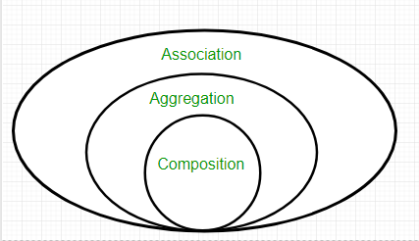
ASSOCIATION, COMPOSITION AND AGGREGATION IN JAVA

Slide 27
Association Association refers to the relationship between multiple objects. It refers to how objects are related to each other and how they are using each other's functionality. Composition and aggregation are two types of association. Composition The composition is the strong type of association. An association is said to composition if an object owns another object and another object cannot exist without the owner object. Consider the case of human having a heart. Here human object contains the heart and heart cannot exist without human. Aggregation Aggregation is a weak association. An association is said to be aggregation if both objects can exist independently. For example, a team object and a player object. The team contains multiple players but a player can exist without the team.

Slide 28
ADVANTAGES OF RELATIONSHIP BETWEEN CLASSES
Code reusability
Cost cutting
Reduce Redundancy – unnecessary code will be removed.

Slide 29
Association
class Bank
{
private String name;
Bank(String name)
{ this.name = name; }
public String getBankName()
{ return this.name; }
}
// Association between both the
// classes in main method
class Association
{
public static void main (String[] args)
{
Bank bank = new Bank("Axis");
Employee emp = new Employee("Neha");
System.out.println(emp.getEmployeeName() +
" is employee of " + bank.getBankName());
}
}
Output:
Neha is employee of Axis
class Employee
{
private String name;
Employee(String name)
{ this.name = name; }
public String getEmployeeName()
{
return this.name;
}
}

Slide 30
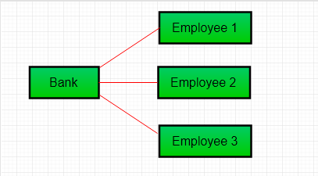
In previous example two separate classes Bank and Employee are associated through their Objects. Bank can have many employees, So it is a one-to-many relationship.

Slide 31
AGGREGATION IN JAVA
Consider a situation, Employee object contains many information such as id, name, emailId etc. It contains one more object named address, which contains its own information such as city, state, country, zipcode etc. as given below.
class Employee
{
int id;
String name;
Address address;//Address is a class
...
}
In such case, Employee has an entity reference address, so relationship is Employee HAS-A address.

Slide 32
WHY USE AGGREGATION? For Code Reusability.

Slide 33
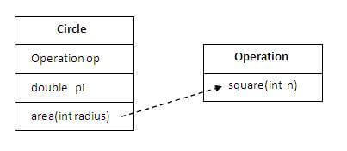
SIMPLE EXAMPLE OF AGGREGATION

Slide 34
class Operation
{
int square(int n)
{
return n*n;
}
}
class Circle
{
Operation op;//aggregation
double pi=3.14;
double area(int radius)
{
op=new Operation();
int rsquare=op.square(radius);//code reusability (i.e. delegates the method call).
return pi*rsquare;
}
public static void main(String args[]){
Circle c=new Circle();
double result=c.area(5);
System.out.println(result);
}
}

Slide 35
WHEN USE AGGREGATION?
Code reuse is also best achieved by aggregation when there is no is-a relationship.
Inheritance should be used only if the relationship is-a is maintained throughout the lifetime of the objects involved; otherwise, aggregation is the best choice.

Slide 36
public class Address
{
String city,state,country;
public Address(String city, String state, String country)
{
this.city = city;
this.state = state;
this.country = country;
}
}
public class Emp
{
int id;
String name;
Address address;
public Emp(int id, String name, Address address)
{
this.id = id;
this.name = name;
this.address=address;
}
void display(){
System.out.println(id+" "+name);
System.out.println(address.city+" "+address.state+" "+address.country);
}
public static void main(String[] args)
{
Address address1=new Address("gzb","UP","india");
Address address2=new Address("gno","UP","india");
Emp e=new Emp(111,"varun",address1);
Emp e2=new Emp(112,"arun",address2);
e.display();
e2.display();
}
}
Output:
111 varun
gzb UP india
112 arun
gno UP india

