Slide 1
METHOD OVERRIDING IN JAVA
Declaring a method in sub class which is already present in parent class is known as method overriding.
Overriding is done so that a child class can give its own implementation to a method which is already provided by the parent class.
In this case the method in parent class is called overridden method and the method in child class is called overriding method.

Slide 2
METHOD OVERRIDING EXAMPLE
We have two classes:
A child class Boy and a parent class Human.
The Boy class extends Human class.
Both the classes have a common method void eat().
Boy class is giving its own implementation to the eat() method or in other words it is overriding the eat() method.
The purpose of Method Overriding is clear here. Child class wants to give its own implementation so that when it calls this method, it prints Boy is eating instead of Human is eating.

Slide 3
class Human
{
//Overridden method
public void eat()
{
System.out.println("Human is eating");
}
}
class Boy extends Human
{
//Overriding method
public void eat()
{
System.out.println("Boy is eating");
}
public static void main( String args[])
{
Boy obj = new Boy();
//This will call the child class version of eat()
obj.eat();
}
}

Slide 4
ADVANTAGE OF METHOD OVERRIDING
The main advantage of method overriding is that the class can give its own specific implementation to a inherited method without even modifying the parent class code.
This is helpful when a class has several child classes, so if a child class needs to use the parent class method, it can use it and the other classes that want to have different implementation can use overriding feature to make changes without touching the parent class code.

Slide 5
METHOD OVERRIDING AND DYNAMIC METHOD DISPATCH
Method Overriding is an example of runtime polymorphism.
When a parent class reference points to the child class object then the call to the overridden method is determined at runtime, because during method call which method(parent class or child class) is to be executed is determined by the type of object.
This process in which call to the overridden method is resolved at runtime is known as dynamic method dispatch.

Slide 6
class ABC
{
public void disp() //Overridden method
{
System.out.println("disp() method of parent class");
}
}
class Demo extends ABC
{
public void disp() //Overriding method
{
System.out.println("disp() method of Child class");
}
public void newMethod()
{
System.out.println("new method of child class");
}
public static void main( String args[])
{
/* When Parent class reference refers to the parent class object then in this case overridden method (the method of parent class) is called.*/
ABC obj = new ABC();
obj.disp();
/* When parent class reference refers to the child class object then the overriding method (method of child class) is called. This is called dynamic method dispatch and runtime polymorphism */
ABC obj2 = new Demo();
obj2.disp();
}
}
Output:
disp() method of parent class
disp() method of Child class

Slide 7
Note: in dynamic method dispatch the object can call the overriding methods of child class and all the non-overridden methods of base class but it cannot call the methods which are newly declared in the child class. In the above example the object obj2 is calling the disp(). However if you try to call the newMethod() method (which has been newly declared in demo class) using obj2 then you would give compilation error.

Slide 8
RULES OF METHOD OVERRIDING IN JAVA
Argument list: The argument list of overriding method (method of child class) must match the Overridden method(the method of parent class). The data types of the arguments and their sequence should exactly match.
Access Modifier of the overriding method (method of subclass) cannot be more restrictive than the overridden method of parent class. For e.g. if the Access Modifier of parent class method is public then the overriding method (child class method ) cannot have private, protected and default Access modifier,because all of these three access modifiers are more restrictive than public.

Slide 9
class MyBaseClass
{
public void disp()
{
System.out.println("Parent class method");
}
}
class MyChildClass extends MyBaseClass
{
protected void disp()
{
System.out.println("Child class method");
}
public static void main( String args[])
{
MyChildClass obj = new MyChildClass();
obj.disp();
}
}
Output:
Exception in thread "main" java.lang.Error: Unresolved compilation
problem: Cannot reduce the visibility of the inherited method from MyBaseClass

Slide 10
class MyBaseClass
{
protected void disp()
{
System.out.println("Parent class method");
}
}
class MyChildClass extends MyBaseClass
{
public void disp()
{
System.out.println("Child class method");
}
public static void main( String args[])
{
MyChildClass obj = new MyChildClass();
obj.disp();
}
}
Output:
Child class method

Slide 11
RULES OF METHOD OVERRIDING IN JAVA
private, static and final methods cannot be overridden as they are local to the class. However static methods can be re-declared in the sub class, in this case the sub-class method would act differently and will have nothing to do with the same static method of parent class.
Overriding method (method of child class) can throw unchecked exceptions, regardless of whether the overridden method(method of parent class) throws any exception or not. However the overriding method should not throw checked exceptions that are new or broader than the ones declared by the overridden method.
Binding of overridden methods happen at runtime which is known as dynamic binding.
If a class is extending an abstract class or implementing an interface then it has to override all the abstract methods unless the class itself is a abstract class.

Slide 12
SUPER KEYWORD IN METHOD OVERRIDING
The super keyword is used for calling the parent class method/constructor.
super.myMethod() calls the myMethod() method of base class while super() calls the constructor of base class.
As we know that we override a method in child class, then call to the method using child class object calls the overridden method. By using super we can call the overridden method

Slide 13
class ABC
{
public void myMethod()
{
System.out.println("Overridden method");
}
}
class Demo extends ABC
{
public void myMethod()
{
//This will call the myMethod() of parent class
super.myMethod();
System.out.println("Overriding method");
}
public static void main(String args[])
{
Demo obj = new Demo();
obj.myMethod();
}
}

Slide 14
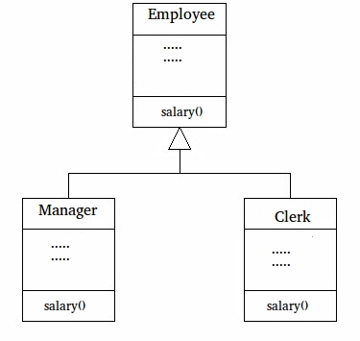
EXAMPLE

Slide 15
class Clerk extends Employee// Inherited class
{
int salary() // This method overrides salary() of Parent
{
return base + 10000;
}
}
class Main // Driver class
{
// This method can be used to print the salary of any type of employee using base class reference
static void printSalary(Employee e)
{
System.out.println(e.salary());
}
public static void main(String[] args)
{
Employee obj1 = new Manager();
System.out.print("Manager's salary : ");
printSalary(obj1);
Employee obj2 = new Clerk();
System.out.print("Clerk's salary : ");
printSalary(obj2);
}
}
class Employee
{
public static int base = 10000;
int salary()
{
return base;
}
}
// Inherited class
class Manager extends Employee
{
// This method overrides salary() of Parent
int salary()
{
return base + 20000;
}
}

Slide 16
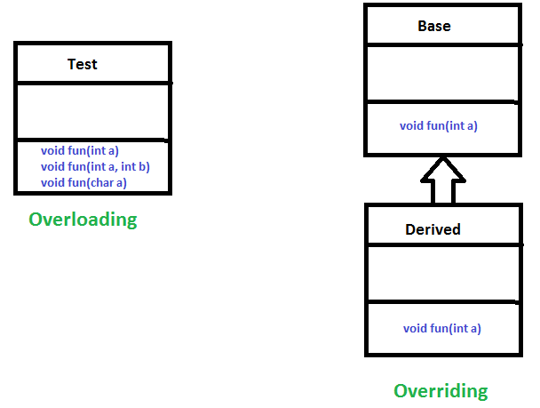
OVERRIDING VS OVERLOADING :
Overloading is about same method have different signatures. Overriding is about same method, same signature but different classes connected through inheritance.

Slide 17
No. | Method Overloading | Method Overriding
1) | Method overloading is used to increase the readability of the program. | Method overriding is used to provide the specific implementation of the method that is already provided by its super class.
2) | Method overloading is performed within class. | Method overriding occurs in two classes that have IS-A (inheritance) relationship.
3) | In case of method overloading, parameter must be different. | In case of method overriding, parameter must be same.
4) | Method overloading is the example of compile time polymorphism. | Method overriding is the example of run time polymorphism.
5) | In java, method overloading can't be performed by changing return type of the method only. Return type can be same or different in method overloading. But you must have to change the parameter. | Return type must be same or covariant in method overriding.

Slide 18
JAVA POLYMORPHISM
Polymorphism is one of the OOPs feature that allows us to perform a single action in different ways.
Poly – many
morphs – forms
Polymorphism means "many forms", and it occurs when we have many classes that are related to each other by inheritance.
Inheritance lets us inherit attributes and methods from another class.
Polymorphism uses those methods to perform different tasks.
This allows us to perform a single action in different ways.

Slide 19
TYPES OF POLYMORPHISM
There are two types of polymorphism in java:
1) Static Polymorphism also known as compile time polymorphism
2) Dynamic Polymorphism also known as runtime polymorphism

Slide 20
EXAMPLE OF STATIC POLYMORPHISM
class SimpleCalculator
{
int add(int a, int b)
{
return a+b;
}
int add(int a, int b, int c)
{
return a+b+c;
}
}
public class Demo
{
public static void main(String args[])
{
SimpleCalculator obj = new SimpleCalculator();
System.out.println(obj.add(10, 20));
System.out.println(obj.add(10, 20, 30));
}
}

Slide 21
RUNTIME POLYMORPHISM (OR DYNAMIC POLYMORPHISM)
class ABC
{
public void myMethod()
{
System.out.println("Overridden Method");
}
}
public class XYZ extends ABC
{
public void myMethod(){
System.out.println("Overriding Method");
}
public static void main(String args[]){
ABC obj = new XYZ();
obj.myMethod();
}
}

Slide 22
When an overridden method is called through a reference of parent class, then type of the object determines which method is to be executed. Thus, this determination is made at run time.
ABC obj = new ABC();
obj.myMethod();
// This would call the myMethod() of parent class ABC
XYZ obj = new XYZ();
obj.myMethod();
// This would call the myMethod() of child class XYZ
ABC obj = new XYZ();
obj.myMethod();
// This would call the myMethod() of child class XYZ

Slide 23
VARIABLE ARGUMENT (VARARGS):
The varrags allows the method to accept zero or muliple arguments. Before varargs either we use overloaded method or take an array as the method parameter but it was not considered good because it leads to the maintenance problem. If we don't know how many argument we will have to pass in the method, varargs is the better approach.
Advantage of Varargs:
We don't have to provide overloaded methods so less code.
Syntax of varargs:
The varargs uses ellipsis i.e. three dots after the data type. Syntax is as follows:
return_type method_name(data_type... variableName){}

Slide 24
class VarargsExample1
{
static void display(String... values)
{
System.out.println("display method invoked ");
}
public static void main(String args[])
{
display();//zero argument
display("my","name","is","varargs");//four arguments
}
}
Output:display method invoked
display method invoked

Slide 25
class VarargsExample2
{
static void display(String... values)
{
System.out.println("display method invoked ");
for(String s:values)
{
System.out.println(s);
}
}
public static void main(String args[])
{
display();//zero argument
display("hello");//one argument
display("my","name","is","varargs");//four arguments
}
}

Slide 26
RULES FOR VARARGS:
While using the varargs, you must follow some rules otherwise program code won't compile. The rules are as follows:
There can be only one variable argument in the method.
Variable argument (varargs) must be the last argument.
void method(String... a, int... b){}//Compile time error
void method(int... a, String b){}//Compile time error

Slide 27
class VarargsExample3
{
static void display(int num, String... values)
{
System.out.println("number is "+num);
for(String s:values)
{
System.out.println(s);
}
}
public static void main(String args[])
{
display(500,"hello");//one argument
display(1000,"my","name","is","varargs");//four arguments
}
}

Slide 28
FINAL KEYWORD IN JAVA – FINAL VARIABLE, METHOD AND CLASS

Slide 29
FINAL VARIABLE
final variables are nothing but constants. We cannot change the value of a final variable once it is initialized.
class Demo
{
final int MAX_VALUE=99;
void myMethod()
{
MAX_VALUE=101;
}
public static void main(String args[])
{
Demo obj=new Demo();
obj.myMethod();
}
}
/Demo.java:8: error: cannot assign a value to final variable MAX_VALUE MAX_VALUE=101; error

Slide 30
BLANK FINAL VARIABLE
A final variable that is not initialized at the time of declaration is known as blank final variable. We must initialize the blank final variable in constructor of the class otherwise it will throw a compilation error (Error: variable MAX_VALUE might not have been initialized).
class Demo{
final int MAX_VALUE; //Blank final variable
Demo(){
//It must be initialized in constructor
MAX_VALUE=100;
}
void myMethod(){
System.out.println(MAX_VALUE);
}
public static void main(String args[]){
Demo obj=new Demo();
obj.myMethod();
}
}
Output:
100

Slide 31
FINAL METHOD
A final method cannot be overridden. Which means even though a sub class can call the final method of parent class without any issues but it cannot override it.
class XYZ{
final void demo(){
System.out.println("XYZ Class Method");
}
}
class ABC extends XYZ{
void demo(){
System.out.println("ABC Class Method");
}
public static void main(String args[]){
ABC obj= new ABC();
obj.demo();
}
}
This program would throw a compilation error, however we can use the parent class final method in sub class without any issues. Lets have a look at this code: This program would run fine as we are not overriding the final method. That shows that final methods are inherited but they are not eligible for overriding.

Slide 32
FINAL CLASS
We cannot extend a final class. Consider the below example
final class XYZ{
}
class ABC extends XYZ{
void demo(){
System.out.println("My Method");
}
public static void main(String args[]){
ABC obj= new ABC();
obj.demo();
}
}
Output:
The type ABC cannot subclass the final class XYZ

