Slide 1
ABSTRACTION IN JAVA

Slide 2
ABSTRACTION
Object-oriented programming, abstraction is a process of hiding the implementation details from the user, only the functionality will be provided to the user. In other words, the user will have the information on what the object does instead of how it does it.
In Java, abstraction is achieved using Abstract classes and interfaces.
Abstraction helps in reducing programming complexity and effort.

Slide 3
ABSTRACT CLASS
A class that is declared using “abstract” keyword is known as abstract class.
It can have abstract methods(methods without body) as well as concrete methods (regular methods with body). A normal class(non-abstract class) cannot have abstract methods.
An abstract class can not be instantiated, which means you are not allowed to create an object of it.

Slide 4
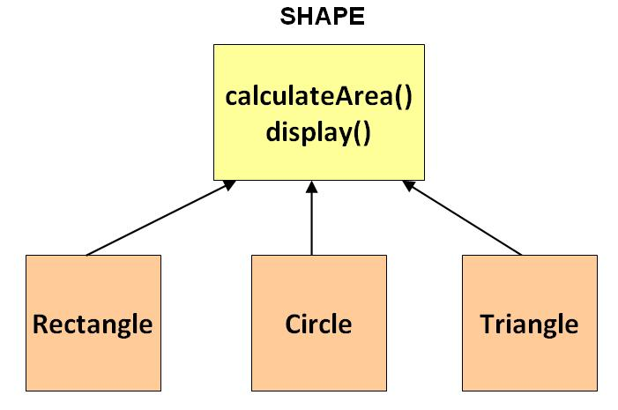
Consider the following class hierarchy consisting of a Shape class which is inherited by three classes Rectangle, Circle, and Triangle. The Shape class is created to save on common attributes and methods shared by the three classes Rectangle, Circle, and Triangle. calculateArea() is one such method shared by all three child classes and present in Shape class.

Slide 5
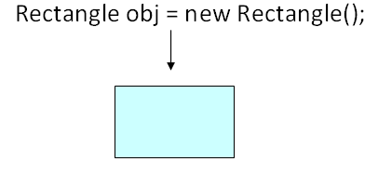
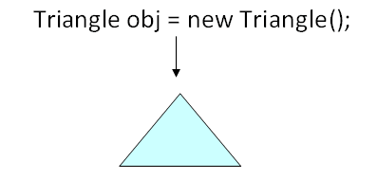
Now, assume you write code to create objects for the classes depicted above. Let's observe how these objects will look in a practical world.
An object of the class rectangle will give a rectangle, a shape we so commonly observed in everyday life.
An object of the class triangle will give a triangle, again a common everyday shape

Slide 6
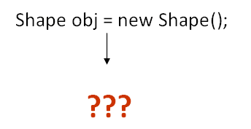
But what would an object of Class Shape look like in a practical world ??
If you observe the Shape class serves in our goal of achieving inheritance and polymorphism. But it was not built to be instantiated. Such classes can be labelled Abstract. An abstract java class cannot be instantiated.
Syntax:
abstract class Shape
{
// code
}
It is possible that you DO NOT label Shape class as Abstract and then instantiate it. But such object will have no use in your code and will open a room for potential errors. Hence this is not desirable.

Slide 7
ABSTRACT METHODS
ABSTRACT METHOD in Java, is a method that has just the method definition but does not contain implementation.
A method without a body is known as an Abstract Method. It must be declared in an abstract class.
The abstract method will never be final because the abstract class must implement all the abstract methods.

Slide 8
ABSTRACT METHODS
As we all know, the formula for calculating area for rectangle, circle, & triangle is different. The calculateArea() method will have to be overridden by the inheriting classes. It makes no sense defining it in the Shape class, but we need to make sure that all the inheriting classes do have the method. Such methods can be labeled abstract.
Syntax:
abstract public void calculateArea();
For an abstract method, no implementation is required. Only the signature of the method is defined.

Slide 9
RULES OF ABSTRACT METHOD
Abstract methods do not have an implementation; it only has method signature
Always end the declaration with a semicolon(;).
If a class is using an abstract method, they must be declared abstract. The opposite cannot be true. This means that an abstract class does not necessarily have an abstract method.
If a regular class extends an abstract class, then that class must implement all the abstract methods of the abstract parent

Slide 10
WHY CAN’T WE CREATE THE OBJECT OF AN ABSTRACT CLASS?
Because these classes are incomplete, they have abstract methods that have no body so if java allows you to create object of this class then if someone calls the abstract method using that object then What would happen? There would be no actual implementation of the method to invoke.
Also because an object is concrete. An abstract class is like a template, so you have to extend it and build on it before you can use it.

Slide 11
abstract class MyClass
{
public void disp(){
System.out.println("Concrete method of parent class");
}
abstract public void disp2();
}
class Demo extends MyClass
{
/* Must Override this method while extending MyClass*/
public void disp2()
{
System.out.println("overriding abstract method");
}
public static void main(String args[]){
Demo obj = new Demo();
obj.disp2();
}
}

Slide 12
abstract class Sum
{ /* These two are abstract methods, the child class must implement these methods*/
public abstract int sumOfTwo(int n1, int n2);
public abstract int sumOfThree(int n1, int n2, int n3);
public void disp() //Regular method
{
System.out.println("Method of class Sum");
}
}
//Regular class extends abstract class
class Demo extends Sum
{ /* If I don't provide the implementation of these two methods, the program will throw compilation error. */
public int sumOfTwo(int num1, int num2)
{ return num1+num2; }
public int sumOfThree(int num1, int num2, int num3)
{ return num1+num2+num3;}
public static void main(String args[])
{
Sum obj = new Demo();
System.out.println(obj.sumOfTwo(3, 7));
System.out.println(obj.sumOfThree(4, 3, 19));
obj.disp();
}
}

