Slide 1
JAVA INTERFACE

Slide 2
INTERFACE IN JAVA
Abstract class is used for achieving partial abstraction.
Unlike abstract class an interface is used for full abstraction.
Abstraction is a process where you show only “relevant” data and “hide” unnecessary details of an object from the user.
Interface looks like a class but it is not a class.
An interface can have methods and variables just like the class but the methods declared in interface are by default abstract (only method signature, no body). Also, the variables declared in an interface are public, static & final by default.

Slide 3
WHAT IS THE USE OF INTERFACE IN JAVA?
As mentioned they are used for full abstraction.
Since methods in interfaces do not have body, they have to be implemented by the class before you can access them.
The class that implements interface must implement all the methods of that interface.
Also, java programming language does not allow you to extend more than one class, However you can implement more than one interfaces in your class.

Slide 4
SYNTAX:
interface MyInterface
{
/* All the methods are public abstract by default
* As you see they have no body
*/
public void method1();
public void method2();
}
class implements interface but an interface extends another interface.

Slide 5
interface MyInterface
{
/* compiler will treat them as:public abstract void method1();public abstract void method2();*/
public void method1();
public void method2();
}
class Demo implements MyInterface
{
/* This class must have to implement both the abstract methods else you will get compilation error*/
public void method1()
{ System.out.println("implementation of method1"); }
public void method2()
{ System.out.println("implementation of method2");}
public static void main(String arg[])
{
MyInterface obj = new Demo();
obj.method1();
}
}
Output:
implementation of method1

Slide 6
INTERFACE AND INHERITANCE
An interface can not implement another interface. It has to extend the other interface.
interface Inf1{
public void method1();
}
interface Inf2 extends Inf1 {
public void method2();
}
public class Demo implements Inf2{
/* Even though this class is only implementing the interface Inf2, it has to implement all the methods of Inf1 as well because the interface Inf2 extends Inf1*/
public void method1(){
System.out.println("method1");
}
public void method2(){
System.out.println("method2");
}
public static void main(String args[]){
Inf2 obj = new Demo();
obj.method2();
}
}

Slide 7
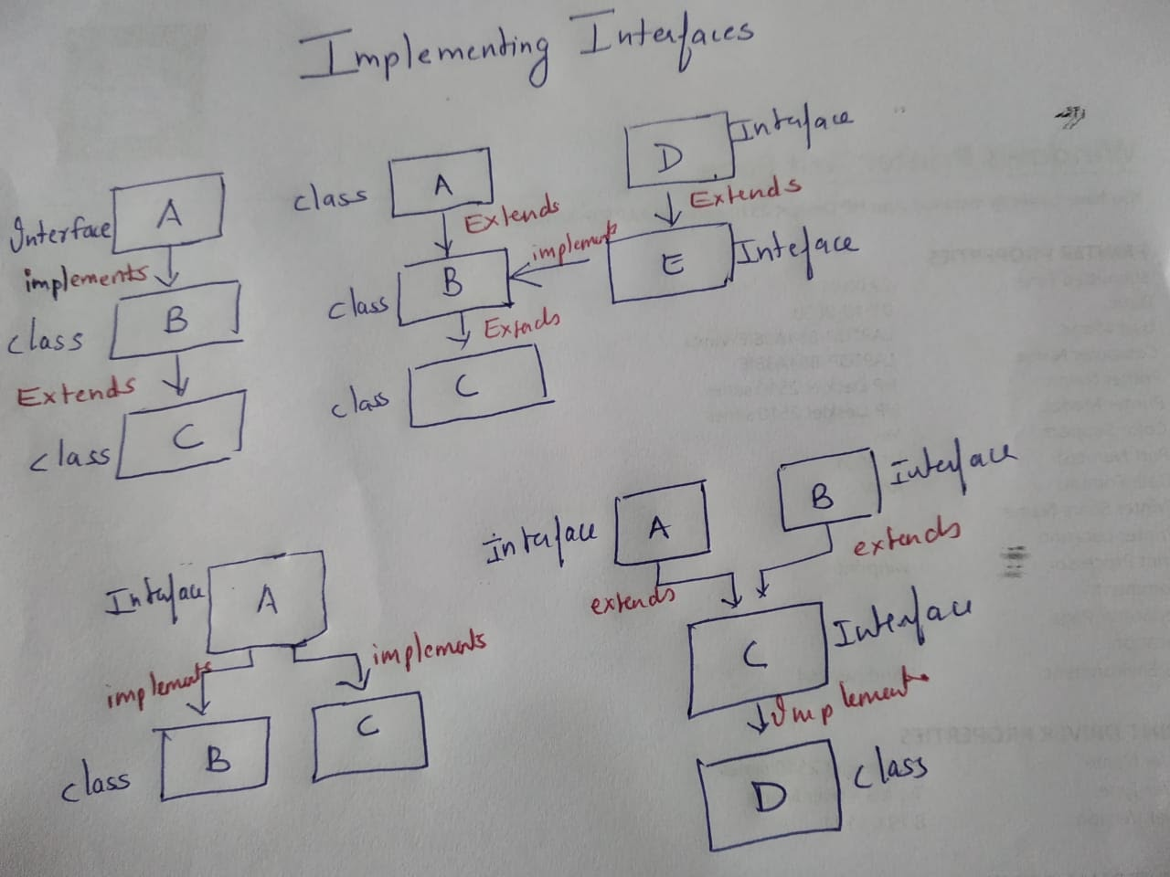

Slide 8
Area
Interface
Implements
Implements
Rectangle
Circle

Slide 9
interface Area
{
final static float pi=3.14F;
float compute(float x, float y);
}
class Rectangle implements Area
{
public float compute(float x,float y)
{
return(x*y);
}
}
class Circle implements Area
{
public float compute(float x,float y)
{
return(pi*x*x);
}
}
public class InterfaceTest
{
public static void main(String args[])
{
Rectangle rect=new Rectangle();
Circle cir=new Circle();
Area area;
area=rect;
System.out.println("Area of Rectangle="+area.compute(10,20));
area=cir;
System.out.println("Area of Circle="+area.compute(20,0));
}
}

Slide 10
IMPLEMENTING MULTIPLE INHERITANCE
student
sport
class
Interface
extends
Test
class
Implements
extends
Result
class

Slide 11
class Student
{
int rollNumber;
void getNumber(int n)
{
rollNumber=n;
}
void putNumber()
{
System.out.println("Roll No:"+rollNumber);
}
}
class Test extends Student
{
float part1,part2;
void getMarks(float m1,float m2)
{
part1=m1;
part2=m2;
}
void putMarks()
{
System.out.println("Part1="+part1); System.out.println("Part2="+part2);
}
}
interface Sports
{
float sportwt=6.0F;
void putWt();
}

Slide 12
class Result extends Test implements Sports
{
float total;
public void putWt()
{
System.out.println("Sports wt="+sportwt);
}
void display()
{
total=part1+part2+sportwt;
putNumber();
putMarks();
putWt();
System.out.println("Total Score="+total);
}
}
public class Hybrid
{
public static void main(String args[])
{
Result student1=new Result();
student1.getNumber(1234);
student1.getMarks(27.5F,33.0F);
student1.display();
}
}

Slide 13
KEY POINTS
Here are the key points to remember about interfaces:
1) We can’t instantiate an interface in java. That means we cannot create the object of an interface
2) Interface provides full abstraction as none of its methods have body. On the other hand abstract class provides partial abstraction as it can have abstract and concrete(methods with body) methods both.
3) implements keyword is used by classes to implement an interface.
4) While providing implementation in class of any method of an interface, it needs to be mentioned as public.
5) Class that implements any interface must implement all the methods of that interface, else the class should be declared abstract.
6) Interface cannot be declared as private, protected.
7) All the interface methods are by default abstract and public.

Slide 14
8) Variables declared in interface are public, static and final by default.
interface Try
{
int a=10;
public int a=10;
public static final int a=10;
final int a=10;
static int a=0;
} All of the above statements are identical.
9) Interface variables must be initialized at the time of declaration otherwise compiler will throw an error.
interface Try
{
int x;//Compile-time error
}Above code will throw a compile time error as the value of the variable x is not initialized at the time of declaration.

Slide 15
10) Inside any implementation class, you cannot change the variables declared in interface because by default, they are public, static and final.
11) An interface can extend any interface but cannot implement it. Class implements interface and interface extends interface.
12) A class can implement any number of interfaces.
13) If there are two or more same methods in two interfaces and a class implements both interfaces, implementation of the method once is enough
14) Variable names conflicts can be resolved by interface name.
interface A
{
int x=10;
}
interface B
{
int x=100;
}
class Hello implements A,B{
public static void main(String args[]){
/* reference to x is ambiguous both variables are x so we are using interface name to resolve the variable */
System.out.println(x);
System.out.println(A.x);
System.out.println(B.x);
}
}.

Slide 16
DIFFERENCE BETWEEN ABSTRACT CLASS AND INTERFACE IN JAVA
 | Abstract Class | Interface
1 | An abstract class can extend only one class or one abstract class at a time | An interface can extend any number of interfaces at a time
2 | An abstract class can extend another concrete (regular) class or abstract class | An interface can only extend another interface
3 | An abstract class can have both abstract and concrete methods | An interface can have only abstract methods
4 | In abstract class keyword “abstract” is mandatory to declare a method as an abstract | In an interface keyword “abstract” is optional to declare a method as an abstract
5 | An abstract class can have protected and public abstract methods | An interface can have only have public abstract methods

