Slide 1
PACKAGES IN JAVA

Slide 2
What is Package in Java?
PACKAGE in Java is a collection of classes, sub-packages, and interfaces.
It helps organize your classes into a folder structure and make it easy to locate and use them. More importantly, it helps improve code reusability.
Although interfaces and classes with the same name cannot appear in the same package, they can appear in different packages. This is possible by assigning a separate namespace to each Java package.
Package in java can be categorized in two form, built-in package and user-defined package.
There are many built-in packages such as java, lang, awt, javax, swing, net, io, util, sql etc.
In java we have several built-in packages, for example when we need user input, we import a package like this:
import java.util.Scanner
Here:
→ java is a top level package
→ util is a sub package
→ and Scanner is a class which is present in the sub package util.

Slide 3
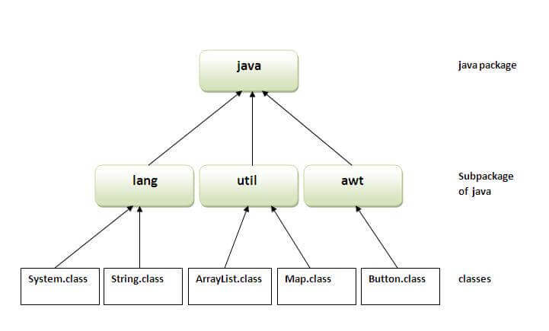

Slide 4
Advantage of Java Package
1) Reusability: Reusability of code is one of the most important requirements in the software industry. Reusability saves time, effort and also ensures consistency. A class once developed can be reused by any number of programs wishing to incorporate the class in that particular program.
2) Easy to locate the files.
3) In real life situation there may arise scenarios where we need to define files of the same name. This may lead to “name-space collisions”. Packages are a way of avoiding “name-space collisions”.
It is a good practice to group related classes implemented by you so that a programmer can easily determine that the classes, interfaces are related.

Slide 5
Many implementations of Java use a hierarchical file system to manage source and class files. It is easy to organize class files into packages.
All we need to do is put related class files in the same directory, give the directory a name that relates to the purpose of the classes, and add a line to the top of each class file that declares the package name, which is the same as the directory name where they reside.

Slide 6
Defining a Package
● This statement should be used in the beginning of the program to include that program in that particular package.
package <package name>;
● The package keyword is used to create a package in java.
To Compile: javac -d directory javafilename.java
To Run: java packagename.classname
● The -d switch specifies the destination where to put the generated class file
● If you want to keep the package within the same directory, you can use . (dot).

Slide 7
Simple example of java package
The package keyword is used to create a package in java.
//save as Simple.java
package mypack;
public class Simple
{
public static void main(String args[])
{
System.out.println("Welcome to package");
}
}

Slide 8
How to compile java package
If you are not using any IDE, you need to follow the syntax given below:
javac -d directory javafilename
For example
javac -d . Simple.java
The -d switch specifies the destination where to put the generated class file. You can use any directory name like d:/abc. If you want to keep the package within the same directory, you can use . (dot).
How to run java package program :You need to use fully qualified name e.g. mypack.Simple etc to run the class.
To Compile: javac -d . Simple.java
To Run: java mypack.Simple
Output:Welcome to package
The -d is a switch that tells the compiler where to put the class file i.e. it represents destination. The . represents the current folder.

Slide 9
How to access package from another package?
There are three ways to access the package from outside the package.
1. import package.*;
2. import package.classname;
3. fully qualified name.
Using packagename.*
● If you use package.* then all the classes and interfaces of this package will be accessible but not subpackages.
● The import keyword is used to make the classes and interface of another package accessible to the current package.

Slide 10
Using packagename.classname
● If you import package.classname then only declared class of this package will be accessible.
Using fully qualified name
● If you use fully qualified name then only declared class of this package will be accessible.
● Now there is no need to import. But you need to use fully qualified name every time when you are accessing the class or interface.
● It is generally used when two packages have same class name e.g. java.util and java.sql packages contain Date class.
Note: If you import a package, all the classes and interface of that package will be imported excluding the classes and interfaces of the subpackages. Hence, you need to import the subpackage as well.

Slide 11
Example of package that import the packagename.*
//save by A.java
package pack;
public class A
{
public void msg()
{ System.out.println("Hello"); }
}
//save by B.java
package mypack;
import pack.*;
class B
{
public static void main(String args[])
{
A obj = new A();
obj.msg();
}
}
Output:Hello

Slide 12
Using packagename.classname
If you import package.classname then only declared class of this package will be accessible.
Example of package by import package.classname
//save by A.java
package pack;
public class A
{
public void msg(){ System.out.println("Hello"); }
}
//save by B.java
package mypack;
import pack.A;
class B
{
public static void main(String args[])
{
A obj = new A();
obj.msg();
}
}
Output:Hello

Slide 13
Using fully qualified name
If you use fully qualified name then only declared class of this package will be accessible. Now there is no need to import. But you need to use fully qualified name every time when you are accessing the class or interface.
Example of package by import fully qualified name
//save by A.java
package pack;
public class A
{
public void msg(){System.out.println("Hello");}
}
//save by B.java
package mypack;
class B
{
public static void main(String args[])
{
pack.A obj = new pack.A();//using fully qualified name
obj.msg();
}
}

Slide 14
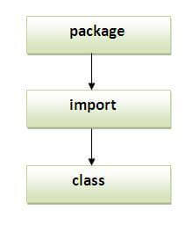
Note: Sequence of the program must be package then import then class.

Slide 15
A class can have only one package declaration but it can have more than one package import statements. For example:
package abcpackage; //This should be first
import xyzpackage;
import anotherpackage;
import anything;

Slide 16
import like package.* should be used carefully when working with subpackages. For example: Lets say: we have a package abc and inside that package we have another package foo, now foo is a subpackage.
classes inside abc are: Example1, Example 2, Example 3
classes inside foo are: Demo1, Demo2
So if I import the package abc like this:
import abc.*;
Then it will only import classes Example1, Example2 and Example3 but it will not import the classes of sub package.
To import the classes of subpackage you need to import like this:
import abc.foo.*;
This will import Demo1 and Demo2 but it will not import the Example1, Example2 and Example3.
So to import all the classes present in package and subpackage, we need to use two import statements like this:
import abc.*;
import abc.foo.*;
abc
Example1
Example2
Example3
foo
Demo1
Demo2

Slide 17
How to put two public classes in a package?
If you want to put two public classes in a package, have two java source files containing one public class, but keep the package name same.
For example:
//save as A.java
package pack1;
public class A{}
//save as B.java
package pack1;
public class B{}

Slide 18
Java Static Import
The static import feature of Java 5 facilitate the java programmer to access any static member of a class directly. There is no need to qualify it by the class name.
Advantage of static import:
Less coding is required if you have access any static member of a class often.
Disadvantage of static import:
If you overuse the static import feature, it makes the program unreadable and unmaintainable.

Slide 19
import static java.lang.System.*;
class StaticImportExample
{
public static void main(String args[])
{
out.println("Hello");//Now no need of System.out
out.println("Java");
}
}
Output:Hello
Java

Slide 20
Without Static Imports
class Demo1
{
public static void main(String args[])
{
double var1= Math.sqrt(5.0);
double var2= Math.tan(30);
System.out.println("Square of 5 is:"+ var1);
System.out.println("Tan of 30 is:"+ var2);
}
}

Slide 21
import static java.lang.System.out;
import static java.lang.Math.*;
class Demo2
{
public static void main(String args[])
{
//instead of Math.sqrt need to use only sqrt
double var1= sqrt(5.0);
//instead of Math.tan need to use only tan
double var2= tan(30);
//need not to use System in both the below statements
out.println("Square of 5 is:"+var1);
out.println("Tan of 30 is:"+var2);
}
}

