Slide 1
XML and DTD

Slide 2



Scenario:
Moving Books from Library A to Library B
Library A
Library B
if(is_wf("books.xml")) {
save_to_DB("books.xml");
}
Java EE
PHP

Slide 3

Better Way
Library A
Library B
if(is_wf("books.xml") and
is_valid("books.xml") {
save_to_DB("books.xml");
}
Java EE
PHP

Slide 4



Creating XML languages
XML
OOXML
(.docx)
MathML
(.mml)
XHTML
(.xhtml)

Slide 5
DOCUMENT TYPE DEFINITION

Slide 6
In General
DTD is used both in XML and SGML
Specifying the structure and tag-names in XML-language:
  Tag names, order, amount
  Attribute names and datatypes
  The order of the elements

Slide 7
Associating DTDs with Documents
A DTD is associated with an XML document via a Document Type Declaration
Internal vs. external subset
  Internal: DTD is part of the declaration and is embedded into the xml-document
  External: DTD is in external file and declaration links to the file

Slide 8
General Syntax: External Subset
<?xml version="1.0"?>
<!DOCTYPE root-element [SYSTEM OR PUBLIC FPI] "uri">
<root>
<foo>...</foo>
</root>

Slide 9
Root Element
<?xml version="1.0"?>
<!DOCTYPE root [SYSTEM OR PUBLIC FPI] "uri">
<root>
<foo>...</foo>
</root>

Slide 10
System or Public
Document Type Declaration can be
  System: DTD is for private system
  Public: DTD is open to the public
System
  <!DOCTYPE root SYSTEM "uri">
Public
  <!DOCTYPE root PUBLIC FPI "uri">

Slide 11
Public
If PUBLIC keyword is chosen, after declaration must have Formal Public Identifier:
  <!DOCTYPE root PUBLIC FPI "uri">

Slide 12
URI
Example:
  <!DOCTYPE ROOT PUBLIC
  "[registration]//[organization]//[type]
  [label]//[language]"
  URI>
URI
  The URI to the DTD - file

Slide 13
Examples
  <!DOCTYPE html PUBLIC
  "-//W3C//DTD XHTML 1.0 Strict//EN"
  "http://www.w3.org/TR/xhtml1/DTD/xhtml1-strict.dtd">
  <!DOCTYPE books PUBLIC
  "-//TAMK//DTD MY BOOKS//EN"
  "books.dtd">
  <!DOCTYPE books SYSTEM
  "books.dtd">

Slide 14
Internal DTD
<?xml version="1.0"?>
<!DOCTYPE root [
<!ELEMENT root (foo)>
<!ELEMENT foo (#PCDATA)>
]>
<root>
<foo>...</foo>
</root>

Slide 15
External DTD: foo.xml (public)
<?xml version="1.0"?>
<!DOCTYPE root PUBLIC "-//TAMK//DTD MY BOOKS//EN"
"foo.dtd">
<root>
<foo>...</foo>
</root>

Slide 16
External DTD: foo.xml (system)
<?xml version="1.0"?>
<!DOCTYPE root SYSTEM "foo.dtd">
<root>
<foo>...</foo>
</root>

Slide 17
External DTD: foo.dtd
<!ELEMENT root (foo)>
<!ELEMENT foo (#PCDATA)>

Slide 18
DTD's ELEMENT Declaration
ELEMENT defines tag-name:
  <!ELEMENT tagname (values)>
Values defines child-elements
  <!ELEMENT tagname (child1, child2)>
Or the type of the element
  <!ELEMENT tagname (type)>
Types?
  #PCDATA, ANY or EMPTY
Amount
    + = 1 - n
    * = 0 - n
    ? = 0 - 1

Slide 19
Example of ELEMENT - usage
XML:
  <student>
  <name>Tiina</name>
  </student>
DTD:
  <!ELEMENT student (name)>
  <!ELEMENT name (#PCDATA)>

Slide 20
Attribute Declaration
Attribute is defined with ATTLIST.
SYNTAX: <!ATTLIST ELEMENTNAME ATTRIBUTENAME TYPE REQUIRED>
  ELEMENTNAME: The element which the attribute is given
  ATTRIBUTENAME: attribute name
  TYPE: attribute contents
  REQUIRED: Is the attribute mandatory or not
Example:

Slide 21
Example :
<!ELEMENT myMessage ( message )>
<!ELEMENT message ( #PCDATA )>
<!ATTLIST message id CDATA #REQUIRED>
XML Document:
<myMessage>
<message id = "445">
Welcome to XML!
</message>
</myMessage>

Slide 22
Attribute Types
Attribute Datatypes
  CDATA: character data
  ENTITY or ENTITIES: entity defined somewhere else
  ID: Unique value. Must begin with letter, underscore or colon.
  IDREF or IDREFS: Reference to ID
  NMTOKEN or NMTOKENS: CDATA without spaces
  NOTATION: Link to external resource

Slide 23
Attribute Requirements
Requirements
  #REQUIRED, mandatory
  #FIXED, value is fixed
  #IMPLIED, optional

Slide 24
Entity in DTD's
It's possible to create your own entities in DTD's:
    Syntax: <!ENTITY company "My Company">
    Usage in XML: &company;
Getting entity value from external file
    <!ENTITY company SYSTEM "company.txt">

Slide 25
Is the XML Valid?
XML
  <students>
  <student>
  <name>Tiina Virtanen</name>
  <gender>Female</gender>
  </student>
  </students>
DTD
  <!ELEMENT students (student)>
  <!ELEMENT student (name, gender)>
  <!ELEMENT name (#PCDATA)>
  <!ELEMENT gender (#PCDATA)>

Slide 26
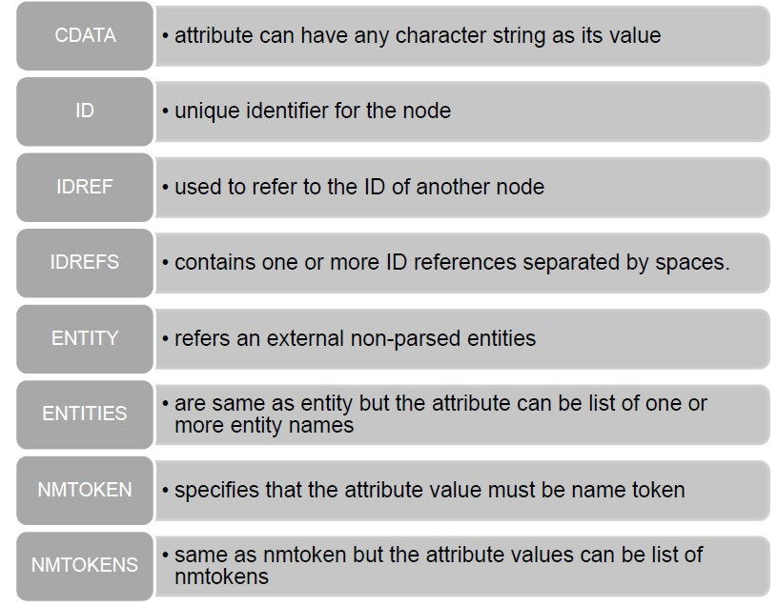
Attribute Types

Slide 27
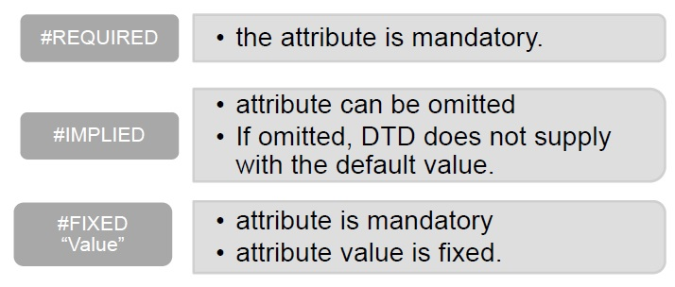
Attribute Values

Slide 28
Attribute Declarations: Attribute Behavior
Default value assigned:
  If the user doesn't supply a value for this attribute, the XML processor assumes a default value is supplied in the DTD.
  Specifying a default value in the DTD is often a good idea when one value is most common
  <!ATTLIST message importance (high | medium | low) "medium“ >
  When the user omits the importance attribute in the <message> element, the XML processor uses the default value.
  (high | medium | low) - enumerated value list

Slide 29
Contd..
Attribute is optional (#IMPLIED)
  to declare an attribute to be optional, the XML processor does not assign any default value
  the attribute is effectively absent
  #IMPLIED keyword is used to say that there is no default value and that use of the attribute is optional
  <!ATTLIST reservation frills (aisle-seat|meal-included|pillow) #IMPLIED >

Slide 30
Contd..
User must supply a value (#REQUIRED)
  if there is no good default value, and the attribute can't be blank, you should declare it to be #REQUIRED.
  leaving out the attribute or giving it a blank value will result in a parser error
  <!ATTLIST book isbn CDATA #REQUIRED>

Slide 31
Contd..
User must supply a value (#REQUIRED)
  if there is no good default value, and the attribute can't be blank, you should declare it to be #REQUIRED.
  leaving out the attribute or giving it a blank value will result in a parser error
  <!ATTLIST book isbn CDATA #REQUIRED>

Slide 32
Attribute Declarations: Attribute Types
Attribute Types can take three kinds of value
  Strings {do not impose any constraint on attribute values} (CDATA)
  Tokenized Attributes {impose constraint on attribute values} (ID, IDREF, ENTITY, NMTOKEN)
  Enumerated Attributes {most restrictive. Can take only one of the values listed in the attribute declaration}

