Slide 1
Different ways of writing CSS files
In-line CSS style
Internal/Embedded CSS Style
External Style Sheet
  @import Style Sheet

Slide 2
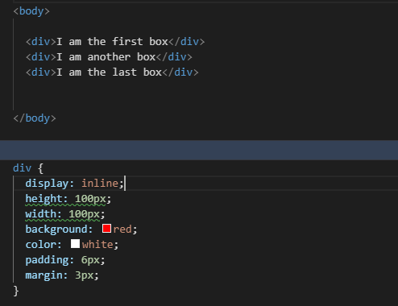
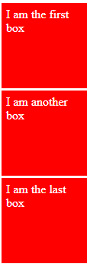

CSS-Creating layouts

Slide 3
Font properties-short hand notation
font-family
font-size
font-stretch
font-style
font-variant
font-weight
line-height
p.a {
font: 15px Arial, sans-serif;
}
p.b {
font: italic small-caps bold 12px/30px Georgia, serif;
}

Slide 4
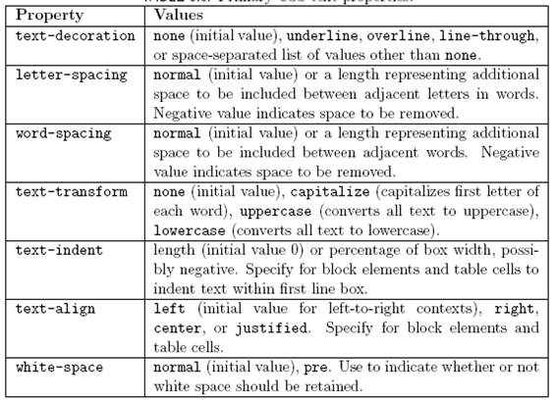
Text Properties

Slide 5
Example
h1 {
text-align: center;
font-size: 3em;
font-weight:bolder;
line-height: 2;
border:1px solid red;
word-spacing: 4px;
text-shadow: 4px 4px 5px brown;
}

Slide 6

Background-properties
.box {
background-image: url(star.png);
background-repeat: no-repeat;
background-position:top 20px right 10px;
}

Slide 7
Background Shorthand Property
background: shorthand rule for setting background properties at the same time:
is equal to writing:
  Some browsers will not apply BOTH color and image for background if using shorthand rule
background: #FFF0C0 url("back.gif") no-repeat fixed top;
background-color: #FFF0C0;
background-image: url("back.gif");
background-repeat: no-repeat;
background-attachment: fixed;
background-position: top;

Slide 8
Border Shorthand Property
border: shorthand rule for setting border properties at once:
is equal to writing:
Specify different borders for the sides via shorthand rules: border-top, border-left, border-right, border-bottom
When to avoid border:0
border: 1px solid red
border-width:1px;
border-color:red;
border-style:solid;

Slide 9
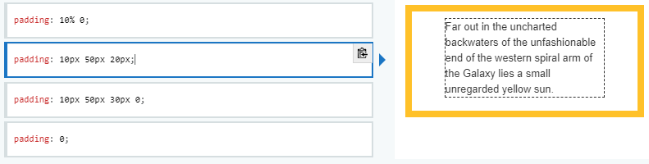
Example-padding

Slide 10
LINKs
a:link, a:visited, a:focus {
background: yellow;
}
a:hover {
background: orange;
}
a:active {
background: red;
color: white;
}

Slide 11
THANK YOU

