Slide 1



Slide 2


Addresses are used to locate objects
Names are easier to remember than numbers
You would like to get to the address or other objects using a name
DNS provides a mapping from names to resources of several types

Slide 3


Domain name is a way to identify and locate computers connected to internet
No two organizations can have same domain name
A domain name always consists of two or more components separated by
periods called dots (.)
EXAMPLE: www.yahoo.co.in, www.facebook.com etc.
Once a domain has been established subdomains can be created within the domain
EXAMPLE: The domain for the large company could be “Vni.com” and within this domain subdomains can be created for each of the company’s regional office.
Eg: Bombay.vni.com

Slide 4



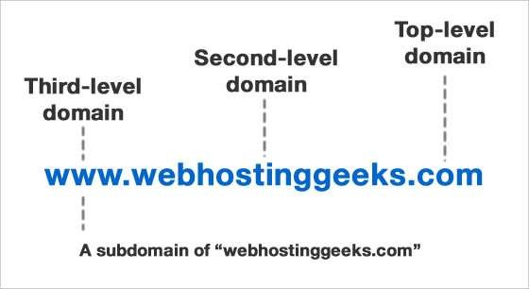
Last name. subdomain. second-level domain. top-level domain
EXAMPLE: vijay.Bombay.vni.com

Slide 5
IP address of www.google.co m

Slide 6


Top level domains are classified into 3 categories:
Organizational or generic domains
Geographical or country domains
Reverse domains

Slide 7


It consists of three character code which indicates the primary function of the organization or their generic behavior
Most commonly used top level domains are:
.com
.net
.gov
.edu
.org
.mil
for commercial organization for networking organizations for government organizations for educational organizations
for non-commercial organizations for military organizations
eg www.yahoo.com eg www.zedge.net
eg www.newjersey.gov eg www.uducause.edu
eg www.eklavya.org eg www.dod.mil
eg www.itu.int
.int
for international organizations

Slide 8


It consists of two characters which represents different countries/regions all around the world
These codes have been standardized by International Standard Organizational (ISO)
EXAMPLE:
.in
.jp
.us
.fr
.it
.cn
.au
India Japan
United States france
Italy China Australia

Slide 9

Each domain name has a corresponding IP address
When the user types the domain name in the address bar, the corresponding IP address is supplied. Such a translation is possible with the help of system called DNS (DOMAIN NAME SYSTEM)
DEFINITION:
“DOMAIN NAME SYSTEM is a collection of the databases that contain information about domain names and their
corresponding IP address.”

Slide 10



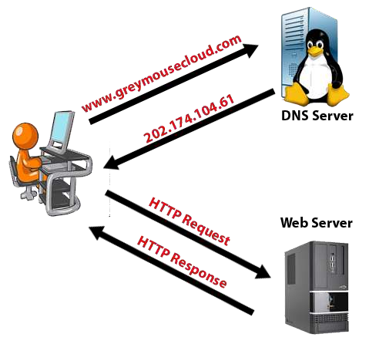

Slide 11

When an application program needs to communicate with other computer, it needs to translate the name and the other computer into its IP address. The applications program that requests the service then becomes the client of DNS.
It then sends the request to DNS server. The server looks up the name and then returns correct IP address.
A large number of DNS servers may be involved to get the right IP address. After receiving the correct IP address, the communication between two computers starts.

Slide 12


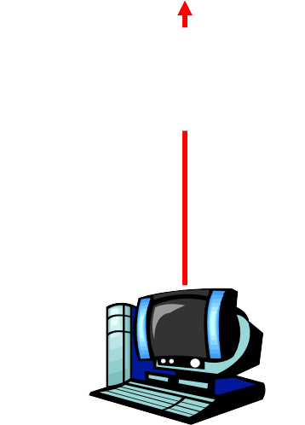
1. When you type name www.yahoo.com into your browser it asks local DNS server (at ISP’s end) for its IP address.
root DNS
server
2
3
com DNS server
4
2. When local DNS server does not find the IP address of given name, it forwards request to root DNS server and again enquire about IP address of it.
local DNS server
At ISP End
1
3. The root DNS server replies “ I do not know the IP address of www.yahoo.com but know the IP address of the com DNS server”.
Yahoo.com DNS server
4. The local DNS then asks the com DNS server for IP address
DNS client requesting for
www.yahoo.com
14

Slide 13

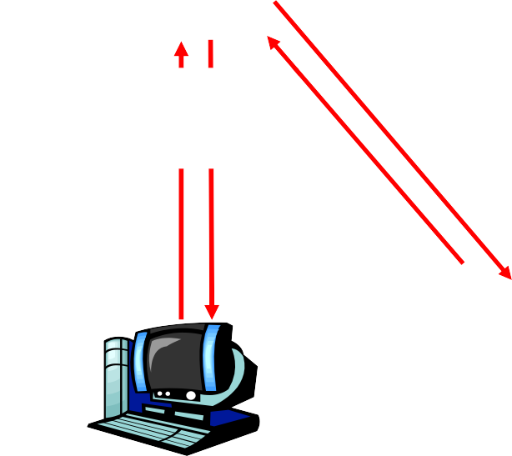
5. The com DNS server replies with same answer it does not know the IP address of www.yahoo.com but know the IP address of
root DNS
server
2
3
com DNS server
yahoo.com DNS server which is then return to local DNS server.
4
5
6. The local DNS server then ask the yahoo.com
DNS server for IP address
local DNS server
At ISP End
6
7
7. It then replies with IP address corresponding to www.yahoo.com which it has
1
8
8. The local DNS server then sends this IP address back to the client computer that send the request
Yahoo.com DNS server
DNS client requesting for
www.yahoo.com

Slide 14



Slide 15

Data is maintained locally, but retrievable globally
No single computer has all DNS data
DNS lookups can be performed by any device
Remote DNS data is locally catchable to improve performance

Slide 16


No limit to the size of the database
One server has over 20,000,000 names
No limit to the number of queries
24,000 queries per second handled easily
Queries distributed among masters, slaves, and caches

Slide 17


Database can be updated dynamically
Add/delete/modify of any record
Modification of the master database triggers replication
Only master can be dynamically updated
Creates a single point of failure

Slide 18


Data is replicated
Data from master is copied to multiple slaves
Clients can query
Master server
Any of the copies at slave servers
Clients will typically query local caches
DNS protocols can use either UDP or TCP
If UDP, DNS protocol handles retransmission, sequencing, etc.

Slide 19


The database is always internally consistent
Each version of a subset of the database (a zone) has a serial number
The serial number is incremented on each database change
Changes to the master copy of the database are replicated according to timing set by the zone administrator
Cached data expires according to timeout set by zone administrator

