Slide 1
Web Application Architecture

Slide 2
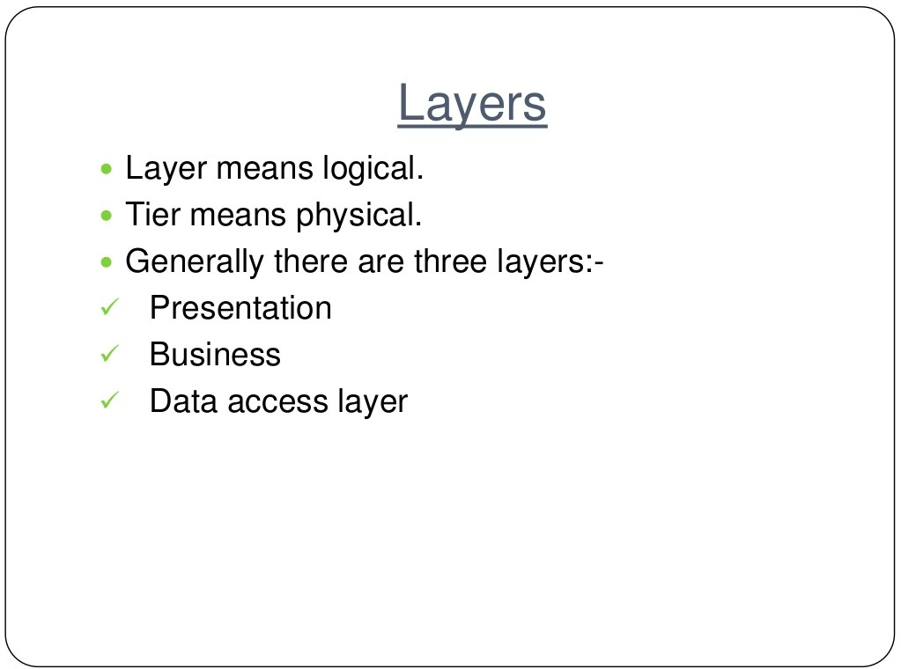

Slide 3
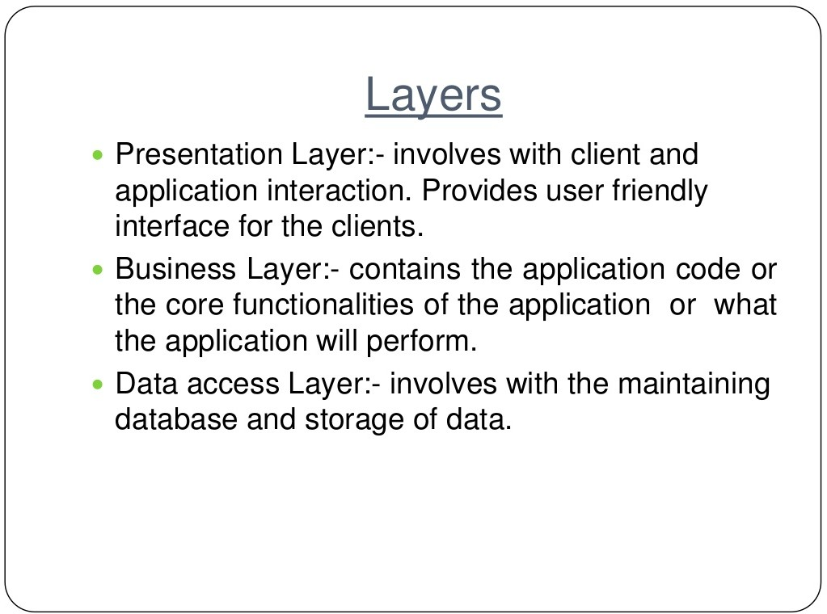

Slide 4
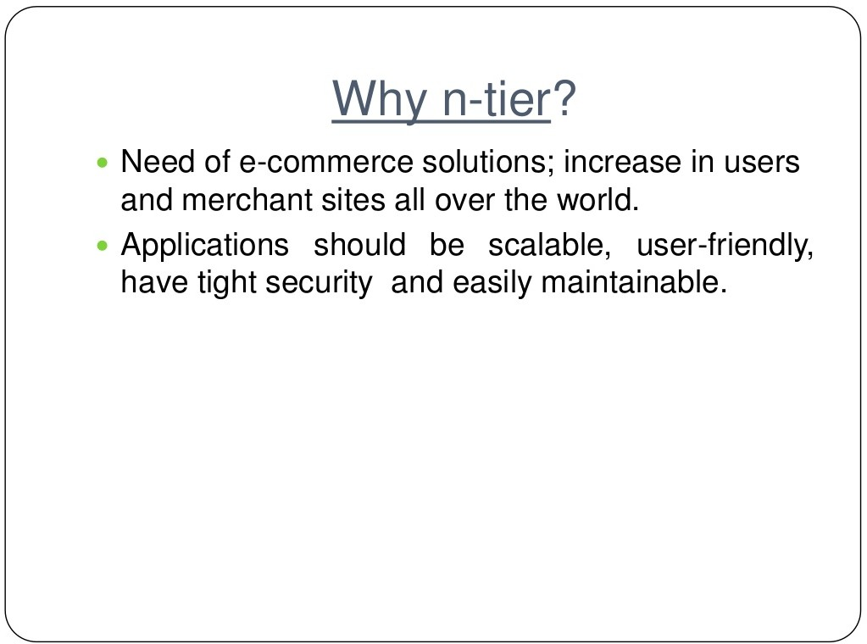

Slide 5
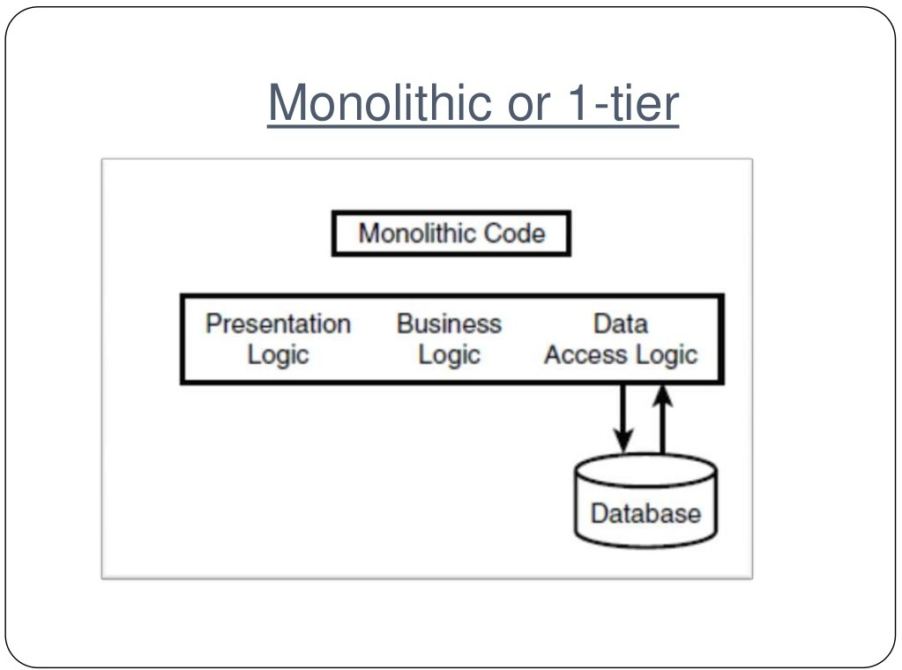

Slide 6
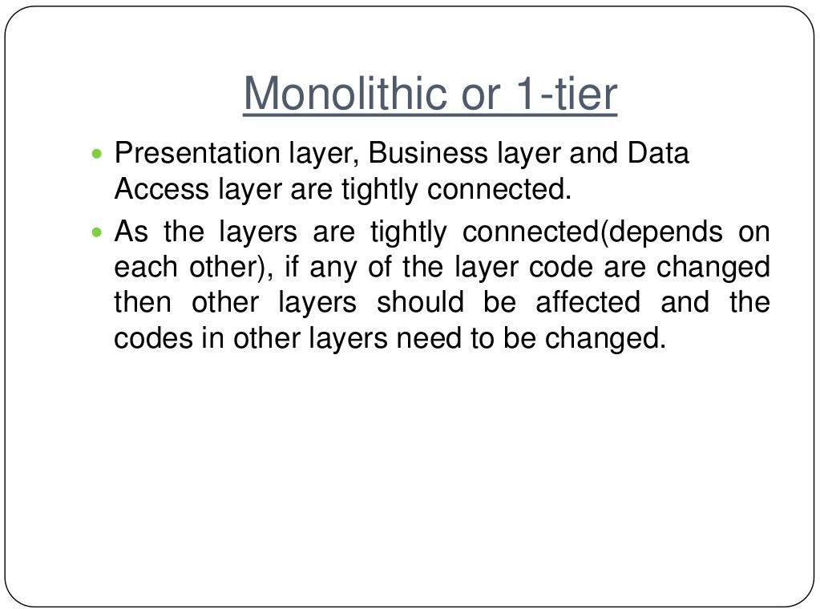

Slide 7
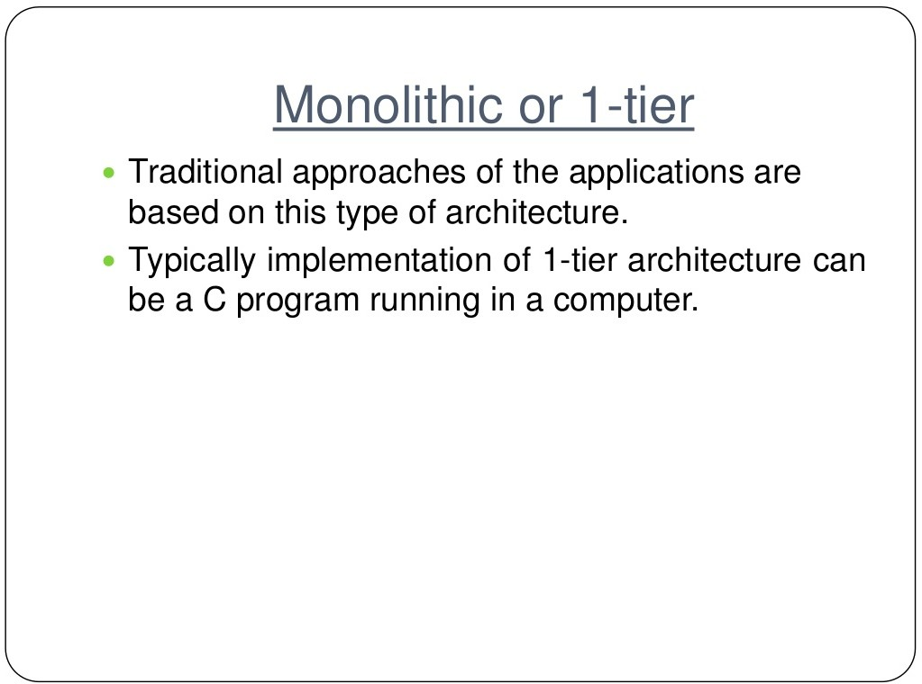

Slide 8
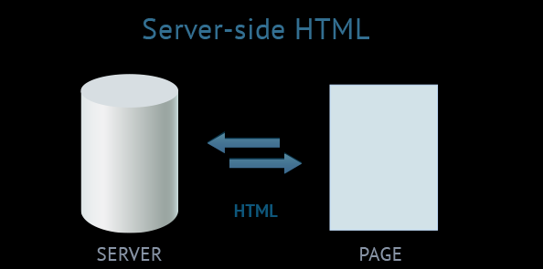
Type 1: server-side HTML web application

Slide 9
The server generates HTML content and sends it to the client as a full-fledged HTML-page.
Sometimes this architecture is called ''Web 1.0'', since it was the first to appear and currently dominates the sphere of web development.
A huge amount of data is transferred between the server and the client.
The user has to wait until the whole page reloads, responding to trivial actions, for example, when only a part of the page needs to be reloaded.
UI templates on the client depend directly on the frameworks applied on the server. Due to the limitations of mobile internet and huge amounts of transferred data, this architecture is hardly applicable in the mobile segment.
There are no means of sending instant data updates or changes in real time.

Slide 10
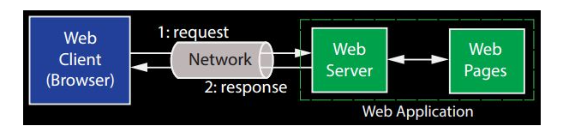
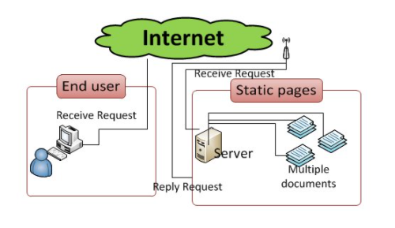
Web Application – Architecture
Web 1.0
HTML, HTTP and URI
CHARACTERISTICS:
They have read only content.
information available to anyone at any time.
static web pages and use basic Hypertext Mark-up Language. LIMITATIONS:
The Web 1.0 pages can only be understood by humans (web readers)
They do not have machine compatible content.
The web master is solely responsible for updating users and managing the content of website

Slide 11
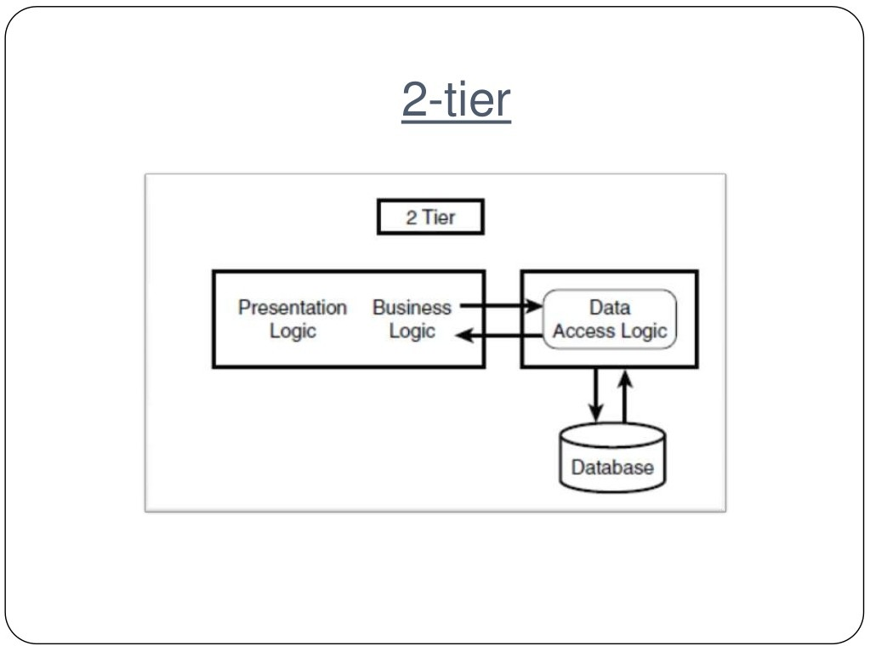

Slide 12
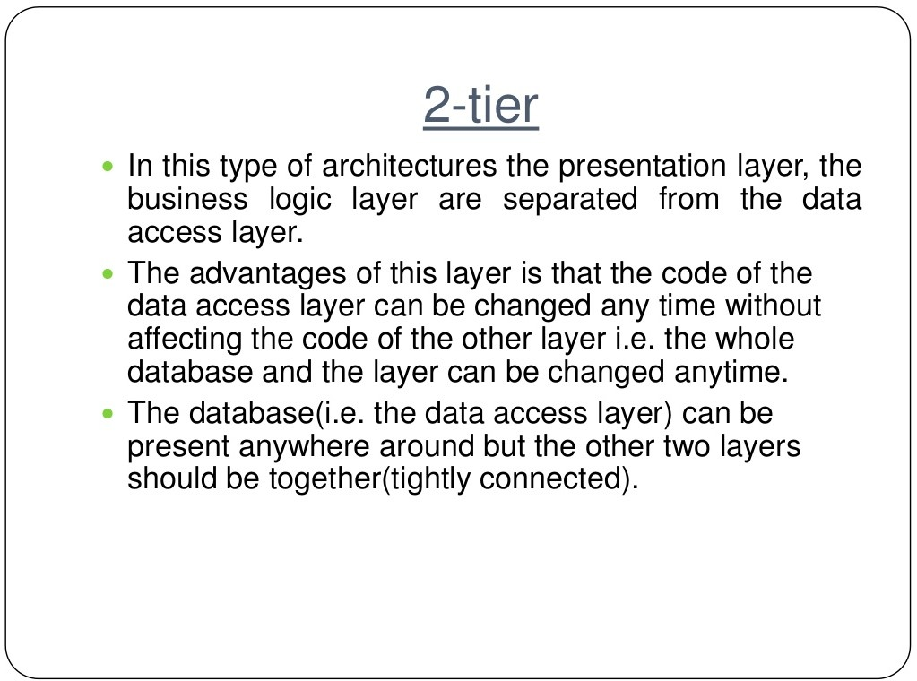

Slide 13
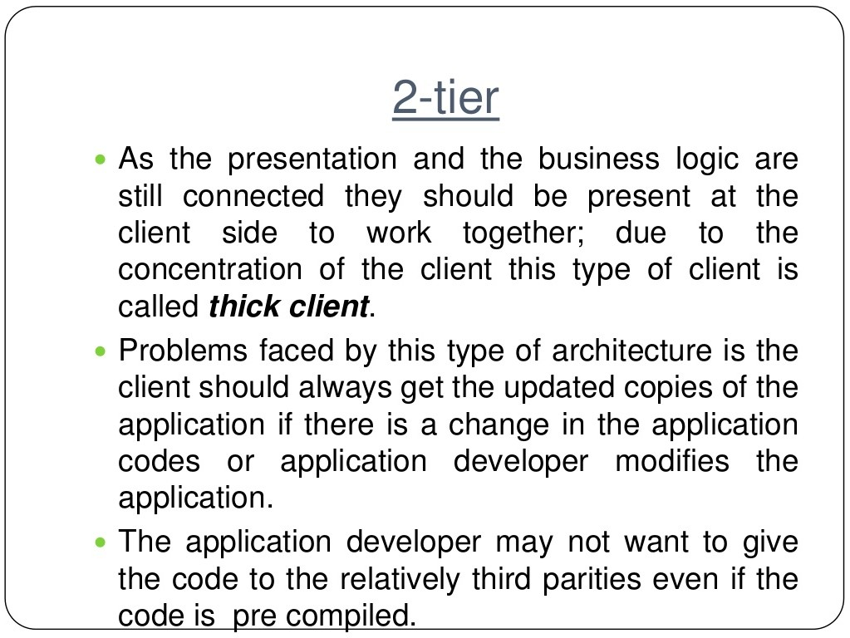

Slide 14
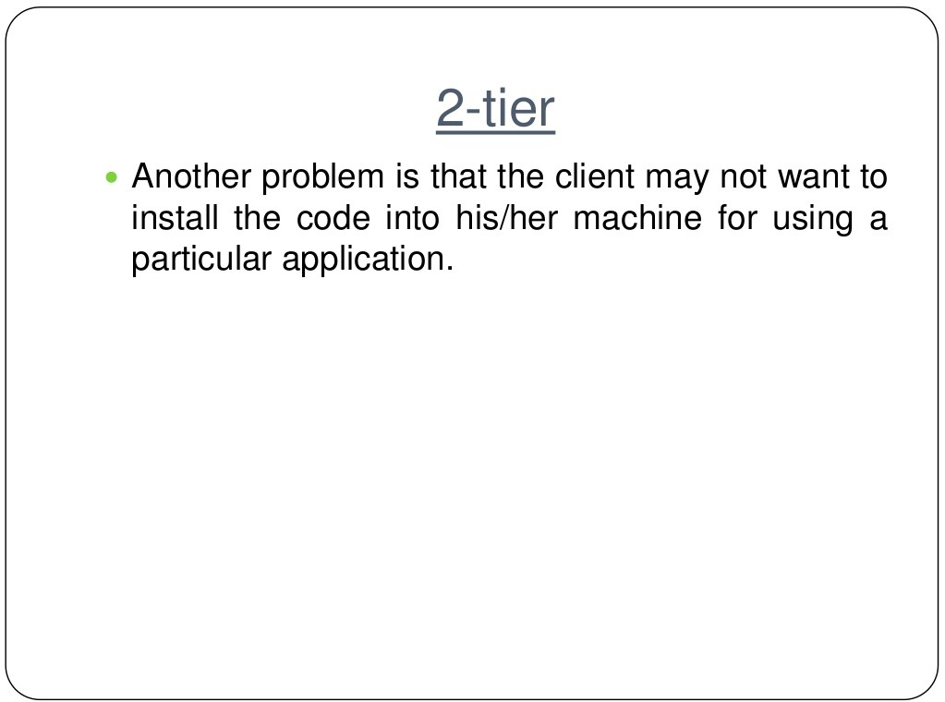

Slide 15
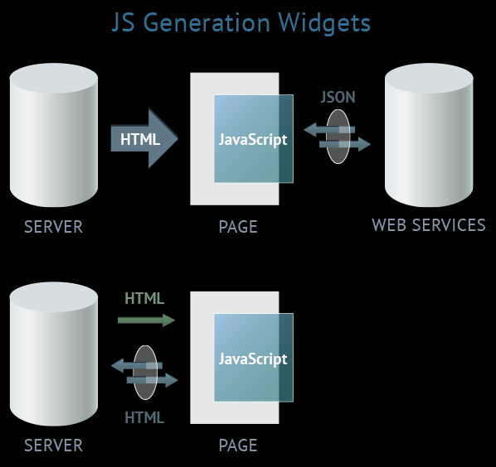
Type 2: JS generation widgets (AJAX)

Slide 16
If updates from the server arrive only for the part of the page requested by the client. It's also good that widgets are separated functionally.
A particular widget is in charge of a part of the page; partial changes will not affect the whole page.
There's a problem with updating or caching the data displayed on the widget.
This functionality has to be implemented additionally: in the manifest one can indicate only names of the files that will be cached from the server.
Correlation between the widget template file, cached in the manifest, and the page behavior logic requires extra effort.

Slide 17
Web 2.0
Technology Centric Definition:
platform with software above the level of a single device.
Technology that is associated with blogs, wikis, podcasts, RSS feeds etc.
Business Centric Definitions:
architecting software and businesses.
The business revolution in the computer industry caused by the move to internet as platform and an attempt to understand the rules for success on that of new platform.
User Centric Definitions:
The Social Web is often used to characterize sites that consist of communities.
It is all about content management and new ways of communication and interaction between users.
Web applications that facilitate collective knowledge production, social networking and increases user to user information exchange.
Limitations:
Constant iteration cycle of Change and Updates to services
Ethical issues concerning build and usage of Web 2.0
Interconnectivity and knowledge sharing between platforms across community boundaries are still limited

Slide 18
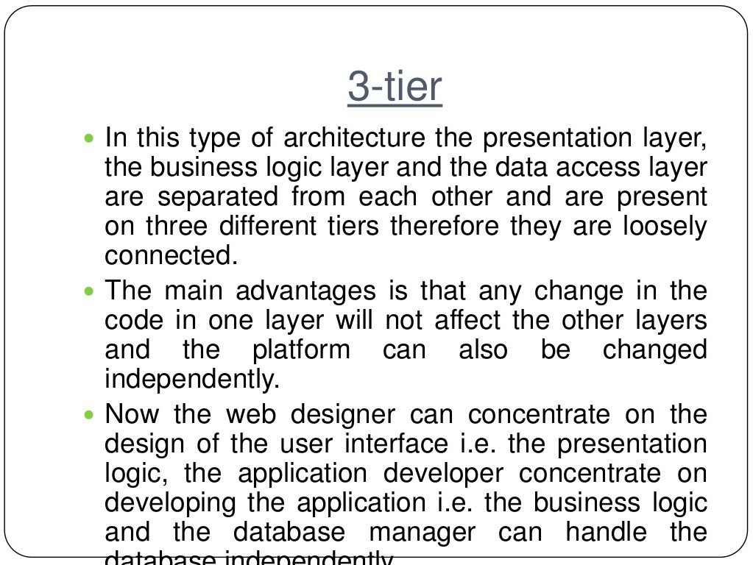

Slide 19
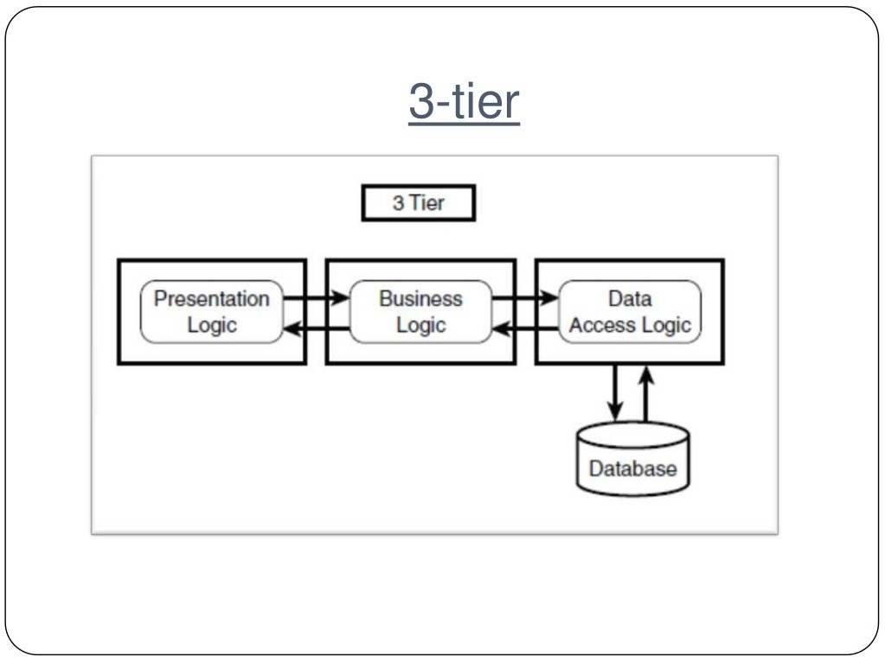

Slide 20
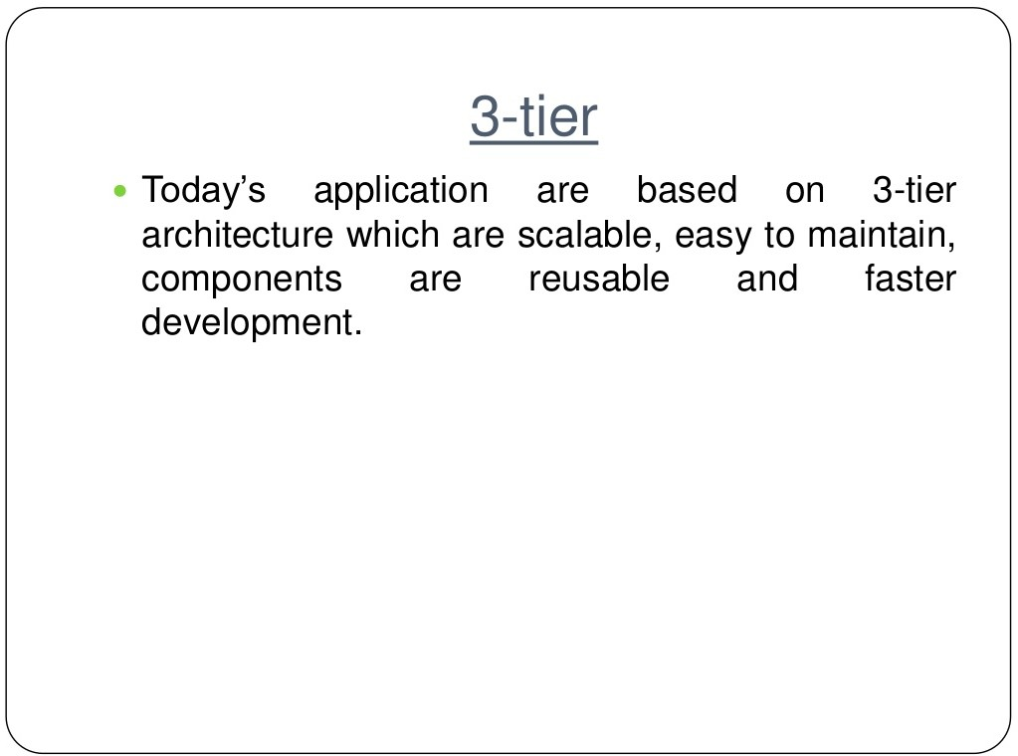

Slide 21
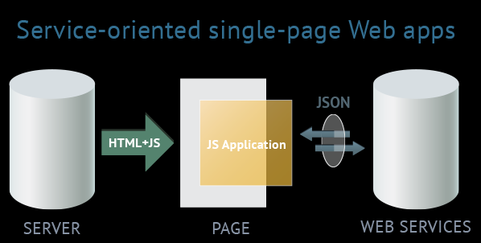
Type 3: service-oriented single-page web apps (Web 2.0, HTML5 apps)
The term ''Web 2.0'' isn't quite correct here. One of peculiarities of Web 2.0 is the principle of involving users into filling and repeated adjustments of content. Basically the term ''Web 2.0'' means projects and services which are actively developed and improved by users themselves: blogs, wikis, social networks. This means Web 2.0 isn't bound to one technology or a set of technologies.

Slide 22
Web 3.0
CHARACTERISTICS
SaaS Business Model.
Open Source Software Platform.
Distributed Database –“The World Wide Database”.
Web Personalization.
Resource Pooling
Intelligent Web.
CHALLENGES:
Vastness: The World Wide Web contains many billions of pages. Redundancy in Data may occur which has not yet been able to eliminate all semantically duplicated terms
Vagueness: This arises from the vagueness of user queries, of concepts represented by content providers, of matching query terms to provider terms and of trying to combine different knowledge bases with overlapping but subtly different concepts.
Inconsistency: These are logical contradictions which will inevitably arise during the development of large ontologies, and when ontologies from separate sources are combined.
Deceit: This is when the producer of the information is intentionally misleading the consumer of the information.

Slide 23
Single Page Applications (aka SPA), and Service Oriented Architecture (aka SOA)
SPA refers to the architecture of the UI, specifically the Web UI.
SOA refers to the architecture of the back-end business layer, architecting for service reusability.
This approach avoids interruption of the user experience between successive pages, making the application behave more like a desktop application.
In an SPA, either all necessary code – HTML, JavaScript, and CSS – is retrieved with a single page load
Appropriate resources are dynamically loaded and added to the page as necessary, usually in response to user actions.
Thick and Thin architectures for client and server- Stateful and Stateless Versions

Slide 24
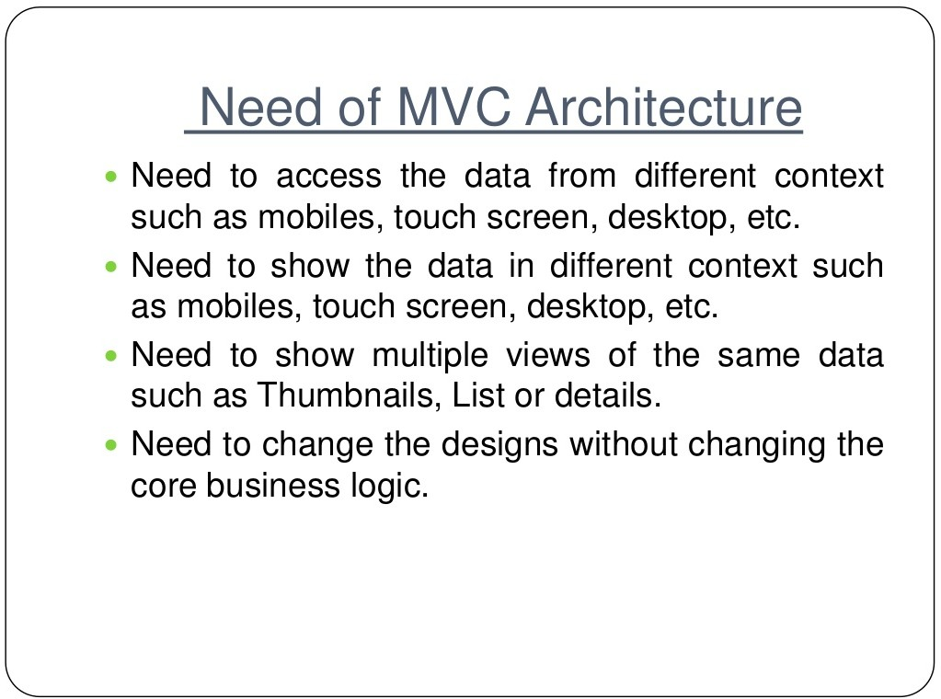

Slide 25
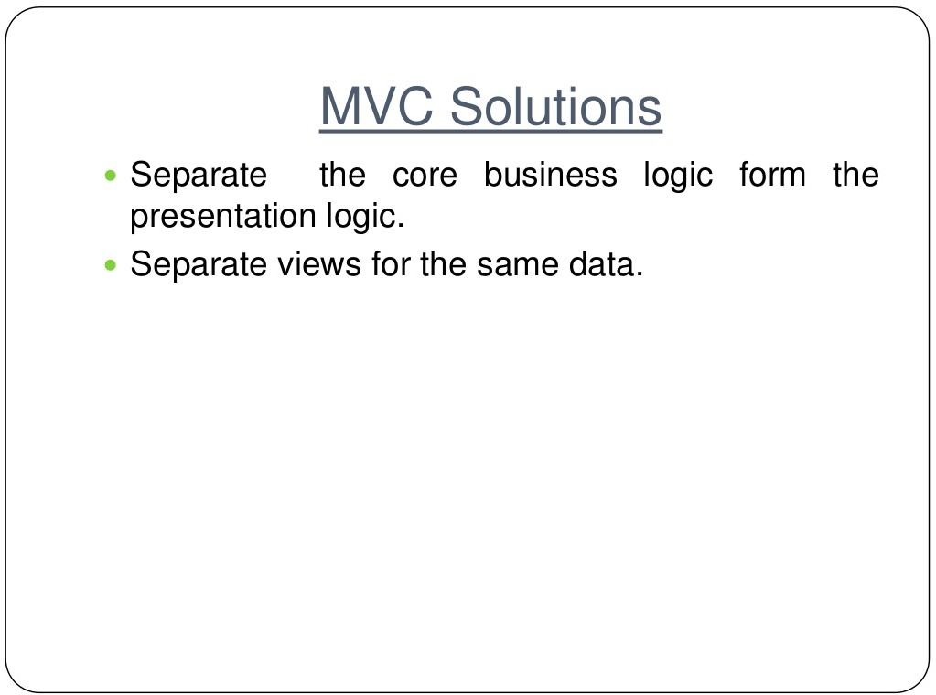

Slide 26
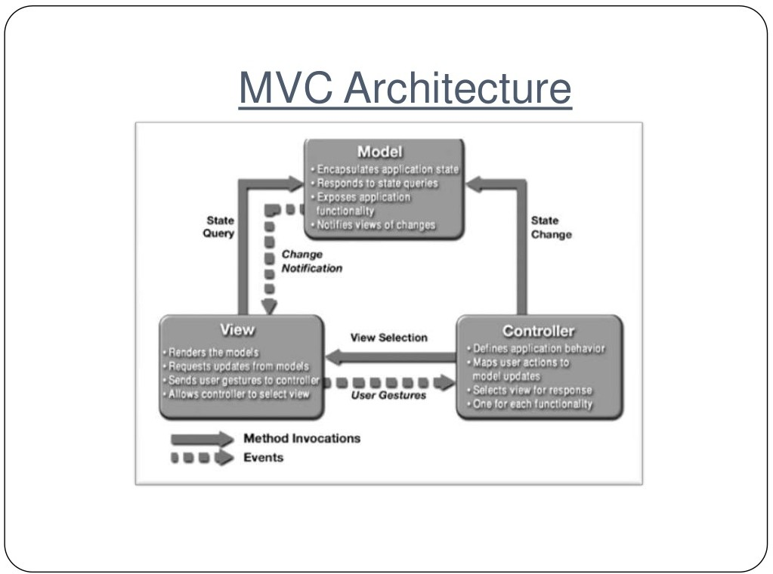

Slide 27
  The model contains the underlying classes whose instances (objects) are to be viewed and manipulated
    Model will likely contain classes from the domain that may be general and form the application itself, which may be unique or specialized to the application.
    These may be very complicated software objects.
  The view contains objects used to render the appearance of the data from the model in the user interface and the controls with which an actor can interact.
  The controller contains the objects that control and handle the user’s interaction with the view and the model.
    Controller contains business logic…and response to events.
  (The Observable design pattern is normally used to separate the model from the view (later)

Slide 28
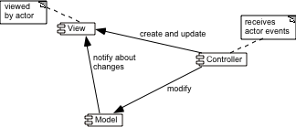
MVC exhibits layer cohesion, as the model has no idea
what view and controller are attached to it (doesn’t care!).
Model is ‘passive’ in this respect.
The View (UI), business services (controller), and model
(business entities / core abstractions) will reside in different architectural layers.

Slide 29
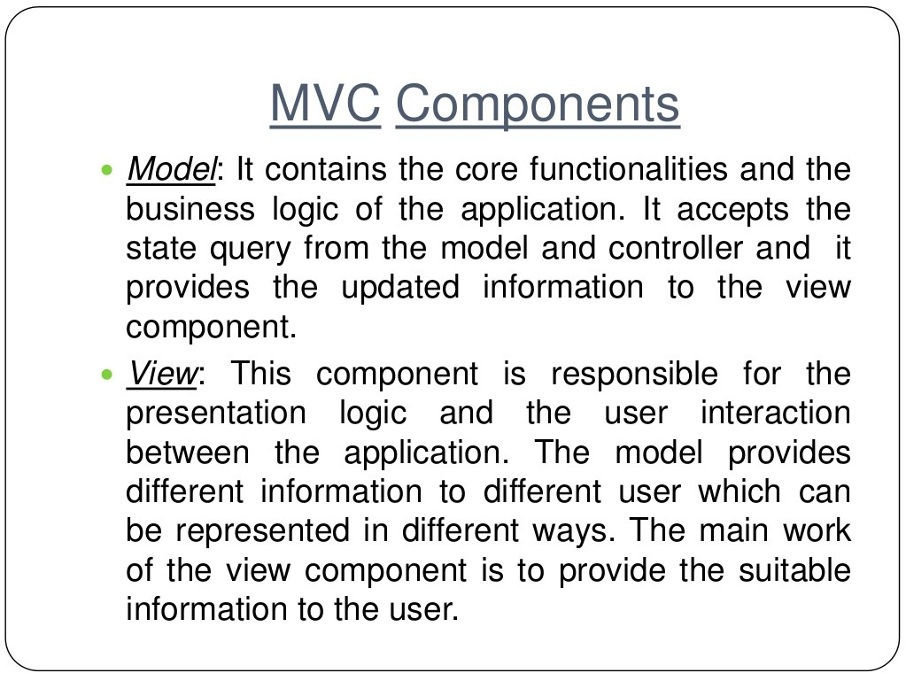

Slide 30
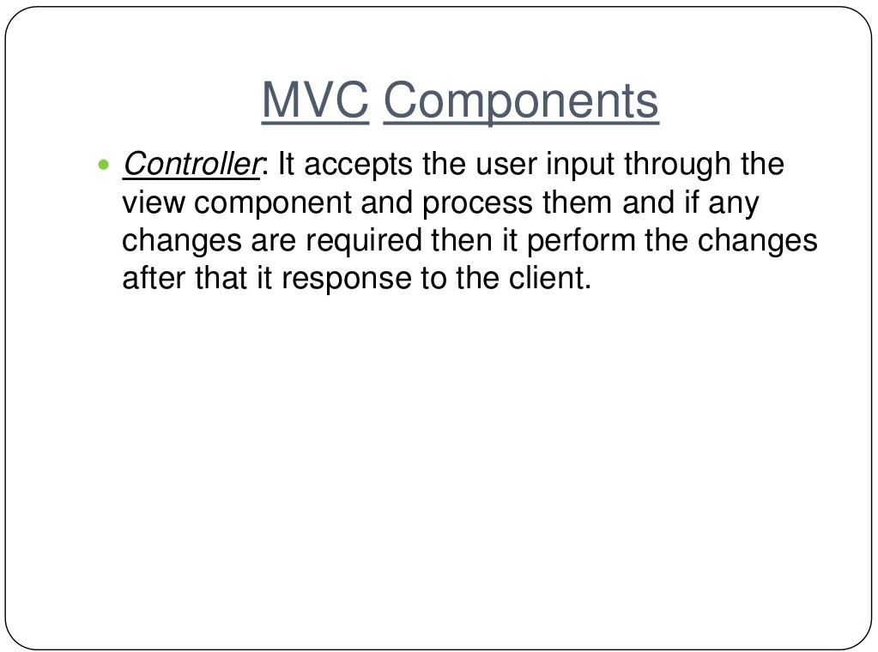

Slide 31
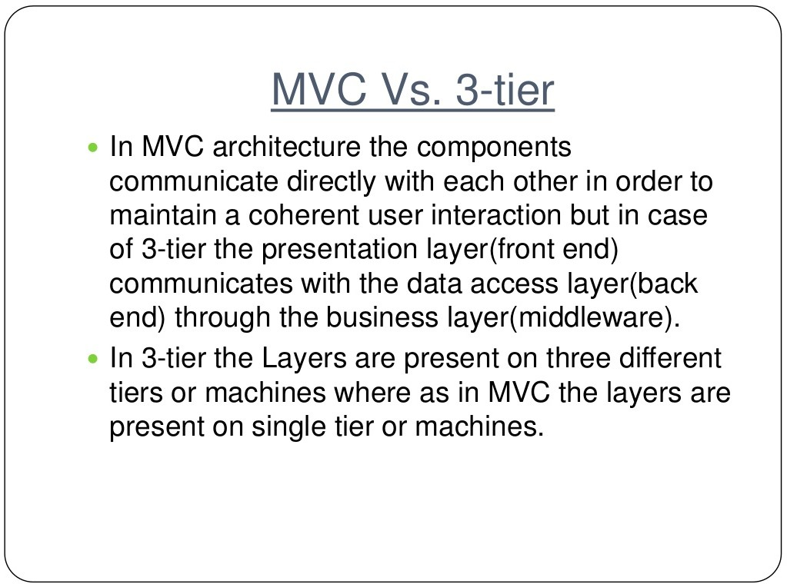

Slide 32
MVC Architecture and Design Principles
  1. Divide and conquer: Three components can be somewhat independently designed.
  2. Increase cohesion: Components have stronger layer cohesion than if the view and controller were together in a single UI layer.
  3. Reduce coupling: Minimal communication channels among the three components.
  6. Increase reuse: The view and controller normally make extensive use of reusable components for various kinds of UI controls.
  7. Design for flexibility: It is usually quite easy to change the UI by changing the view, the controller, or both.
  10. Design for testability: Can test application separately from the UI.

Slide 33
