Slide 1
Course Overview
15CSE402-Structure and Interpretation of computer Programs
Ms.D.Bharathi
Assistant professor (sR.gr)
Department of Computer Science and Engineering,
Amrita School of Engineering, Amrita Vishwa Vidyapeetham, Coimbatore.

Slide 2
Objectives
Introduction to Functional Programming
Exposure to Procedural Abstraction
Apply and manipulate Abstract data
Understanding Modularity and Streams

Slide 3
Course Outcomes
Course Outcome | Description | Bloom’s Taxonomy Level
CO1 | Apply the elements of scheme programming to write functional programs | L3
CO2 | Formulate abstractions with (higher –order) procedures | L4
CO3 | Understand organizational principles and apply effectively the Scheme data structure, list, for program synthesis | L3
CO4 | Formulate and model abstractions with data | L4
 |  | Course plan

Slide 4
Faculty Team
S.No | Name of the Faculty
1 | Dr.C.Shunmuga Velayutham
2 | Dr.K.Raghesh Krishnan
3 | Ms.D.Bharathi
4 | Ms.G.Radhika
5 | Ms. Rimjhim Singh

Slide 5
Evaluation Pattern
S.NO | Evaluation | Count | Mode | Marks
1. | Quiz | 1 quiz per week | MS Teams and AUMS | 20 marks
2. | Programming Assignment | 3 Assignment( one per unit) | AUMS | 30Marks
3. | Term work |  | AUMS | 20 marks
4. | End Sem-Online | 1 | AUMS | 15 marks
5. | End Sem-Viva | 1 | MS Teams | 15 marks
 |  |  | Total | 100 marks

Slide 6
Teaching Materials / Mode of delivery
Live lectures - MS Teams
Demo - Dr.Racket IDE
Flipped Classroom - Recorded Videos

Slide 7
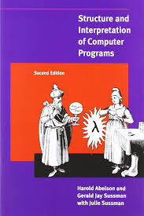
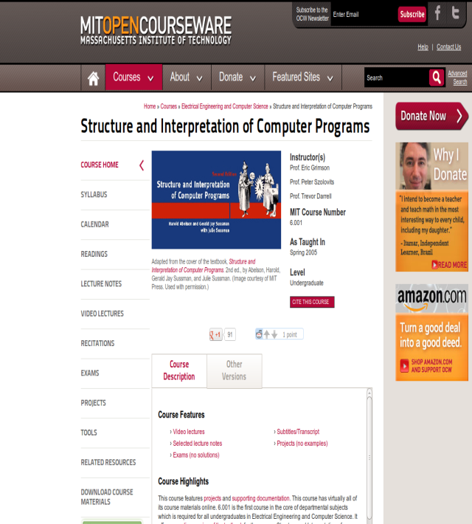
Text Book and References
Abelson H and Sussman G. J., “Structure and Interpretation of Computer Programs”, Second Edition, MIT Press, 2005.
MIT OPENCOURSEWARE

Slide 8
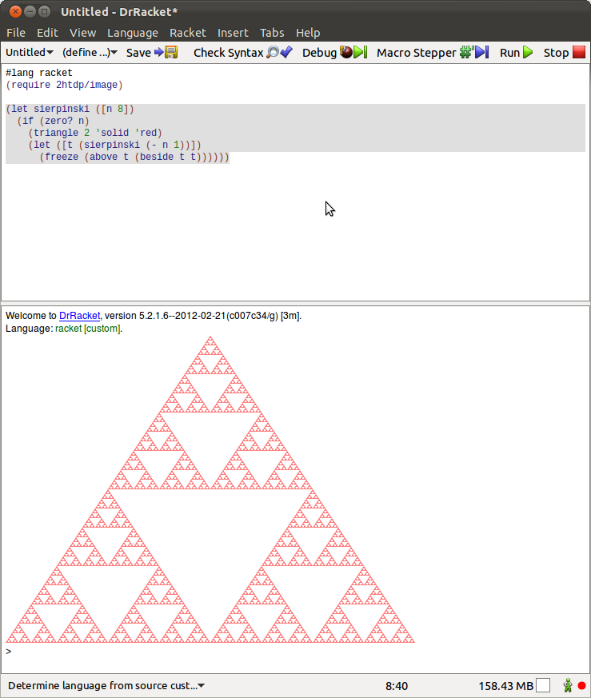

Tools Required
Racket v7.7 – General purpose programming language(open source)
Racket v7.7

Slide 9
SICP -Overview
SICP is to think about programming process than details of a language.
It uses the idea of functions as data.
It addresses the techniques used to control complexity of large software systems.
If focuses on the idea of abstraction(finding general patterns from specific patterns).
It uses scheme language for understanding the techniques.

Slide 10
Functional Programming
Programs were constructed by applying functions.
It is a declarative type of paradigm which will not change the state of the program.
Functions can be passed as arguments, returned from other functions.
It is evolved from Lambda calculus.
Example: Lisp, Scheme, clojure.
Functional feature is supported in language like C++, PHP, Python, Scala.

Slide 11
Introduction to Scheme
Functional programming language first appeared in 1975.
Scheme was developed at MIT AI lab by Guy L. Steele and Gerald Jay Sussman.
Scheme is a dialect of Lisp.
It uses Interpreter.
It is used in embedded system, compiler design, scripting , Google App inventor for Android.

