Slide 1
XSL

Slide 2
XSL stands for EXtensible Stylesheet Language.
Components
XSLT: It is a language for transforming XML documents into various other types of documents.
XPath: It is a language for navigating in XML documents.
XQuery: It is a language for querying XML documents.
XSL-FO: It is a language for formatting XML documents.

Slide 3
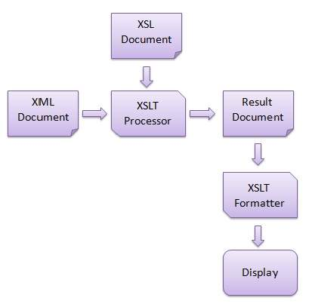

Slide 4
Example

Slide 5
Elements
Parent elements | xsl:stylesheet, xsl:transform
Child elements | xsl:apply-imports,xsl:apply-templates,xsl:attribute, xsl:call-template, xsl:choose, xsl:comment, xsl:copy, xsl:copy-of, xsl:element, xsl:fallback, xsl:for-each, xsl:if, xsl:message, xsl:number, xsl:param, xsl:processing-instruction, xsl:text, xsl:value-of, xsl:variable, output elements

Slide 6
Xsl:template
<xsl:template
name = Qname
match = Pattern
priority = number
mode = QName >
</xsl:template>

Slide 7
<xsl:value-of
select = Expression // Xpath
disable-output-escaping = "yes" | "no" >
</xsl:value-of>
<xsl:for-each
select = Expression >
</xsl:for-each>

Slide 8
<xsl:sort
select = string-expression
lang = { nmtoken }
data-type = { "text" | "number" | QName }
order = { "ascending" | "descending" }
case-order = { "upper-first" | "lower-first" } >
</xsl:sort>
<xsl:sort select = "firstname"/>

Slide 9
<xsl:if
test = boolean-expression >
</xsl:if>
<xsl:if test = "marks > 90">

Slide 10
<xsl:choose>
<xsl:when test = "marks > 90">
High
</xsl:when>
<xsl:when test = "marks > 85">
Medium
</xsl:when>
<xsl:otherwise>
Low
</xsl:otherwise>
</xsl:choose>

Slide 11
<xsl:message
terminate = "yes" | "no" >
</xsl:message>
<xsl:if test = "firstname = ''">
<xsl:message terminate = "yes">A first name field is empty.
</xsl:message>
</xsl:if>

Slide 12
xlink:show
Embed →insert the presentation of the target resource (the one at the end of the arc) in
place of the source resource (the one at the beginning of the arc, where traversal
was initiated) (example: as images in HTML)
New→ display the target resource some other place without affecting the presentation
of the source resource (example: as target="_blank" in an HTML link)
Replace→ replace the presentation of the resource containing the source
with a presentation of the destination (example: as normal HTML links)
Other → behavior specified elsewhere
None→ no behavior is specified

Slide 13
xlink:actuate
onLoad → traverse the link immediately when recognized (example: as HTML images)
onRequest → traverse when explicitly requested (example: as normal HTML links)
Other → behavior specified elsewhere
None →
no behavior is specified

Slide 14
<?xml version="1.0" encoding="UTF-8"?> <bookstore xmlns:xlink="http://www.w3.org/1999/xlink"> <book title="Harry Potter"> <description xlink:type="simple" xlink:href="/images/HPotter.gif" xlink:show="new"> As his fifth year at Hogwarts School of Witchcraft and Wizardry approaches, 15-year-old Harry Potter is....... </description> </book> <book title="XQuery Kick Start"> <description xlink:type="simple" xlink:href="/images/XQuery.gif" xlink:show="new"> XQuery Kick Start delivers a concise introduction to the XQuery standard....... </description> </book> </bookstore>

