Slide 1
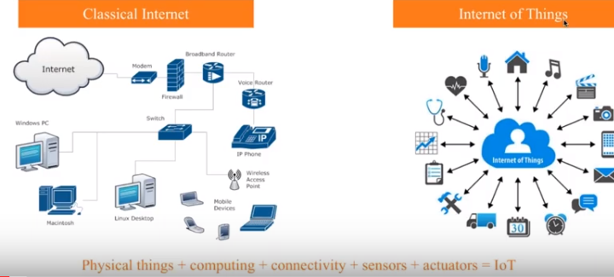
What is IoT? Recap

Slide 2
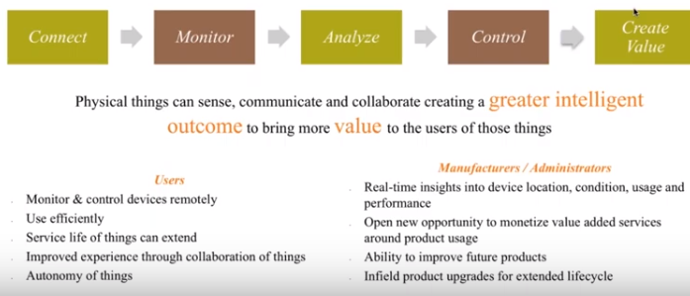
Why IoT? Recap

Slide 3
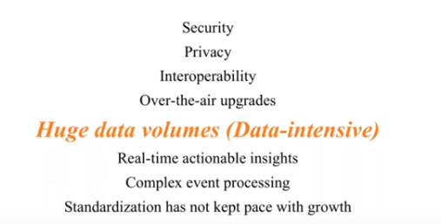
Challenges in IoT Recap

Slide 4
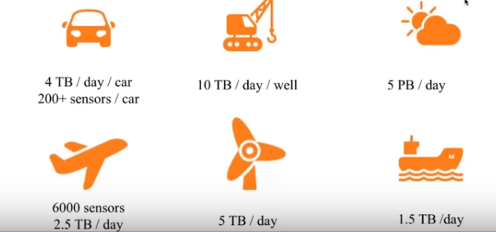
The Data Challenge Recap

Slide 5
What is Data Analytics?
Analytics is defined as “a process of transforming data into actions through analysis and insight in the context of organisational decision making and problem-solving.”
Data Analytics lifecycle consists of
Business case evaluation
Data Identification
Data acquisition and filtering
Data extraction
Data validation and cleansing
Data aggregation and representation
Data analysis
Data visualization
Utilization of analysis results

Slide 6
Why Data Analytics?
Data analytics can be used to find
Masked patterns
Anonymous correlations
Customer preferences
Market trends
Other necessary decisions for business purpose

Slide 7
Example use cases
Consider a dataset of 1gb related to customer purchase data
Finding out what would be the customer’s next possible purchase
Rank the longest-standing customers in a particular state
Calculate the moving average of retail volume over a specified time
Compare the current sales bonus each salesperson received against his or her previous bonus
Finding out what happened so far, like
Sales pattern identification
Demographics of the customer

Slide 8
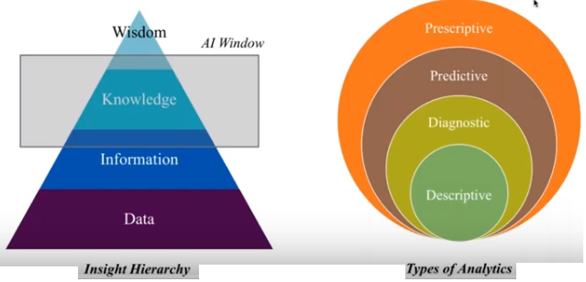
How to draw Data insights?

Slide 9
Five Categories of Analytics Capabilities
Descriptive Analytics: answer the question, “what happened?”
Involves collection of relevant data, processing of the data, data analysis and data visualization
Diagnostic Analytics: answer the question, “why something has happened?”
Discovery in Analytics: answer the question, “what happened that we don’t know about?”
Predictive Analytics: answer the question, “what is likely to happen?”
Involves variety of statistical and machine learning techniques, such as: neural networks, decision trees, and regression
Prescriptive Analytics: answer the question, “What should I do about what has happened or is likely to happen?”
Involves machine learning strategies that can find patterns in large datasets

Slide 10
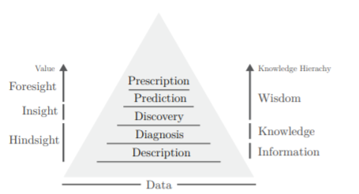
Analytics and the Knowledge and Value Hierarchies
This is a common framework used in the Knowledge Management domain
This categorisation of analytic capabilities
enables to establish what the aim of analysis is
allows to relate to the vision of IoT deployment as often expressed in research roadmaps.
The value of each capability, is also highlighted in the figure.

Slide 11
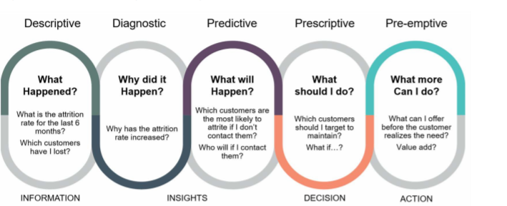
Example in Customer Relationship Management (CRM)

Slide 12
Analytics and the Knowledge and Value Hierarchies
The knowledge hierarchy starts with data at the base, examples of which are facts, figures and observations (e.g. the raw data produced by IoT ’things’).
Information is interpreted data with context, for example, temperature as represented by descriptive analytics: an average over a month or a categorical description of the day being sunny and warm.
Knowledge is information within a context with added understanding and meaning, perhaps possible reasons for the high average temperature this month.
Finally, wisdom is knowledge with insight, for example, discovering a particular trend in temperature and projecting it across future months while providing cost saving energy management solutions for heating a smart home based on these predictions

Slide 13
Analytics and the Knowledge and Value Hierarchies
A review of organisations adopting analytics categorised them as
Aspirational
Experienced and
Transformed
Aspirational organisations were seen to use analytics in hindsight as a justification for actions, utilising the data, information and knowledge tiers in the process.
Experienced organisations utilised insights to guide decisions
Transformed organisations were characterised by their ability to use analytics to prescribe their actions, effectively applying foresight in their decision making process.

Slide 14
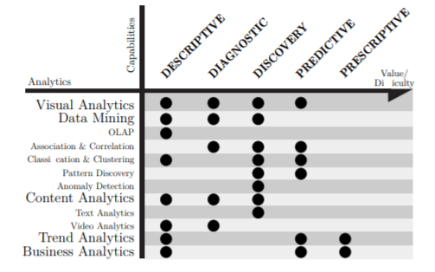
Analytics and capabilities

Slide 15
What is IoT Analytics?
Internet of Things analytics (IoT analytics) refers to analyzing and examining the large volume of data obtained by the Internet of Things.
Performs both real-time and non-real time analysis
Sensors, network end devices and other data storing and transmitting equipment are the key components of collection of Internet of Things data, upon which analysis is performed.

Slide 16
What is IoT Analytics?
The first thing to understand about analytics on IoT data is that it involves datasets generated by sensors.
The potential of sensors lies in their ability to gather data about the physical environment (generally a time-stamped data), which can then be analyzed or combined with other forms of data to detect patterns.
Now let us see the types of data and sources that generate IoT data

Slide 17
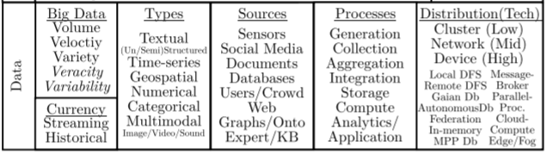
Data in IoT

Slide 18
Use cases of combining IoT data with other data for analytics
Case 1:
IoT Data: IoT connected coffee makers transmit information to the manufacturer about how many pots of coffee a consumer is brewing per day.
Social media Data: consumers who brew more coffee are more likely to be actively discussing the brand on social media.
Analytics:
IoT data about product usage yield actionable marketing insights about your customers.
Further helps in launching new products by brands.

Slide 19
Use cases of combining IoT data with other data for analytics
Case 2:
IoT data: Data from biometric sensor in an environment , say related to a player or a coach in a game)
Camera Data: when free throws happen, when 3-pointers happen etc.,
Analytics: construct ‘agitation index’ for coaches, which analyzes movement to measure their level of involvement throughout the game.

Slide 20
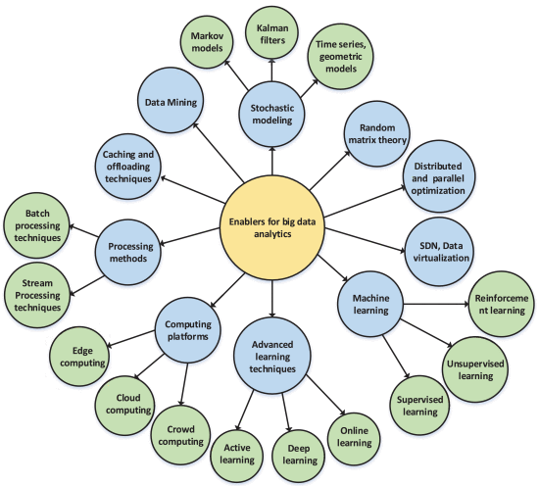
Enablers of IoT Data Analytics

Slide 21
Patterns of data produced/generated by IoT environment
The following 3 patterns of data surround the use of data.
Data from passive: These are sensors that must be activated before they can transmit data, and they only produce data when asked to do so.
Example: a sensor that measures ground water saturation only produces current data when the API is invoked
This produces discrete events
Data from active: means that the sensor is typically streaming data ( these sensors constantly toss off data).
Example: Temperature data, pressure data, etc., in an environment
Thus, you need to absorb the data in near real-time, and the applications need sophisticated IoT data communications capabilities.
Data can’t be lost, it must be correctly parsed from the stream, and placed in the correct format for both storage and processing.

Slide 22
Patterns of data produced/generated by IoT environment
Data from dynamic: These are devices with sensors that communicate dynamically (bidirectional) with IoT applications
Example smart thermostat
The data from dynamic is like an IoT application talking to another application. They do not just deal with data points that devices produce, but can alter the data produced to meet the needs of the target IoT application
These are also self- and auto-configurable, and these dynamic capabilities really provide the best IoT capabilities.
The challenge is when we get mixed form of data – This makes short duration and long duration events processing complex.

Slide 23
Time series Data - Event Stream Processing
Event-Based Windows: break time series data into windows that flag on significant events pattern within the data.
An event may also be defined as a “change of state,” when a measurement exceeds a predefined threshold of time, temperature or other value – that is really where IoT comes in.
Non IoT data event processing: This is especially relevant in financial data where analysis often focuses on specific events as triggers to other activity.
Eg. Given an input stream of stock quotes, the stock analyst may want to place the input quotes into a new group whenever the spread (the difference between the ask price and the bid price) exceeds five cents. If we view each such group as a window of events, then the window endpoints are defined by the occurrence of certain event types.

Slide 24
Time series Data - Event Stream Processing
IoT data event processing: Example: Smart health care
Multiple medical devices (to sense blood pressure Cuff, weight scale , or Pulse oximeter for a slight decrease in activity) connect patients to healthcare providers over the Internet. This produces multiple streams of data .
Relational databases are mostly not used to process real-time streaming data
Instead, data stream management systems (DSMS) are used to process continuous feeds of data in a method analogous to a database.
These data streams when aggregated together, these readings may indicate oncoming or acute heart failure, or some other critical situation specific to that patient’s chronic health condition
These streams need to be processed in real-time to do the following:
filter out events as meaningless,
combine or aggregate events to form new derived events, or
to respond to one or more events as appropriate
Courtesy: https://www.linkedin.com/pulse/complex-event-processing-healthcare-iot-solutions-eric-bruno

Slide 25
Time series Data - Event Stream Processing
By analysing contextual knowledge in connection with physiological data and being sensitive and adaptive to parameters that vary less frequently, such systems are able to provide descriptive analytics to care-givers and a form of discovery analytics to detect anomalies to trigger emergency warnings.

Slide 26
Case Study 1: RFM Model in CRM Learn the model from RFM.pdf file attached

Slide 27
Case Study 1: Customer Journey: Knowing customer needs
Product suggestions based on recently viewed items, ads personalized to the consumer and automated CRM processes are the norm by now.
The more retailers know about their customers, the more accurately they can align their product selection, advertising, and stores with consumer needs and buying habits

Slide 28
Case Study 1: Customer Journey: Knowing customer needs
The Future-Shape Company near Munich has deployed SensFloor system.
The retailers use sensors in the floor to gain information on paths customers take through the store, what shelves or ads they linger at and when they prefer to be in specific areas.
Identify the registered customer behavior by a set of motion sensors, floor sensors and touch sensors.
This subsequently generate heat maps for the monetary value based on the Recency and Frequency .
This could be used to automatically control lighting, digital signage content or customer service stations.

Slide 29
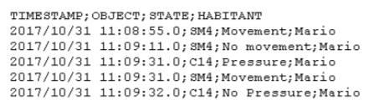
Case Study 1: Customer Journey: Knowing customer needs
Sample Data File motion sensor

Slide 30
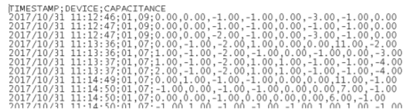
Case Study 1: Customer Journey: Knowing customer needs
Sample Data File Floor sensor

Slide 31
Case Study 1: Customer Journey: Knowing customer needs
Recency: When did the customer look at the ad board in the pathway or object in the store?
Frequency: How many times did the user show interest on particular ad board or object?
Monetary: The expected revenue from the customer.

Slide 32
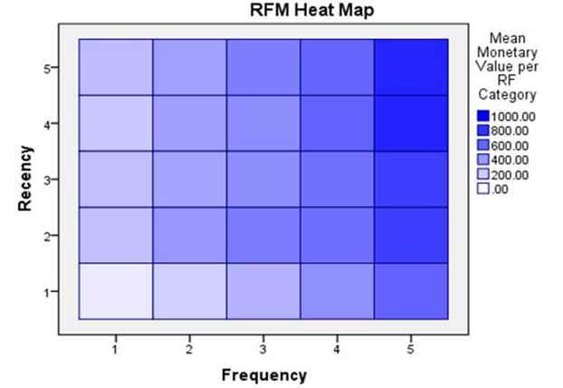
Case Study 1: Customer Journey: Knowing customer needs

Slide 33
Case Study 1: Customer Journey: Knowing customer needs
Based on this RFM scoring and heat map of your existing customers, the company can now laser focus on the allotting sales individuals for marketing the interested customers with the highest 3-digit score and the darkest square colors.
This will save you money by directing human resources with the right targets, inform you with who best to communicate with via email or direct mail, and which customers will have the biggest impact on your net revenue.

Slide 34
Case Study 2: Air Pollution level detection in Smart City
Smart city is currently dealing with rapidly increasing air pollution that result from variety of sources.
The main cause of pollution is fumes gas from traffic system with a huge number of vehicles.
In order to help the city’s environment people to deal with air pollution in smart ways, to find the best healthy area in the smart city which are suitable for living.
In this paper we apply the K-means clustering algorithm on air pollution data level of pollution relying on available datasets generated from The CityPulse project.
The volume of data collected from each region of The CityPulse project can be extremely enormous and dynamic due to the number of mobile sensors deployed in the same location at the same time and their measurement frequency.
This paper provides to viewer the actual level of pollution by position.

Slide 35
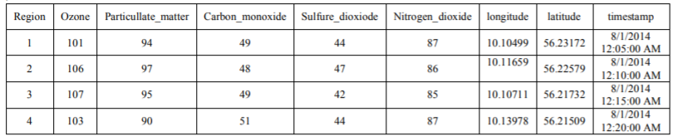
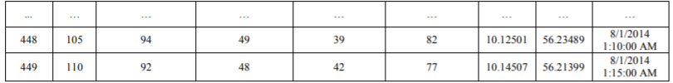
Case Study 2: Air Pollution level detection in Smart City

Slide 36
Case Study 2: Air Pollution level detection in Smart City
K-Means Clustering:
Algorithm: k-means.
Input: E = {e1, e2,..., en} (set of objects to be clustered)
k (number of clusters)
Output: C = {c1, c2,..., ck} (set of cluster centroids)
L={l(e) | e = 1,2,...,n} (set of cluster labels of E)
Methods:
Randomly choose k points from the data set D as the initial cluster means (centroids);
Assign each object to the group to which is the most closest, based on the means values of the objects in the cluster;
Recalculate the mean value of the objects for each cluster;
Repeat the steps 2 and 3 until no change in the means values for the groups

Slide 37
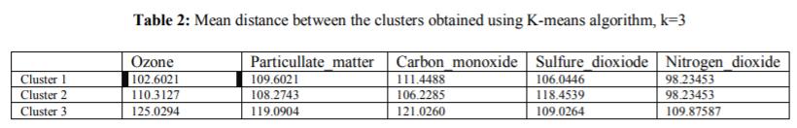
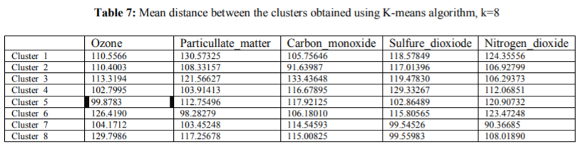
Case Study 2: Air Pollution level detection in Smart City

Slide 38
Data Processing Challenges
Insufficient Bandwidth
Intermittent Connection
Perishable Data
High Latency
Security and Compliance
No Real-time Insights
Delayed (No) Actions

Slide 39
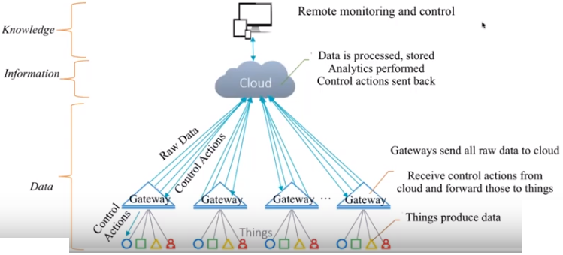
Architecture

Slide 40
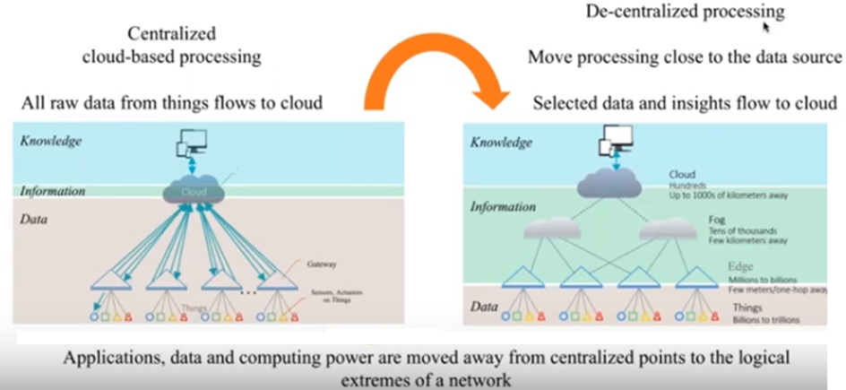
Solution Edge/Fog Computing

Slide 41
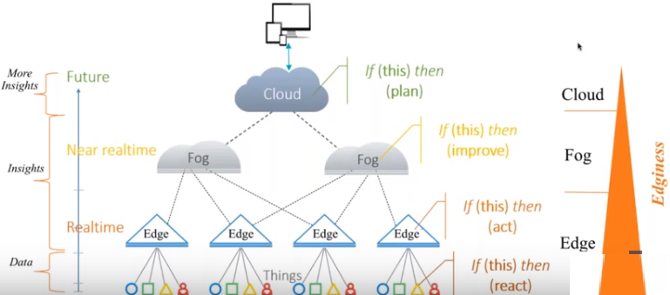
Things-to-Cloud Continuum

Slide 42
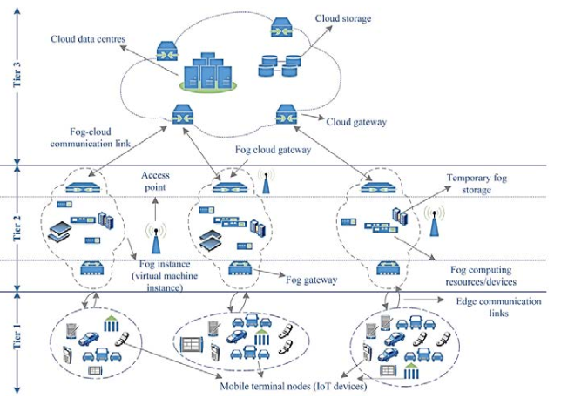
Fog Architecture(2)

Slide 43
Fog Computing
With fog, routers, switches, application servers, and storage servers will converge into fog nodes, with each fog node providing a common hardware and software platform to support computing, networking, and storage.

Slide 44
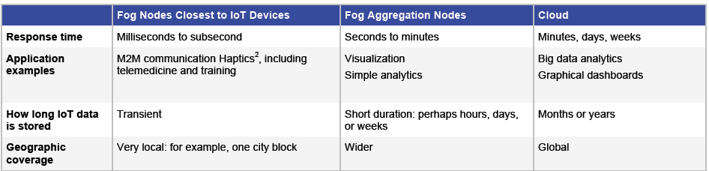
Edge, Fog and Cloud comparison
A fog gateway is a edge device.
A fog aggregation nodes is a collection of small computing node.
A cloud is a large data center or a collection of datacenter.

Slide 45
Data Analytics at edge/fog and cloud
Tasks at cloud
Predictive analysis: Various features of big data can be utilized in order to monitor the events which may be periodic or random in nature. Based on the global view of the network and historical data, cloud can implement suitable prediction techniques to forecast future events, and to provide this information to the edge computing units in order to better utilize the network resources.

Slide 46
Data Analytics at edge/fog and cloud
Task at edge/fog
Descriptive Analytics: The massive data-sets are collected from multiple locations, heterogeneous formats and semi-structured and unstructured in nature. The data-sets are in a raw form with inconsistency, high redundancy and much useless information.
Therefore, it becomes highly beneficial to carry out data pre-processing such as data integration, redundancy elimination and data cleansing at the edge-side in order to avoid the unnecessary storage space, and also to enhance the computational efficiency.

Slide 47
Advantage of Edge/Fog Computing
Insufficient Bandwidth Make big data smaller
Intermittent Connection Nearest compute capacity leveraged
Perishable Data Processing closer to data source
High Latency Low Latency
Security and Compliance Data stays at source only insight flows
No Real-time Insights Near Real time decisions
Delayed (No) Actions Instant actions possible

Slide 48
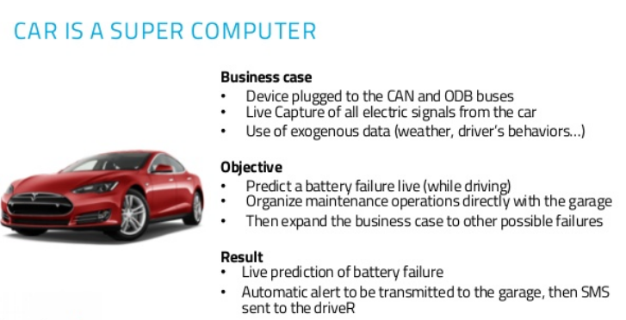
Popular Examples of Edge/Fog computing

Slide 49
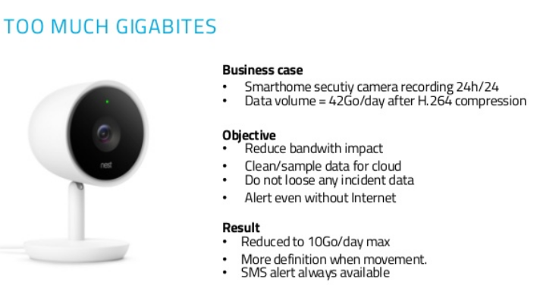
Pouplar Examples of Edge/Fog Compting

Slide 50
Use Cases for IoT Edge/Fog
Category | IoT Foundation Supporting general IoT functionality | IoT Service Enablers Adding value to IoT | IoT Solutions Supporting customer solutions
Use case | Device Management Security | Priority Messaging Data Aggregation Data Replication Cloud Enablement | IoT Image and Audio Processing

