Slide 1
RFM
In digital marketing and data analysis

Slide 2
About RFM
RFM stands for RECENCY,FREQUENCY,MONETARY
It is a data analysis concept used for behaviour based customer segmentation in digital marketing
It has been around for about 40 years and was used for catalogue marketing
RFM analysis is based on marketing axiom that “ 80% of your business comes from 20% of the customers ” derived from the Pareto Principle

Slide 3
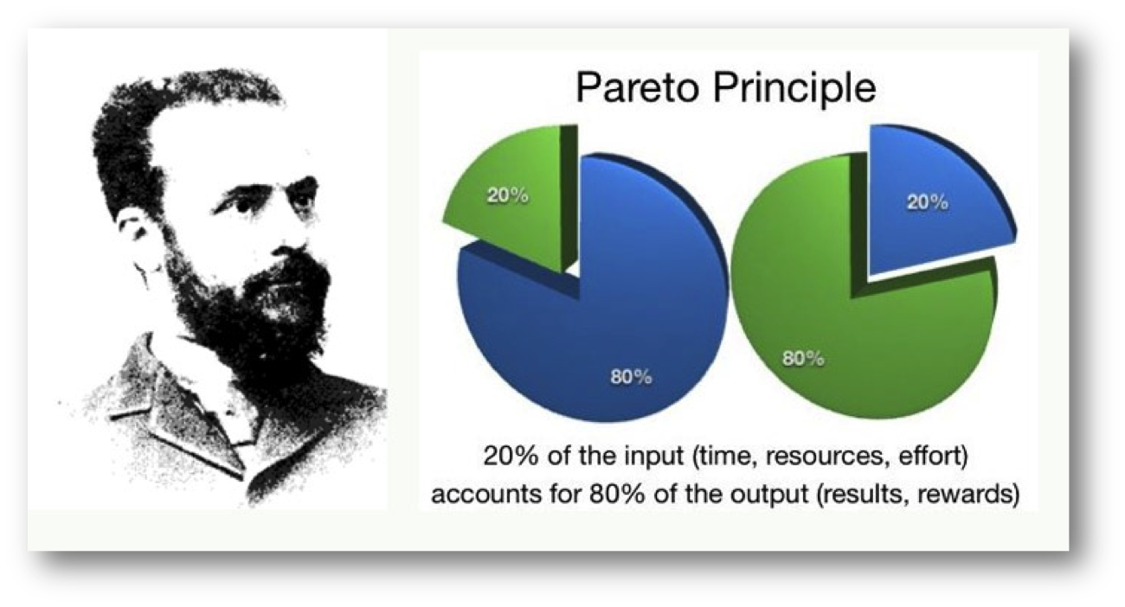
Pareto Principle

Slide 4
It groups customers based on their transaction history
HOW to group the customers?
-How recently(recency), How frequently (frequency), How much (monetary)
WHY group the customers?
-Different customers have different requirements
-Customer personalization and to find out which customers responds well to promotions

Slide 5
Why a combination of the three parameters
Who is the best customer ?
On who bought recently? - What if the customer buys only during the sales season?
One who buys frequently? - What if a business has different plans such as monthly vs annual
One who spends the most? - What if it was only once and a long time ago..

Slide 6
Judging the customer based on one aspect will give you an inaccurate report of the customer base and their lifetime value
Hence in RFM, we combine these three parameters to create RFM score.
We maintain a score for recency, frequency and monetary and combine them to get RFM score

Slide 7
Targeting
Different customers have different requirements and respond to different messaging
Example :
Price sensitive customer : Discounts and offers
A regular customer : A new product launch
It’s important to target only specific groups that will turn out to be most profitable
Understand the customers a little better and then send them the relevant campaigns

Slide 8
Calculate RFM score
There is sufficient data about all the customer transactions in the customer database
What we need
1. Customer name/ID for identification
2.Recency(R) as days since last purchase : Last purchase 1 day ago? 2 days ago?
3.Frequency(F) as total number of transactions : How many purchases have been made over a period of time?
4.Monetary(M) as the total money spent : How much money spent by the customer over a period of time?

Slide 9
What we do with these R/F/M values
We assign a ranking from 1 to 5 (with 5 being the highest) to all the three parameters
After getting the R/F/M values we write them down in the descending order
Most recent Purchase ranked higher(1 day ago) than the purchases made a while ago(1 month ago)
Most frequent customers are ranked higher (5) than the less frequent ones (1)
Also customers who spent a lot will be ranked higher (5) than the customers who spent low (1)

Slide 10
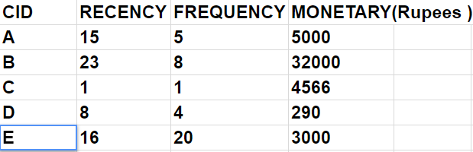
Take a look at the following customer database

Slide 11
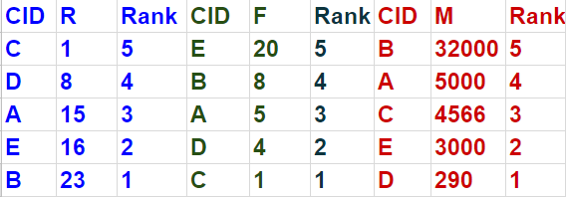
It is important to notice that R/F/M values are different from the R/F/M scores

Slide 12
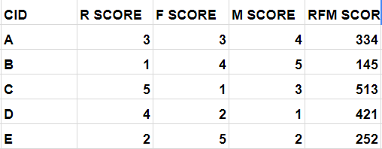
Now lets calculate the combined RFM scores
The value of 555 is the ideal value and the value of 111 being the least desirable
There a 5 values for each parameter hence can we get 125 different customer segments

Slide 13
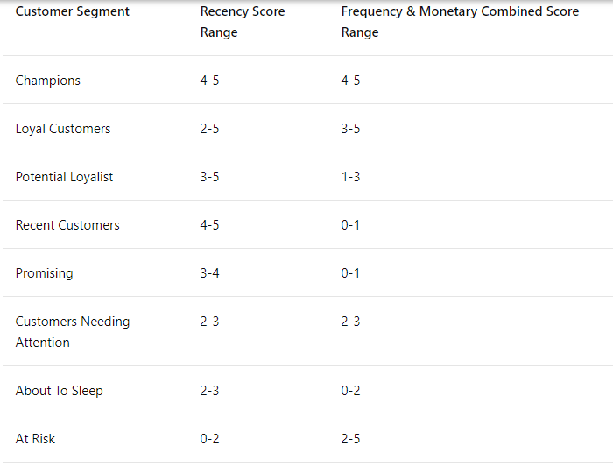
Customer segments
We can group customers into different segments
and personalize our services to get maximum profits and the customer interaction

Slide 14
Different methods to calculate the score
Simple Fixed Ranges :
Define a range for each score and can have Range Thresholds
Depends on individual business, owners set their own ranges
Quantiles - Make five equal parts based on available values
Quantile is just like percentile instead of 100 equal parts we have 5 equal parts
Quantiles are preferred over fixed ranges because it distributes customers evenly and not have crossovers

Slide 15
Versions of RFM
RFD (Recency,Frequency,Duration)
Duration here is time spent
For example on viewership / surfing a website / readership
RFE (Recency,Frequency,Engagement)
Engagement can be any value based on time spent
For example, in the context of online shopping the list of products visited,
Or social media engagement

Slide 16
Some benefits of applying RFM to the business
Better email marketing - Personalise the emails for different customer segmented lists
New product launches - Can contact loyal customers before building a product
Increase loyalty and user engagement - customers who bought once are likely to buy again. So, user engagement can be increased by sending relevant information.
Minimize marketing costs - It’s easy to work on small segments of customers than all of the customer base at once and can be productive

Slide 17
Remarketing and Retargeting - can bring back the lost customers by giving them limited time offers or special discounts
Understand your business better - Since RFM is based on transaction history it is helpful to understand the customers better and in turn the business itself

Slide 18
Thank you :)

