Slide 1






15CSE480
Internet of Things
Dr. V Anantha Narayanan
Mr A Baskar
Mr A K Sumesh (Mentor)
Dept. of CSE.,
ASE, Coimbatore

Slide 2
Session 2

Slide 3
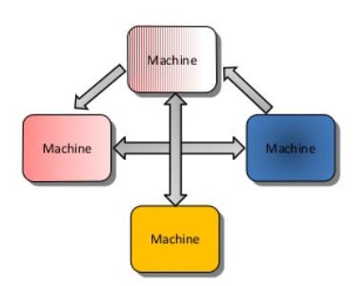
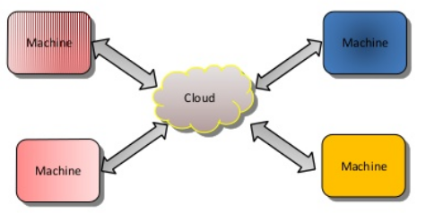
M2M vs IoT
Def: M2M is communicating among machines to manipulate content/data
M2M
IoT

Slide 4
2 C’s for M2M
Content
Connectivity
You need additional 4C’s for M2M to qualify as an IoT.
What are they ???

Slide 5
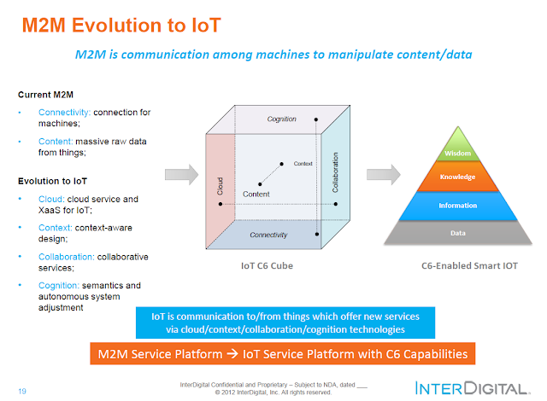

Slide 6



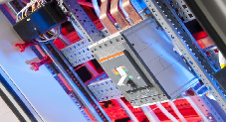

onem2m - Standards for M2M and the Internet of Things - https://www.onem2m.org/
E-Health Industrial Automation Home Automation

Slide 7
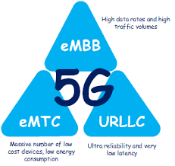
What is eMTC???
How it is related to M2M or IoT

Slide 8
WSN vs IoT

Slide 9
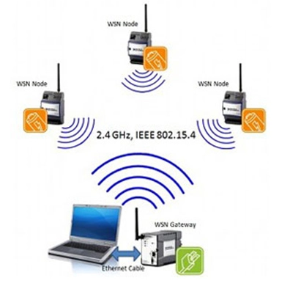
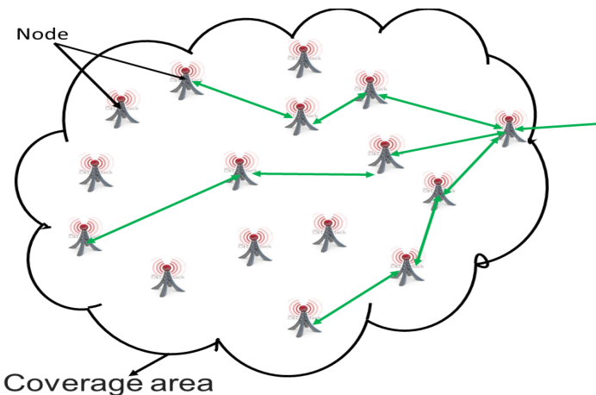
WSN as a Subset of IoT
IoT exists at a higher level than WSN.
WSN is often a technology used within an IoT system. A large collection of sensors, as in a mesh network, can be used to individually gather data and send data through a router to the internet in an IoT system.

Slide 10
WSN as a Subset of IoT
WSN consists of a network of only wireless sensors. If the network was to include a wired sensor, it could no longer be labeled a "wireless sensor network." This is unlike IoT. Essentially any device that connects to the internet can be considered an IoT device. An "IoT system" can therefore be interpreted as a group of many IoT devices.

Slide 11
WSN vs IoT
Wireless Sensor Network | Internet of Things
There is no direct connection of sensors to the internet | All of the sensors directly send their information to the internet
The various sensors connect to some kind of router or central node. A person may then route the data from the router or central node as they see fit. | For example, a sensor may be used to monitor the temperature of a body of water. In this case, the data will be immediately or periodically sent directly to the internet, where a server can process the data and it can be interpreted on a front-end interface.
IoT system can utilize a wireless sensor network by communicating with its router to gather data

Slide 12
IoT vs CPS

Slide 13
Cyber-Physical Systems (CPS) and Internet of Things (IoT) are complementary paradigms because both aim at integrating digital capabilities, including connectivity with physical devices and systems.
Moreover, CPS and IoT include interacting logical, physical, and human components by integrating logic and physics.
However, there are some differences. For example, IoT makes more emphasis on connecting “things” towards connecting “everything”, whereas CPS put more attention on integrating computation, networking and physical systems.

Slide 14
CPS is commonly used (and preferred over IoT) by the engineering communities (e.g., mechanical engineering, aerospace engineering, aeronautics). It is also used extensively by computer scientists working on embedded systems and systems testing & verification. Also, CPS is preferred over IoT in USA.
IoT is commonly used (and preferred over CPS) by the telecommunications, and networking communities, including computer scientists that work on the broader areas of next generation networks and future internet. In EU, IoT tends to be used more than CPS (But, CPS is gaining popularity in areas such as future manufacturing e.g., Industry 4.0 initiative).

Slide 15
CPS vs IoT
Cyber Physical System | Internet of Things
Cyber Physical System (CPS) are physical and engineered systems whose operations are monitored, coordinated, controlled and integrated by computing and communication core. | IoT refers to any systems of interconnected people, physical objects, and IT platforms, as well as any technology to better build, operate, and manage the physical world via pervasive data collection, smart networking, predictive analytics, and deep optimization.
They are not necessarily connected with internet. | They are basically connected to internet.
IoT forms the foundation for CPS

Slide 16
Web of Things
While IoT is about creating a network of objects, things, people, systems and applications, WoT tries to integrate them to the Web.
Web of Things (WoT) describes a set of standards by the W3C for solving the interoperability issues of different Internet of Things (IoT) platforms and application domains.
WoT can be thought as a flavour/option of an application layer added over the IoT's network layer.

Slide 17
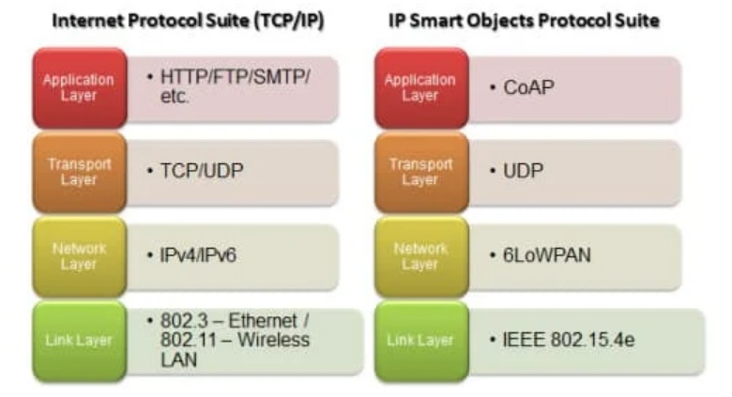
TCP / IP Protocol Stack and IP Smart Object (IPSO) Protocol Stack

Slide 18
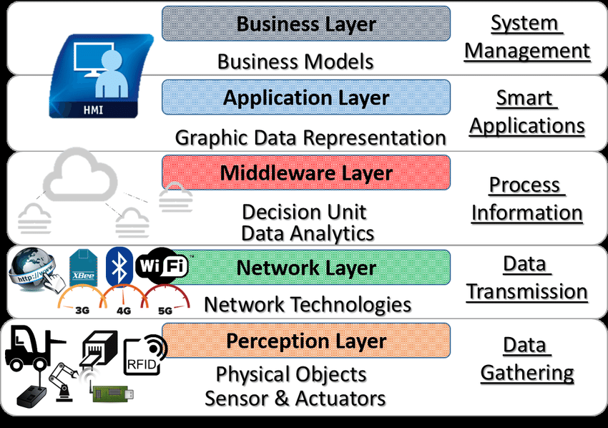

Slide 19







Arrange them in a 7 layer with respect to IoT Reference Architecture

Slide 20
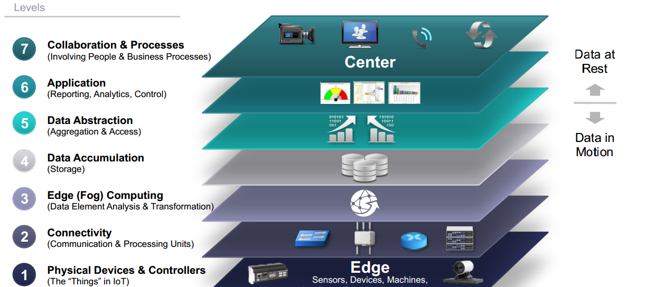

Slide 21
Industry IOT 4.0
The Industrial Internet of Things (iIoT), which is also known as Industry 4.0 when applied to the manufacturing industry, is a concept of integrating smart manufacturing machinery, AI-powered automation, and advanced analytics to help make every worker and every factory more efficient.

Slide 22
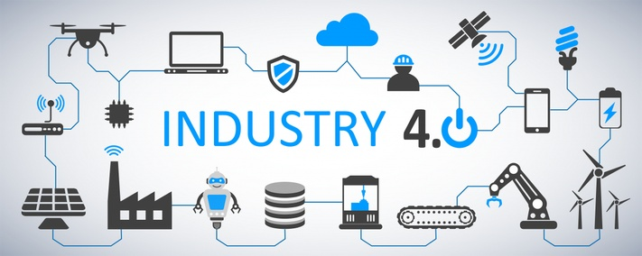

Slide 23
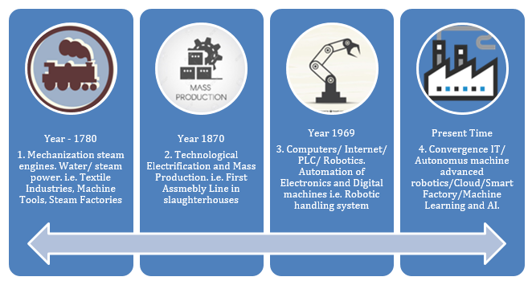

Slide 24
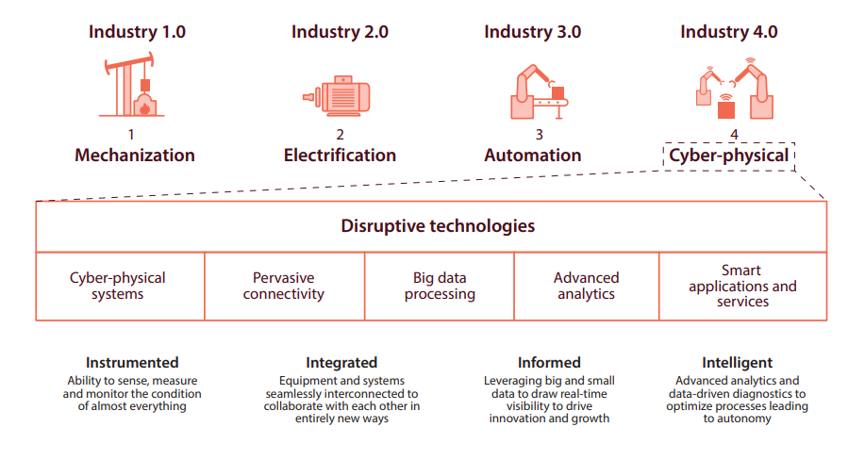

Slide 25
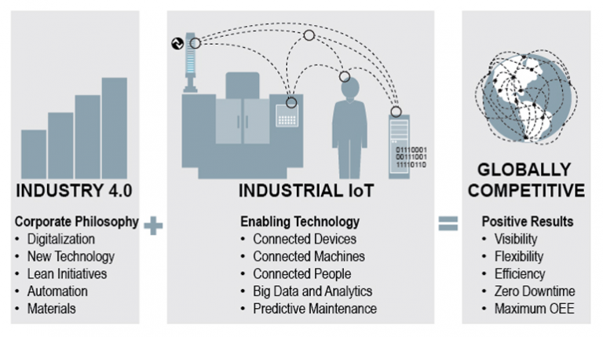

Slide 26
Live Demo

Slide 27
Quiz
Refer attached word document
Activities
Refer attached word document

Slide 28
Quiz

Slide 29
Activities and Interactions

Slide 30


Predictive Analytics and IoT Research Group
Dept. of Computer Science and Engineering
Amrita Vishwa Vidyapeetham
Amrita Nagar, Coimbatore
v_ananthanarayanan@cb.amrita.edu
+91 94432 51227

