Slide 1
Recap of IoT

Slide 2
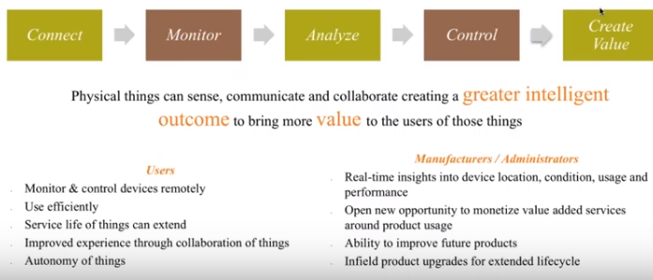

Slide 3
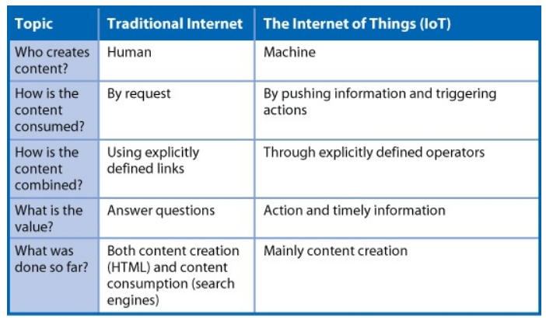
Traditional Networks vs Internet of Things
First and most important difference: identity of the content creation
https://www.rtinsights.com/differences-between-the-iot-and-traditional-internet/

Slide 4
Characteristics of IoT
Connectivity
Intelligence and Identity
Scalability
Dynamic and Self Adapting
Reference Architecture
Safety and Security

Slide 5
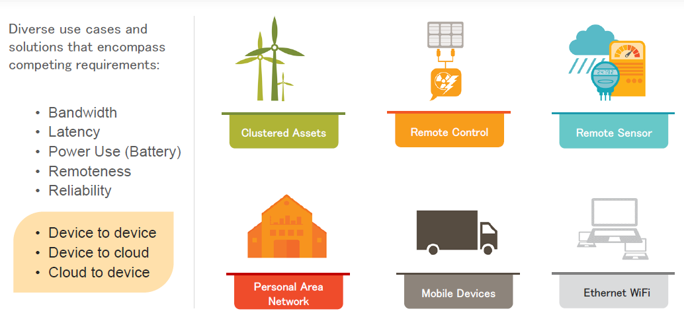
Connectivity use cases in IoT

Slide 6
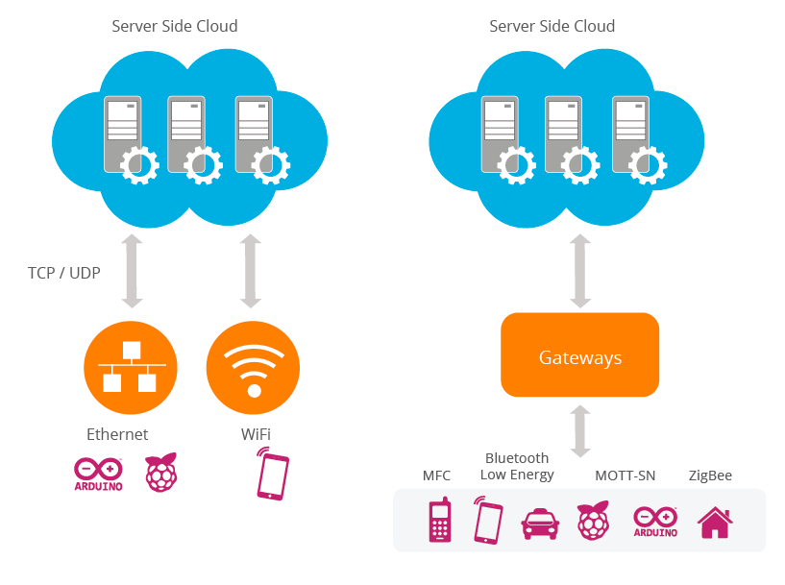
Connectivity use cases in IoT

Slide 7
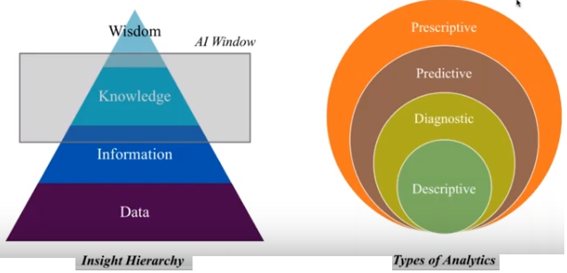
How to draw Data insights?

Slide 8
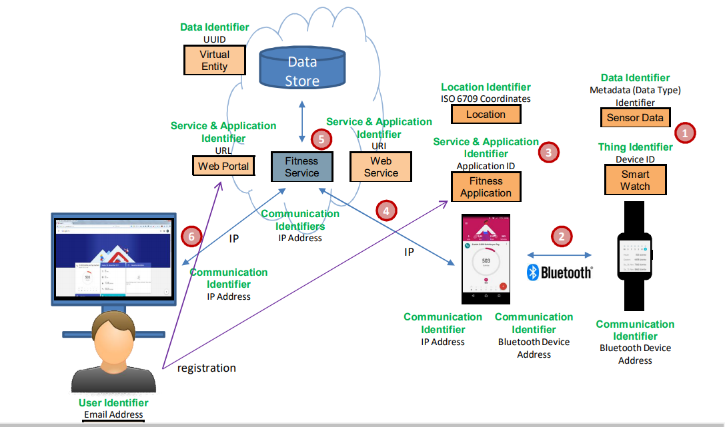

Slide 9
Scalability
http://117.232.97.121/RealTime_tnpcb_cac/index.html
https://app.cpcbccr.com/ccr/#/caaqm-dashboard/caaqm-landing/caaqm-data-availability

Slide 10
Dynamic and Self Adapting
IoT devices and systems may have the capability to dynamically adapt with the changing contexts and take actions based on their conditions, user’s context or sensed environment. For example, consider a surveillance system comprising of a number of surveillance cameras.
○The surveillance camera can adapt their modes based on whether it is day or night.

Slide 11
Camera could switch from lower resolution to higher resolution modes when any motion is detected and alert nearby camera to do the same.
In this example, the surveillance system is adapting itself based on the context and changing conditions.
https://www.cisco.com/c/en/us/products/physical-security/video-surveillance-ip-cameras/index.html

Slide 12
Self-Configuring IoT devices may have self-configuring capability, allowing a large number of devices to work together to provide certain functionality.
These devices have ability to configure themselves, setup the networking and fetch latest software upgrades with minimal manual or user intervention.
IoT devices may support a number of interoperable communication protocols and can communicate with the other devices and also with the infrastructure. (BLE/ZigBee/Dash7 /Wireless HART/….

Slide 13
Reference Architecture
CISCO IoT Ref Arch
Azure IoT Ref Arch
Intel IoT Ref Arch
OpenIoT ref Arch

Slide 14
https://wiprodigital.com/2017/11/21/enterprise-reference-architecture-a-primer-on-iot-based-systems/
https://wso2.com/whitepapers/a-reference-architecture-for-the-internet-of-things/#03
https://docs.microsoft.com/en-us/azure/architecture/reference-architectures/iot
http://cdn.iotwf.com/resources/71/IoT_Reference_Model_White_Paper_June_4_2014.pdf
http://www.intel.com/content/www/us/en/internet-of-things/white-papers/iot-platform-reference-architecture-paper.html
https://github.com/OpenIotOrg/openiot/wiki/OpenIoT-Architecture

Slide 15
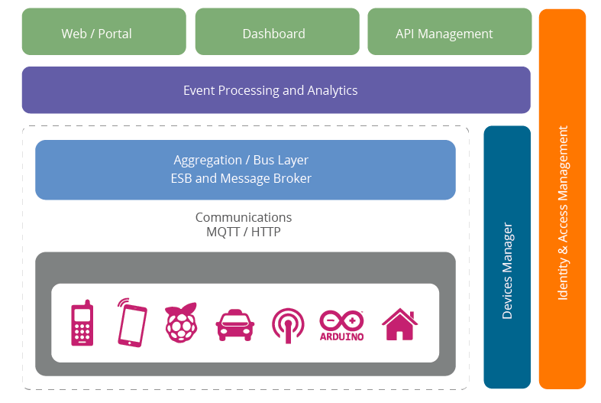

Slide 16
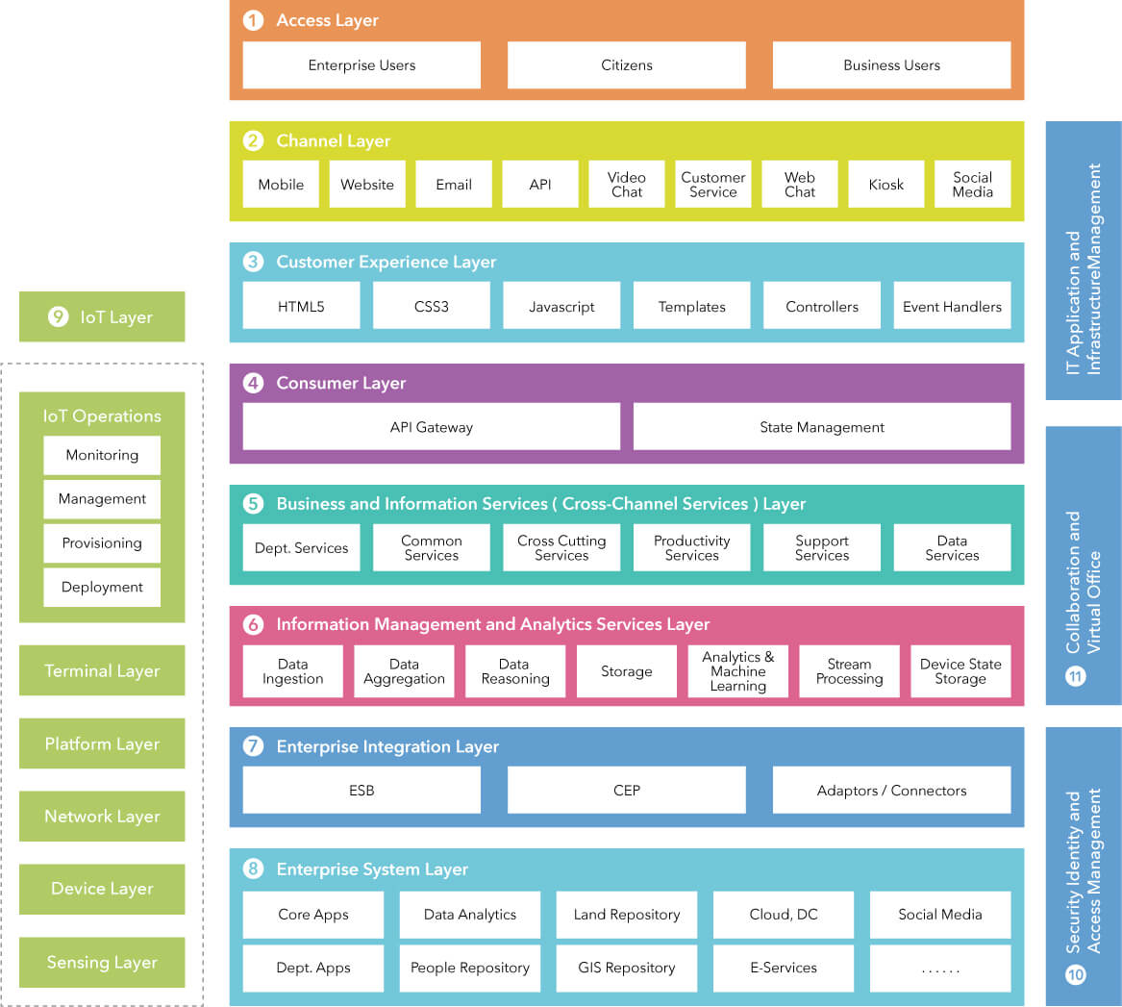

Slide 17
Safety and Security

Slide 18
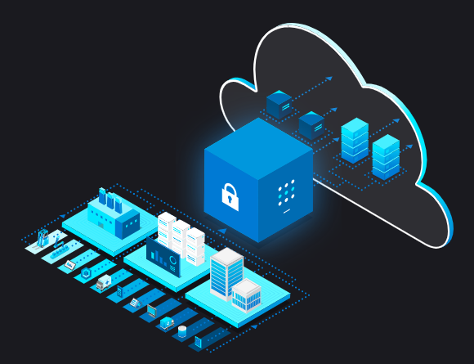
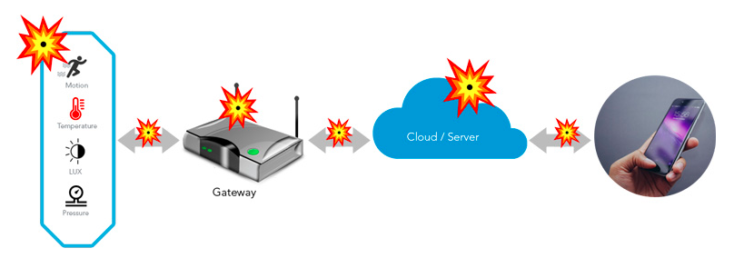
Build safer applications with the IoT industry's only end-to-end security solution
Hardened devices
Get powerful protection for your new and existing MCU-powered devices with Azure Sphere.
Safer connections
Help ensure that data transmitted from device to hub is confidential, tamperproof, and authenticated.
A more secure cloud
Improve data security in the cloud, at the edge, and everywhere in between.

Slide 19
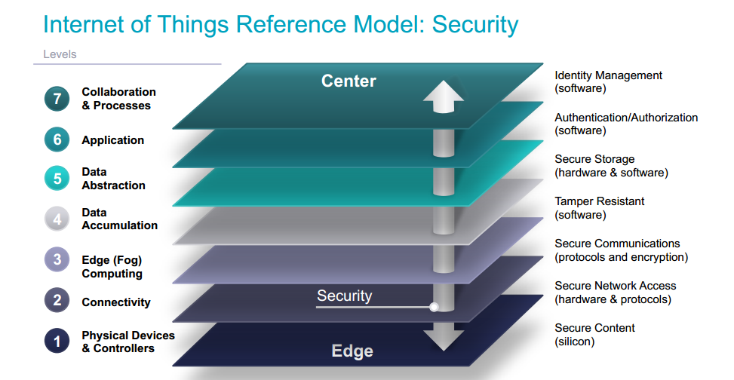

Slide 20
IoT Security Related Service Providers
Perytons.com – IoT Pentration Testing Tool
Owasp.org - IoT Testing Guidelines
Payatu.com – IoT Hardware Testing Service provider.
Ldra.com- Software verification and quality testing service provider.
MISRA Standards
CERT Standards

Slide 21
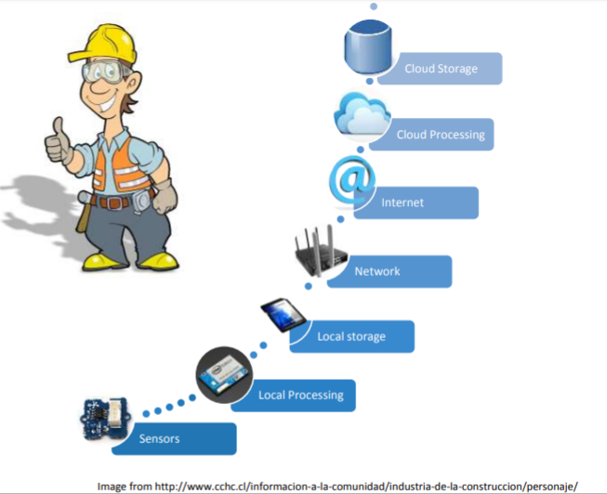
Detailed components of IoT Ecosystem or Logical Design

Slide 22

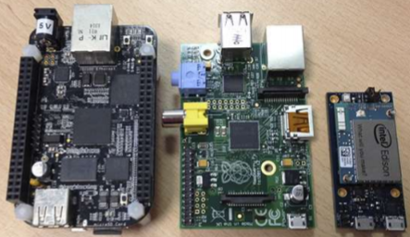
Detailed components of IoT Ecosystem
Sensor
  Measure values
  Send raw data
  Low power
Local Storage and Processing
  Get data from sensors
  Process
  Send some data to
Edge/Fog Computing

Slide 23
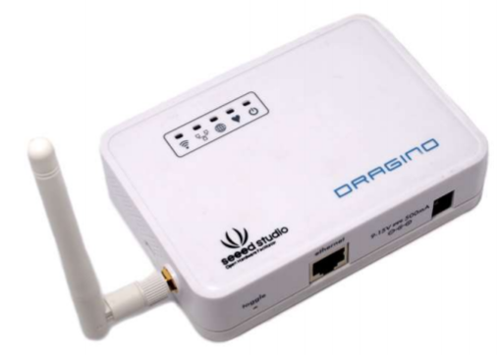
Detailed components of IoT Ecosystem
Network and Internet
  IoT Gateway
  Gathers data from sensors
  Protocols
    CoAP
    MQTT
    HTTP
    XMPP
Cloud Processing and Storage
  Aggregate Data
  Storage
  Inferences

Slide 24
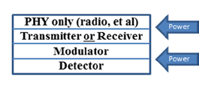
Design of IoT Component Architecture
Step1- IoT device to perceive the environment
IoT Device 1
The devices have the capability to sense and actuate, say each device captures one of temperature, light, noise, position of people and equipment, particles in the air, building systems operations, security systems, factory machines and more
  Minimal TCP/IP stack
  Short data range
  Limited battery life
    The problem is connecting to cloud needs a long range connection.
How to distribute to storage??
IoT Device 2
.
.
.
IoT Device n

Slide 25
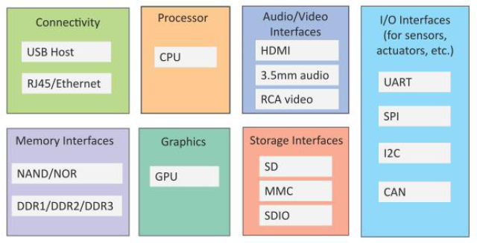
Design of IoT Component Architecture
Step1- IoT device to perceive the environment
General Block diagram of an IoT Device
An IoT device may consist of several interfaces for connections to other devices, both wired and wireless.
  I/O interfaces for sensors
  Interfaces for Internet connectivity
  Memory and storage interfaces
  Audio/video interfaces.

Slide 26
Design of IoT Component Architecture
Step2 - Gateway to distribute the data
Traditionally, gateway devices is a internetworking device capable of joining two different protocol based network.
  Extension of router to perform data translation and protocol conversion
Example :
  Automotive fleet monitoring application
    3 core features of gateway
      Access vehicles internal CAN network to read say, velocity, engine RPM
      A compute platform to process or reduce this data and respond to requests from an external application
      Communication with the remote location through cellular services

Slide 27

Design of IoT Component Architecture
Step2 - Gateway to distribute the data
IoT Device 1
Internet
IoT Device 2
Gateway
(protocol translation, device management)
IoT devices generate a huge amount of data however everything is not important.
  Example a video data generator taking pictures of empty hallway
How to filter data with IoT Gateway??
.
.
.
IoT Device N

Slide 28
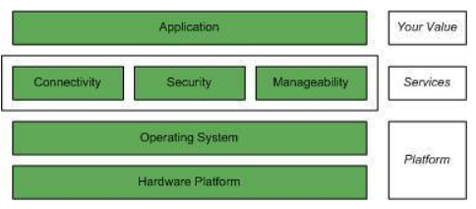
Design of IoT Component Architecture
Step2 - IoT gateway to distribute the data
IoT Device 1Design of IoT Infrastructure
Internet
IoT Device 2
IoT Gateway
.
.
.
IoT Device N
Ethernet ey allow to publish the data received from (TCP/UDP messages) into a MQTT Server

Slide 29
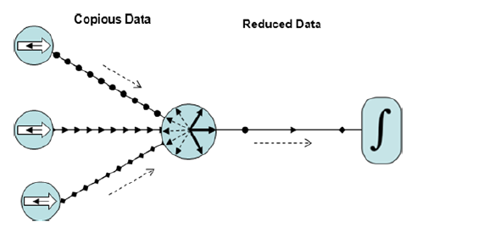
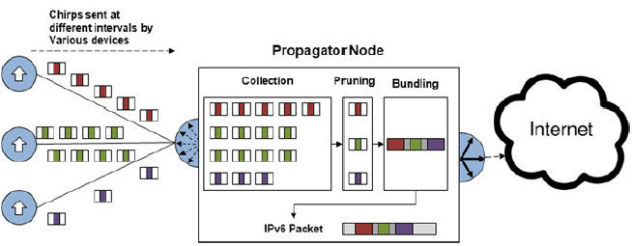
Design of IoT Component Architecture
Step2 – IoT Gateway to distribute the data
Multiple identical messages may be received; some are discarded
Now the IoT Gateway now collects, prunes and bundles

Slide 30
Design of IoT Component Architecture
Step2 – IoT Gateway to distribute the data
IoT is receiver-centric:
  Single message delivery is not critical/important
  Publish-subscribe model, push-pull model
Efficiency out of redundancy:
  data is Over-provisioned
    Hence no individual message is critical, there’s no need for any error-recovery or integrity-checking overhead

Slide 31
Design of IoT Component Architecture
Step2 – IoT Gateway to distribute the data
  Some application prefers local processing over global data processing (Need For Edge Computing)
    Reducing latency,
    localizing data,
    battery-limited feature of device
    Limited bandwidth
  Example: about 5 Gigabyte data will be generated by a Boeing 787 every second, but the bandwidth between the airplane and either satellite or base station on the ground is not large enough for data transmission
  This gives rise to Edge /Fog Computing

Slide 32
Design of IoT Component Architecture
Step2 – IoT Gateway to distribute the data
What is Edge Computing?
  Edge Computing is the optimization of cloud, to move close to source of data, to the edge (which means any computing and network resources along the path between the data source and cloud centers)

Slide 33
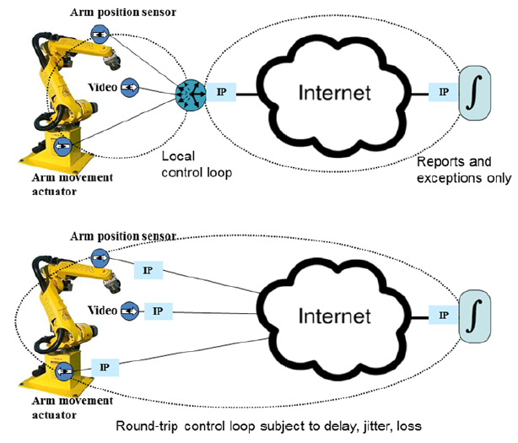

Slide 34
Design of IoT Component Architecture
Step2 – IoT Edge for analyses and data distribution
IoT Device 1
Internet
IoT Device 2
IoT edge gateway
(protocol translation, device management, data cleaning, aggregation, and analyze data )
.
.
.
IoT Device N

Slide 35
Design of IoT Component Architecture
Step2 – IoT Edge Gateway to distribute the data
Example :
  Automotive fleet monitoring application
    3 core features of edge gateway
      Access vehicles internal CAN network to read say, velocity, engine RPM
      A compute platform to process or reduce this data and respond to requests from an external application
      Communication with the remote location through cellular services

Slide 36
Design of IoT Component Architecture
Edge Device
Storage
Analyze
Visualize

Slide 37
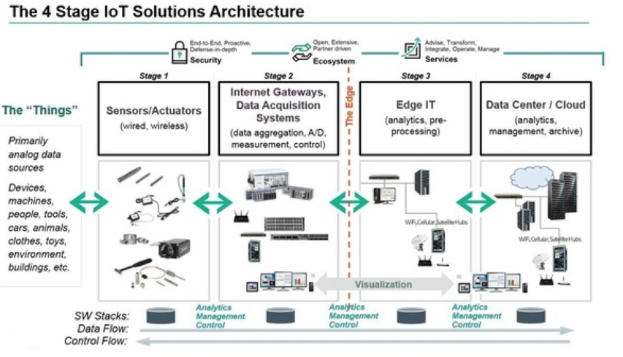
Must Read
Reference: https://medium.com/datadriveninvestor/4-stages-of-iot-architecture-explained-in-simple-words-b2ea8b4f777f

Slide 38
Use Case

Slide 39
Quiz

Slide 40
Live Demo

Slide 41
Take Care and Be Safe

