Slide 1
Use Case

Slide 2
ThyssenKrupp - Giving cities a lift with the Internet of Things
ThyssenKrupp Elevator wanted to gain a competitive edge by focusing on what matters most to their customers: Reliability

Slide 3
https://www.cgi-group.co.uk/en-gb/media/case-study/cgi-helping-thyssenkrupp-elevator https://discover.microsoft.com/thyssenkrupp-digital-transformation/ https://azure.microsoft.com/en-in/resources/videos/thyssenkrupp-giving-cities-a-lift-with-the-internet-of-things/

Slide 4
For example,
ThyssenKrupp partnered with two other companies CGI and Microsoft Azure to send alerts when their elevators need repairs. Predictive maintenance is the name of the application that sends alerts when an elevator is about to go out of function and even teaches the technicians the areas of error.

Slide 5
CGI, THYSSENKRUPP ELEVATOR AND MICROSOFT – LAUNCHING THEIR IOT-BASED PREDICTIVE MAINTENANCE SOLUTION
Microsoft’s Intelligent Systems Solution (ISS)
CGI - who provide end-to-end IT and business process
THYSSENKRUPP ELEVATOR
Predictive maintenance solution for more than 1.1m elevators under maintenance worldwide.

Slide 6
CGI developed a solution that securely connects ThyssenKrupp’s “things” - the thousands of sensors and systems in its elevators that monitor everything from motor temperature to shaft alignment, cab speed and door functioning; the data they gather; and PCs and mobile devices used by its workforce of technicians - to the cloud with Microsoft Azure Intelligent Systems Service.
.

Slide 7
ThyssenKrupp - Giving cities a lift with the Internet of Things
Drawing on the potential of the Internet of Things (IoT) and Microsoft technologies by connecting their elevators to the cloud, gathering data from their sensors and systems, and transforming that data into valuable business intelligence, ThyssenKrupp is vastly improving operations—and offering something their competitors do not: predictive and even preemptive maintenance.

Slide 8
Optimizing system performance with digital twins
By attaching IoT sensors to a building’s systems—from elevators and lighting to heating, ventilation, and air conditioning—thyssenkrupp can collect and analyze real-time data inside a digital twin.
Building owners, managers, and maintenance staff can use this insight to optimize performance and create consistently pleasant experiences for residents, commercial tenants, and visitors.

Slide 9
Elevator reliability - Key Differentiator
Connected, intelligent line-of-business (LOB) asset monitoring system.
By connecting elevators to the cloud, gathering data from sensors and systems, and transforming that data into valuable business intelligence, ThyssenKrupp is vastly improving its maintenance services.
.

Slide 10
Instead of just reacting to a failure alarm, technicians can use real-time data to define a required repair even before a breakdown occurs.
With two-way flow of data, technicians can remotely put an elevator into diagnostics mode, or send it to another floor. It all adds up to less travel time, better efficiency, and reduced costs.

Slide 11
Ensuring around-the-clock service reliability with IoT - Providing first-rate customer care with mixed reality.
Empowering employees with high-tech tools
Optimize their routes to locate parts
Highlight items needed for orders
Accelerate delivery schedules
Increase customer satisfaction

Slide 12
Andreas Schierenbeck, ThyssenKrupp Elevator CEO says
“We wanted to go beyond the industry standard of preventative maintenance, to offer predictive and even pre-emptive maintenance, thereby guaranteeing a higher uptime percentage on our elevators”

Slide 13
Real Time Data Analysis for Manufacturing Sector
An entirely automated IoT Analytics aids in using real time data to watch out for certain patterns and send alerts to the concerned departments.
Manufacturers in all the major industries – electronics, automotive, chemical, durable goods have all heavily invested in IoT Analytics to improve their efficiency and production.
New manufacturing equipment with intelligent sensors are already incorporated in these industries to help with smart manufacturing. This generates huge monetization opportunities aiding in revenue generation initiatives and cost containment.

Slide 14
Predictive Maintenance
Right data and the right IoT analytics tools - Can predict the future.
Down Time.
IoT-based predictive maintenance.
Restaurants - refrigeration units - failure - food spoils. (Lazza Ice Cream outlet use case)
Manufacturers - remote equipment monitoring to avoid a breakdown of critical equipment that could impact the entire operation.
In an effort to reduce the 190 million hours elevators are out of service each year, they’re putting IoT devices on them.

Slide 15
Where does Industrial IoT data come from?
Most people would say it comes from assets like pumps, turbine engines and drilling rigs.
But there’s more to industrial IoT than machine data.
Machine data doesn’t tell a complete story in every case.
By combining data from disparate sources you can create new insights.
And give engineers a complete view of the problem they need to solve.

Slide 16
Advances in sensor technology have made streaming real-time data easier than ever. Temperature, flow, pressure and humidity sensors have become big sources of industrial IoT data.
Example: Remote water quality monitoring.
Process industries produce waste water that could contaminate drinking water if procedures aren’t followed. Contamination does more damage to the environment. It often results in a PR disaster for the company responsible.
By monitoring water quality, you can respond to contamination faster than ever before.
But what if you could predict the contamination before it happened? That’s what the next type of data source is for.

Slide 17
Apart from offering low-cost computation, storage and operational capabilities (embedded even at the lowest levels), these real time data analytics can save a lot of time because the need for bringing data to a central location is eliminated. It is only the insights and not the entire data that get shared at the central/higher levels.
Enterprises can be more proactive to the demands of their shareholders/consumers/clients as it is always fresh data that is analyzed in real time. Fresh data is actionable data and it has a huge monetization potential

Slide 18
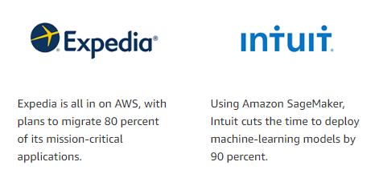
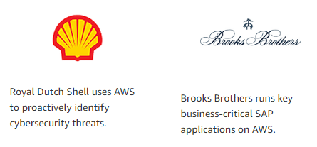

Slide 19
AWS IoT Case Study

Slide 20
AWS IoT Case Study
https://aws.amazon.com/iot/solutions/
https://aws.amazon.com/solutions/case-studies/iot/
https://aws.amazon.com/solutions/case-studies/lg-electronics/
https://aws.amazon.com/blogs/iot/aws-iot-analytics-oil-and-gas-customer-use-case/

Slide 21
LG Electronics – AWS IoT Case Study
By using AWS for LGE new IoT platform, LGE saved 80 percent in development cost. It also enables developers to focus on writing business logic for LG service scenarios.
Chief of the Service Development Team, LG Cloud Center, LG Electronics

Slide 22
LG ThinQ - AI
The concept of ThinQ is to embed Wi-Fi chips in LG products, which allows these products to communicate with each other while learning about their user’s behavioral patterns and environments.
LG successfully migrated its IT platform for home appliances, including more than 1,000 servers, from its data center to Amazon Web Services (AWS). The business adopted Amazon Elastic Compute Cloud (Amazon EC2) and Amazon Simple Storage Service (Amazon S3).

Slide 23
AWS IoT Core to maintain continuous connectivity between ThinQ devices and its IoT platform.
LG also started using AWS Lambda (Lambda) for serverless computing that registers ThinQ devices on the cloud, stores device data, and controls device status information.
For authentication between ThinQ devices and its IoT platform’s servers, LG uses X.509 certificates. The ThinQ platform also stores data in Amazon ElastiCache and Amazon DynamoDB, which provide historical data for services.
“With the previous infrastructure, we retrieved data directly from devices to get status information. Now, the Device Shadow Service feature for AWS IoT enables the system to cache the status information from the server. This feature has made it possible to deliver better service consistency

Slide 24
LG is also using AWS IoT and a server-less architecture for air-quality monitoring services, customer service chatbots, and energy solutions. Since March 2018, a chatbot service for customer support that was developed using serverless services has been running in Korea and the United States.

Slide 25
AWS IoT – Oil and Gas
AWS IoT Analytics
Better understand their assets in the field (for example, pumps, generators, valve assemblies, and so on).
Derive actionable insights from their data.
Build a predictive maintenance solution to help reduce their costs.

Slide 26
Exploring machine learning models through AWS IoT - Jupyter Notebook templates.
They can quickly modify the template to meet their use cases and then build and test it against their historical IoT data they can load directly in IoT Analytics.
Customer learned how challenging it can be to get IoT data from connected assets in the field and then stream that data to the cloud.

Slide 27
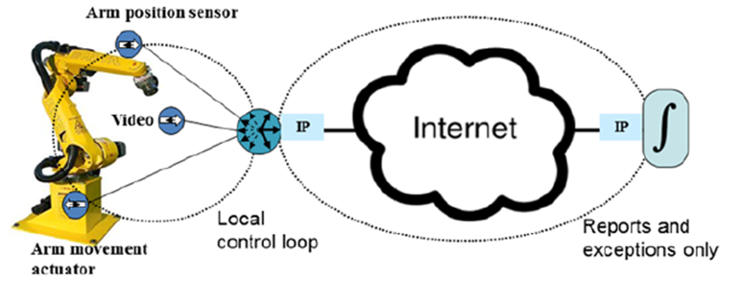
Customer plans to test their anomaly-detection models in IoT Analytics and deploy them at the edge using IoT Greengrass ML inference. This is for use cases where even milliseconds are not fast enough. A round-trip to the cloud and back yields too much latency or is not assured due to connectivity challenges.

Slide 28
Machine learning services like Cortana Analytics, SAP HANA and IBM Watson have opened the doors for IoT-based predictive maintenance.
By applying a machine learning algorithm to your SCADA data, you can predict a pump failure. Or determine the remaining useful life of a turbine engine.
https://www.kaggle.com/data/46933
https://hub.packtpub.com/25-datasets-deep-learning-iot/
https://archive.ics.uci.edu/ml/datasets/Gas+sensors+for+home+activity+monitoring#

Slide 29
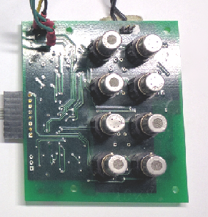
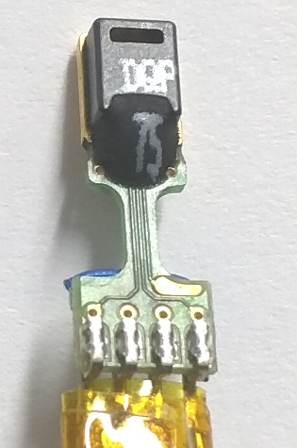

Slide 30
Research Challenges in IoT

Slide 31
Embedded Programming – Energy and Resource Optimization
Connectivity Protocols – BLE / ZigBee/WiFi ( HW DK and Wireshark)
Data Connectivity Protocols – CoAP / MQTT
Device Management
Service Discovery and Management
Semantic Web, WoT (Eg: BIM)
Data Analytics
Security and Blockchain (Bosch Spares UC)
IoT Security Analytics

Slide 32
Quiz

Slide 33
Take Care and Be Safe

Slide 34
Live Demo

