Slide 1
15CSE480 Internet of Things
Lab Based Course

Slide 2
Course Details
Credits | 3 - 0 - 0 - 3
Offered to | VII Sem B.Tech CSE (2018-22 Batch)
Class Strength and No of Sections | Total: 231 students in 3 Groups
Faculty Members | Mr A Baskar (Mentor), Mr AK Sumesh, Dr R Gowtham
Department | CSE

Slide 3
Objective of the course
To introduce various concepts in IoT based applications and the associated HW and SW design
To understand and apply different enabling technologies for IoT like application level protocols, identification, device management, service discovery in various use cases.
To explore the integration of IoT with Cloud and the usage of Edge / Fog Computing along with Data Analytics to build Autonomous Systems.

Slide 4
Course outcomes
 | Course Outcome | BTL
CO 1 | Understand the key techniques and theory behind Internet of Things | L2
CO 2 | Apply effectively the various enabling technologies (both hardware and software ) for IoT | L3
CO 3 | Understand the integration of Cloud and IoT , Edge and Fog Computing | L2
CO 4 | Apply various techniques for Data Accumulation, Storage and Analytics | L3
CO 5 | Design and build IoT system for any one interesting Use case | L4

Slide 5
15CSE480-Internet of Things (3 Credits)
Unit - I
Introduction to loT - loT definition - Characteristics - Things in loT - loT Complete Architectural Stack - loT enabling Technologies - loT Challenges - loT Levels - A Case Study to realise the stack. Sensors and Hardware for loT - Accelerometer, Proximity Sensor, lR sensor, Gas Sensor, Temperature Sensor, Chemical Sensor, Motion Detection Sensor. Hardware Kits - Arduino, Raspberry Pi, nodeMCU. A Case study with any one of the boards and data acquisition from sensors (Lab Component)
Unit – II
Protocols for loT – lnfra structure protocol (IPV4/V6|RPL), Identification (URLs), Transport (Wi-Fi, Li-Fi, BLE), Discovery, Data Protocols, Device Management Protocols. - A Case Study with MQTT/CoAP usage. (Lab Component). Cloud and Data analytics- Types of Cloud - loT with cloud challenges - Selection of cloud for loT applications. Fog computing for loT - Edge computing for loT - Cloud security aspects for loT applications. RFM for Data Analytics. Case study with AWS / AZURE / Adafruit / IBM Bluemix (Lab Component).
Unit – III
Case studies with architectural analysis:
IoT applications - Smart City - Smart Water - Smart Agriculture - Smart Energy - Smart Healthcare - Smart Transportation - Smart Retail -Smart waste management . (Lab Component - As a project)

Slide 6
Text Book/Reference Books
Text Book:
1. "lnternet of Things: A Hands-on Approach", by Arshdeep Bahga and Vijay Madisetti (Universities Press)
References:
1. lnfosys Training E Materials. Infosys Knowledge Institute (IKI)
2. "The Internet of Things: Enabling Technologies, Platforms, and Use Cases',, by pethuru Raj and Anupama C. Raman (CRC press)
3. Adrian McEwen, Designing the lnternet of Things, Wiley (B November 2Ot3), ISBN-13:978-.11-L1,8430620,
4. NPTEL Reference : https://nptel.ac.in/courses/106/105/106105166/
5. NPTEL IIoT (Prof Sudip Misra IIT Kharagpur) https://onlinecourses.nptel.ac.in/noc20_cs24/unit?unit=14&lesson=125
6. Swayam portal: https://swayam.gov.in/nd1_noc20_cs69/preview
7. RBCCPS IISc: https://cps.iisc.ac.in/ IUDX

Slide 7
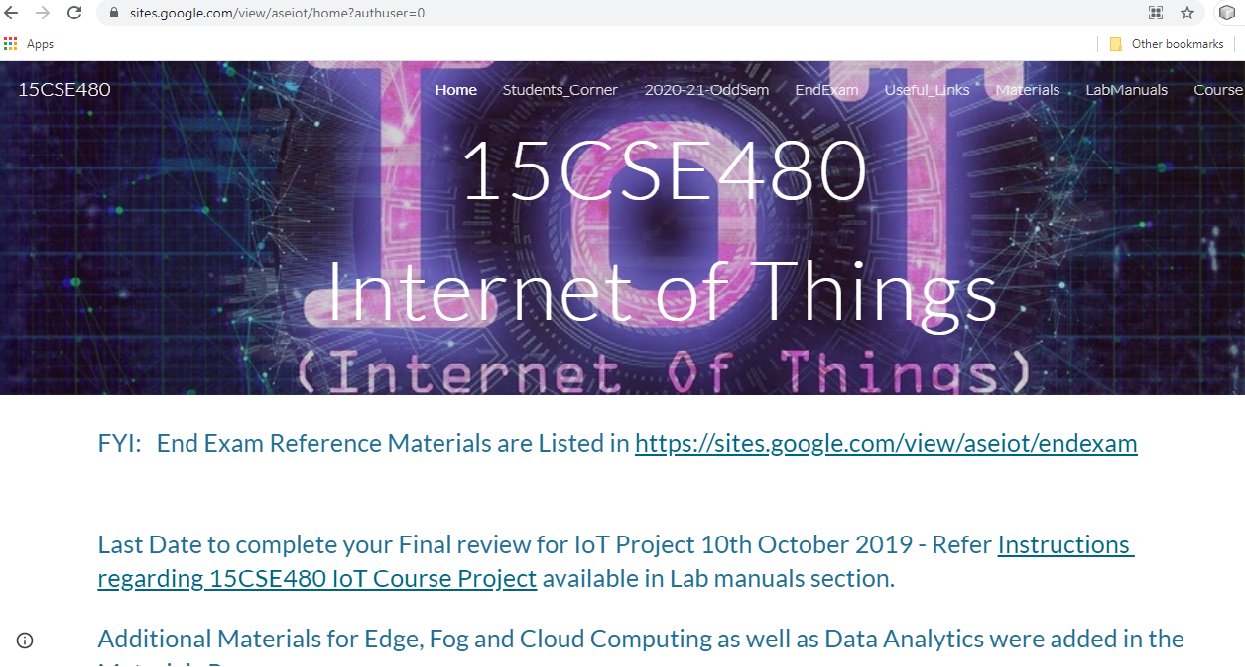
15CSE480 Course Repository
https://sites.google.com/view/aseiot

Slide 8
Evaluation Pattern
S. No | Components | Weightage in %
Internal (70 Marks)
1 | Mid Term Exam (Online exam) | 10
2 | Mid Term Exam (Online Viva) | 10
3 | Continuous Assessment –Theory | 10
 | 3.a No of online Quiz (3) 3.b Missed online Quiz (1) | Quiz1: 3 Quiz2: 3 Quiz3: 4
4 | Continuous Assessment-Lab | 40
 | 4.a Use case –Design-Sprint #1 (No of Review:2) | Review1:5 Review2:15
 | 4.b Use case-Implementation- Sprint #2 (No of Review:1) | Review3 :20
External (30 Marks)
5 | End semester Exam (Online Exam) | 10
6 | End Semester Exam (Online Viva) | 20

Slide 9
Suggestions for improvement in the next iteration of this course
S.No | Details
1 | It is suggested that this course may be moved to lower semesters so that placements will not overlap with hands on sessions
2 | It is requested to keep the IoT lab open till 8.00pm on all working days when the course is offered in the campus.
3 | Latest hardware modules should be used for subsequent offering of the course

Slide 10
Hardware and Software details
Hardware:
Node MCU ESP8266 /ESP32
Raspberry pi / Intel IoT
Software
Arduino IDE
MicroPython
Cloud Platform
Adafruit
Thingspeak
AWS
Google Cloud Platform

