Slide 1






15CSE480
Internet of Things
Lecture - 3
Dr. V Anantha Narayanan
Mr A Baskar
Mr A K Sumesh (Mentor)
Dept. of CSE.,
ASE, Coimbatore

Slide 2
Definition and Characteristics of
Internet of Things

Slide 3
IEEE Definition of IoT
IEEE described the phrase “Internet of Things” as:
“A network of items each embedded with sensors which are connected to the Internet.”
Ref: Special report on Internet of Things issued in March 2014
The IEEE Standards Association (IEEE SA) has a portfolio of over 900 active standards and more than 500 standards under development. In its research into IoT, it has identified over 140 existing standards and projects that are relevant to the IoT. (See http://standards.ieee.org/innovate/iot/ for the lists of Standards and projects.)

Slide 4
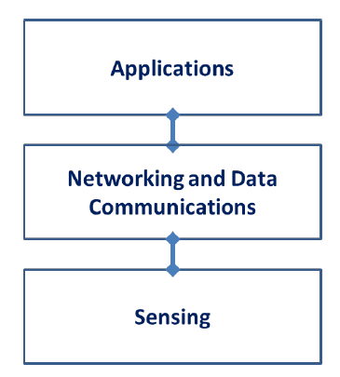
IEEE P2413 - define an architectural framework, addressing descriptions of various IoT domains, definitions of IoT domain abstractions, and identification of commonalities between different IoT domains.
Three Tier Architecture of IoT – IEEE P2413

Slide 5








People Connecting to Things
ECG sensor
Internet
Motion sensor
Motion sensor
Motion sensor

Slide 6
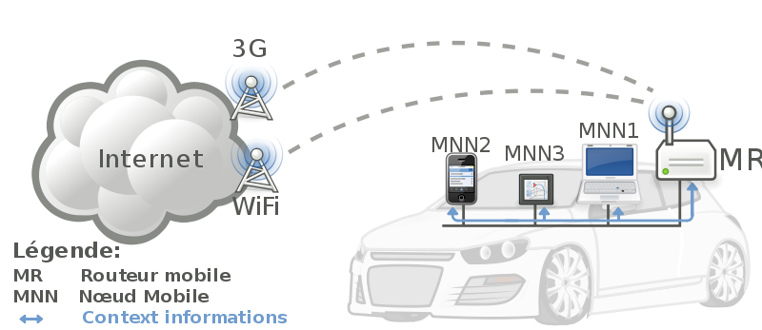


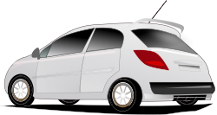
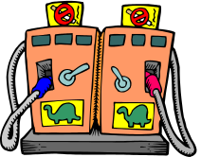

Things Connecting to Things
- Complex and heterogeneous
resources and networks

Slide 7
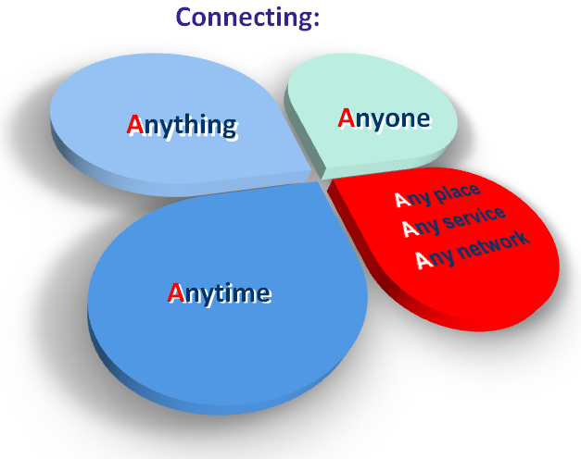
ITU Definition of IoT
IoT enables the objects (which eventually are the things) to be sensed, while also controlling it remotely, which enables better interaction of physical world to the computers.
This would improve the efficiency, accuracy with limited human intervention.
ITU endorses the definition of IoT as a network that is: “Available anywhere, anytime, by anything and anyone.”

Slide 8
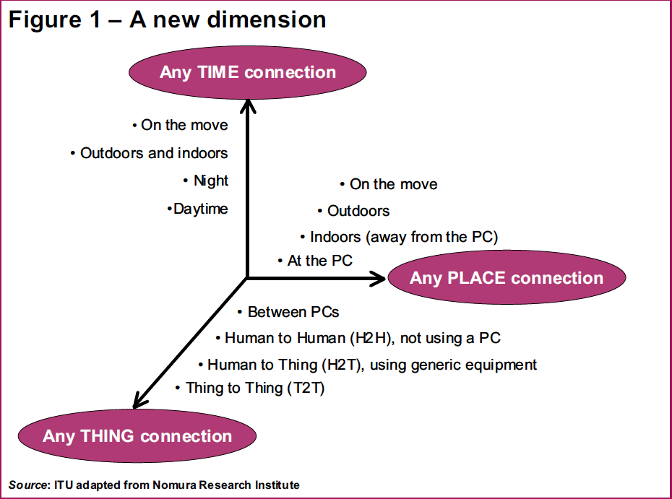
From any time ,any place connectivity for anyone, we will now have connectivity for anything!
Notes:
An interesting conclusion

Slide 9
ITU-T Definition of IoT
ITU –T Study group 13 defined IoT as:
A global infrastructure for the information society, enabling advanced services by interconnecting (physical and virtual) things based on existing and evolving interoperable information and communication technologies.

Slide 10
IETF Definition of IoT
IETF provides its own description of IoT, along with definitions for “Internet” and “thing” (IETF, “Internet of Things,” 2010):
“The basic idea is that IoT will connect objects around us (electronic, electrical, non-electrical) to provide seamless communication and contextual services provided by them. Development of RFID tags, sensors, actuators, mobile phones make it possible to materialize IoT which interact and co-operate each other to make the service better and accessible anytime, from anywhere.”

Slide 11
Definition of IOT
Bahga & Madisetti, © 2015
“A dynamic global network infrastructure with self-configuring capabilities based on standard and interoperable communication protocols where physical and virtual “things” have identities, physical attributes, and virtual personalities and use intelligent interfaces, and are seamlessly integrated into the information network.”.

Slide 12
What are ‘Things’ in Internet?
‘Things’ - computers, sensors, people, actuators, refrigerators, TVs, vehicles, mobile phones, clothes, food, medicines, books, etc.
  These things are classified as three scopes:
    people,
    machine (for example, sensor, actuator, etc.) and
    information (for example, clothes, food, medicine, books, etc.).
  These ‘things’ should be identified at least by one unique way of identification for the capability of addressing and communicating with each other and verifying their identities.
  https://aioti.eu/identifiers-in-internet-of-things/

Slide 13
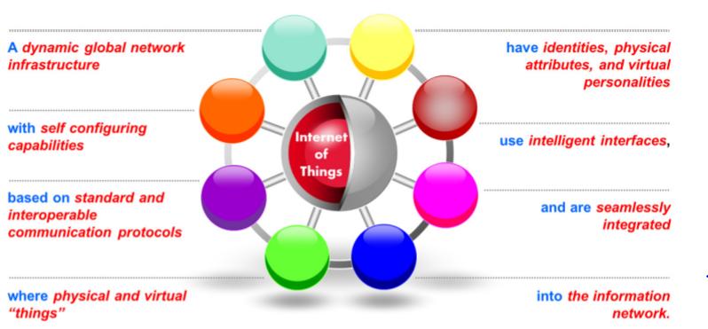
Definition of IOT
Bahga & Madisetti, © 2015
Definition of IOT

Slide 14
Characteristics of IoT
Connectivity
Intelligence and Identity
Scalability
Dynamic and Self Adapting
Architecture
Safety

Slide 15
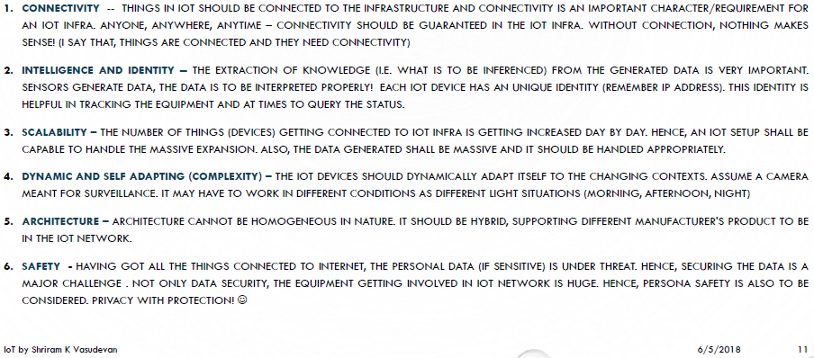
Characteristics of IoT

Slide 16
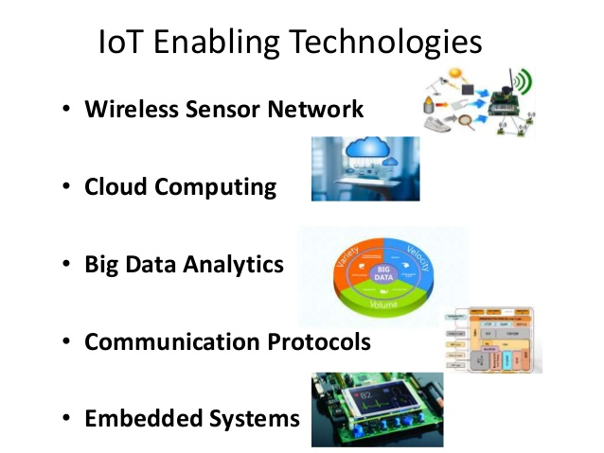

Slide 17
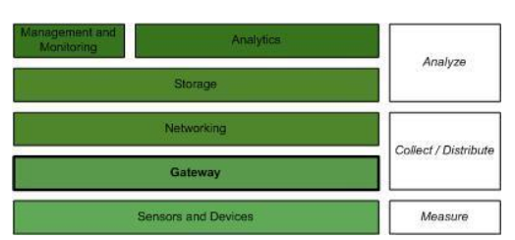
IoT Ecosystem or Logical Design

Slide 18
IoT Ecosystem or Logical design
The bottom layer contains the sensors and devices used to measure the world and effect changes.
The gateway acts as a secure intermediary between these sensors and devices and the cloud (through networking and eventually persistence in a storage system).
The top layer handles overall monitoring and management of the IoT ecosystem, with analytics of the collected and persisted data, including applications and the value the IoT ecosystem exposes.

Slide 19
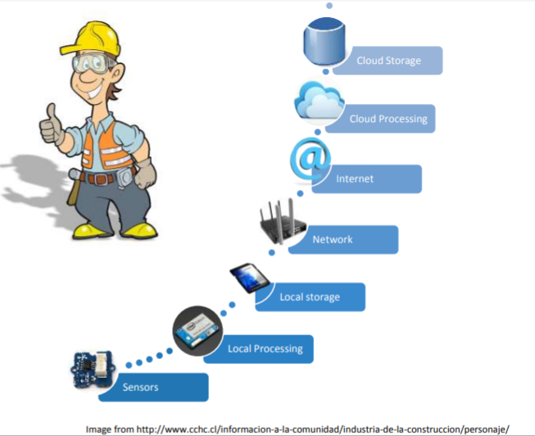
Detailed components of IoT Ecosystem

Slide 20
Demo

Slide 21
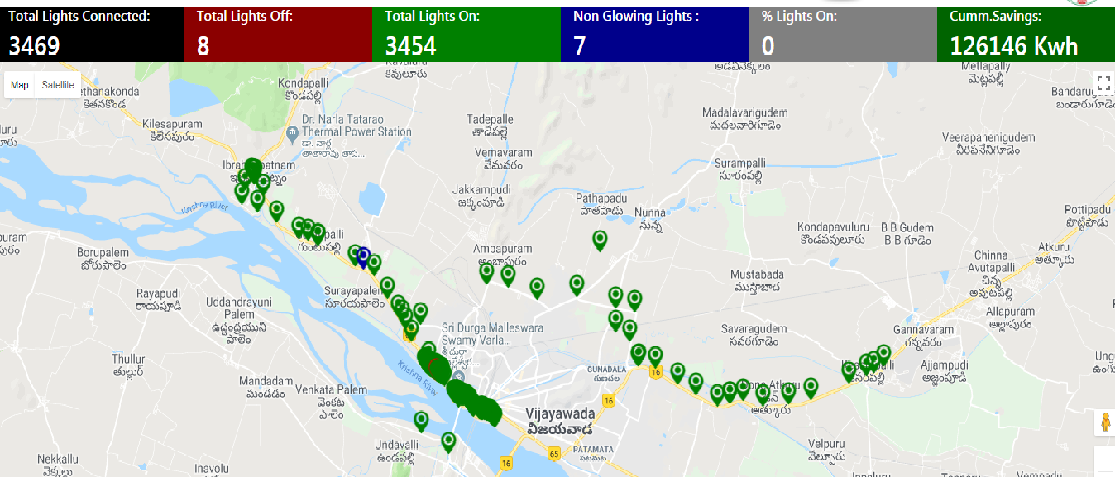

Slide 22
Interactive Sessions

