Slide 1
15CSE401 Machine Learning and Data Mining Lecture 1,2,3
Course Information
An Introduction to Data Mining
CSE Dept.
Amrita School of Engg.

Slide 2
Course Objective
To provide in-depth knowledge about data mining.
To implement the machine learning models in data mining problems .
To improve the understanding of the on-going research.

Slide 3
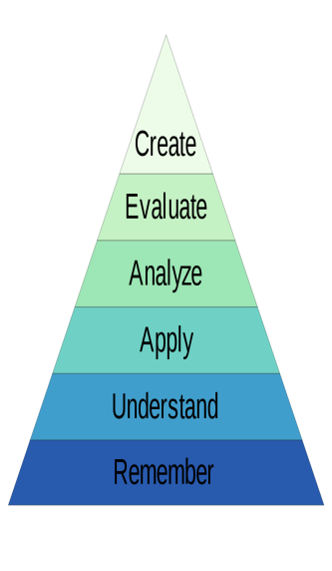
Course Outcome
 | Course Outcome | BTL
CO1 | Understand the fundamental concepts of Data mining and basic theory underlying Machine learning. | L2
CO2 | Understand the types of the data to be mined and apply pre-processing methods | L3
CO3 | Apply appropriate classification and clustering techniques for real word applications | L3
CO4 | Analyze the performance of various classifiers and clusters techniques | L4
CO5 | Apply and evaluate the interesting patterns discovered from association mining | L4

Slide 4
Course Syllabus
Unit 1: Introduction to Machine learning: Supervised learning, Unsupervised learning, some basic concepts in machine learning, Review of probability, Computational Learning theory. Bayesian concept learning, Likelihood, Posterior predictive distribution, Naive Bayes classiﬁers, The log-sum-exp trick, Feature selection using mutual information, Linear Regression, Logistic regression.
Unit 2: Introduction to data mining - challenges and tasks, measures of similarity and dissimilarity, Classification - Rule based classifier, Nearest-neighbour classifiers - Bayesian classifiers - decision trees; support vector machines, Class imbalance problem performance evaluation of the classifier, comparison of different classifiers.
Unit 3: Association analysis – frequent item generation rule generation, evaluation of association patterns. Cluster analysis, K means algorithm, cluster evaluation, application of data mining to web mining and Bioinformatics. Classifying documents using bag of words advertising on the Web, Recommendation Systems, and Mining Social network graphs.
The topics in red was covered in 15CSE432.

Slide 5
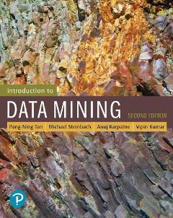
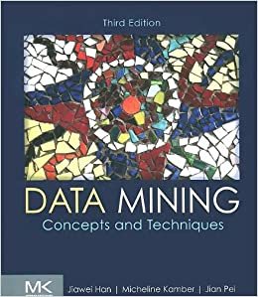
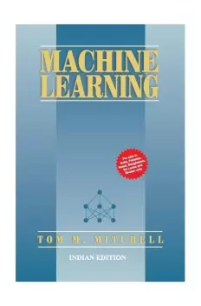
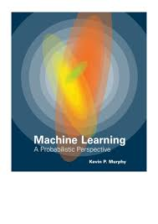
Text Books and References
Jiawei Han and Micheline Kamber, Jian Pei, “Data Mining: Concepts and Techniques”, Third Edition, Elsevier, 2012.
Kevin P. Murphey, “Machine Learning, a probabilistic perspective”, The MIT Press, 2012.
Tom Mitchell, “Machine Learning”, McGraw Hill, 1997
Pang-Ning Tan, Michael Steinbach and Vipin Kumar, “Introduction to Data Mining”, First Edition, Pearson Education, 2006.

Slide 6
Modified Course plan
CourseEntry_Summary_15CSE401.docx

Slide 7
Evaluation Pattern
L-T-P | Evaluation Pattern | Assessments Planned | Marks | Weight
1-0-0 | Internal: 50% | Mid Term Exam | 10 | 50%
2-0-0 |  | Viva | 20
3-0-0 |  | CA - Quizzes ( covering each CO) - 5* 4 | 20
4-0-0
3-0-2 | End Semester: 50%
2-1-0 |  | Online End Sem | 20 | 50%

