Slide 1
15CSE401 Machine Learning and Data Mining Lecture 4,5
Measuring Data Similarity and Dissimilarity
CSE Dept.
Amrita School of Engg.

Slide 2
Significance of Similarity Measure -Data Mining & Machine Learning
Similarity is the measure of how much alike two data objects are.
Similarity in a data mining context is usually described as a distance with dimensions representing features of the objects.
A small distance indicating a high degree of similarity and a large distance indicating a low degree of similarity.

Slide 3
Significance of Similarity Measure -Data Mining & Machine Learning
Similarity is subjective and is highly dependant on the domain and application.
Example: Two people are more similar because they have the same first name or because they live in the same city?
Care should be taken when calculating distance across dimensions/features that are unrelated.
The relative values of each feature must be normalized or one feature could end up dominating the distance calculation.
Example: Considered two people similar by their height and how far apart they currently live from each other.
If you measured both of these in centimeters, then the distance between their dwellings would dominate any correlation in their heights.

Slide 4
Similarity, Dissimilarity and Proximity
Similarity measure or similarity function
A real-valued function that quantifies the similarity between two objects
Measure how two data objects are alike: The higher value, the more alike
Often falls in the range [0,1]: 0: no similarity; 1: completely similar
Dissimilarity (or distance) measure
Numerical measure of how different two data objects are
In some sense, the inverse of similarity: The lower, the more alike
Minimum dissimilarity is often 0 (i.e., completely similar)
Range [0, 1] or [0, ∞) , depending on the definition
Proximity usually refers to either similarity or dissimilarity

Slide 5
Data Matrix and Dissimilarity Matrix
Data matrix
A data matrix of n data points with l dimensions
Dissimilarity (distance) matrix
n data points, but registers only the distance d(i, j) (typically metric)
Usually symmetric, thus a triangular matrix
Distance functions are usually different for real, boolean, categorical, ordinal, ratio, and vector variables
Weights can be associated with different variables based on applications and data semantics

Slide 6
Proximity Measure for Nominal Attributes
Can take 2 or more states, e.g., red, yellow, blue, green (generalization of a binary attribute)
Method 1: Simple matching
m: # of matches, p: total # of variables
Method 2: Use a large number of binary attributes
creating a new binary attribute for each of the M nominal states

Slide 7
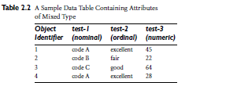


Dissimilarity for Nominal Attributes example
Dissimilarity Matrix (on attribute test-1)
D(2,1) = (1-m)/p= (1-0)/ 1) =1

Slide 8
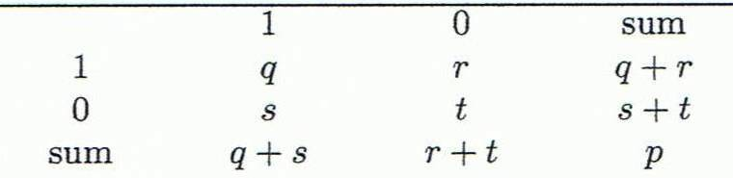
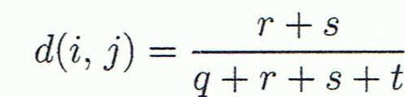
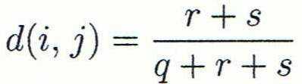
Proximity Measure for Binary Attributes
A contingency table for binary data
Distance measure for symmetric binary variables:
Distance measure for asymmetric binary variables:
Object j
Object i

Slide 9

Proximity Measure for Binary Attributes
Jaccard coefficient (similarity measure for asymmetric binary variables):
Note: Jaccard coefficient is the same as “coherence”:
(a concept discussed in Pattern Discovery)

Slide 10
Example: Dissimilarity between Asymmetric Binary Variables
Gender is a symmetric attribute (not counted in)
The remaining attributes are asymmetric binary
Let the values Y and P be 1, and the value N be 0
Distance:

Slide 11
Jim
Mary
 | 1 | 0 | ∑_{row}
1 | 2 | 0 | 2
0 | 1 | 3 | 4
∑_{col} | 3 | 3 | 6
 | 1 | 0 | ∑_{row}
1 | 1 | 1 | 2
0 | 1 | 3 | 4
∑_{col} | 2 | 4 | 6
Jack
Jack
Mary
 | 1 | 0 | ∑_{row}
1 | 1 | 1 | 2
0 | 2 | 2 | 4
∑_{col} | 3 | 3 | 6
Jim

Slide 12
Standardizing Numeric Data
Z-score:
X: raw score to be standardized, μ: mean of the population, σ: standard deviation
the distance between the raw score and the population mean in units of the standard deviation
negative when the raw score is below the mean, “+” when above

Slide 13
Standardizing Numeric Data
An alternative way: Calculate the mean absolute deviation
where
standardized measure (z-score):
Using mean absolute deviation is more robust than using standard deviation

Slide 14
Dissimilarity on Numeric Data: Minkowski Distance
Minkowski distance: A popular distance measure
where i = (x_{i1}, x_{i2}, …, x_{il}) and j = (x_{j1}, x_{j2}, …, x_{jl}) are two l-dimensional data objects, and p is the order (the distance so defined is also called L-p norm)

Slide 15
Dissimilarity on Numeric Data: Minkowski Distance
Properties
d(i, j) > 0 if i ≠ j, and d(i, i) = 0 (Positivity)
d(i, j) = d(j, i) (Symmetry)
d(i, j) ≤ d(i, k) + d(k, j) (Triangle Inequality)
A distance that satisfies these properties is a metric
Note: There are nonmetric dissimilarities, e.g., set differences

Slide 16
Special Cases of Minkowski Distance
p = 1: (L₁ norm) Manhattan (or city block) distance
p = 2: (L₂ norm) Euclidean distance

Slide 17
Special Cases of Minkowski Distance
p → ∞: (L_{max} norm, L∞ norm) “supremum” distance
The maximum difference between any component (attribute) of the vectors

Slide 18
Example: Data Matrix and Dissimilarity Matrix
Data Matrix
Dissimilarity Matrix (by Euclidean Distance)

Slide 19
Manhattan (L₁)
Euclidean (L₂)
Supremum (L∞)

Slide 20
Proximity measure for Ordinal Variables
An ordinal variable can be discrete or continuous
Order is important, e.g., rank (e.g., freshman, sophomore, junior, senior)
Can be treated like interval-scaled
Replace an ordinal variable value by its rank:
Map the range of each variable onto [0, 1] by replacing i-th object in the f-th variable by

Slide 21
Proximity measure for Ordinal Variables
Example: freshman: 0; sophomore: 1/3; junior: 2/3; senior 1
Then distance: d(freshman, senior) = 1, d(junior, senior) = 1/3
Compute the dissimilarity using methods for interval-scaled variables

Slide 22
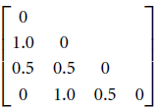
Example for Ordinal Attribute
Rank (fair, good, excellent) =(1,2,3) and M_{f} =3
Standardized rank (fair, good, excellent) = (0, ½, 1)
Dissimilarity Matrix =

Slide 23
Proximity Measure for Attributes of Mixed Type
A dataset may contain all attribute types: Nominal, symmetric binary, asymmetric binary, numeric, and ordinal
In this case, we can use a weighted formula to combine their effects:
Where weight w_{ij}^{(f)} = 0, if
Either x_{if} or x_{jf} has missing value for feature f
OR x_{if} =x_{jf} =0 and attribute f is asymmetric binary
Otherwise weight w_{ij}^{(f)} = 1

Slide 24

Proximity Measure for Attributes of Mixed Type
The contribution of attribute f to the dissimilarity between i and j (i.e., d_{ij}^{f)} is computed dependent on its type:
If numeric : normalize and compute
where h is running over all non-missing objects of attribute f.
If f is binary or nominal: d_{ij}^{(f)} = 0 if x_{if} = x_{jf}; or d_{ij}^{(f)} = 1 otherwise
If f is ordinal, Compute ranks r_{if} and , then compute the distance.

Slide 25
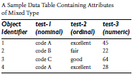
Practice Question
Compute the dissimilarity matrix for the following mixed type data:

Slide 26
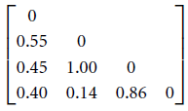


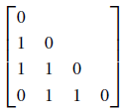
Computing Test-3 requires . =22 and = 64
d(2, 1) = | 22- 45| / (64- 22) = 23 / 42 = 0.55
d(3,1) = | 64- 45| / ( 64-22) = 19 / 42 = 0.45
And so on
As computed earlier Test -1 Test- 2

Slide 27
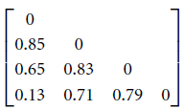
Test -1 Test2 Test 3
Dissimilarity of the mixed feature vector is computed as follows:
d(2,1) = ((1*1) + (1 * 1) + (1 * 0.55)) / (1+1+1) = 2.55 / 3 = 0.85
d(3,1) = ((1*1) + (1 * 0.5) + (1 * 0.45)) / (1+1+1) = 1.95 / 3 = 0.65
And so on
Dissimilarity of mixed type:

Slide 28
Practice Question
Compute the dissimilarity of the following data matrix:
Ordinal ranking (incubation, Prodromal, Illness, decline) is (1,2,3,4)
Name | Weight (numeric) | Diabetic (binary) | Viral Infection levels (ordinal) | Type of disease (nominal) | Cough (binary)
Jack | 70 | Y | Incubation | infectious | N
Mary | 33 | N | Prodromal | nosocomial | Y
Jim | 56.5 | Y | Illness | zoonotic | Y
John | 67 | N | decline | infectious | N
Jose | 80 | Y | Incubation | infectious | Y
Stefan | 48 | N | Illness | nosocomial | Y

Slide 29
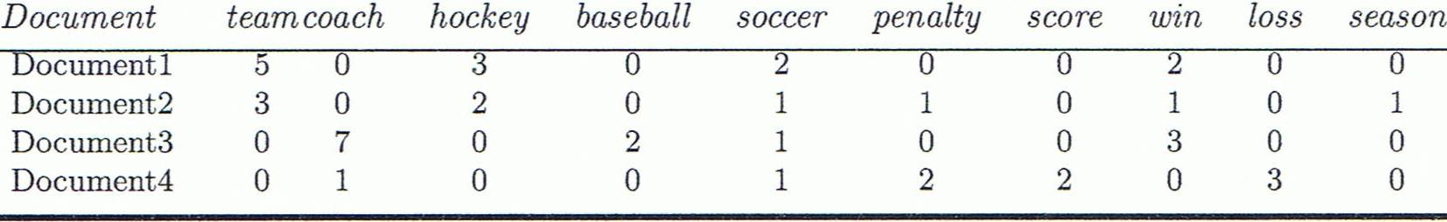
Cosine Similarity of Two Vectors
A document can be represented by a bag of terms or a long vector, with each attribute recording the frequency of a particular term (such as word, keyword, or phrase) in the document
Other vector objects: Gene features in micro-arrays
Applications: Information retrieval, biologic taxonomy, gene feature mapping, etc.

Slide 30
Cosine Similarity of Two Vectors
Cosine measure: If d₁ and d₂ are two vectors (e.g., term-frequency vectors), then
where • indicates vector dot product, ||d||: the length of vector d
Machine learning uses Cosine Similarity in applications such as data mining and information retrieval.
Example, document comparison.

Slide 31
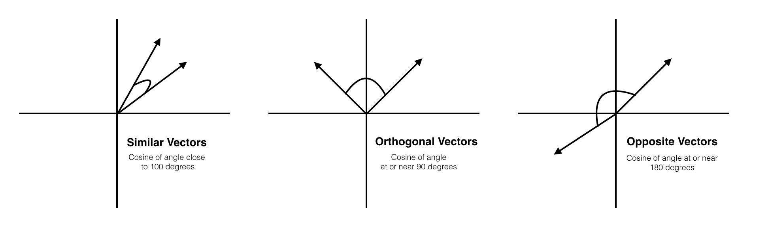
Cosine Similarity of Two Vectors
In short, two cosine vectors that are
aligned in the same orientation will have a similarity measurement of 1,
aligned perpendicularly will have a similarity of 0 and
diametrically opposed, meaning they are oriented in exactly opposite directions (i.e. back-to-back), then the similarity measurement is -1.

Slide 32
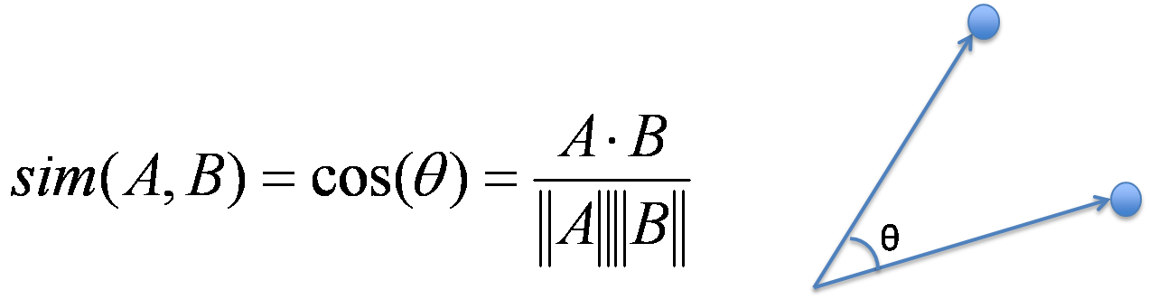
Example: Calculating Cosine Similarity
Calculating Cosine Similarity:
where • indicates vector dot product, ||d||: the length of vector d
Ex: Find the similarity between documents 1 and 2.
d₁ = (5, 0, 3, 0, 2, 0, 0, 2, 0, 0) d₂ = (3, 0, 2, 0, 1, 1, 0, 1, 0, 1)
First, calculate vector dot product
d₁•d₂ = 5 * 3 + 0 * 0 + 3 * 2 + 0 * 0 + 2 * 1 + 0 * 1 + 0 * 1 + 2 * 1 + 0 * 0 + 0 * 1
= 25

Slide 33
Example: Calculating Cosine Similarity
Then, calculate ||d₁|| and ||d₂||
Calculate cosine similarity:
cos(d₁, d₂ ) = 25/ (6.481 X 4.12) = 0.94

Slide 34
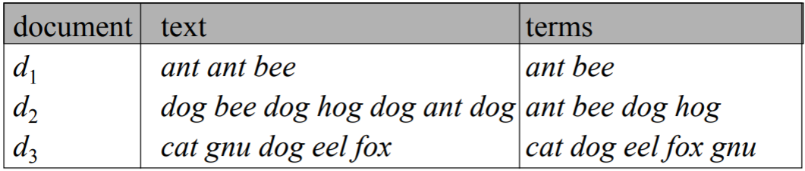
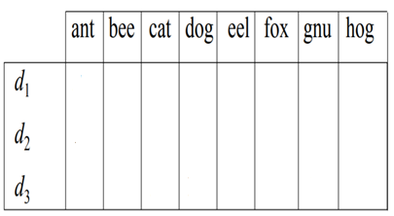
Practice Question: Cosine Similarity (frequency based)
Compute the cosine similarity between every document
Start by filling this:

Slide 35
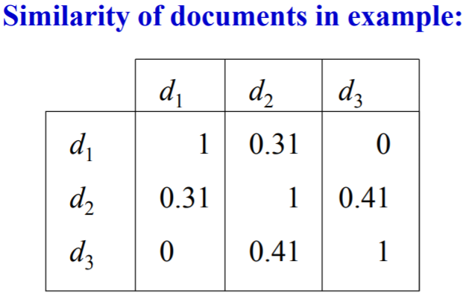
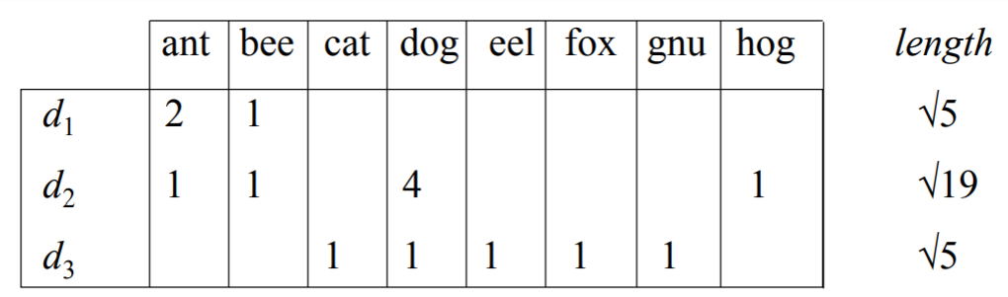
Answer to previous slide

Slide 36
Summary
Data attribute types: nominal, binary, ordinal, interval-scaled, ratio-scaled
Many types of data sets, e.g., numerical, text, graph, Web, image.
Gain insight into the data by:
Measure data similarity
Above steps are the beginning of data preprocessing.
Many methods have been developed but still an active area of research.

Slide 37
References
References
W. Cleveland, Visualizing Data, Hobart Press, 1993
T. Dasu and T. Johnson. Exploratory Data Mining and Data Cleaning. John Wiley, 2003
U. Fayyad, G. Grinstein, and A. Wierse. Information Visualization in Data Mining and Knowledge Discovery, Morgan Kaufmann, 2001
L. Kaufman and P. J. Rousseeuw. Finding Groups in Data: an Introduction to Cluster Analysis. John Wiley & Sons, 1990.
H. V. Jagadish, et al., Special Issue on Data Reduction Techniques. Bulletin of the Tech. Committee on Data Eng., 20(4), Dec. 1997
D. A. Keim. Information visualization and visual data mining, IEEE trans. on Visualization and Computer Graphics, 8(1), 2002
D. Pyle. Data Preparation for Data Mining. Morgan Kaufmann, 1999
S. Santini and R. Jain,” Similarity measures”, IEEE Trans. on Pattern Analysis and Machine Intelligence, 21(9), 1999
E. R. Tufte. The Visual Display of Quantitative Information, 2nd ed., Graphics Press, 2001
C. Yu , et al., Visual data mining of multimedia data for social and behavioral studies, Information Visualization, 8(1), 2009

