Slide 1

Software Project Management
4th Edition
Chapter 4
Selection of an appropriate project approach
Notes:
This talk provides an overview of the basic steps needed to produce a project plan. The framework provided should allow students to identify where some of the particular issues discussed in other chapters are applied to the planning process. As the focus is on project planning, techniques to do with project control are not explicitly described. However, in practice, one element of project planning will be to decide what project control procedures need to be in place.

Slide 2
Selection of project approaches
Build or buy decision
In-house development: most of these issues resolved by IS planning and standards. Developer and user in same organization
Software houses: more applicable as different customers have different needs
Selection of approach governed by:
  uncertainties of the project
  properties of application to be built
Notes:
Sections 4.1 and 4.2 of the textbook discuss these issues. Different types of project need different types of approach. If you are working in one particular environment which specializes in one type of software, then the approach is likely not to change much from one project to another. Where you work for different clients in different organizations developing a variety of applications then the approach for each project may need to be tailored.

Slide 3
General approach
Look at risks and uncertainties (product, process and resource) e.g.
  are requirement well understood? (product)
  are technologies to be used well understood? (process)
Look at the type of application being built e.g.
  information system? embedded system?
  criticality? differences between target and development environments?
Tools and techniques
Hardware Requirements
Safety critical systems
Concurrent development ?
Clients’ own requirements (Type of user)
  need to use a particular method
Notes:
See section 4.2 of the textbook.

Slide 4
Choice of process models
Structured models (include OOPS)
‘waterfall’ also known as ‘one-shot’, ‘once-through’
incremental delivery
evolutionary development
Also use of ‘agile methods’ e.g. extreme programming
Notes:
It could be argued that extreme programming is mainly a particular way of carrying out incremental and evolutionary development

Slide 5
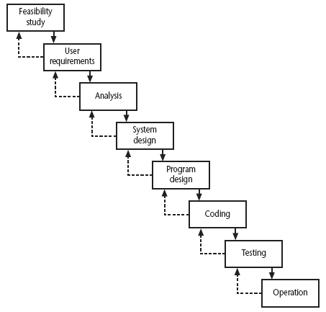
Waterfall
The waterfall model
Notes:
Section 4.6 of the textbook discusses this topic.
We have already touched upon the Waterfall approach in Lecture/Chapter 1 when we discussed the ISO 12207. The way that the Waterfall approach is usually interpreted, it implies that all work on one phase has to be completed and checked off before the next one can start. However, it can be argued that ISO 12207 is really a technical model showing the order technical processes need to be carried out on a software component. You might break down an application into component increments, but the technical processes relating to that increment are carried out in the ISO 12207 sequence. You can, within the ISO 12207 sequence, loop back in an iterative manner, but the technical sequence still remains.

Slide 6
Waterfall
the ‘classical’ model
imposes structure on the project
every stage needs to be checked and signed off
BUT
  limited scope for iteration

Slide 7
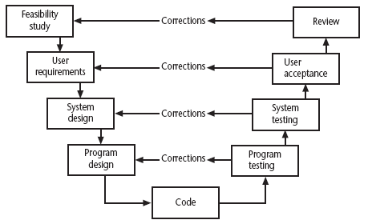
V-process model
Another way of looking at the waterfall model
Notes:
Section 4.7 of the text book discusses this topic
Essentially the testing phase of the Waterfall model is expanded. For each developmental activity going down the slope of the left hand side of the V, there is a matching testing or evaluation phase as you climb up the right hand side of the V.
Each activity checks the implementation of each of the develoomental stages. For example, at the system testing stage systems analyst may be checking that the design that was specified has been correctly implemented. He or she may also be checking the design itself is adequate.

Slide 8
Evolutionary delivery: prototyping
‘ An iterative process of creating quickly and inexpensively live and working models to test out requirements and assumptions’
Sprague and McNurlin main types
‘throw away’ prototypes
evolutionary prototypes
what is being prototyped?
human-computer interface
functionality

Slide 9
Reasons for prototyping
learning by doing
improved communication
improved user involvement
a feedback loop is established
reduces the need for documentation
reduces maintenance costs i.e. changes after the application goes live
prototype can be used for producing expected results
Notes:
A prototype is a working model of one or more aspects of the project application. It is constructed quickly and inexpensively in order to test out assumptions.
Sections 4.9, 4.10 and 4.11 discuss this topic.
learning by doing - useful where requirements are only partially known
improved communication - users are reluctant to read massive documents, but when system is ‘live’ you get a better feeling for it
improved user involvement - user ideas and requests are quickly implemented
the reduction of maintenance costs – the idea is that if you do not have a prototype then the first release of the application will effectively become a prototype as users will find things that they do not like and then ask for them to be changed. It is easier and safer to make such changes before the application becomes operational.
testing - involves devising test cases and then documenting the results expected when the test cases are run. If these are done by hand, then effectively you have a manual prototype. Why not get the software prototype to generate the expected results?

Slide 10
Prototyping: some dangers
users may misunderstand the role of the prototype
lack of project control and standards possible
additional expense of building prototype
focus on user-friendly interface could be at expense of machine efficiency

Slide 11
Other ways of categorizing prototyping
what is being learnt?
  organizational prototype
  hardware/software prototype (‘experimental’)
  application prototype (‘exploratory’)
to what extent
  mock-ups
  simulated interaction
  partial working models: vertical (some features are prototyped fully) versus horizontal (all features are prototyped but partially)
Notes:
When a prototype is to be produced as part of a student’s final year project, then the learning objectives that the prototypes will help be achieved need to defined at project inception. The details of what has been learnt through the development and exercising of the prototype should be documented during the project.

Slide 12
Incremental delivery
delivered
system
design
build
install
evaluate
increment
1
first incremental delivery
increment
2
design
build
install
evaluate
second incremental delivery
increment
3
design
build
install
evaluate
third incremental delivery
Notes:
The application to be delivered is broken down into a number of components each of which will be actually used by the users. Each of these is then developed as a separate ‘mini-project’ or increment.

Slide 13
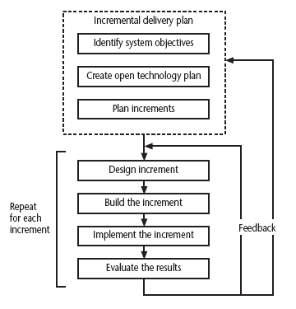
The incremental process
Intentional
incremental
delivery
Notes:
This approach has had a very vocal advocate in Tom Gilb (see the book Principles of Software Engineering Management published by Addison-Wesley (1988)).
Gilb argues that the initial focus should be on high level business objectives. There may be many ways in which important objectives can be achieved and we ought to allow ourselves freedom in the way we try to achieve the objectives.
Open technology plan – we need to ensure that the technologies we use are ones that facilitate the addition of components to an existing application.
Plan increments – the nature and order of the increments to be delivered needs to be delivered to the users have to be planned at the outset.

Slide 14
Incremental approach:benefits
feedback from early stages used in developing latter stages
shorter development thresholds
user gets some benefits earlier
project may be put aside temporarily
reduces ‘gold-plating’:
BUT there are some possible disadvantages
loss of economy of scale
‘software breakage’
Notes:
Advantages of prototyping
feedback from early stages used in developing latter stages
shorter development thresholds - important when requirements are likely to change
user gets some benefits earlier - may assist cash flow
project may be put aside temporarily - more urgent jobs may emerge
reduces ‘gold-plating’ i.e. features requested but not used
But there are possible disadvantages
loss of economy of scale - some costs will be repeated
‘software breakage’ - later increments might change earlier increments

Slide 15
The outline incremental plan
steps ideally 1% to 5% of the total project
non-computer steps should be included
ideal if a step takes one month or less:
  not more than three months
each step should deliver some benefit to the user
some steps will be physically dependent on others

Slide 16
Which step first?
some steps will be pre-requisite because of physical dependencies
others may be in any order
value to cost ratios may be used
  V/C where
  V is a score 1-10 representing value to customer
  C is a score 0-10 representing value to developers

Slide 17
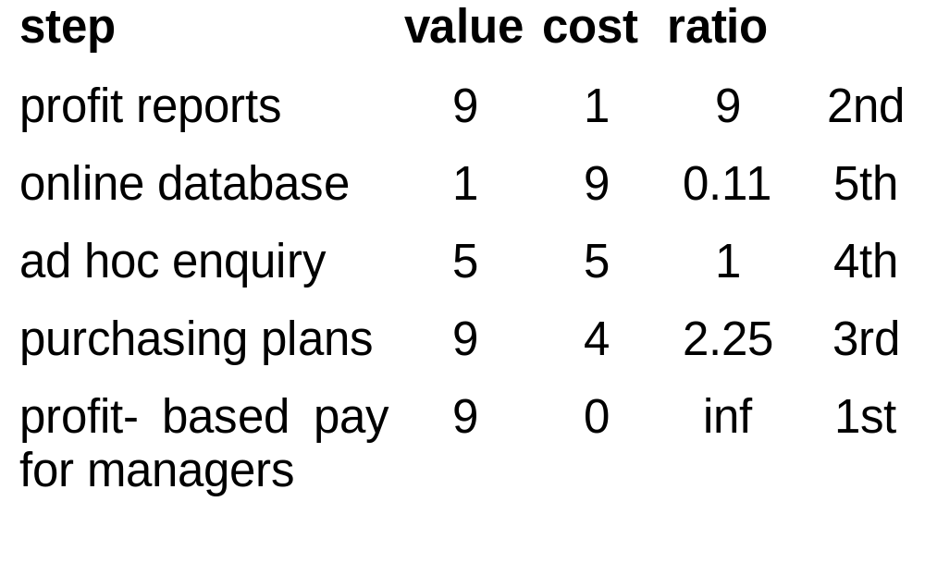
V/C ratios: an example

Slide 18
‘Agile’ methods
structured development methods have some perceived advantages
  produce large amounts of documentation which can be largely unread
  documentation has to be kept up to date
  division into specialist groups and need to follow procedures stifles communication
  users can be excluded from decision process
  long lead times to deliver anything etc. etc
The answer? ‘Agile’ methods? – Crystal, Scrum, XP, Atern

Slide 19
Dynamic system development method
UK-based consortium now called Atern
arguably DSDM can be seen as replacement for SSADM
DSDM is more a project management approach than a development approach
Can still use DFDs, LDSs etc!
Notes:
A fuller explanation can be found in Jennifer Stapleton’s DSDM: A Framework for Business-Centred Development Addison-Wesley 2002
SSADM is Structured Systems Analysis and Design Method a very heavy-weight and bureaucratic methodology that was promoted by the UK government
DFD = Data Flow Diagram
LDS = Logical Data Structure, effectively an Entity-Relationship Diagram

Slide 20
Eight core Atern principles
Focus on Business need with active user involvement
Frequent delivery of products on time
3. Collaborate
4. Maintain quality
5. Develop Iteratively
6. Incremental delivery
7. Communicate continuously
8. Demonstrate control
Notes:
This can be seen as a re-packaging of a lot of the ideas that have been discussed under the incremental and evolutionary approaches

Slide 21
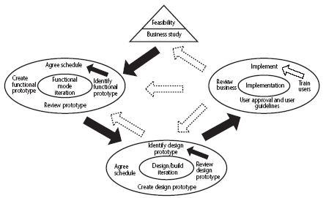
DSDM framework
Figure 4.6 here
DSDM process model
Notes:
The feasibility/business study stage will not only look at the business feasibility of the proposed project, but also as whether DSDM would be the best framework for it. Applications where there is a prominent user interface would be prime candidates.

Slide 22
DSDM: time-boxing
time-box fixed deadline by which something has to be delivered
typically two to six weeks
MOSCOW priorities
  Must have - essential
  Should have - very important, but system could operate without
  Could have
  Want - but probably won’t get!
Notes:
Time-boxes mean that the focus moves from having a fixed set of functional requirements and then extending the planned project completion until they have all been developed. The deadline is fixed and we deliver what we have completed so far even if it is not everything that was originally planned.
In order to make the delivered package coherent and as useful as possible to the users, requirements are prioritized according to the MoSCoW rules.

Slide 23
Extreme programming
increments of one to three weeks
  customer can suggest improvement at any point
argued that distinction between design and building of software are artificial
code to be developed to meet current needs only (releases)
frequent re-factoring to keep code structured
Notes:
Associated with Kent Beck - see Extreme programming explained
Developed originally on Chrysler C3 payroll (Smalltalk) project
Agile methods include Jim Highsmith’s Adaptive Software Development and Alistair Cocburn’s Chrystal Lite methods

Slide 24
Extreme programming - contd
developers work in pairs
test cases and expected results devised before software design
after testing of increment, test cases added to a consolidated set of test cases

Slide 25
Grady Booch’s concern
Booch, an OO authority, is concerned that with requirements driven projects:
‘Conceptual integrity sometimes suffers because this is little motivation to deal with scalability, extensibility, portability, or reusability beyond what any vague requirement might imply’
Tendency towards a large number of discrete functions with little common infrastructure?

Slide 26
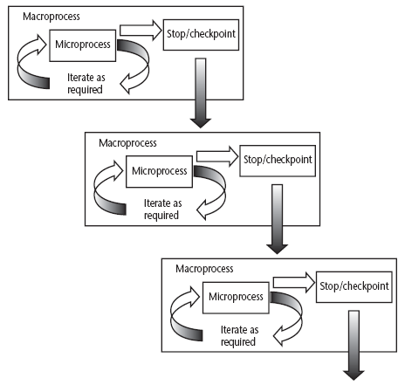
Macro and micro processes
A macro process containing three iterative micro processes
Notes:
Section 4.14 discusses these ideas in a little more detail

Slide 27
‘rules of thumb’ about approach to be used
IF uncertainty is high
  THEN use evolutionary approach
IF complexity is high but uncertainty is not
  THEN use incremental approach
IF uncertainty and complexity both low
  THEN use one-shot
IF schedule is tight
  THEN use evolutionary or incremental

Slide 28
Combinations of approach
installation
one-shot
incremental
evolutionary
one-shot
yes
yes
no
construction
incremental
yes
yes
no
evolutionary
yes
yes
yes
one-shot or incremental installation - any
construction approach possible
evolutionary installation implies evolutionary construction

