Slide 1
Introduction to Cassandra

Slide 2
Apache Cassandra
Cassandra was born at FACEBOOK-2008
2009 becomes Apache incubator project
2010 onwards became top-level project in Apache
Its built on Amazon dynamo and Google Big Table
It is a column-oriented database designed to support peer-to-peer symmetric nodes instead of the master slave architecture.
Cassandra does not compromise on availability( There is no master slave architecture – No single point of point failure)
It is highly scalable, high performance distributed database.
It distributes and manages gigantic amount of data across commodity servers
It has adherence to the Availability and Partition Tolerance of CAP theorem. It takes care of consistency using BASE Approach

Slide 3
Features Of Cassandra
Open source
Distributed
Decentralized(Server symmetry)
No single point of failure
Column- oriented
Peer to Peer
Elastic scalability

Slide 4

Companies successfully deployed Cassandra
Netflix
online DVD and Blu-Ray movie retailer
Nielsen study showed that 38% of Americans use or subscribe to Netflix
Why Cassandra?
Using a central SQL database negatively impacted scalability and availability
International Expansion required Multi-Datacenter solution
Need for configurable Replication, Consistency, and Resiliency in the face of failure
Cassandra on AWS offered high levels of scalability and availability

Slide 5

Companies successfully deployed Cassandra
Spotify
Streaming digital music service
Music for every moment on computer, phone, tablet, and more
Why Cassandra?
With more users, scalability problems arised using postgreSQL
With multiple data centers, streaming replication in postgreSQL was problematic
ex: high write volumes
Chose Cassandra
lack of single points of failure
no data loss confidence
Big Table design

Slide 6

Companies successfully deployed Cassandra
Hulu
a website and a subscription service offering on-demand streaming video media
~30 million unique viewers per month
Why Cassandra?
need for Availability
need for Scalability
Good Performance
Nearly Linear Scalability
Geo-Replication
Minimal Maintenance Requirements

Slide 7
Companies successfully deployed Cassandra
Twitter
Cisco
Adobe
eBay
Rack space

Slide 8
Features of Cassandra

Slide 9
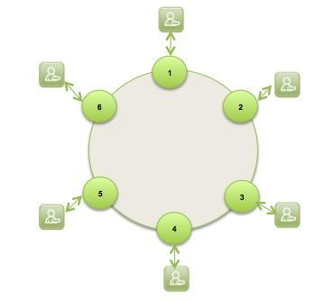
Peer to Peer Network
Cassandra is designed to distribute and manage large data loads across multiple nodes in a cluster.
Does not have Master Slave architecture( no SOP)
A node in Cassandra is structurally identical to any other node.
In case any node fails, it definitely impacts the throughput.
However incase of graceful degradation where everything does not come crashing at any given instant owing to node failure

Slide 10
Gossip Protocol and Failure Detection
Gossip protocol is used for intra ring communication.
It is a peer to peer communication protocol which eases discovery and sharing of location and state information with other nodes in cluster.
Network Communication protocols inspired for real life rumor spreading.
Example – Node A wish to search for pattern in data
Round 1 – Node A searches locally and then gossips with node B.
Round 2 – Node A,B gossips with C and D.
Round 3 – Nodes A,B,C and D gossips with 4 other nodes ……
Round by round doubling makes protocol very robust.

Slide 11
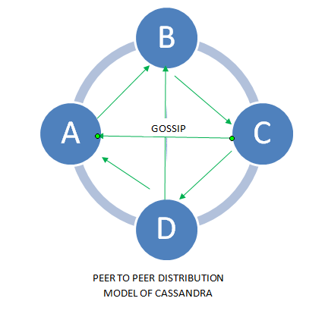
Gossip Protocol

Slide 12
Failure Detection- Anti-Entropy and Read Repair
For repairing unread data, Cassandra uses what’s called an anti-entropy version of the gossip protocol.
Anti-entropy and Read Repair
A cluster is made of several nodes.
To achieve fault tolerance, a given piece of data is replicated on one or more nodes.
A client can connect to any node in the cluster to read data.
How many nodes will be read before responding to the client is based on consistency level specified by the client.
If the client specified consistency level is not met, the read operation is blocked.

Slide 13
Failure Detection- Anti-Entropy and Read Repair
Some times few nodes may respond with out –of date value . This can be repaired using Read Repair operation to bring replication with stale values up to date.
AntiEntropy means comparing all the replicas of each piece of data that exist (or are supposed to) and updating each replica to the newest version.
Read repair operation is performed either before or after returning the value to the client as per the specified consistency level.

Slide 14
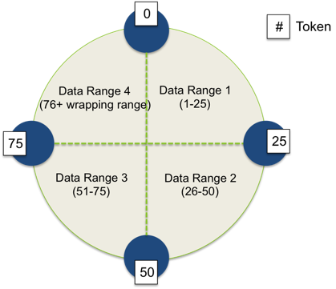
Partitioner
A partitioner takes a call on how to distribute data on the various nodes in cluster. Nodes are logically structured in Ring Topology.
It also determines a node on which to place the very first copy of the data.
Basically a partitioner is a hash function to compute the token of the partition key.

Slide 15
Replication
Replication Factor(RF) determines the number of copies of data.
RF should ideally be more than one and not more than the number of nodes in the cluster.
Two replication strategies are,
Simple strategy
Network Topology strategy

Slide 16
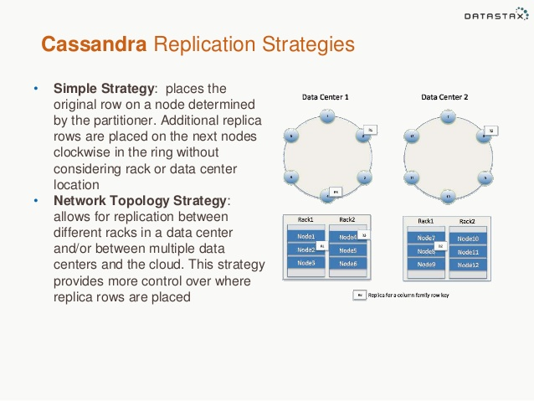
Two different Replication strategies

Slide 17
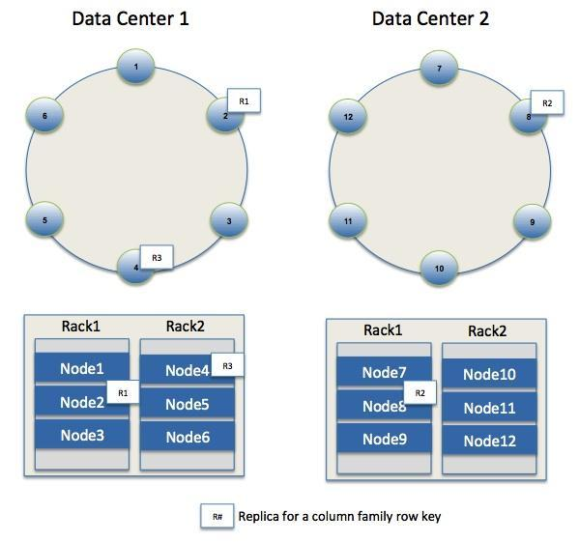
Replication
Different Replication Policies
Rack Unaware – replicate data at N-1 successive nodes after its coordinator
Rack Aware – uses ‘Zookeeper’ to choose a leader which tells nodes the range they are replicas for
Datacenter Aware – similar to Rack Aware but leader is chosen at Datacenter level instead of Rack level.

Slide 18
Writes in Cassandra
A client that initiates a write request.
It is first written to the commit log. A write is taken as successful only if it is written to the commit log.
The next step is to push the write to a memory resident data structure called Memtable. A threshold value is defined in the Memtable.
When the number of objects stored in the Memtable reaches a threshold, the contents of Memtable are flushed to the disk in a file called SSTable (Stored string Table). Flushing is a non-blocking operation.
It is possible to have multiple Memtables for a single column family.
One out of them is current and the rest are waiting to be flushed.

Slide 19
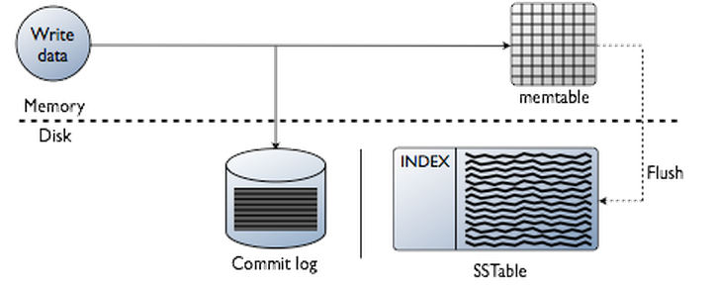
Writes in Cassandra

Slide 20




Hinted Handoffs
Coordinator
Node C is down.
Write a hint in your table
A
Writes Row K
Client
System hints table
Replicates Row K
B
Hint will have the following data:
Location of the node on which the replica is to be placed
Version meta data
The Actual data
C

Slide 21
Read Operation
Client
Query
Result
Cassandra Cluster
Read repair if digests differ
Closest replica
Result
Replica A
Digest Query
Digest Response
Digest Response
Replica B
Replica C
* Figure taken from Avinash Lakshman and Prashant Malik (authors of the paper) slides.

Slide 22
Tunable Consistency
Consistency describes how and whether a system is left in a consistent state after an operation.
In distributed data systems like Cassandra, this usually means that once a writer has written, all readers will see that write.
On the contrary to the strong consistency used in most relational databases (ACID ) Cassandra is at the other end of the spectrum (BASE for Basically Available Soft-state Eventual consistency).
Cassandra weak consistency comes in the form of eventual consistency which means the database eventually reaches a consistent state.
As the data is replicated, the latest version of something is sitting on some node in the cluster, but older versions are still out there on other nodes, but eventually all nodes will see the latest version.

Slide 23
Read Consistency
ONE | Returns a response from the closest node (replica) holding the data.
QUORUM | Returns a result from a quorum of servers with the most recent timestamp for the data.
LOCAL_QUORUM | Returns a result from a quorum of servers with the most recent timestamp for the data in the same data center as the coordinator node.
EACH_QUORUM | Returns a result from a quorum of servers with the most recent timestamp in all data centers.
ALL | This provides the highest level of consistency of all levels and the lowest level of availability of all levels. It responds to a read request from a client after all the replica nodes have responded.

Slide 24
Read Consistency
More specifically:
R=read replica count
W=write replica count
N=replication factor
Q=QUORUM (Q = N / 2 + 1)
If W + R > N, you will have consistency
W=1, R=N
W=N, R=1
W=Q, R=Q where Q = N / 2 + 1
Cassandra provides consistency when R + W > N
A Consistency Level of ONE means R or W is 1.
A Consistency Level of QUORUM means R or W is ceiling((N+1)/2).
A Consistency Level of ALL means R or W is N.
So if you want to write with a Consistency Level of ONE and then get the same data when you read, you need to read with Consistency Level ALL.

Slide 25
Write Consistency
ALL | This is the highest level of consistency of all levels as it necessitates that a write must be written to the commit log and Memtable on all replica nodes in the cluster.
EACH_QUORUM | A write must be written to the commit log and Memtable on a quorum of replica nodes in all data centers.
QUORUM | A write must be written to the commit log and Memtable on a quorum of replica nodes.
LOCAL_QUORUM | A write must be written to the commit log and Memtable on a quorum of replica nodes in the same data center as the coordinator node. This is to avoid latency of inter-data center communication.
ONE | A write must be written to the commit log and Memtable of at least one replica node.
TWO | A write must be written to the commit log and Memtable of at least two replica nodes.
THREE | A write must be written to the commit log and Memtable of at least three replica nodes.
LOCAL_ONE | A write must be sent to, and successfully acknowledged by, at least one replica node in the local data center.

Slide 26
Cassandra Data model

Slide 27
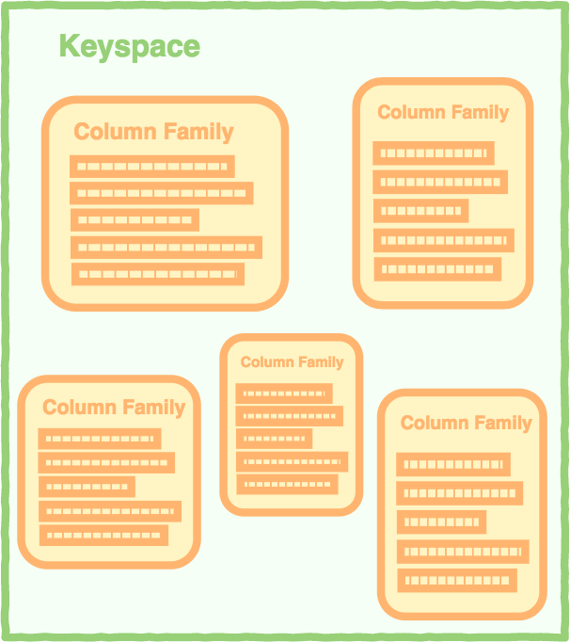
Data Model

Slide 28
Data Model
keyspace
settings
column family
settings
column
name
value
timestamp

Slide 29
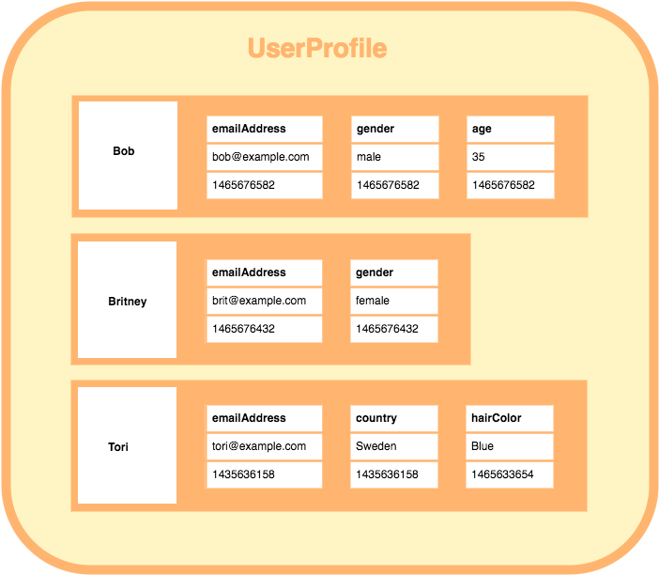
Data Model

Slide 30
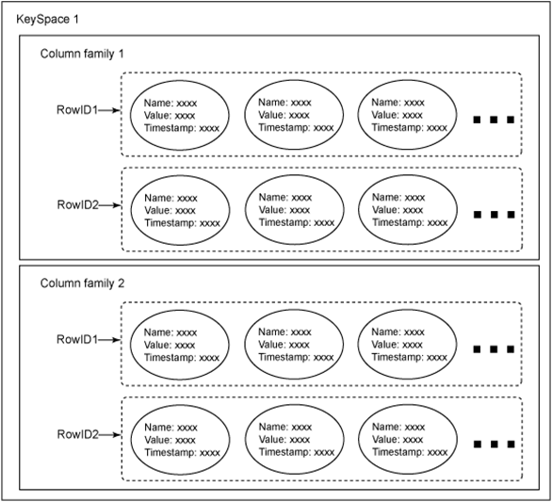
Cassandra data model
Cassandra is a column oriented NoSQL system
Column families: sets of key-value pairs
column family as a table and key-value pairs as a row (using relational database analogy)
A row is a collection of columns labeled with a name

Slide 31
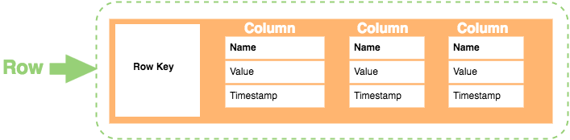
Cassandra Row
the value of a row is itself a sequence of key-value pairs
such nested key-value pairs are columns
key = column name
a row must contain at least 1 column.

Slide 32
Key Space
A Key Space is a group of column families together.
It is only a logical grouping of column families and provides an isolated scope for names

Slide 33
Facebook Inbox Search
Cassandra developed to address this problem.
50+TB of user messages data in 150 node cluster on which Cassandra is tested.
Search user index of all messages in 2 ways.
Term search : search by a key word
Interactions search : search by a user id
Latency Stat | Search Interactions | Term Search
Min | 7.69 ms | 7.78 ms
Median | 15.69 ms | 18.27 ms
Max | 26.13 ms | 44.41 ms

Slide 34
Comparison with MySQL
MySQL > 50 GB Data Writes Average : ~300 ms Reads Average : ~350 ms
Cassandra > 50 GB Data Writes Average : 0.12 ms Reads Average : 15 ms
Stats provided by Authors using Facebook data.

Slide 35
Cassandra Query Language

Slide 36
Starting cqlsh
Start cqlsh using the command cqlsh as shown below. It gives the Cassandra cqlsh prompt as output.
[hadoop@linux bin]$ cqlsh
Connected to Test Cluster at 127.0.0.1:9042.
[cqlsh 5.0.1 | Cassandra 2.1.2 | CQL spec 3.2.0 | Native protocol v3]
Use HELP for help.
cqlsh>

Slide 37
cqlsh commands
Options | Usage
cqlsh --help | Shows help topics about the options of cqlsh commands.
cqlsh --version | Provides the version of the cqlsh you are using.
cqlsh --color | Directs the shell to use colored output.
cqlsh --debug | Shows additional debugging information.
cqlsh --execute cql_statement | Directs the shell to accept and execute a CQL command.
cqlsh --file= “file name” | If you use this option, Cassandra executes the command in the given file and exits.
cqlsh --no-color | Directs Cassandra not to use colored output.
cqlsh -u “user name” | Using this option, you can authenticate a user. The default user name is: cassandra.
cqlsh-p “pass word” | Using this option, you can authenticate a user with a password. The default password is: cassandra.

Slide 38
CQL Data types
Int | 32 bit signed integer
Bigint | 64 bit signed long
Double | 64-bit IEEE-754 floating point
Float | 32-bit IEEE-754 floating point
Boolean | True or false
Blob | Arbitrary bytes, expressed in hexadecimal
Counter | Distributed counter value
Decimal | Variable – precision integer
List | A collection of one or more ordered elements
Map | A JSON style array of elements
Set | A collection of one or more elements
Timestamp | Date plus time
Varchar | UTF 8 encoded string
Varint | Arbitrary-precision integers
Text | UTF 8 encoded string

Slide 39
CQL Data Definition Commands
CREATE KEYSPACE - Creates a KeySpace in Cassandra.
USE - Connects to a created KeySpace.
ALTER KEYSPACE - Changes the properties of a KeySpace.
DROP KEYSPACE - Removes a KeySpace
CREATE TABLE - Creates a table in a KeySpace.
ALTER TABLE - Modifies the column properties of a table.
DROP TABLE - Removes a table.
TRUNCATE - Removes all the data from a table.
CREATE INDEX - Defines a new index on a single column of a table.
DROP INDEX - Deletes a named index.

Slide 40
CQL Data Manipulation Commands
INSERT - Adds columns for a row in a table.
UPDATE - Updates a column of a row.
DELETE - Deletes data from a table.
BATCH - Executes multiple DML statements at once.

Slide 41
CQL Clauses
SELECT - This clause reads data from a table
WHERE - The where clause is used along with select to read a specific data.
ORDERBY - The order by clause is used along with select to read a specific data in a specific order.

Slide 42
CRUD - Keyspace
To create a keyspace by the name “Students”
CREATE KEYSPACE Students WITH REPLICATION = {
'class':'SimpleStrategy', 'replication_factor’:1 };

Slide 43
To Describe existing key spaces
DESCRIBE KEYSPACES;
To get more details about key space like Keyspace name, durable writes, strategy class, etc.
SELECT * FROM system.schema_keyspaces;
To use keyspace
> USE KEYSPACE NAME

Slide 44
CRUD – Create Table
To create a column family or table by the name “student_info”.
CREATE TABLE Student_Info ( RollNo int PRIMARY KEY, StudName text, DateofJoining timestamp, LastExamPercent double );

Slide 45
CRUD - Insert
Insert writes one or more columns to a record in Cassandra table automatically.
Insert statement does not return output.
Primary key is must.
To insert data into the column family “student_info”.
BEGIN BATCH
INSERT INTO student_info (RollNo,StudName,DateofJoining,LastExamPercent) VALUES (1,'Michael Storm','2012-03-29', 69.6)
INSERT INTO student_info (RollNo,StudName,DateofJoining,LastExamPercent) VALUES (2,'Stephen Fox','2013-02-27', 72.5)
APPLY BATCH;

Slide 46
CRUD - Select
To view the data from the table “student_info”.
SELECT *FROM student_info;
To view only those record where the roll no column either has a value 1 or 2 or 3
SELECT *FROM student_info WHERE RollNO IN (1,2,3)

Slide 47
CRUD – Create Index
To create an index on the “studname” column of the “student_info” column family use the following statement
CREATE INDEX ON student_info(studname);
To execute the query using Index
SELECT * FROM student_info WHERE studname=‘Stephen Fox’;
To Create another index on column LastExamPercent
CREATE INDEX ON student_info(LastExamPercent);

Slide 48
Other operators
Limit
AS (alias)
Order By
Group By
Desc
ASC ( the default sorting order)
SELECT rollno, hobbies, language, lastexampercent FROM student_info LIMIT 2;
SELECT rollno, language AS “known language” FROM student_info;

Slide 49
CRUD – Update
To update the value held in the “StudName” column of the “student_info” column family to “David Sheen” for the record where the RollNo column has value = 2.
Note: An update updates one or more column values for a given row to the Cassandra table. It does not return anything.
UPDATE student_info SET StudName = 'David Sheen' WHERE RollNo = 2;

Slide 50
Update Primary Key
UPDATE student_info SET rollno=6 WHERE rollNo = 2;
But it returns Bad request . It does not allow to update primary key column.

Slide 51
Updating more than one column of a row
1. Before update
Select rollno, studname,lastexam percent from student_info where rollno=3;
2. Applying update
UPDATE student_info SET lastexampercent = 85 WHERE rollNo = 3;
Another Example:
UPDATE Movies SET col1 = val1, col2 = val2 WHERE movieID = key1;

Slide 52
Update a column in several rows at once:
UPDATE users SET state = 'TX' WHERE user_uuid IN (88b8fd18-b1ed-4e96-bf79-4280797cba80, 06a8913c-c0d6-477c-937d-6c1b69a95d43, bc108776-7cb5-477f-917d-869c12dfffa8)

Slide 53
CRUD – Delete
To delete the column “LastExamPercent” from the “student_info” table for the record where the RollNo = 2.
Note: Delete statement removes one or more columns from one or more
rows of a Cassandra table or removes entire rows if no columns are specified.
DELETE LastExamPercent FROM student_info WHERE RollNo=2;

Slide 54
Delete Row from table
DELETE FROM student_info WHERE rollno=2;

Slide 55
Why ALLOW FILTERING?
Let’s take for example the following table:
CREATE TABLE blogs (blogId int,
time1 int,
time2 int,
author text,
content text,
PRIMARY KEY(blogId, time1, time2));
To execute the following query:
SELECT * FROM blogs;

Slide 56
Why ALLOW FILTERING?
If you now want only the data at a specified time1
SELECT * FROM blogs WHERE time1 = 1418306451235;
In response, you will receive the following error message:
Bad Request: Cannot execute this query as it might involve data filtering and thus may have unpredictable performance. If you want to execute this query despite the performance unpredictability, use ALLOW FILTERING.

Slide 57
Why ALLOW FILTERING?
Cassandra knows that it might not be able to execute the query in an efficient way.
It is therefore warning you: “Be careful. Executing this query as such might not be a good idea
as it can use a lot of your computing resources”.
The only way Cassandra can execute this query is by retrieving all the rows from the table blogs and then by filtering out the ones which do not have the requested value for the time1 column.
SELECT * FROM blogs WHERE time1 = 1418306451235 ALLOW FILTERING;

Slide 58
Why ALLOW FILTERING?
If your table contains for example a 1 million rows and 95% of them have the requested value for the time1 column, the query will still be relatively efficient and you should use ALLOW FILTERING.
On the other hand, if your table contains 1 million rows and only 2 rows contain the requested value for the time1 column, your query is extremely inefficient. Cassandra will load 999, 998 rows for nothing. If the query is often used, it is probably better to add an index on the time1 column.

Slide 59
Making Right Choice
When your query is rejected by Cassandra because it needs filtering, you should resist the urge to just add ALLOW FILTERING to it. You should think about your data, your model and what you are trying to do. You always have multiple options.
You can change your data model, add an index, use another table or use ALLOW FILTERING.

Slide 60
Collections

Slide 61
Collections
When to use collection?
Use collection when it is required to store or denormalize a small amount of data.
What is the limit on the values of items in a collection?
The values of items in a collection are limited to 64K.
Where to use collections?
Collections can be used when you need to store the following:
Phone numbers of users.
Email ids of users.

Slide 62
Different Collections
SET collection
A column of type set consists of unordered unique values.
LIST collection
When the order of elements is required we can use list. List allows to store the same values multiple times.
MAP collection
Map is used to map one thing to another. A map is a pair of typed values.
Each element of the map is stored as a Cassandra column.

Slide 63
Collections - Set
To alter the schema for the table “student_info” to add a column “hobbies”.
ALTER TABLE student_info ADD hobbies set<text>;

Slide 64
Collections - Set
To update the table “student_info” to provide the values for “hobbies” for the student with Rollno =1.
UPDATE student_info SET hobbies = hobbies + {'Chess, Table Tennis'} WHERE RollNo=1;

Slide 65
Collections - List
To alter the schema of the table “student_info” to add a list column “language”.
ALTER TABLE student_info ADD language list<text>;

Slide 66
Collections - List
To update values in the list column, “language” of the table “student_info”.
UPDATE student_info SET language = language + ['Hindi, English'] WHERE RollNo=1;
DELETE language[1] FROM student_info WHERE rollno=1;

Slide 67
Collections - Map
To alter the “users” table to add a map column “todo”.
ALTER TABLE users ADD todo map<timestamp, text>;

Slide 68
Collections - Map
To update the record for user (user_id = ‘AB’) in the “users” table.
UPDATE users SET todo = { ‘2014-9-24’: ‘Cassandra Session’, ‘2014-10-2 12:00’ : ‘MongoDB Session’ } WHERE user_id = ‘AB’;

Slide 69
More Practice on Collections
1. TO create a table “ users” with an “emails” column. Email column type as SET.
2. To insert values into the “ emails” column of the “ users” table.
3. Add an element to a set using the UPDATE command and the addition (+) operator.
4. To remove an element from a set using the subtraction (-) operator.
UPDATE users SET emails= emails-{XX@gmail.com} WHERE user_id=‘XX’;
5. To alter the users table to add a column, “top places of type list.
Note:
To append use + operator.

Slide 70
COUNTER
A counter is a special column that is changed in increments.
For example we may need a counter column to count the number of times a particular book is issued from the library by the student.
Step1:
CREATE TABLE library_book ( Counter_ value counter,
Book_Name varchar,
stud_name varchar,
PRIMARY KEY(Book_Name, stud_name)
);

Slide 71
COUNTER
Step2:
UPDATE library_book SET counter_value=counter_value+1 WHERE Book_Name=‘Business Analytics’ AND stud_name=‘jeet’;
Step 3: Increase the value of counter
UPDATE library_book SET counter_value=counter_value+1 WHERE Book_Name=‘Business Analytics’ AND stud_name=‘shann’;
Step 4:
UPDATE library_book SET counter_value=counter_value+1 WHERE Book_Name=‘Business Analytics’ AND stud_name=‘jeet’;

Slide 72
Time To Live

Slide 73
Time To Live
Data in a column, other than a counter column, can have an optional expiration period called TTL (time to live). The client request may specify a TTL value for the data. The TTL is specified in seconds.
CREATE TABLE userlogin( userid int primary key, password text );
INSERT INTO userlogin (userid, password) VALUES (1,'infy') USING TTL 30; SELECT TTL (password) FROM userlogin WHERE userid=1;

Slide 74
ALTER COMMAND
Alter command can be used to change the structure of the table/column.
1. Change the type of the column.
ALTER TABLE sample ALTER sampleid TYPE int;
2. To delete a column.
ALTER TABLE sample DROP sampleid;

Slide 75
DROP command
Drop a table
DROP COLUMNFAMILY Table name ;
Drop a data base
DROP KEYSPACE Keyspace name;

Slide 76
Export to CSV

Slide 77
Export data to a CSV file
Export the contents of the table/column family “elearninglists” present in the “students” database to a CSV file (d:\elearninglists.csv).
COPY elearninglists (id, course_order, course_id, courseowner, title) TO
'd:\elearninglists.csv';

Slide 78
Import from CSV

Slide 79
Import data from a CSV file
To import data from “D:\elearninglists.csv” into the table “elearninglists” present in the “students” database.
COPY elearninglists (id, course_order, course_id, courseowner, title)
FROM 'd:\elearninglists.csv';

Slide 80
IMPORT from STDIN
COPY persons (id, fname, lname) FROM STDIN;
EXPORT from STDOUT
COPY elearninglists (id, course id, title, owner) TO STDOUT;

Slide 81
Querying System Tables
SELECT * FROM system.schema_keyspaces;
SELECT * FROM system.schema_columnfamilies;
SELECT * FROM system.schema_column;

